Slide 1
Design To Value Methodology
What is it? Where and how is it used? How is it done?

Slide 2
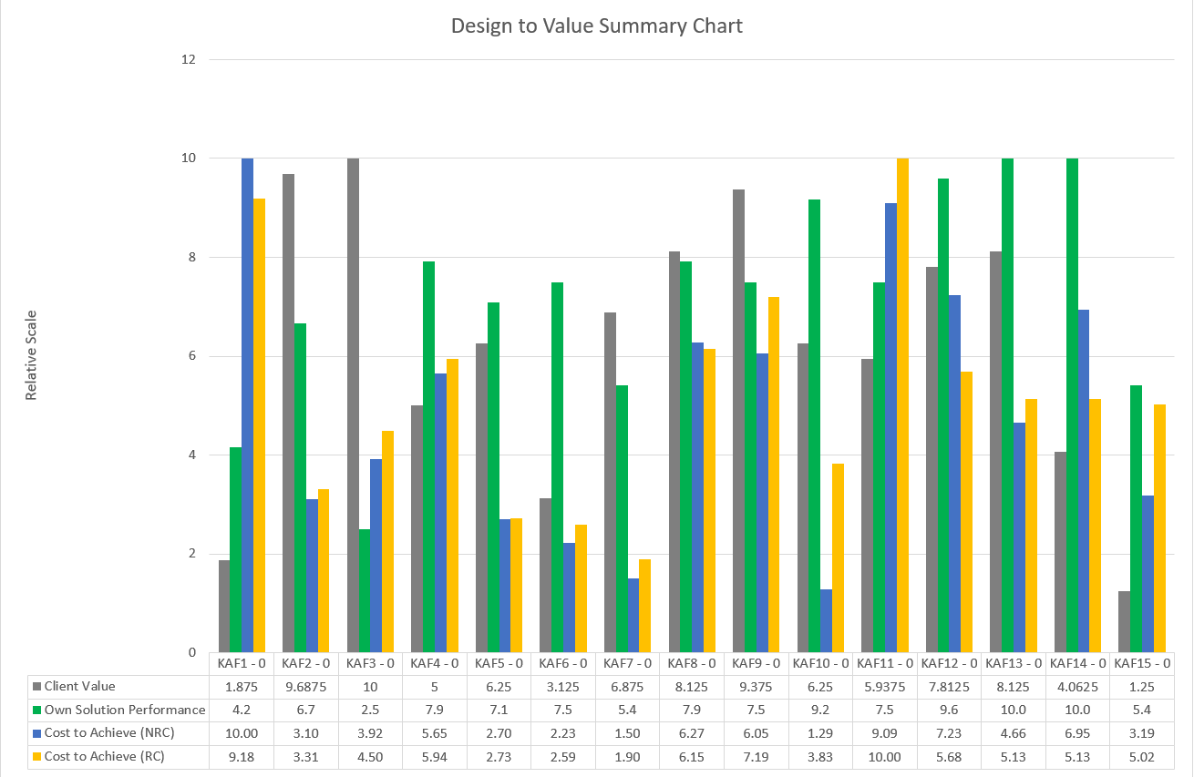
What is Design to Value (DTV)?
A methodology to identify, assess and enable action to improve value, reduce cost or modify performance to align toward Customer value-importance.
A basic end result (illustration)
Single Customer/Market, Single Product
Proportioned cross-comparisons across;
Ranked Customer Key Acquisition Factors in terms of Value Importance
Solution performance
Recurring cost (RC) to achieve solution
Non-recurring cost (NRC) to achieve solution

Slide 3
Why?
How can this be used?
Regular Uses
Bids, particularly large or complex
New Product releases
Assess and prioritise development/engineering efforts to target Customer value
Use to develop Customer and/or System Requirements
Use output to position (PTW) correctly
Support sales/marketing effort and discussions
Extended Uses
Evaluate competition
Evaluate international vs domestic markets (different acquisition factors and/or different importance ranking)

Slide 4
Some illustrative conclusions
A
~highest costs, very low importance and low performance.
Negatively disproportionate.
Consider scaling back or cutting out.
A
B
C
D
E
B
Highest importance to Customer but lowest performance with costs proportionally higher.
Look at absolute costs and see what is driving factor.
C
Important to Customer, achieving good performance at low cost.
Enhance or leave as is.
D
Good balance between Value and Performance with low development cost. Production cost could be looked at.
Look at absolute costs and see what is driving factor
E
Performance is higher than what the customer values.
Selling point or opportunity to reduce cost.

Slide 5
Some illustrative conclusions
A
~highest costs, very low importance and low performance.
Negatively disproportionate.
Consider scaling back or cutting out.
Justifying Value-based pricing or price increase possible because…
B
Highest importance to Customer but lowest performance with costs proportionally higher.
Look at absolute costs and see what is driving factor.
A
B
C
D
E
C
Important to Customer, achieving good performance at low cost.
Enhance or leave as is.
D
Good balance between Value and Performance with low development cost. Production cost could be looked at.
E
Performance is higher than what the customer values.
Selling point or opportunity to reduce cost.

Slide 6
Post-DTV options
DTV presents a number of opportunities and benefits
Where can we reduce costs? Getting low performance at high expense
Where should we increase performance to meet Customer value-importance?
Where are we over-achieving performance for low Customer importance?
Where are we exceeding expectations?
Promotes greater awareness and visibility between Business-Customer and engineering development
“Tangibly” underpin Value based pricing
Identify areas of focus for cost reduction (Productivity savings in NRC and RC)
Strengthen understanding to support Profitable new business
Pinpoints where to focus

Slide 7
DTV Outline Process
Six main steps for basic uses.
Expandable for more detailed analysis (competitor, multiple markets, concept comparison, etc)
Step 1 – Determine, classify and rank Key Acquisition Factors for Customer Value-Importance
Step 2 – Analyse Solution performance (Own and Competitors’)
Step 3 – Assess Price options and produce Price – Performance Value Map
Step 4 – Divide own solution to key elements, assign contribution % of each element to each KAF
Step 5 – Estimate Recurring and Non-recurring cost for each element
Step 6 – Final Calculations and Plotting
Use the comparison to inform the way forward
All scoring and ranking adopts the same scaling to proportionally/relatively compare
Requires the correct team to act as Customers or get Customer engagement directly
Best carried out in workshops

