Slide 1
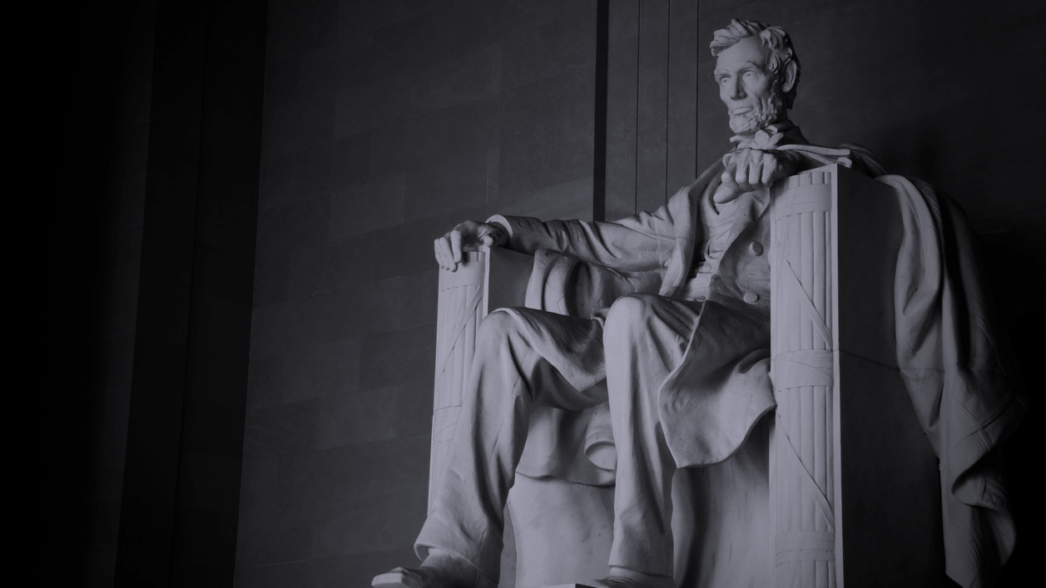

February 26,, 2018

Slide 2
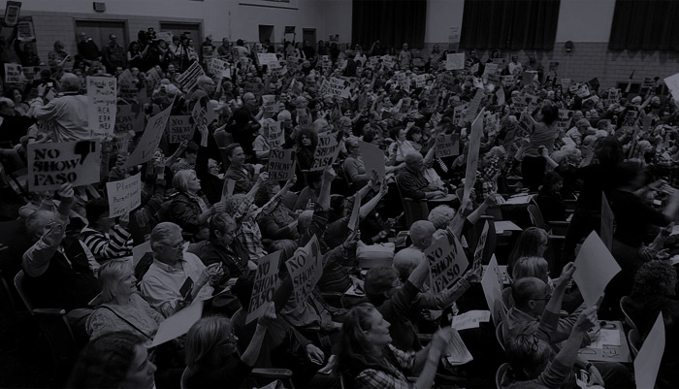
Agenda
Business
  Congratulations to INH’s 8 new Ward Delegates!
  Officer’s meeting update
  Treasurer's report
Actions
  Reapprove bylaws
  Scholarship update
Two speakers
  Miranda Viscoli - NewMexicans to prevent Gun Violence
  Paul Moya CD 1 candidate

Slide 3
Important matters
Gun Control
Discussion on Parkland Fla Shooting
  What actions should we take?
    March 24 Rally -Local?
      Student organized. INH helping
    Scholarship for two students to go in DC
      Sent criteria to APS superintendent
      Collected $371. Pls consider a contribution
Other Student/teacher actions to watch and participate in
  Wed March 14 - 10 am for 17 minute walkout
  Fri Apr 20 - National School Walkout Day to rally and march

Slide 4
Collection of membership dues
$25 per year, as stated in our bylaws
Pay via cash, check or credit card
  Square credit card payments = $25.00 (see Toni, payment in person only)
  ActBlue credit card payments = $30.00 (increase is to cover the administrative fees charged by ActBlue) Pay via indivisiblenobhill.com website anytime
Members are entitled to vote on actions of INH in accordance with the bylaws.

Slide 5
Events & Announcements
National Popular Vote
Bypassing the electoral college to ensure 2020 President wins by popular vote. Need 270 electoral vote, currently 11 states with 165 electoral votes have passed it. NM can add 5! NM Senate passed the NPV bill in Feb 2017, the House Local Government, Elections, Land Grants and Cultural Affairs Committee later defeated
  Indivisible Intergroup meeting 1/25/18
    Write a NPV position paper
    Letter to Abq Journal Editor
    Develop integrated strategy to pass NPV in 2019 State Legislative session

Slide 6
Events & Announcements
March for our Lives
  Fundraising link
  T-Shirt Purchase Link; purchase by March 4 to recieve in time for the march
  Contribute to scholarship fund in person - See Tom with cash or check. See Rayellen for credit card donations
  Location will change - Civic Plaza is booked.
News from Senator Martin Heinrich
  He’s donated the $2000 he received from NRA in 2010
  He’s working hard to get an F
March 21 It's a Beautiful Earth concert
NM Gang Task Force speaker - David Clarke
  Call them and ask them to cancel this divisive individual from their annual dinner
    Duke Kouri
    NMGTF Program Manager
    Contact by email
    505-875-3556
    505-238-8664 cell

Slide 7

Actions are described in detail in the newsletter from Melora - here are the highlights. See the email for the specific links and detailed information - include prepared ‘call scripts’
Call Senators and ask them to vote NO on the Concealed Carry Reciprocity Act
Contact friends and family in other states and urge them to vote out anybody that accepted NRA funds
Call Senators and House reps to vote
  FOR net neutrality
  Get DACA done
  NO on infrastructure
  NO on any repeals of Dodd-Frank
Donate to our scholarship fund to send two students to DC for the National March for our Lives event.

Slide 8

Upcoming Speakers:
Mar 5: Bill McCamley / State Auditor
Mar 12: Maggie Toulouse Oliver / Secretary of State
Mar 19: Damian Lara / Congress
Mar 26: Lloyd Princeton / Congress - Libertarian
April 2: Billy Garrett / Lt. Governor

Slide 9
Welcome!
Paul Moya
Candidate for CD1

Slide 10
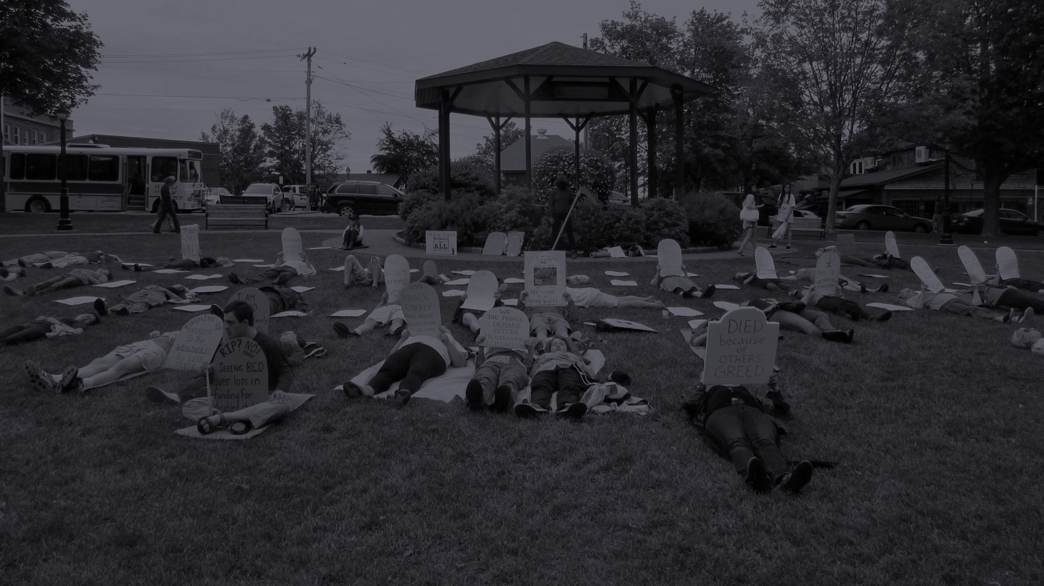

“Let’s stop freaking out alone.
Let’s freak out together."

