Slide 1
February 26, 2018

Slide 2
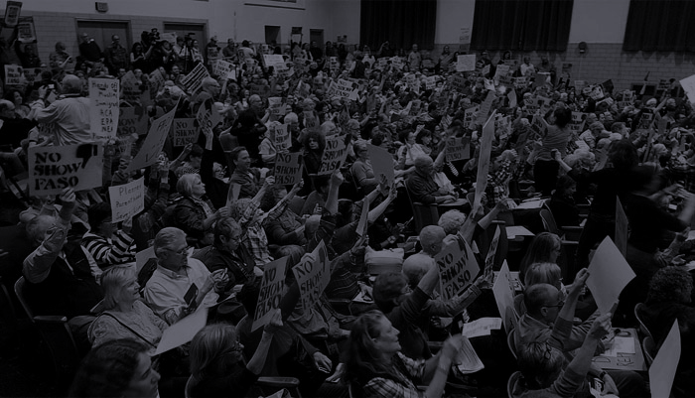
Agenda
Business
Officer’s meeting update
Secretary Position Open
Treasurer's report
Open Discussion Gun Control
Membership Voting, Events and announcements
Actions
Welcome Bill Piefer Bernco Dem Party
Ward meetings
Welcome Working Families

Slide 3
Important matters
Discussion on Parkland Fla Shooting
What actions should we take?
March 24 Rally -Local?
Should we organize it? Partner with Mothers Demand Action?
Scholarship for two students to go in DC ? (Rayellen will personally donate airmiles for 2 individuals - anybody else?)
Other Student/teacher actions to watch and participate in
Wed March 14 - 10 am for 17 minute walkout
Fri Apr 20 - National School Walkout Day to rally and march

Slide 4
Important matters

Slide 5
Collection of membership dues
$25 per year, as stated in our bylaws
Pay via cash, check or credit card
Square credit card payments = $25.00 (see Toni, payment in person only)
ActBlue credit card payments = $30.00 (increase is to cover the administrative fees charged by ActBlue) Pay via indivisiblenobhill.com website anytime
Members are entitled to vote on actions of INH in accordance with the bylaws.

Slide 6
Events & Announcements
National Popular Vote
Bypassing the electoral college to ensure 2020 President wins by popular vote. Need 270 electoral vote, currently 11 states with 165 electoral votes have passed it. NM can add 5! NM Senate passed the NPV bill in Feb 2017, the House Local Government, Elections, Land Grants and Cultural Affairs Committee later defeated
Indivisible Intergroup meeting 1/25/18
Write a NPV position paper
Letter to Abq Journal Editor
Develop integrated strategy to pass NPV in 2019 State Legislative session

Slide 7
Events & Announcements
INH is supporting the March 24 student March for Our Lives in Washington DC
by sponsoring 2 high school students (travel, lodging and food). To donate to the efforts:
Buy t-shirts to support the March
https://www.gofundme.com/march-for-our-lives-albuquerque.

Slide 8
1. Gun Control
Call our Senator’s and tell them:
Don’t pass the Concealed Carry Reciprocity Act
Contact friends and family where MoCs have accepted money from the NRA and ask them to commit to #VoteThemOut.
2. Net Neutrality
FCC officially added its plan to destroy net neutrality. All Democrats and one Republican have said they will support a net neutrality bill in Senate, so call ours and let them know you’re behind them! For a script go to https://stopthefcc.net
3. The DACA cliff is approaching.
On March 5, the number of DACA recipients who lose their protections will rise from 122 per day to over 1,200 per day. Call Sen Udall & Heinrich and tell them we need a #DreamActNow.
4. Republicans (& some Dems) vote to repeal parts of Dodd-Frank.
The Senate is expected to vote on S. 2155, a tell our Senators to vote no on S. 2155.

Slide 9
Upcoming Speakers:
Feb 26: Paul Moya / Congress
Mar 5: Bill McCamley / State Auditor
Mar 12: Maggie Toulouse Oliver / Secretary of State
Mar 19: Damian Lara / Congress
Mar 26: Lloyd Princeton / Congress
April 2: Billy Garrett / Lt. Governor

Slide 10
Welcome!
JD Matthews from
New Mexico Working Families

Slide 11
“Let’s stop freaking out alone.
Let’s freak out together."

