Slide 1
March 5, 2018

Slide 2
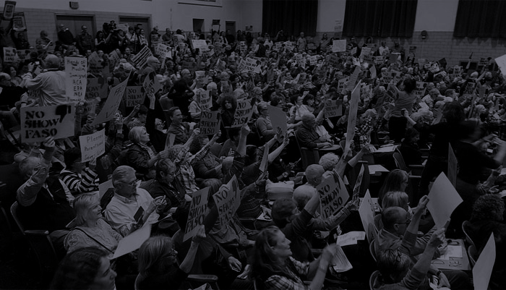
Agenda
Business
Officer’s meeting update
Scholarship update
Treasurer's report
Update on Get Woke and Vote
Actions
New website update
Announcement from Joe Gallant

Slide 3
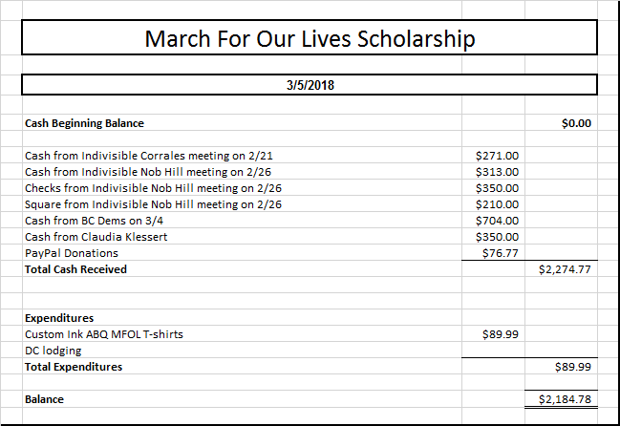
Scholarship update
Four students identified
Two juniors from Manzano nominated by their English teacher
Two self nominated seniors from La Cueva
Let’s send all four!
Bought five T-shirt’s for them (one for host)
Total funds raised

Slide 4
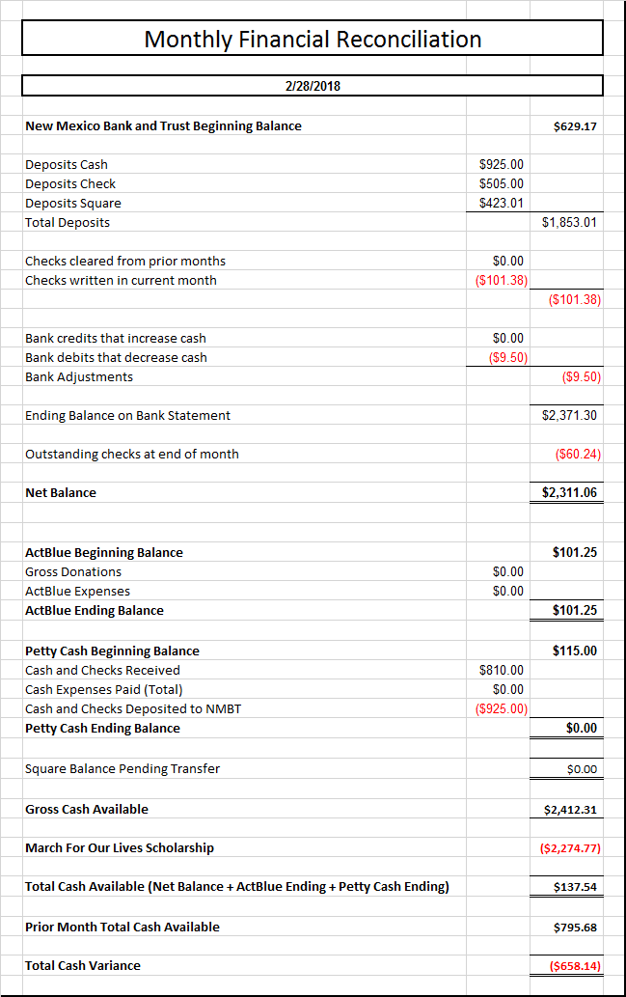
February Financial Recon

Slide 5
Events & Announcements
INH is supporting the March 24 student March for Our Lives in Washington DC
by sponsoring 2 high school students (travel, lodging and food). To donate to the efforts:
Buy t-shirts to support the March
https://www.gofundme.com/march-for-our-lives-albuquerque.

Slide 6
Collection of membership dues
$25 per year, as stated in our bylaws
Pay via cash, check or credit card
Square credit card payments = $25.00
PayPal via the INH website
Members are entitled to vote on actions of INH in accordance with the bylaws.

Slide 7
Events & Announcements
National Popular Vote
Bypassing the electoral college to ensure 2020 President wins by popular vote. Need 270 electoral vote, currently 11 states with 165 electoral votes have passed it. NM can add 5! NM Senate passed the NPV bill in Feb 2017, the House Local Government, Elections, Land Grants and Cultural Affairs Committee later defeated
Indivisible Intergroup meeting 1/25/18
Write a NPV position paper
Letter to Abq Journal Editor
Develop integrated strategy to pass NPV in 2019 State Legislative session

Slide 8
Call our Senators:
Don’t pass the Concealed Carry Reciprocity Act
No on Economic Growth, Regulatory Relief, & Consumer Protection Act
Support S. J. Res. 54: force a Senate vote to unauthorize US in Yemen
Stay strong on clean DREAMact, March 5, more Dreamers lose protections
Vote NO Bank Lobbyist Act
Send postcards and/or tweets
Thank 25 companies who have severed ties with the NRA
Volunteer for Texting-bank
Text voters in PA-18 for Conor Lamb in Pennsylvania, March 10-13
Local Actions:
Call the New Mexico Gang Task Force: NO on sheriff David Clarke as key note speaker at annual conference in April at the Isleta Casino.

Slide 9
Upcoming Speakers:
Mar 12: Maggie Toulouse Oliver / Secretary of State
Mar 19: Damian Lara / Congress
Mar 26: Lloyd Princeton / Congress
April 2: Get Woke and Vote!
April 9: Pat Davis / Congress
April 16: Tim Eichenberg / State Treasurer

Slide 10
Welcome!
Bill McCamley
For State Auditor

Slide 11
“Let’s stop freaking out alone.
Let’s freak out together."

