Slide 1
March 12, 2018

Slide 2
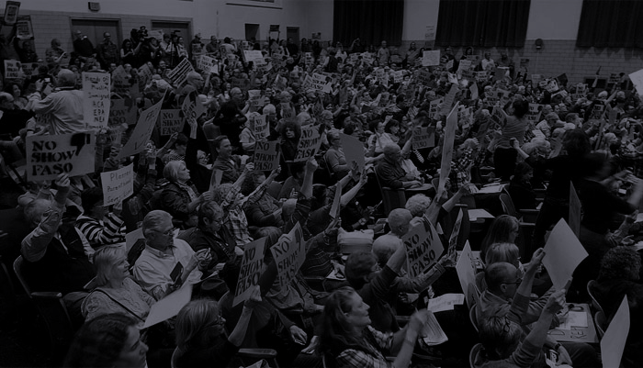
Agenda
Business
Introduce Maria Garre
Results of the Convention
Scholarship update
Treasurer's report on scholarship
Committee update
Items requiring member votes
Actions
Speaker - Maggie Toulouse-Oliver

Slide 3
Results of the Convention
Governor
21.16% Jeff Apodaca
10.05% Joseph Cervantes
1.91% Peter DeBenedittis
66.88% Michelle Lujan Grisham
Lt. Governor
12.91% Jeff Carr
8.87% Billy Garrett
27.94% Rick Miera
50.28% Howie Morales
Auditor
39.4% Brian Colón
60.46% Bill McCamley
Commissioner of Public Lands
43.71% Stephanie Garcia Richard
17.19% George Muñoz
39.11% Garrett VeneKlasen
Congressional District 1
13.55% Patrick Davis
34.80% Debra Haaland
12.09% Damian Lara
10.81% Damon Martinez
3.66% Paul Moya
25.09% Antoinette Sedillo Lopez
DPNM.org for full results

Slide 4
Scholarship update
Meet our March for Our Lives D.C. scholarship winners:
Caroline
Elizabeth
Faith
Katelyn
What are your specific goals for the March?
What can we tell our legislators about your goals?
Let us know how we can help you!

Slide 5
Scholarship
Financial Recon

Slide 6
Committee Updates
Legislative Committee
Get Woke and Vote
Voter Registration
National Popular Vote
Endorsements
Spring Pot Luck Party?

Slide 7
Collection of membership dues
$25 per year, as stated in our bylaws
Pay via cash, check or credit card
PayPal via the INH website
Members are entitled to vote on actions of INH in accordance with the bylaws.

Slide 8
Events & Announcements

Slide 9
National Actions:
Senate motion S. 2155 the "Bank Lobbyists Act" jeopardizes the financial stability of banks and our economy. NM Sen Udall and Heinrich both voted no
Call to thank them and ask them to say “No” in its present form
S.J. Res. 54: #SandersLeeYemen. Motion to force the Senate vote to against US’ involvement in the Yemen war
Call Sen Udall & Hienrich and ask them to say “Yes”

Slide 10
Local Actions:
The New Mexico Gang Task Force annual conference at the Isleta Casino in April. Former Wisconsin sheriff David Clarke is keynote speaker. Clarke is a vocal surrogate of Trump (and certified nasty guy).
Call NMGTF event organizers and tell them “No” to David Clarke
Duke Kouri , NMGTF Program Manager, dana@nmpal.com, 505-875-3556/cell 505 238 8664
Antoinette Apodaca, Gang Specialist, acapodaca@cabq.gov, 505-875-3568
Take the Speak Up New Mexico Survey. Created by Retake Our Democracy, the survey asks New Mexicans to identify priorities to help focus lobbying efforts to make good bills, good laws

Slide 11
Upcoming Speakers:
Mar 19: Damian Lara / Congress
Mar 26: Lloyd Princeton / Congress
April 2: Get Woke and Vote!
April 9: Pat Davis / Congress
April 16: Tim Eichenberg / State Treasurer

Slide 12
Welcome!
Maggie Toulouse-Oliver
New Mexico Secretary of State

Slide 13
“Let’s stop freaking out alone.
Let’s freak out together."

