Slide 1
Autumn Fields Homeowners Common Areas Maintenance Association
2024 Budget Presentation
February 27, 2024

Slide 2
Agenda
Meet your board members
2023 Financial Review & 2024 Budget
Landscaping & Maintenance Update
Architectural Review Committee Update
North Lot Concerns/Laraway Road Project
Questions?

Slide 3
2023 Financial Review & 2024 Budget
(Income)

Slide 4
2023 Financial Review & 2024 Budget
(Expenses)

Slide 5
2023 Financial Review & 2024 Budget
(Expenses cont.)
Notes:
No price increase from Beary for the last 16 years. First price increase (+7%) and new contract 2022-2024.

Slide 6
Landscaping & Maintenance Update
Beary Landscaping maintenance contract: 2022-2024
Fuel Surcharges
15% anticipated increase starting in 2025, will explore competitive bids
Annual mulching to continue in 2024 using less mulch per tree
Did not mulch in 2023 in order for mulch to further settle before resuming mulching
Continue to remove and replace diseased and dead trees
The Village of Frankfort is responsible for the maintenance of parkway trees
Autumn Fields Spring Cleanup Saturday, April 20, 2024
Village of Frankfort encourages residents to clean up our community 9:00 AM - 11:30 AM
Volunteer hours for high school students in the subdivision
Notes:
Autumn Fields has many non native (and even some listed on the invasive species list) plants that ensure an endless cycle of planting, disease, decline, removal and right back to planting. These trees were planted within the last 15-20 years, and most are diseased or declining. Non native trees have higher rates of disease and are detrimental to our ecosystem. Native trees are a safe haven for key fungi, insect and bird populations that play a crucial role in maintaining a healthy and balanced microbiome that limits/ controls harmful insects and diseases.

Slide 7
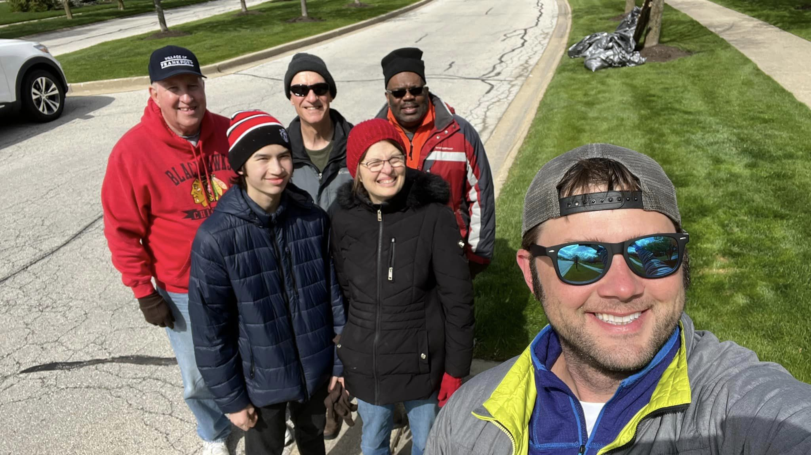
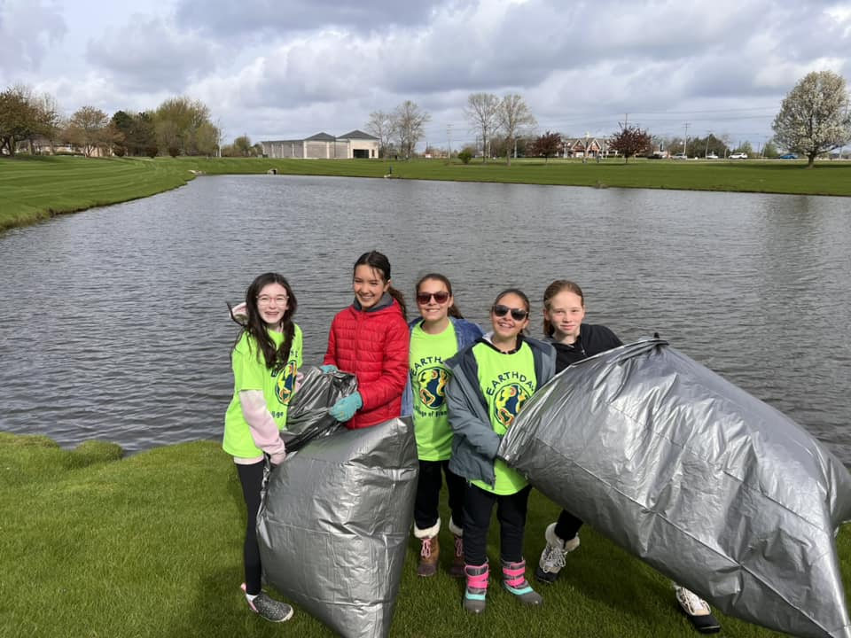
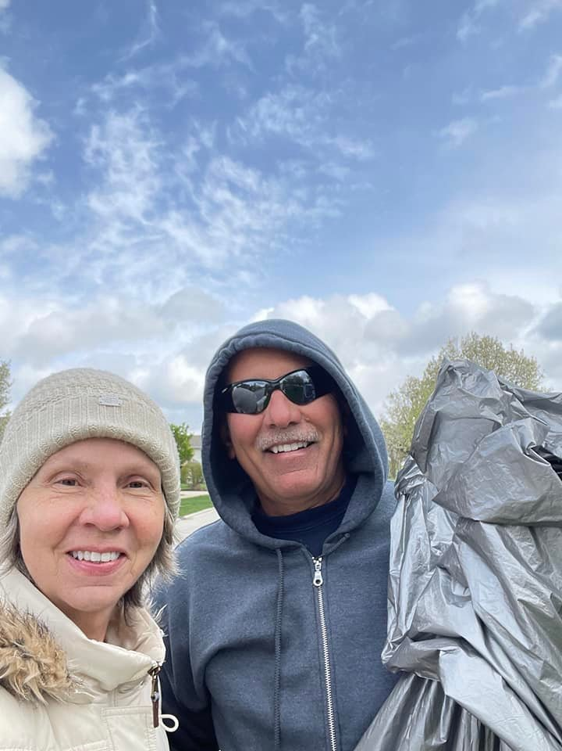
Earth Day Cleanup 2023! Join us April 20th!

Slide 8
Architectural Review Committee Update
When you need a permit from the Village of Frankfort, you will need an ARC approval letter to give to the Village with the permit request
It is HIGHLY recommended that you have the ARC approval letter to turn in with your permit paperwork so that it does not get separated
To obtain an ARC letter, the homeowner must contact arc@autumnfields.net with:
Homeowner’s name, address and phone number
Contractor company name, contact person and phone number
Description of work to be done
Brand of product and color choice

Slide 9
North Lot Concerns
SE Corner of Wolf & Laraway

Slide 10
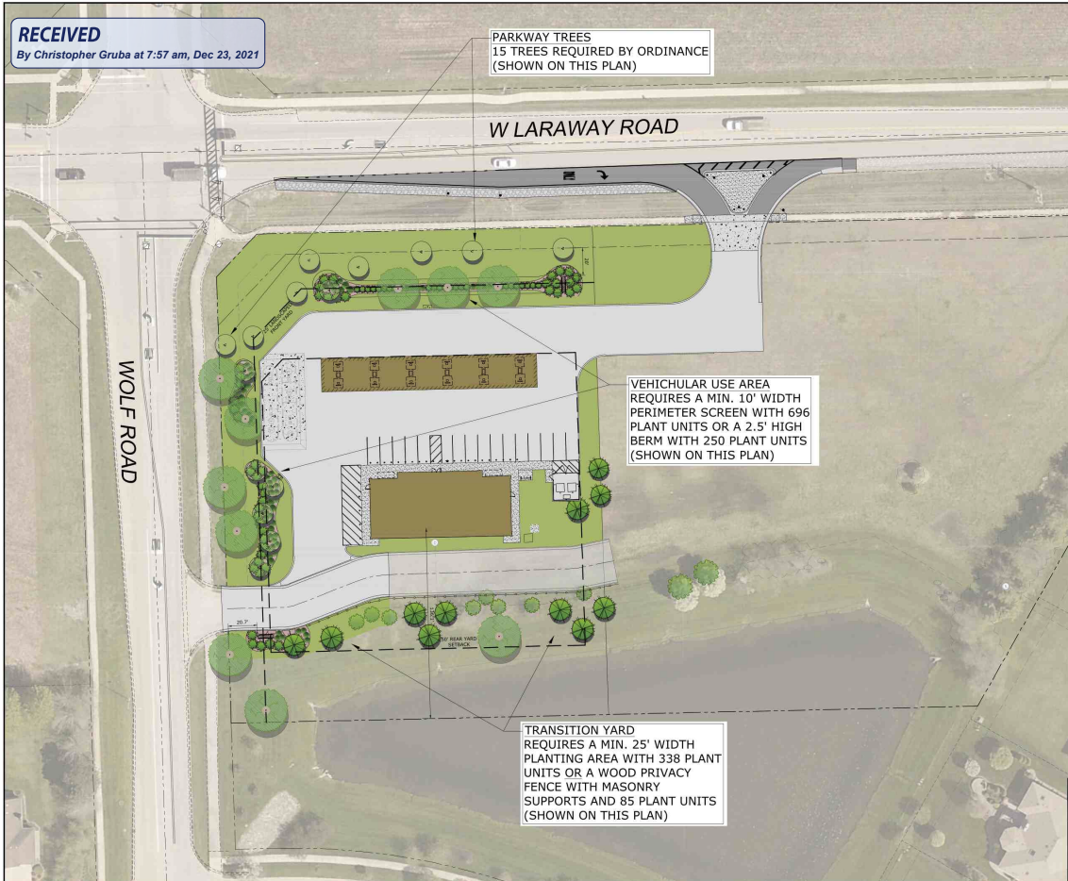

Slide 11
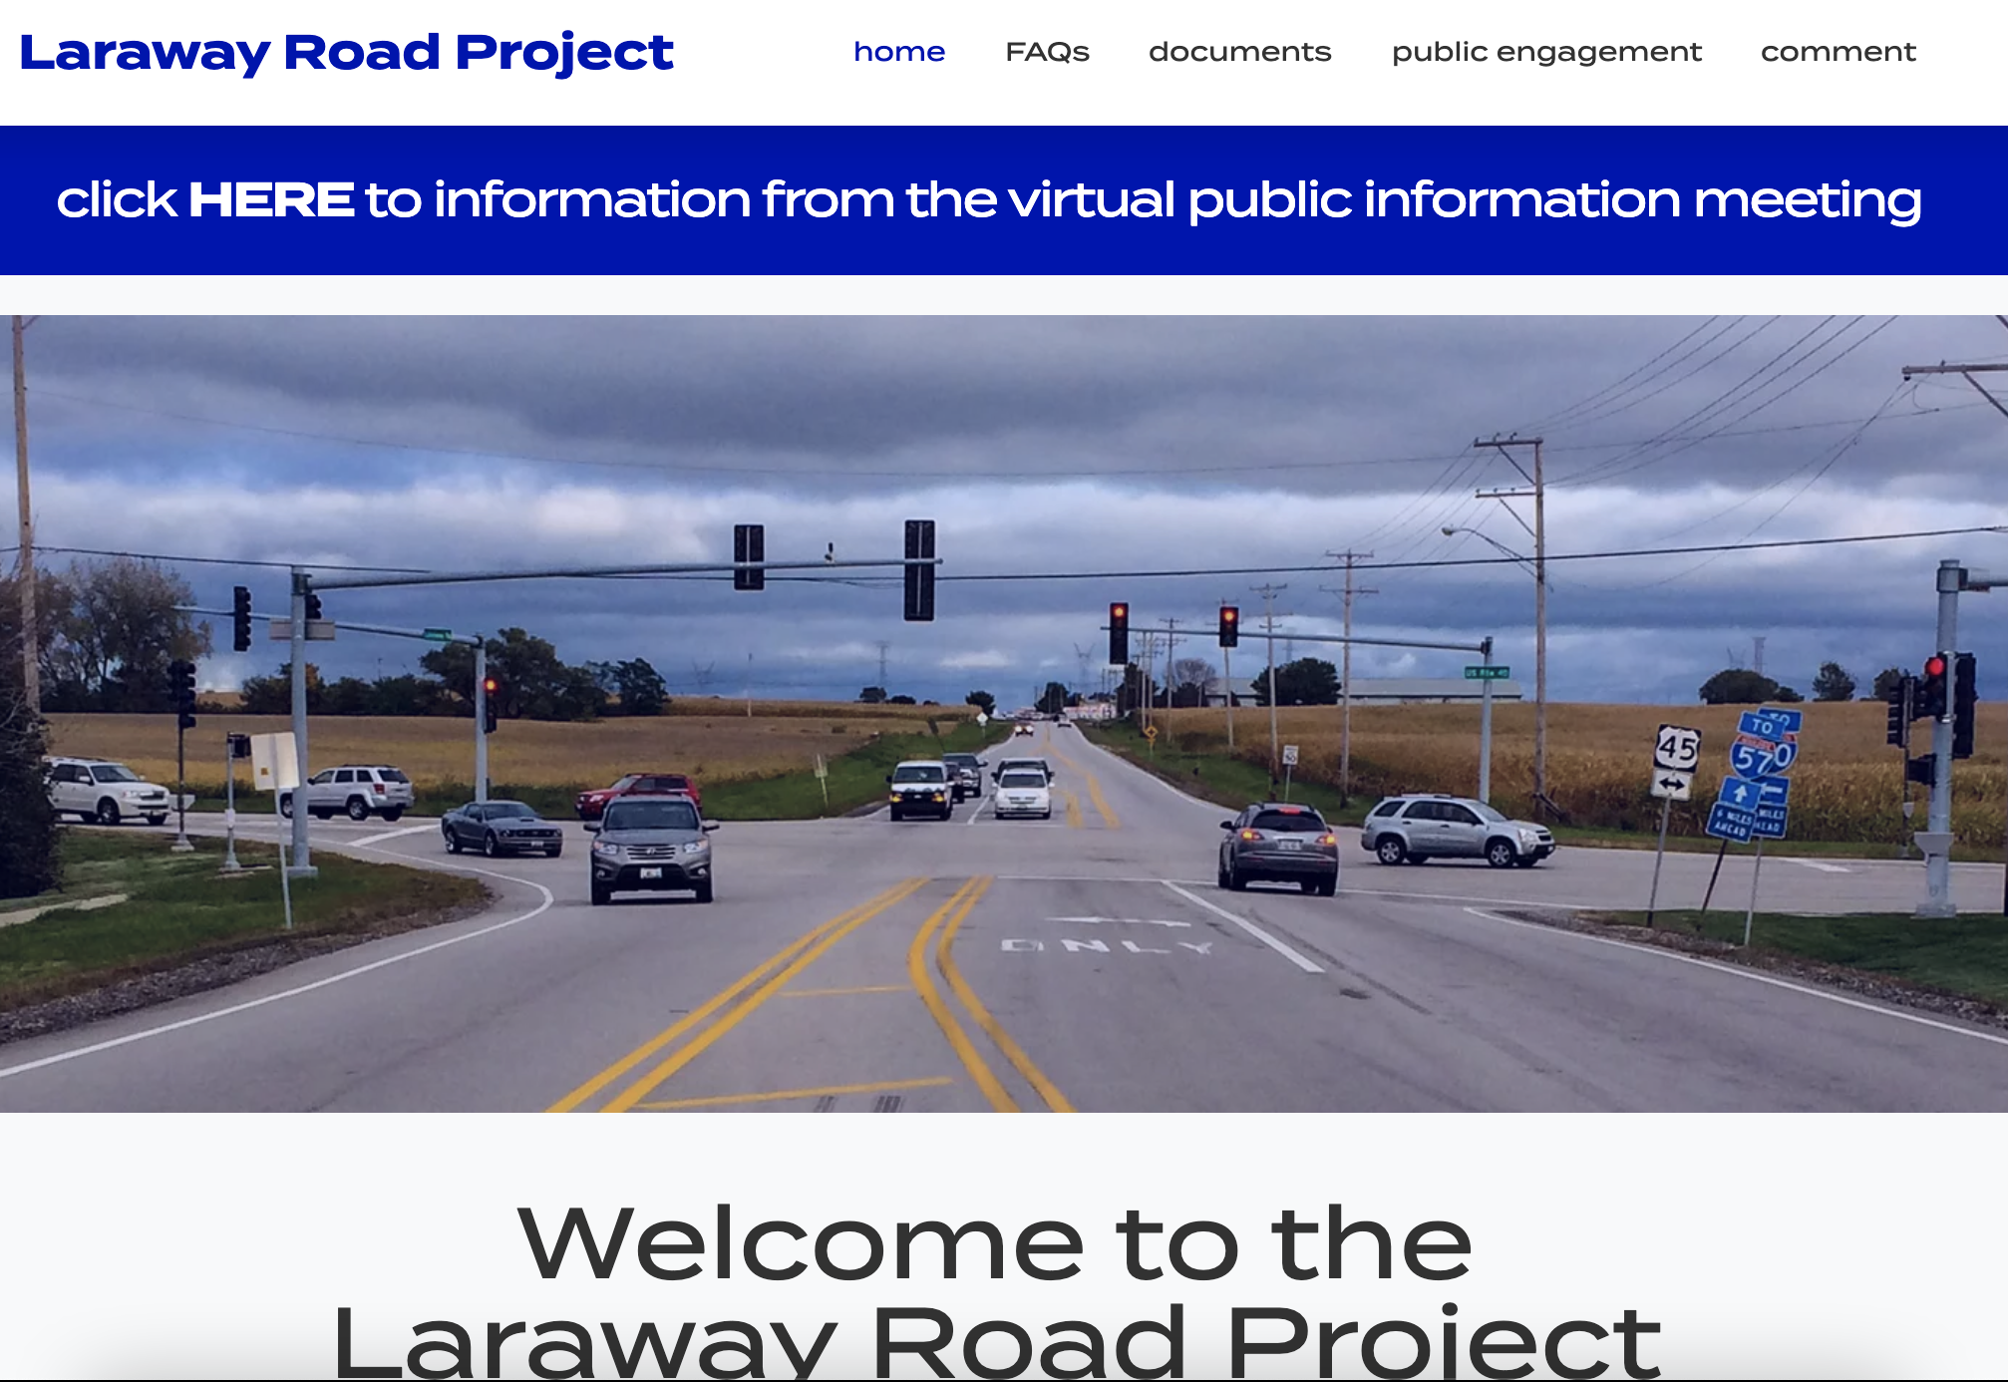
Laraway Road Corridor Project
www.larawayroadcorridor.com

Slide 12
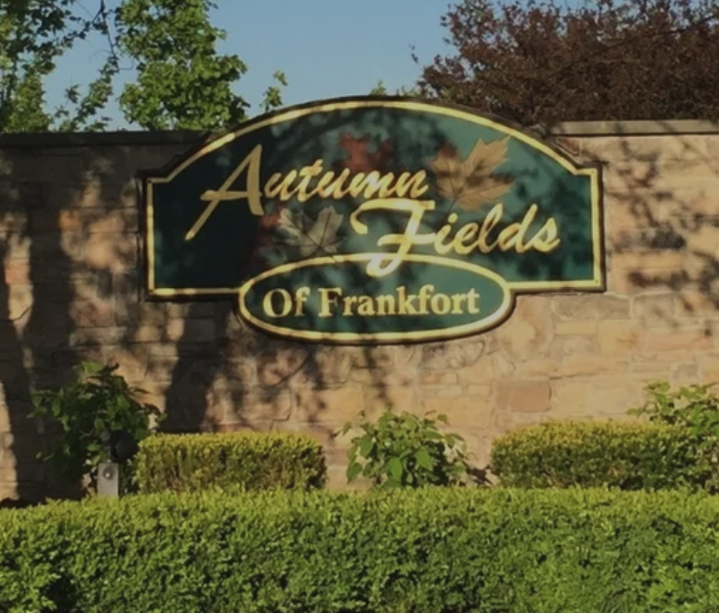
Thanks!
Questions? Contact us at:
board@autumnfields.net
Resources for Residents:
https://autumnfields.net/

