Slide 1
Autumn Fields Homeowners Common Areas Maintenance Association
2022 Budget Presentation
March 22, 2022

Slide 2
Agenda
Meet your board members
2021 Financial Review & 2022 Budget
Landscaping & Maintenance Update
Architectural Review Committee Update
North Lot Proposal/Laraway Road Project
Questions?

Slide 3
Meet your Board Members
David Hurst, President
Greg Flesch, Secretary
Ron Wojcik, Treasurer
Laura Nienhouse, Architectural Review Committee
Gunars Inka, Landscaping & Maintenance
Al Travaglini, Architectural Review Committee

Slide 4
2021 Financial Review & 2022 Budget
(Income)

Slide 5
2021 Financial Review & 2022 Budget
(Expenses)

Slide 6
2021 Financial Review & 2022 Budget
(Expenses cont.)
Notes:
No price increase from Beary for the last 16 years. First price increase (+7%) and new contract 2022-2024.

Slide 7
Landscaping & Maintenance Update
Beary Landscaping maintenance contract renewed 2022-2024
Annual mulching to continue on rotation
Continue to remove and replace diseased and dead trees
Tree/Shrub shortage, increasing costs
Arborists expect further spread of disease to common area trees
Wolf Road common area berm damage/Progressive Insurance claim
The Village of Frankfort is responsible for the maintenance of parkway trees
Autumn Fields entrance sign lighting and electrical repaired at no cost by resident Josh Luedtdke. Thank you Josh!
Notes:
Autumn Fields has many non native (and even some listed on the invasive species list) plants that ensure an endless cycle of planting, disease, decline, removal and right back to planting. These trees were planted within the last 15-20 years, and most are diseased or declining. Non native trees have higher rates of disease and are detrimental to our ecosystem. Native trees are a safe haven for key fungi, insect and bird populations that play a crucial role in maintaining a healthy and balanced microbiome that limits/ controls harmful insects and diseases.

Slide 8
Architectural Review Committee Update
When you need a permit from the Village of Frankfort, you will need an ARC approval letter to give to the Village with the permit request.
It is HIGHLY recommended that you have the ARC approval letter to turn in with your permit paperwork so that it does not get separated.
To obtain an ARC letter, the homeowner must contact arc@autumnfields.net with:
Homeowner’s name, address and phone number.
Contractor company name, contact person and phone number.
Description of work to be done.
Brand of product and color choice.

Slide 9
Casey’s Gas Station Proposal
SE Corner of Wolf & Laraway

Slide 10
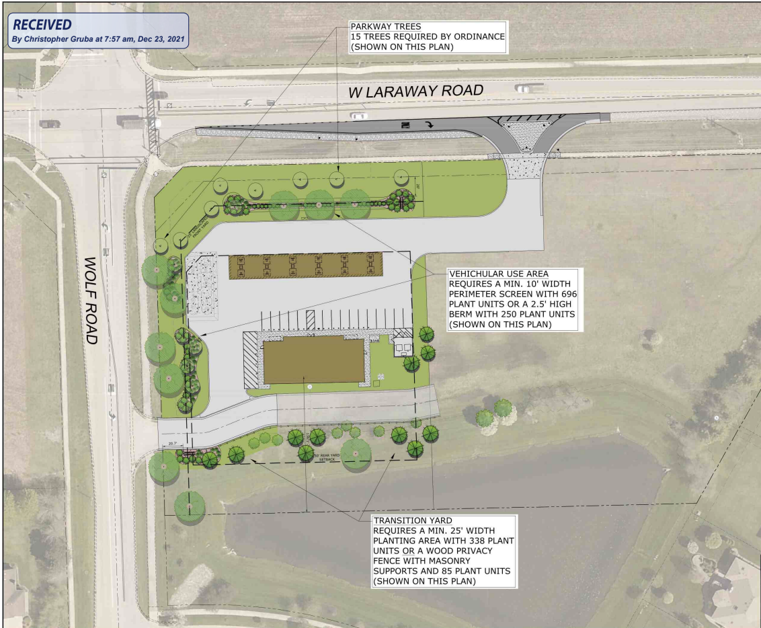

Slide 11
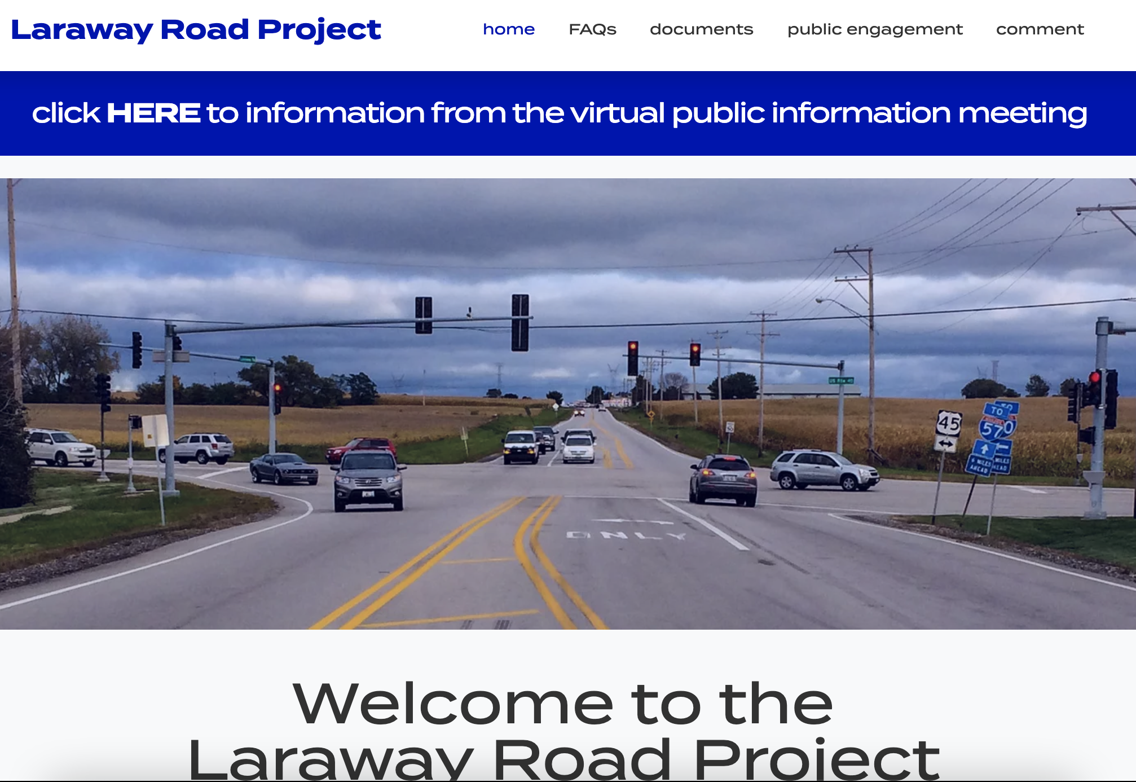
Laraway Road Corridor Project
www.larawayroadcorridor.com

Slide 12
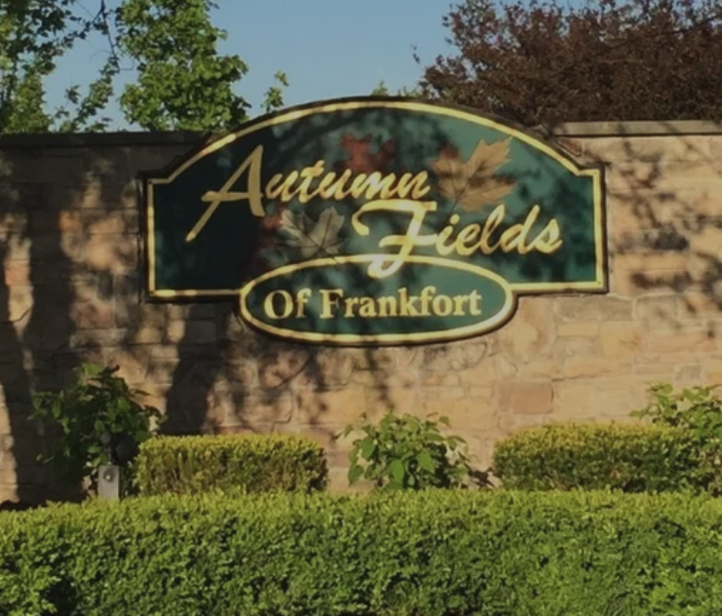
Thanks!
Questions? Contact us at:
board@autumnfields.net
Resources for Residents:
https://autumnfields.net/

