Slide 1
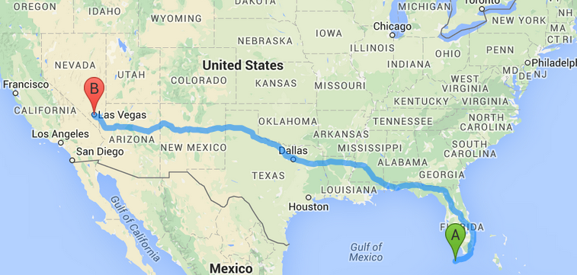
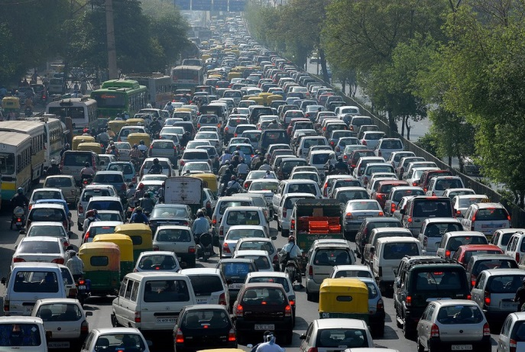





The Impact of Transportation
Vehicles waste on average 42 hrs/ year in congestion
- The drive time between Key West and Las Vegas
There are 1.2 Billion vehicles
on the road worldwide
3.1 Billion
gallons
Amount of fuel wasted in U.S. each year due to
congestion
4.4 million people per year are injured on U.S. Roads
By 2020, U.S. traffic congestion
will waste 8.3 billion hours
Placed end-to-end, public
roadways in U.S. would stretch
4 million miles. Enough to
Circle the Earth 160 times
and 3.8 billion
gallons gas
2020
Drivers in the U.S. collectively drive 3 trillion miles a year. A spaceship traveling at the speed of light would take about 6 months to cover that distance.
Total annual cost
of $192 Billion
1.24 million people worldwide
die in traffic accidents every year

