Slide 1
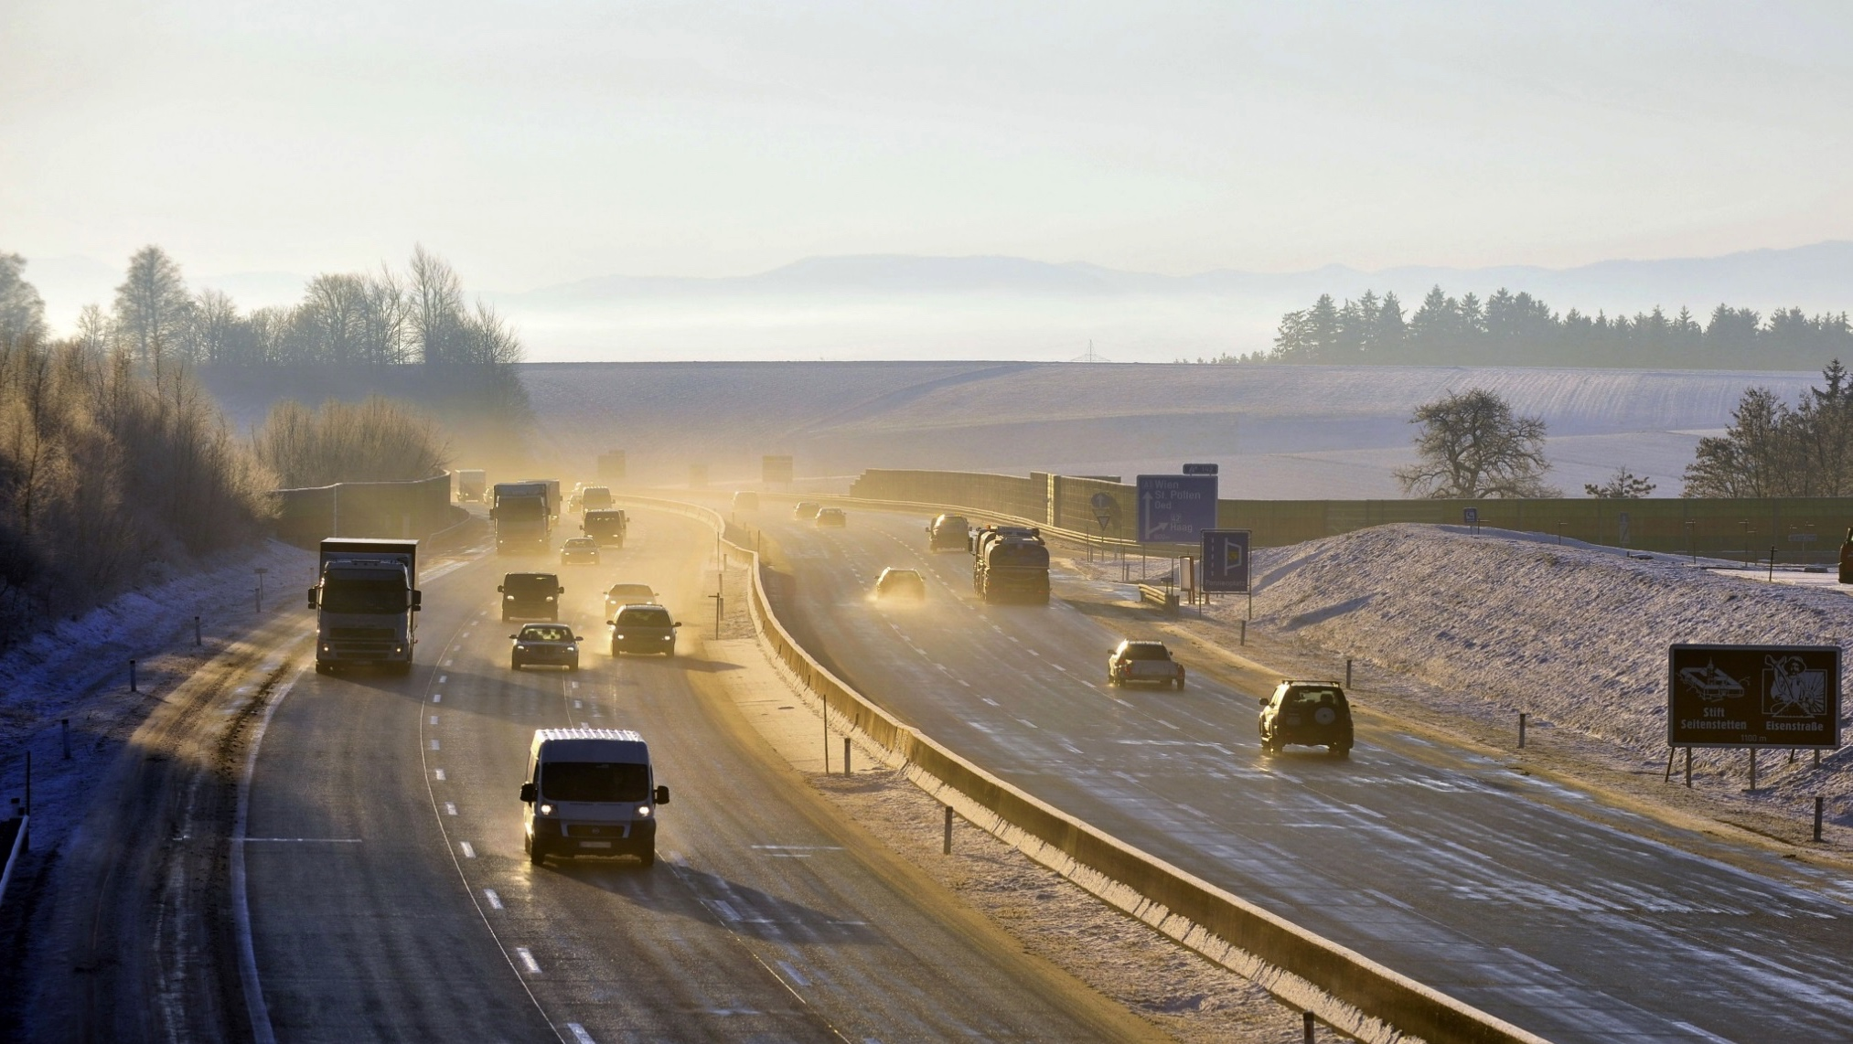

Cisco Connected Roadways
Connected 70,000 Sensors, 6,500 Traffic Cameras
Over Converged IP Network
Business Needs
Create safer, less congested roads
Greater visibility into road conditions
Improve operational efficiency
Better communication in emergencies
Business Outcomes
Centralized communication between agencies
Reduced TCO w/end-to-end converged network
Prevent traffic jams with dynamic speed limits
Better traffic management and real time updates
Maximizing road utilization
Notes:
Based on ASFiNAG case study

Slide 2
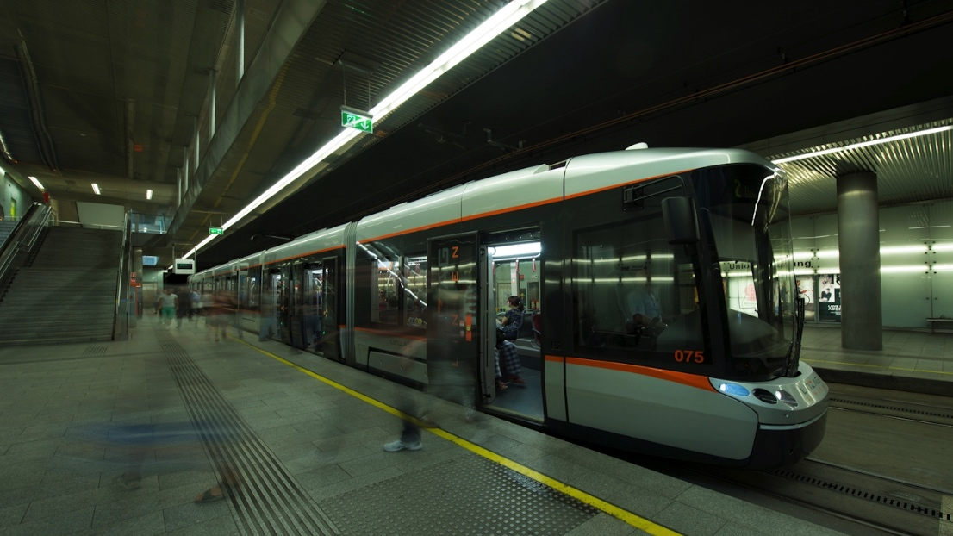

Cisco Connected Mass Transit
Cisco Industrial Ethernet connects stations,
ticketing machines and digital displays
Business Needs
Improve the passenger experience
and increase ridership
Reduce maintenance and operating costs
Protect investment in existing network
Business Outcomes
Increased tram efficiency and performance
Reduced energy consumption by 10%
Reduced carbon dioxide output by 85 tons
Supports 500 simultaneous onboard Wi-Fi users
Notes:
Based on Linz AG (Austria) case study

