Slide 1
Best Practices for Conducting Re-Interviews
Laura Lee Bernstein and Evelyn Arevalo
Consultants for Elevated Recruitment Services

Slide 2

Session Objectives
Understand the purpose and importance of re-interviews in the Title I, Part C program.
Learn best practices for conducting thorough and compliant re-interviews.
Explore strategies for building trust with families during the process.

Slide 3
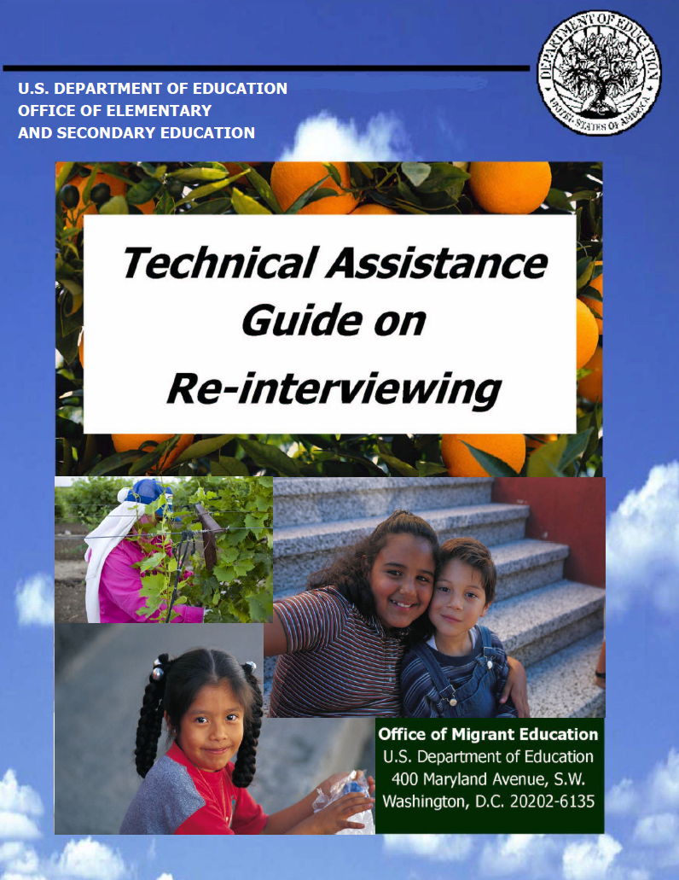
Reading the MEP Re-Interview Guide is recommended to better understand the process.

Slide 4
Purpose of the Re-Interviews
They confirm the state's eligibility determinations and the accuracy of reported migrant children’s number
They help identify and correct issues in the ID&R process and, depending on the re-interview type, establish a discrepancy or defect rate for monitoring and funding purposes

Slide 5

How many types of re-interviews are there?

Slide 6

There are two types of re-interviewing
Prospective Re-Interviewing
Retrospective Re-interviewing

Slide 7
Prospective re-interviews
Prospective re-interviewing is a process that allows states to identify problems in the early identification of families and out-of-school youth (OSY) so they can be quickly resolved. States can use prospective reinterviewing for quality control before submission of the annual child counts.

Slide 8
Retrospective Re-interviews
Retrospective Re-interviewing establishes valid and reliable defect rates that measure the quality of a state’s eligibility determinations for an entire child count year (i.e., eligibility determinations made over the course of a three-year period). Retrospective re-interviewing serves a purpose similar to a manufacturer’s product recall when a serious defect is suspected.

Slide 9
Re-interviewers should always be familiar with the following information:
  Re-interview form
  Policies adopted by the state
  Person to contact for additional phone numbers and updated address
  Services provided by the state
  Resources for families
  Crops grown in the state
  Deadline for completing the re-interviews

Slide 10

What is the recommended number of attempts for conducting phone re-interviews?

Slide 11

Pg. 56
Re-interview guide
Make multiple attempts to contact sampled families. Three attempts are considered the minimum for in-person interviewing, but ten attempts are more typical by phone.

Slide 12

Can the re-interview form be filled out before conducting the re-interview?

Slide 13
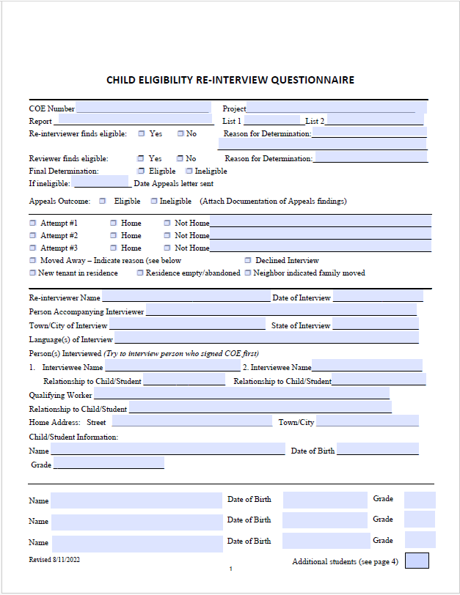

Yes, family data and child data can be filled out before the re-interview

Slide 14

Organizing Data
Organize all re-interviews by grouping them into regions, counties, or school districts. If the re-interviews are conducted by phone, arrange them according to area codes.

Slide 15

What tools can you use to efficiently conduct re-interviews?

Slide 16
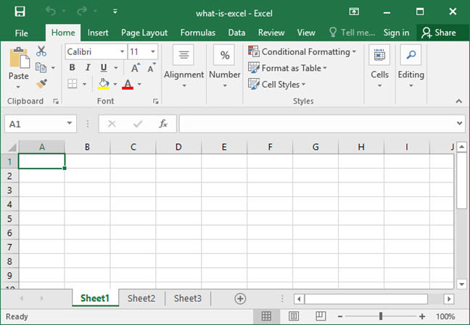
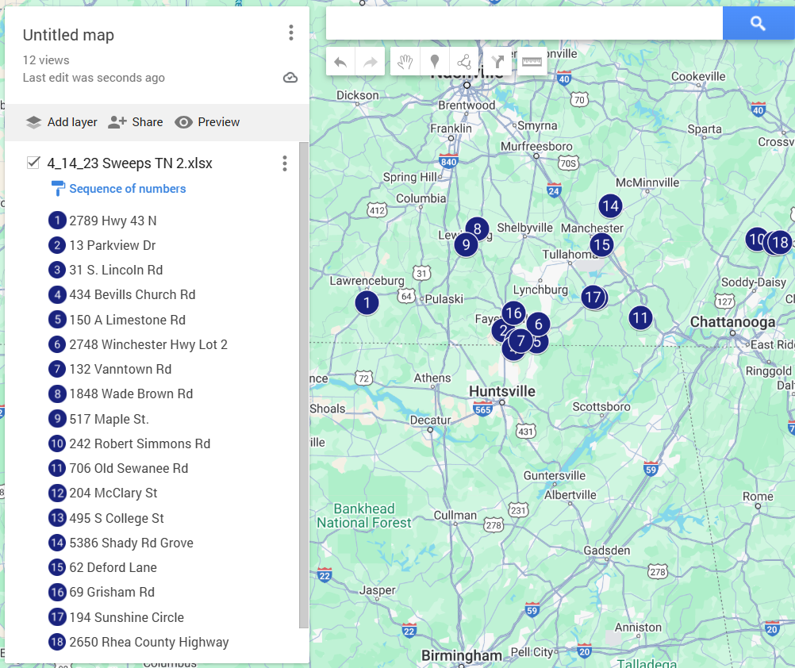

Excel
Google Map
Address
City
State
Zip code
Attempt 1
Attempt 2
Attempt 3
Completed
Disconnected
Left a voicemail
All circuits were busy
Never include identifiable information

Slide 17

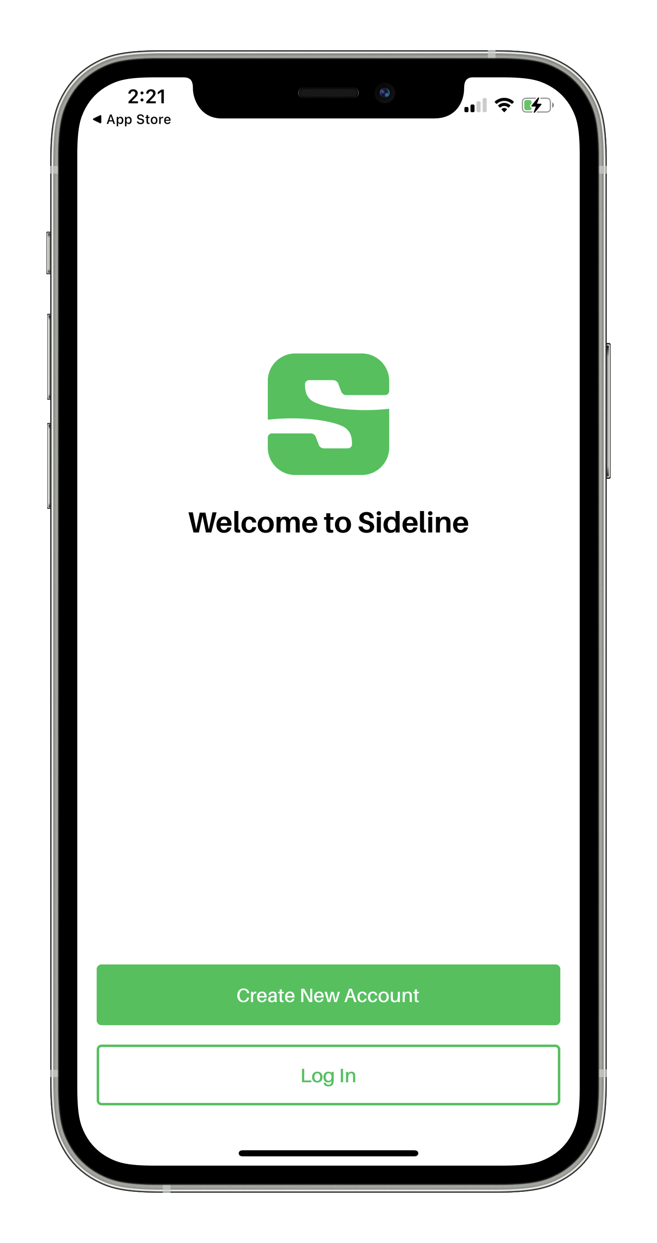
Do not use your personal phone number. Sideline is an excellent app for masking your number.

Slide 18

If you come across a disconnected phone number, try using WhatsApp to reach out instead.

Slide 19

Utilize MSIX to check if the family has enrolled in the MEP in another state.

Slide 20

Always be prepared
Business cards
Door hangers
MEP brochures
State Resources
Flashlight
Business cards
Door hangers

Slide 21
Tips for building trust with families during re-interviews
Clearly explain the purpose of the interview
Show genuine interest in their concerns
Understand and respect their cultural background
Demonstrate empathy by recognizing the challenges they may face
Establish a positive rapport by being friendly, approachable
Assure the family that all the information is confidential and used only for educational purposes.

Slide 22

Example of an interview
Hello, my name is Evelyn, and I work with Mr. Jose Luis from the Migrant Education Program. I have been assigned to update the participants' information in our system to ensure its accuracy. Do you have a few minutes to go over this information with me?

Slide 23

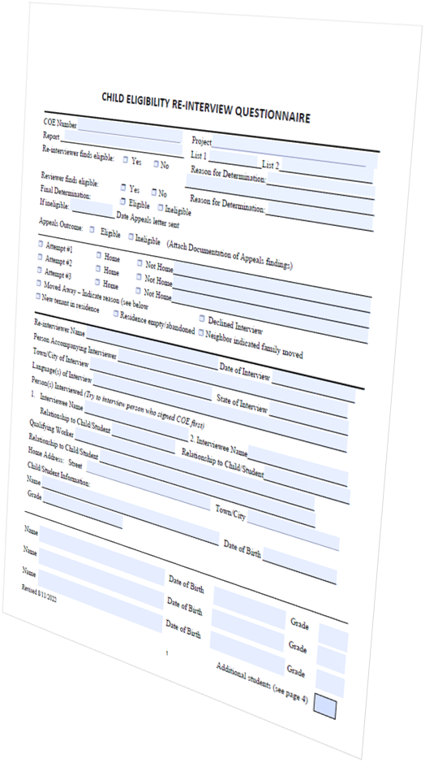
Always start by verifying information that the family is familiar with, such as family data and child data.

Slide 24

Keep thorough notes on the family's responses. Detailed notes provide a complete overview for the re-interview panel. Include as many specifics as necessary to accurately outline the family's eligibility or ineligibility.

Slide 25
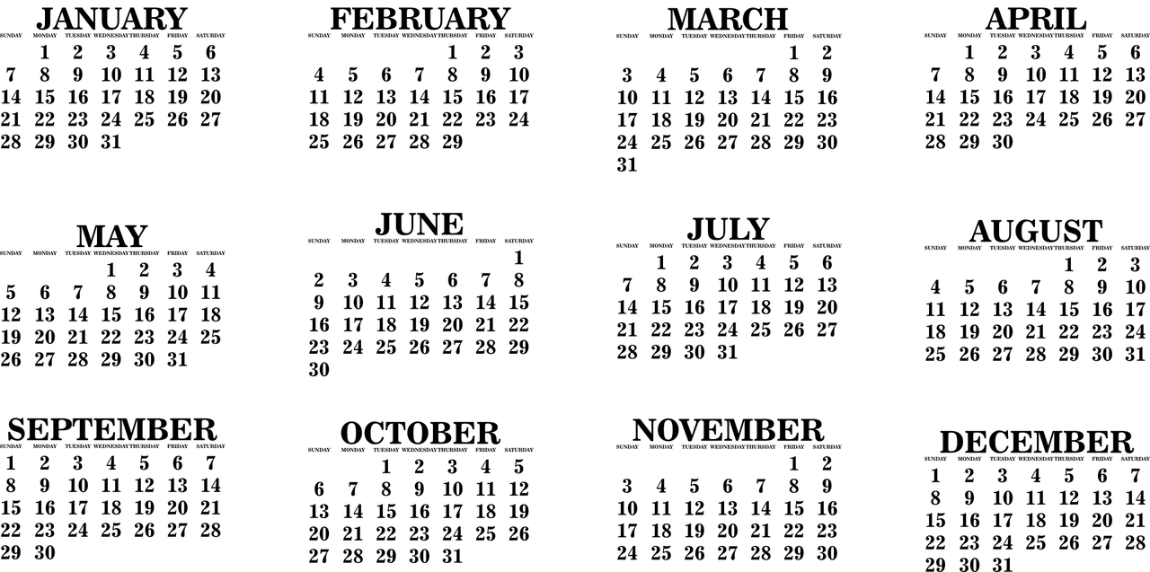

How far back in time can you look to verify eligibility?

Slide 26

It is important to always review the past three years of migratory history to verify a family's eligibility.

Slide 27
Is a family ineligible for the MEP if the information they provide during the re-interview does not match the information documented on the COE?

Slide 28
Pg. 42
Challenges to eligibility determinations may arise from various parties, such as school district staff, recruiters, ID&R staff, state MEP office staff, or parents themselves, depending on who receives notification of the ineligibility decision. Notifications of ineligibility should include clear information on how to appeal the decision, to whom appeals should be directed, and the deadline for submission. It's essential to provide a detailed explanation for the ineligibility decision, such as demonstrating that the employment was not temporary.

Slide 29
Pg. 42
Each state should establish a formal process allowing families, Local Operating Agencies (LOAs), and other stakeholders to contest determinations of ineligibility resulting from the re-interview process. This process must be independent of recruitment and reinterview procedures and should be customized to align with the state's resources and specific needs.

Slide 30

May we discuss the results of the re-interviews conducted with other states?

Slide 31
NO, we all signed a confidentiality agreement that emphasizes the importance of maintaining the confidentiality of our work.
Confidential

Slide 32

Evelyn Arevalo
MEP Consultant/ID&R Specialist
770-540-0178
ers@elevatedrecruitmentservices.com
Laura Lee Bernstein
MEP Consultant
229-815-9809
bernsteinlauralee@gmail.com

