Slide 1
Advancing the Migrant Education Program through the Comprehensive Needs Assessment
Laura Lee Bernstein and Evelyn Arevalo
Consultants for Elevated Recruitment Services

Slide 2

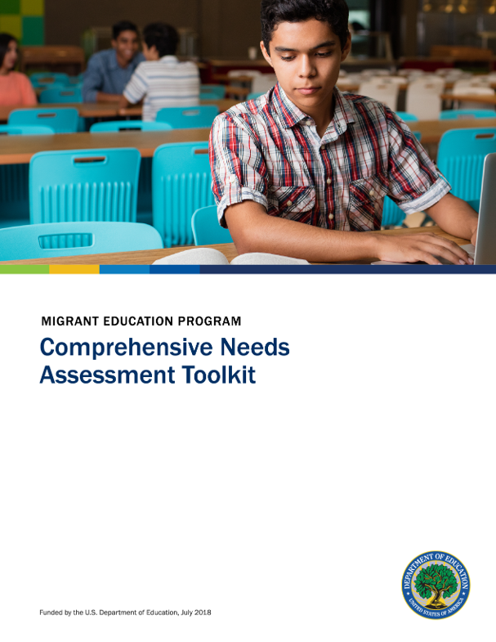
Introduction
Welcome
Session Objectives
Importance of Comprehensive Needs Assessment (CNA)

Slide 3
Understanding the CNA Framework
Legal Requirements Under Title I, Part C
  CNA is mandated under federal law to ensure equitable educational opportunities for migrant students.
  Must align with state and federal guidelines to identify needs and improve services. In other words, it is the Comprehensive Needs Assessment that drives the work and development of the state Service Delivery Plan.

Slide 4

Key Components of a CNA
  Data collection and analysis
  Stakeholder engagement
  Prioritization of needs
  Development of action plans
  Implementation, monitoring, and evaluation

Slide 5

The Role of CNA in the
Migrant Education Program
Why CNA is Essential:
  Identifies unique educational and support needs of migrant children
  Helps evaluate current practices and service delivery gaps
  Aligns program strategies with evidence-based approaches
  It is the roadmap used to develop the state Service Delivery Plan

Slide 6

The Role of CNA in the
Migrant Education Program
Impact on Student Success:
  Supports academic achievement and school readiness
  Addresses socio-emotional needs and community integration

Slide 7
Conducting An Effective CNA
Establishing a Clear Process and Timeline:
  Define goals and objectives
  Create a working team with diverse representation
  Set realistic timelines and benchmarks
Process and Timeline
Goals and objectives
Working Team
Timeline

Slide 8

Conducting An Effective CNA
Key Steps in CNA Implementation:
  Gather and analyze demographic and academic data
  Identify barriers to success for migrant students
  Prioritize needs based on data findings
  Develop and implement strategic interventions
  Monitor progress and make necessary adjustments

Slide 9

Conducting An Effective CNA
Tools and Methodologies for Data Collection and Analysis:
  Surveys, focus groups, and interviews
  Student academic performance records
  Program evaluation reports

Slide 10

Engaging Stakeholders in the CNA Process
Who Are the Key Stakeholders?
  Migrant students and families
  Educators, administrators, and recruiters
  Community organizations and support services
  State and local policymakers

Slide 11

Engaging Stakeholders in the CNA Process
Best Practices for Engagement:
  Culturally responsive outreach strategies
  Family involvement through community forums and surveys
  Establishing collaborative partnerships with schools and service providers

Slide 12

Identifying Needs and Service Gaps
Analyzing Data to Determine Priority Needs:
  Disaggregating data to highlight disparities
  Identifying areas with high dropout rates or low academic performance

Slide 13
Identifying Needs and Service Gaps
Addressing Academic, Social-Emotional, and Support Service Gaps:
  Enhancing language support services
  Improving access to tutoring and mentoring programs
  Providing socio-emotional and mental health resources

Slide 14

Identifying Needs and Service Gaps
Case Studies & Success Stories:
  Example of a state that used CNA outcomes to develop a program to serve Out of School Youth
  District initiatives that improved high school graduation rates for migrant students

Slide 15

Translating CNA Findings Into Actionable Plans
Developing Targeted Interventions & Program Improvements:
  Aligning strategies with identified needs
  Strengthening professional development for educators
  Expanding community-based support networks

Slide 16

Translating CNA Findings Into Actionable Plans
Aligning Findings with Local, State, and Federal Initiatives:
  Ensuring compliance with Title I, Part C mandates
  Leveraging additional funding sources for program sustainability (Ex. Braided Funding)
Compliance

Slide 17

Translating CNA Findings Into Actionable Plans
Continuous Monitoring & Evaluation:
  Setting measurable goals and performance indicators
  Using feedback loops to refine and improve interventions

Slide 18
Translating CNA Findings into Actionable Plans
Developing Targeted Interventions & Program Improvements:
  Aligning strategies with identified needs
  Strengthening professional development for educators
  Expanding community-based support networks

Slide 19
Translating CNA Findings into Actionable Plans
Aligning Findings with Local, State, and Federal Initiatives:
  Ensuring compliance with Title I, Part C mandates
  Leveraging additional funding sources for program sustainability

Slide 20

Translating CNA Findings into Actionable Plans
Continuous Monitoring & Evaluation:
  Setting measurable goals and performance indicators
  Using feedback loops to refine and improve interventions

Slide 21

One More Time: Key Components of a CNA
Data Collection & Analysis:
  Gathering quantitative and qualitative data on student demographics, academic performance, and service access.

Slide 22

One More Time: Key Components of a CNA
Stakeholder Engagement:
  Involving educators, families, community organizations, and policymakers to ensure a comprehensive understanding of needs.

Slide 23

One More Time: Key Components of a CNA
Needs Prioritization:
  Identifying and ranking the most critical gaps in educational services and student support.

Slide 24

One More Time: Key Components of a CNA
  Action Plan Development:
    Translating CNA findings into targeted strategies that enhance student achievement. (i.e. State and Local Service Delivery Plans)

Slide 25

One More Time: Key Components of a CNA
Continuous Monitoring & Evaluation:
  Ensuring ongoing assessment and program adjustments to maintain effectiveness

Slide 26
Next Steps, Resources, and Action Planning
Tools and Frameworks for Ongoing CNA Development:
  National MEP guidelines and resources
  Data collection templates and best practice toolkits
  Work with outside organizations for assistance with conducting the state’s needs assessment

Slide 27

Next Steps, Resources, and Action Planning
Opportunities for Professional Collaboration & Training:
  Networking with other educators and administrators
  Attending follow-up workshops and training sessions

Slide 28
Next Steps, Resources, and Action Planning
Additional Resources for CNA Best Practices:
  U.S. Department of Education resources
  Research studies and reports on migrant education
  Outside consultants with experience developing Comprehensive Needs Assessments for states

Slide 29

Next Steps, Resources, and Action Planning
Next Steps in Action Planning:
  Implementing CNA insights into program design
  Training and professional development for CNA teams
  Developing a roadmap for sustainable program enhancement

Slide 30

Where Are We Headed?
Future Directions in CNA for Migrant Education

Slide 31

Data-Driven Decision Making & Advanced Analytics
  Enhanced Data Collection Methods
    Utilizing real-time data tracking for more accurate student needs assessments
    Implementing AI-driven analytics for predictive modeling of student success

Slide 32
Data-Driven Decision Making & Advanced Analytics
  Cross-Agency Data Sharing
    Strengthening collaboration between school districts, community organizations, and federal programs
    Creating integrated data systems to better track migrant student progress across multiple states

Slide 33
Strengthening Equity-Focused Approaches
  Culturally Responsive CNA Practices
    Ensuring assessments reflect the unique backgrounds, languages, and experiences of migrant students
    Engaging bilingual and culturally competent staff in data collection and program planning

Slide 34
Strengthening Equity-Focused Approaches
  Focus on Holistic Student Success
    Expanding CNA to include mental health, socio-emotional learning, and career readiness assessments
    Addressing systemic barriers such as housing instability, food insecurity, and access to healthcare

Slide 35

Enhancing Stakeholder Engagement & Community Partnerships
Increased Family & Student Voice in CNA
  Incorporating direct feedback from migrant families through participatory research
  Creating advisory panels with migrant students and parents to guide program development

Slide 36
Enhancing Stakeholder Engagement & Community Partnerships
Expanding Public-Private Partnerships
  Collaborating with businesses, nonprofits, and higher education institutions to support career pathways (WIOA – Titles I, II, III, IV)
  Leveraging technology grants and scholarships to enhance educational opportunities

Slide 37
Policy Alignment & Funding Innovation
Aligning CNA with Federal and State Policy Changes
  Adapting CNA frameworks to new federal funding priorities and education policies
  Ensuring compliance with evolving Title I, Part C regulations while maximizing program flexibility

Slide 38
Policy Alignment & Funding Innovation
Exploring Braided & Blended Funding Models
  Combining Title I, Part C funding with other federal, state, and local resources to create sustainable programs
  Utilizing innovative financing models such as social impact bonds and philanthropic partnerships

Slide 39

Technology Integration in CNA Processes
  Digital Platforms for Data Collection & Reporting
    Using cloud-based systems for real-time updates and shared data access
    Developing mobile-friendly survey tools to increase participation from migrant families

Slide 40
Technology Integration in CNA Processes
  Virtual & Hybrid Stakeholder Engagement
    Expanding access to CNA discussions through virtual town halls and online focus groups
    Leveraging social media and messaging apps to improve communication with migrant communities

Slide 41
Continuous Improvement & Long-Term Impact Assessment
  Sustained Program Evaluation Beyond Initial CNA
    Shifting from a one-time assessment to an ongoing, iterative process
    Establishing key performance indicators (KPIs) to measure long-term student outcomes

Slide 42
Continuous Improvement & Long-Term Impact Assessment
  Scaling Best Practices Across Regions
    Creating national and regional knowledge-sharing platforms for CNA findings
    Developing replicable models that states and districts can adapt to their specific needs

Slide 43
Best Practices for CNA Implementation
Real-world examples and Success Stories:
  State that improved service delivery by using CNA-driven strategies
    Georgia – OSY/iPods for English acquisition
  Case study of a community partnership that enhanced migrant student engagement
    Collaboration between Rabun County Health Department, Northeast Eye Center, Rotary Club, Lyons Club, food bank, private business

Slide 44
Best Practices for CNA Implementation
Challenges & Solutions:
  Addressing common roadblocks such as data collection barriers, low stakeholder participation, and resource constraints
  Solutions: Improved outreach efforts, streamlined data systems, and increased collaboration among agencies

Slide 45
Activity & Discussion
Sharing insights and experiences:
  Spend the next 15 minutes discussing any insights or experiences that you have acquired regarding the Comprehensive Needs Assessment either working in your local programs or even through this presentation.
  Groups should designate one person to report out the highlights of your group discussion to everyone.

Slide 46

Evelyn Arevalo
MEP Consultant/ID&R Specialist
770-540-0178
ers@elevatedrecruitmentservices.com
Laura Lee Bernstein
MEP Consultant
229-815-9809
bernsteinlauralee@gmail.com

