Slide 1
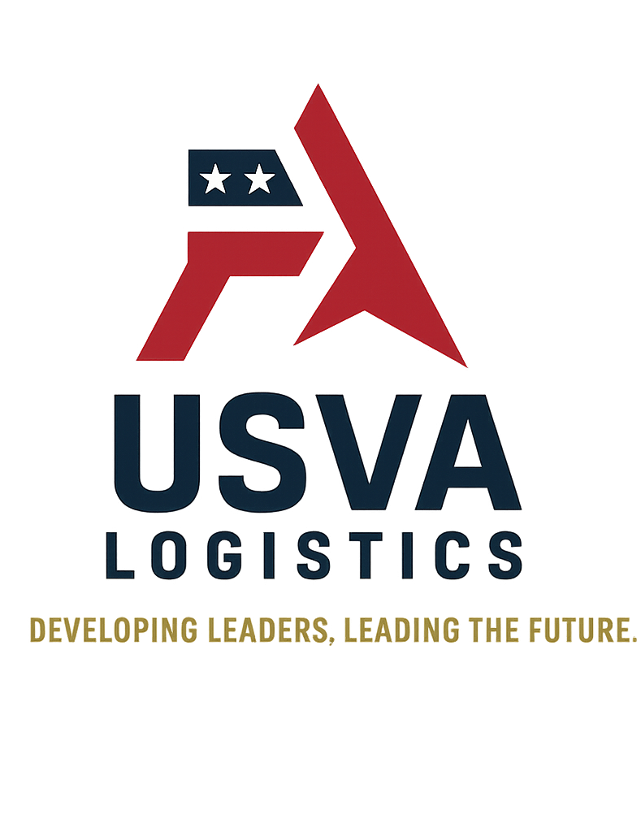
Mission Focused Assessment – Workshop
A government-ready training solution from USVA.

Slide 2
Overview of the Workshop
This two-part, instructor-led virtual workshop equips government professionals with:
Practical tools to design mission-aligned assessments
Strategies for improving training effectiveness
Real-world scenarios and team collaboration
Templates for long-term integration into programs

Slide 3

Curriculum Highlights
Backward Design Framework for Operational Impact
Formative vs. Summative Evaluation in DoD Settings
Scenario-Based Assessment Planning
Peer Review and Feedback Integration Models
After-Action Learning Strategies
Practical Assessment Building Lab

Slide 4
Key Outcomes for Participants
Design better training assessments that reflect mission needs
Replace compliance checks with performance-based validation
Collaborate across teams to create unified training tools
Build internal capability to adapt assessments over time

Slide 5
Who Should Attend?
Government trainers and educators
Military and civilian supervisors
Program managers and learning designers
Policy, HR, or readiness leads

Slide 6
Delivery Format & Contact
Format: Virtual via Teams or Zoom
Duration: Scalable for your needs (2 – 4 hrs.)
Materials: Slides, workbook, certificate, scenarios

