Slide 1

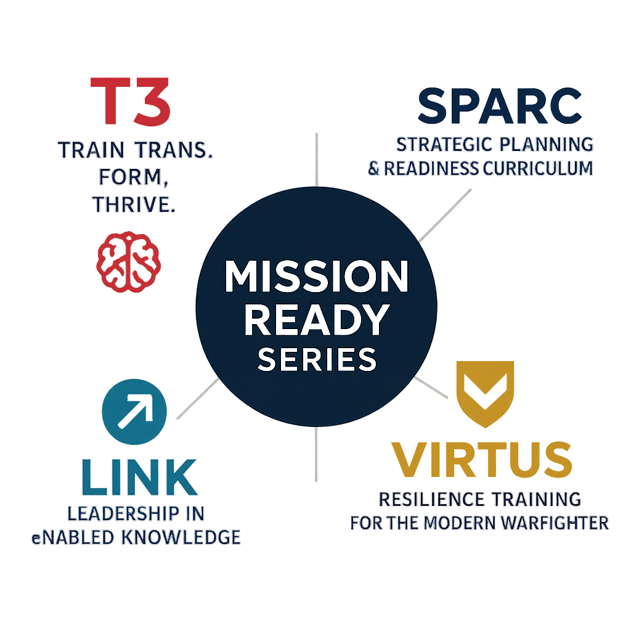
Mission Ready Series
Scalable Training Solutions

Slide 2
Training Ecosystem Overview
Modular training series tailored for defense and government professionals
Participant-centered learning methodology
Focused on leadership, communication, resilience, and planning skills
Supports hybrid, virtual, or in-person delivery models
UNCLASSIFIED

Slide 3
Mission Ready Program Series
T3 – Leadership development & soft skills
VIRTUS – Mental fitness and resilience
LINK – Communication and cultural intelligence
ID-X – Facilitator/instructor mastery
SPARC – Strategic operations & planning
OPUS – Operational and technical staff skills
UNCLASSIFIED

Slide 4
Workshop
4 x 1-hour virtual workshops (20 participants)
Includes job aids, slide decks, and interaction tools
Demonstrates impact and paves way for full rollout
UNCLASSIFIED

Slide 5
Why Choose Mission Ready?
Lower cost than equivalent vendors.
Aligned with 90/20/10 rule and REACTS methodology
Includes job aids, reflection tools, and measurable outcomes
Scalable for small team training or enterprise rollouts
UNCLASSIFIED

