Slide 1
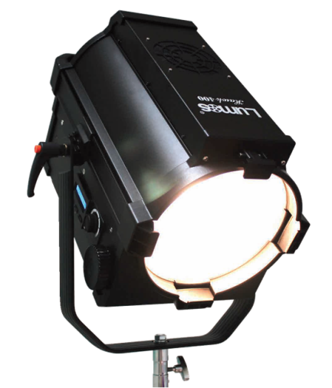
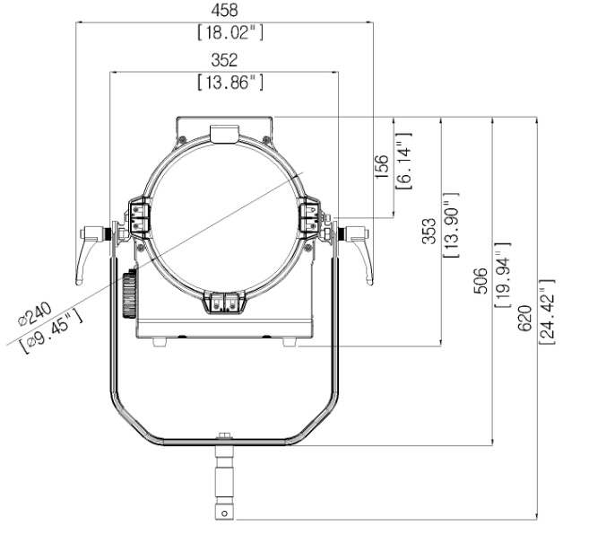
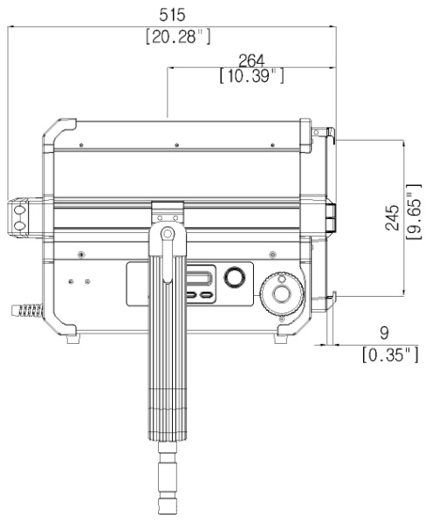
400F
Powerful as Sunlight
Hybrid cooling system
CRI 97 Ra at 3200K / 95 Ra at 5600K
3000W Output
15˚~50˚ Beam angle
Flicker free
Stable dimming (0~100%)
Standard DMX 512
Photometric information of Lumos Hawk 400F
CCT | Beam angle | 4 ft | 8 ft | 12 ft | 16 ft | 20 ft | 1m | 2m | 3m | 4m | 5m
3200K | Spot (15°) | 11,624 Fc | 3,080 Fc | 1,369 Fc | 770 Fc | 492 Fc | 185,995 lux | 49,285 lux | 21,905 lux | 12,320 lux | 7,885 lux
 | Flood (50°) | 1,611 Fc | 427 Fc | 189 Fc | 106 Fc | 68 Fc | 25,780 lux | 6,830 lux | 3,035 lux | 1,705 lux | 1,090 lux
5600K | Spot (15°) | 12,824 Fc | 3,398 Fc | 1,510 Fc | 849 Fc | 543 Fc | 205,195 lux | 54,375 lux | 24,165 lux | 13,590 lux | 8,700 lux
 | Flood (50°) | 1,780 Fc | 471 Fc | 209 Fc | 118 Fc | 75 Fc | 28,485 lux | 7,545 lux | 3,355 lux | 1,885 lux | 1,205 lux
Lumos Hawk 400F Specifications
Power Consumption | 400W Nominal / 450W Maximum
Size | W352 * H353 * L515 (mm) W13.8 * H13.9 * L20 (inch)
Weight | 15 kg / 33 lb
Color Temperature | 3200K or 5600K
E. Characteristics | AC 100~240V / 50~60Hz
Dimming | 0~100% Manual / DMX 512
Flicker | Flicker free
Fresnel lens | 240mm (9.45”) PMMA Fresnel lens
Beam angle | 15° ~ 50°
Cooling system | Hybrid cooling system (fan)
Operating Temp. | 0℃ ~ 45℃
Accessory | 4-leaf barndoor Pole operated yoke (Panning / Tilting / Beam angle) Diffusing filter
Color temperature | 3200K | 5600K
CCT Tolerance | ±150K | ±150K
CRI | 97 Ra | 95 Ra

Slide 2
Photometric information of Lumos Hawk Series (F type)
Model | Beam angle |  |  | 1m | 2m | 3m | 4m | 5m
Lumos Hawk 400F 400W | Spot (15˚) | Illumination | 3200K | 185,995 lux | 49,285 lux | 21,905 lux | 12,320 lux | 7,885 lux
 |  |  | 5600K | 205,195 lux | 54,375 lux | 24,165 lux | 13,590 lux | 8,700 lux
 |  | Beam diameter |  | 0.50 m | 0.77 m | 1.03 m | 1.29 m | 1.56 m
 | Flood 50˚ | Illumination | 3200K | 25,780 lux | 6,830 lux | 3,035 lux | 1,705 lux | 1,090 lux
 |  |  | 5600K | 28,485 lux | 7,545 lux | 3,355 lux | 1,885 lux | 1,205 lux
 |  | Beam diameter |  | 1.17 m | 2.10 m | 3.04 m | 3.97 m | 4.90 m
Lumos Hawk 200F 200W | Spot (15˚) | Illumination | 3200K | 51,420 lux | 14,526 lux | 6,856 lux | 3,953lux | 2,571 lux
 |  |  | 5600K | 61,850 lux | 17,520 lux | 8,190 lux | 4,725 lux | 3,048 lux
 |  | Beam diameter |  | 0.46 m | 0.73 m | 1.00 m | 1.27 m | 1.54 m
 | Flood 50˚ | Illumination | 3200K | 8,205 lux | 2,318 lux | 1,094 lux | 631 lux | 410 lux
 |  |  | 5600K | 11,120 lux | 2,580 lux | 1,386 lux | 769 lux | 485 lux
 |  | Beam diameter |  | 1.13 m | 2.06 m | 3.00 m | 3.95 m | 4.87 m
Lumos Hawk 200A 220W | Spot (15˚) | Illumination | 3200K | 61,704 lux | 17,431 lux | 8,227 lux | 4,744 lux | 3,085 lux
 |  |  | 5600K | 74,220 lux | 21,024 lux | 9,828 lux | 5,670 lux | 3,658 lux
 |  | Beam diameter |  | 0.46 m | 0.73 m | 1.00 m | 1.27 m | 1.54 m
 | Flood 50˚ | Illumination | 3200K | 11,979 lux | 3,384 lux | 1,597 lux | 921 lux | 599 lux
 |  |  | 5600K | 16,235 lux | 3,767 lux | 2,024 lux | 1,123 lux | 708 lux
 |  | Beam diameter |  | 1.13 m | 2.06 m | 3.00 m | 3.95 m | 4.87 m
Lumos Hawk 150F 150W | Spot (15˚) | Illumination | 3200K | 44,100 lux | 12,458 lux | 5,880 lux | 3,390 lux | 2,205 lux
 |  |  | 5600K | 52,500 lux | 14,831 lux | 7,000 lux | 4,036 lux | 2,625 lux
 |  | Beam diameter |  | 0.46 m | 0.73 m | 1.00 m | 1.27 m | 1.54 m
 | Flood 50˚ | Illumination | 3200K | 6,740 lux | 1,904 lux | 899 lux | 518 lux | 337 lux
 |  |  | 5600K | 8,190 lux | 2,314 lux | 1,092 lux | 630 lux | 410 lux
 |  | Beam diameter |  | 1.13 m | 2.06 m | 3.00 m | 3.95 m | 4.87 m
Lumos Hawk 100F 100W | Spot (15˚) | Illumination | 3200K | 28,930 lux | 8,173 lux | 3,857 lux | 2,224 lux | 1,447 lux
 |  |  | 5600K | 34,208 lux | 9,664 lux | 4,561 lux | 2,630 lux | 1,710 lux
 |  | Beam diameter |  | 0.38 m | 0.65 m | 0.91 m | 1.17 m | 1.44 m
 | Flood 50˚ | Illumination | 3200K | 5,830 lux | 1,647 lux | 777 lux | 448 lux | 292 lux
 |  |  | 5600K | 6,210 lux | 1,754 lux | 828 lux | 477 lux | 311 lux
 |  | Beam diameter |  | 1.05 m | 1.99 m | 2.92 m | 3.85 m | 4.78 m
Lumos Hawk 50F 50W | Spot (15˚) | Illumination | 3200K | 20,500 lux | 5,791 lux | 2,733 lux | 1,576 lux | 1,025 lux
 |  |  | 5600K | 22,000 lux | 6,215 lux | 2,933 lux | 1,691 lux | 1,100 lux
 |  | Beam diameter |  | 0.38 m | 0.65 m | 0.91 m | 1.17 m | 1.44 m
 | Flood 50˚ | Illumination | 3200K | 5,530 lux | 1,562 lux | 737 lux | 426 lux | 277 lux
 |  |  | 5600K | 5,970 lux | 1,687 lux | 796 lux | 459 lux | 299 lux
 |  | Beam diameter |  | 1.05 m | 1.99 m | 2.92 m | 3.85 m | 4.78 m

Slide 3
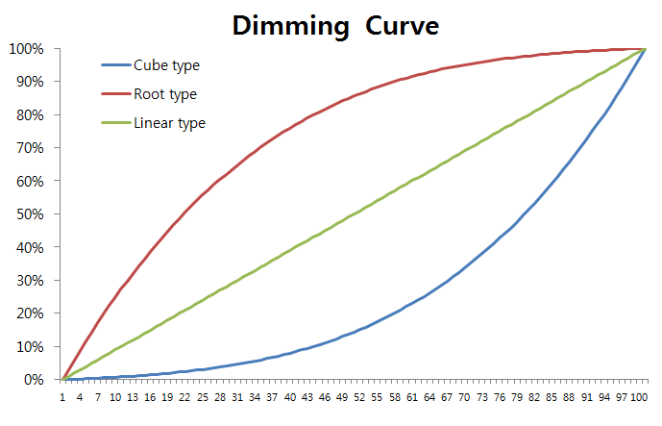
decibel measurements of Lumos Hawk Series
Model | 1m | 2m | 3m
Lumos Hawk 400 400W | 28 dB | 24 dB | 22 dB
Lumos Hawk 200 / 200A 200W / 220W | 21 dB | 19 dB | 18 dB
Lumos Hawk 100 100W | 20 dB | 19 dB | 18 dB
Hybrid cooling system
The patented technology to improve air flow to cool down the heat created inside the product.
Usually the convection heat mode is at low dimming stage.
However fan will be turned on at certain dimming stage as below.
Hawk 400 : Cube 86~100%, Linear 61~100%, Root 28~100%
Hawk 200 : Cube 93~100%, Linear 76~100%, Root 39~100%
Hawk 100 : Cube 80~100%, Linear 51~100%, Root 22~100%
Mode
Mode | Function
Dimming | Stable Dimming (0~100%) Enable to customize the dimming step as each 1% or 4~5%
Dimming curve | Customized dimming steps are available 3-way Dimming curve select to mode button Linear type : Normal increase of lighting intensity Cube type : Detailed control in Low dimming area (0~50%) Root type : Detailed control in high dimming area (50~100%)
DMX channel | Standard DMX 512 Compatibility with various DMX Controllers Firmware available for most DMX Controllers Change DMX channel (1~512)
12~24V Free volt | Compatible with wide range of batteries. V-mount battery or Gold-mount battery

