Slide 1
Overview
What is Anglicanism
History
Polity
Theology
Common Prayer

Slide 2
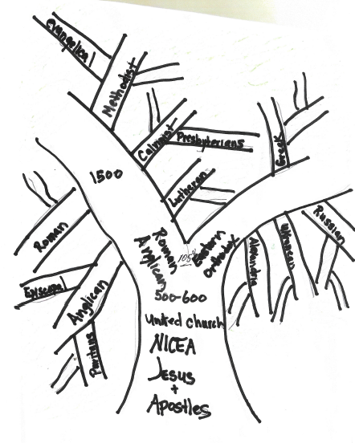

Slide 3
History
Ancient – Joseph of Arimithea and the Tin Trade
St Aristobulus – one of the 70
Synod of Whitby
Occasionally occupied by Roman interests
Retained a character that was both Catholic and Protestant
  Henry the VIII was given defender of the Faith by the Pope
  He write the definitive defense against Martin Luther
The Anglican Church is a by-product of the Magna Carta

Slide 4
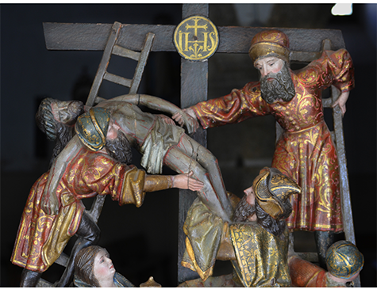

Slide 5
But far better known is this poem by William Blake, based on the same legend, and famously set to music by Sir Hubert Parry as 'Jerusalem':
And did those feet in ancient time
Walk upon England's mountains green?
And was the holy Lamb of God
On England's pleasant pastures seen?
And did the countenance divine
Shine forth upon our clouded hills?
And was Jerusalem builded here
Among those dark satanic mills?
Bring me my bow of burning gold!
Bring me my arrows of desire!
Bring me my spear! O clouds, unfold!
Bring me my chariot of fire!
I will not cease from mental fight,
Nor shall my sword sleep in my hand,
Till we have built Jerusalem
In England's green and pleasant land.

Slide 6
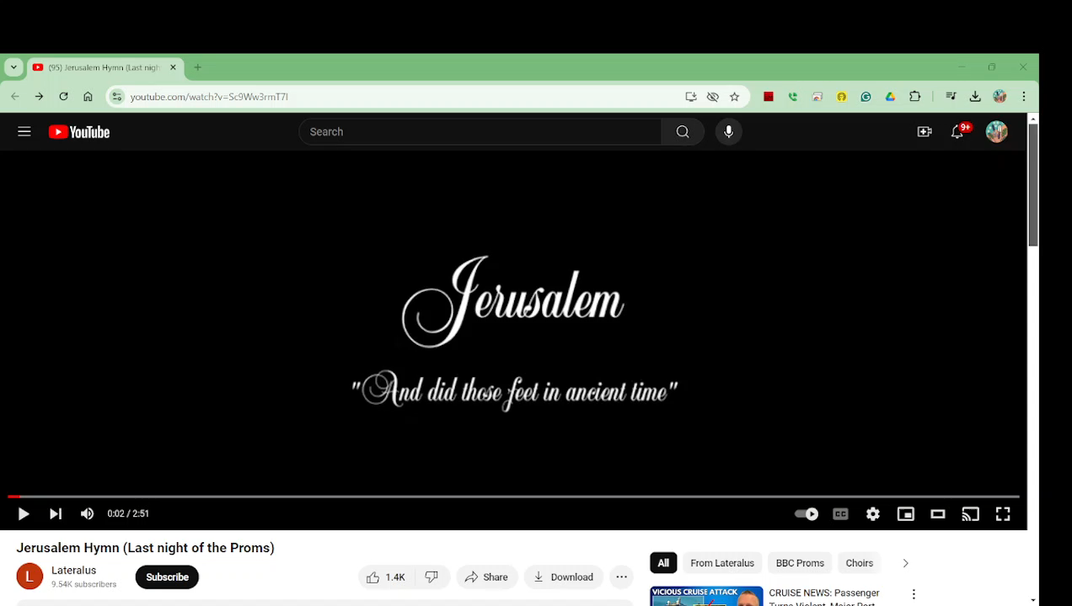
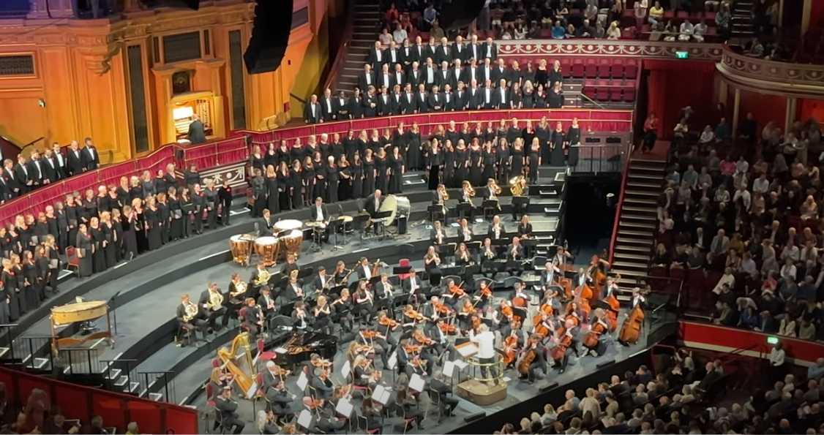

Slide 7
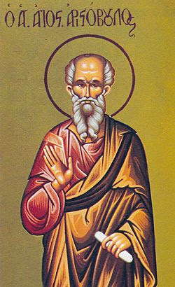
St. Aristobulus of Britannia
St. Aristobulus of Britain (Feast Day - March 15)

Slide 8
Overview
What is Anglicanism
Part 2
History
Polity
Theology
Common Prayer

Slide 10
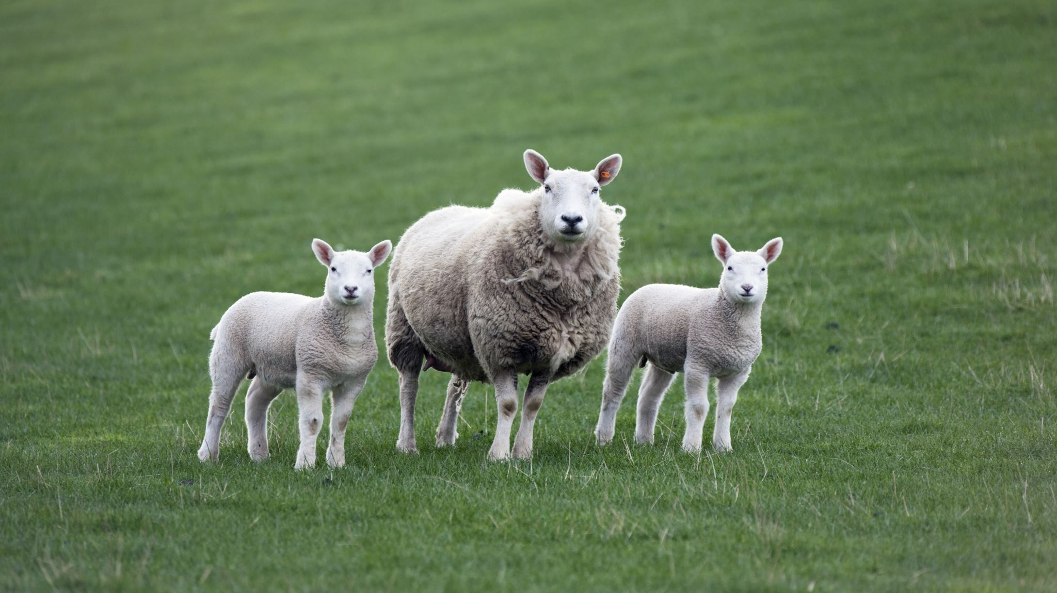
St Paul and the British in Rome
Caradoc was the English King who battled the Romans from 42AD to 49AD
He was betrayed, captured and brought to Rome with his children, Claudia and Linus. The whole family was Christian.
Claudia married a Roman Senator, Rufus Pudens
When St. Paul came to Rome as a prisoner, he was likely housed with other Christian prisoners in the house that became the British Embassy in Rome.
St. Paul mentions Rufus in Romans 16:13 and mentions Rufus, Linus and Claudia in Timothy 4:21. (St. Timothy succeeds St John as the Bishop of Ephesus, which was St. John’s territory.). Celtic Christian Bishops were ordained before Augustine by Greek Patriarchs, not the Pope
St. Paul was buried in the Pudentia cemetery (house cemetery) along with Linus, first Bishop of Rome and Claudia, both also martyrs.

Slide 11
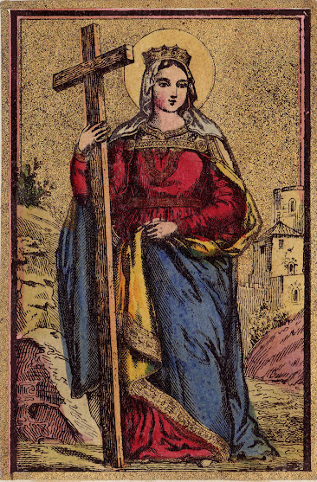
St Helena, Brit, Mother of the Emperor Constantine and discovered the Holy Cross
This Photo by Unknown Author is licensed under CC BY-NC-ND

Slide 12
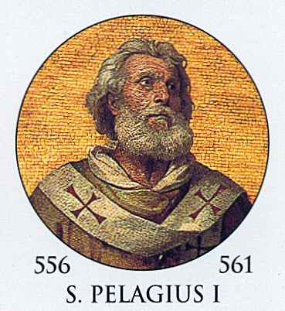
5th century Monk Pelagius was at the center of the Heresy of Works righteousness
This Photo by Unknown Author is licensed under CC BY-SA

Slide 13
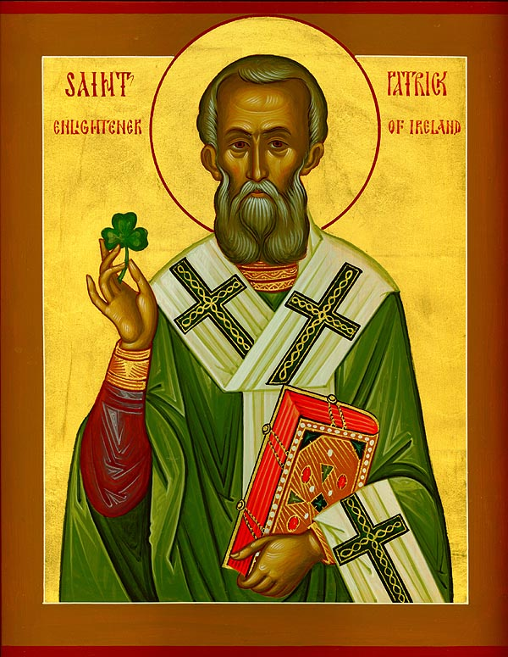
St Patrick evangelized Ireland and celebrated in the vernacular
This Photo by Unknown Author is licensed under CC BY-SA-NC

Slide 14
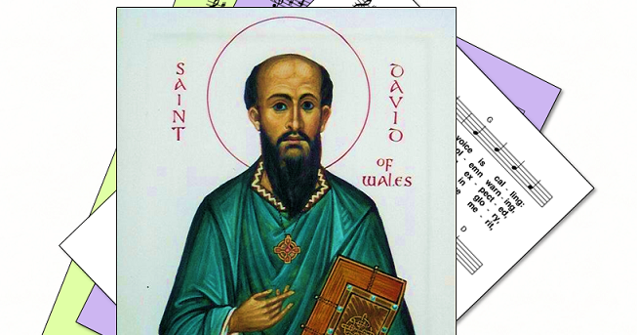
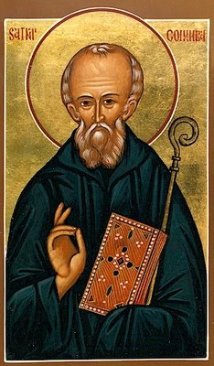
St Columba Evangelist of Scotland
St David of Wales
This Photo by Unknown Author is licensed under CC BY-SA-NC
This Photo by Unknown Author is licensed under CC BY

Slide 15
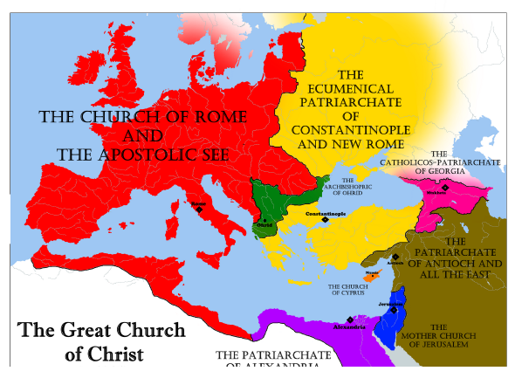
Map depicting the canonical territories of the Chalcedonian Patriarchates shortly before the Schism of the Latins

Slide 16
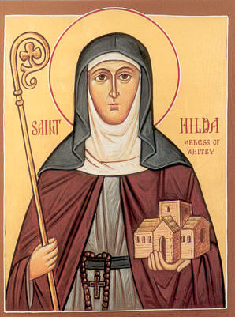
Saint Hilda the Abbess of Whitby
This Photo by Unknown Author is licensed under CC BY-NC-ND

Slide 17
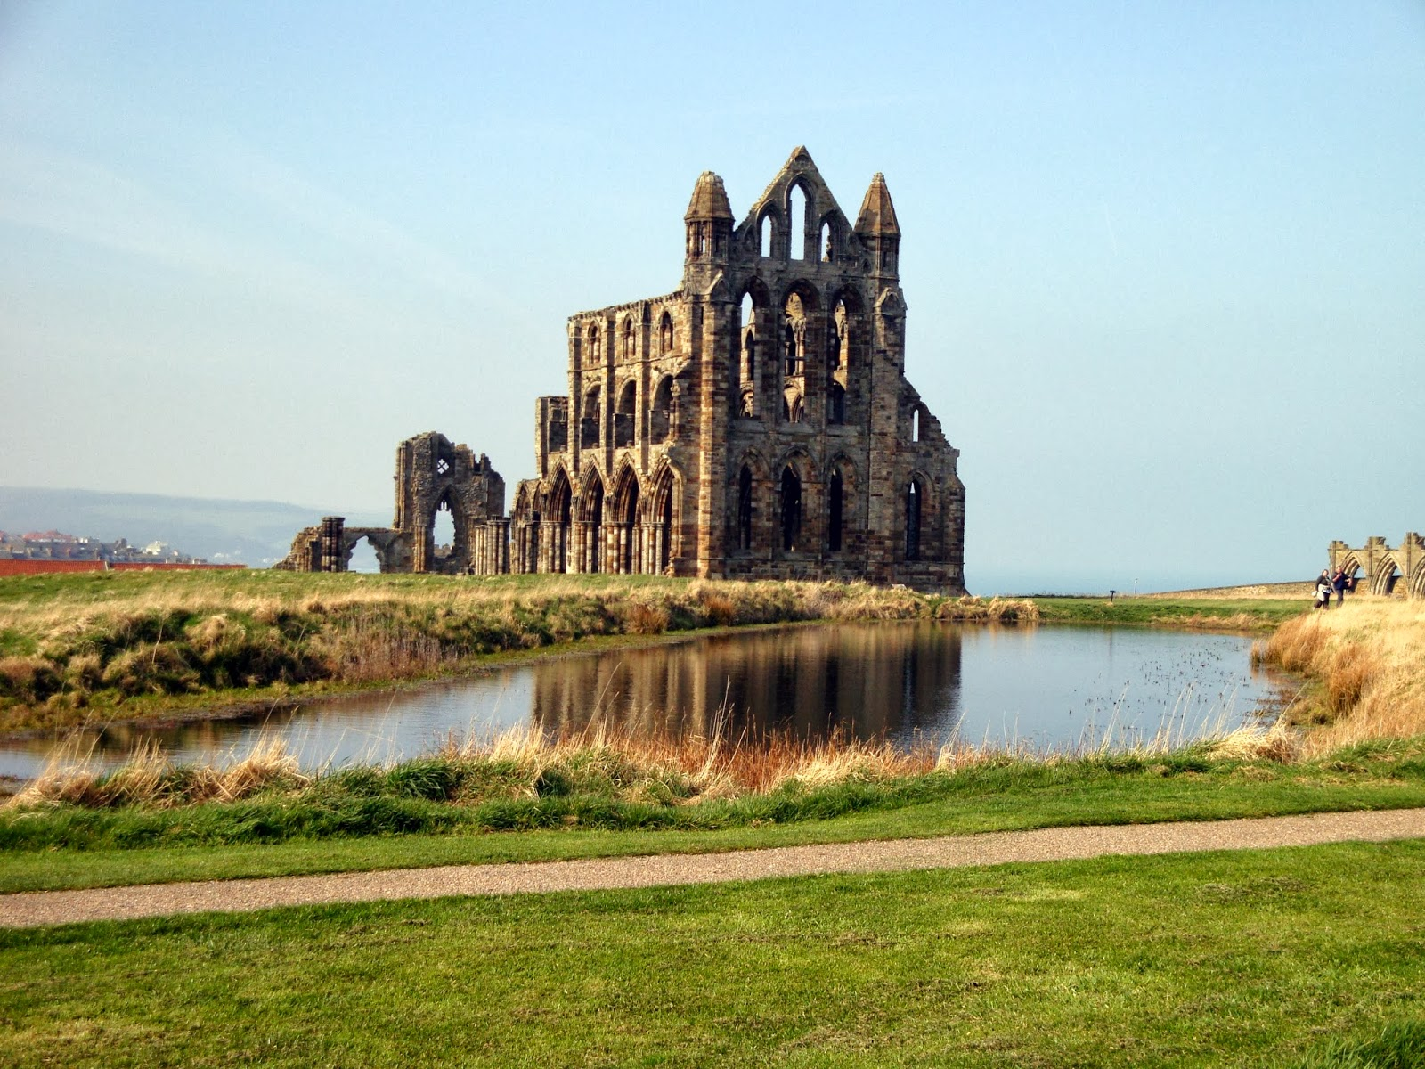
Whitby Abbey
This Photo by Unknown Author is licensed under CC BY-SA

Slide 18
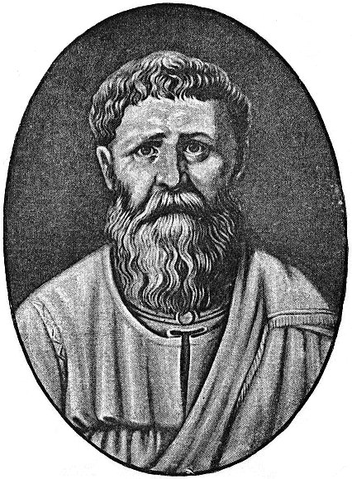
All this was before Augustine arrived in 597

Slide 19
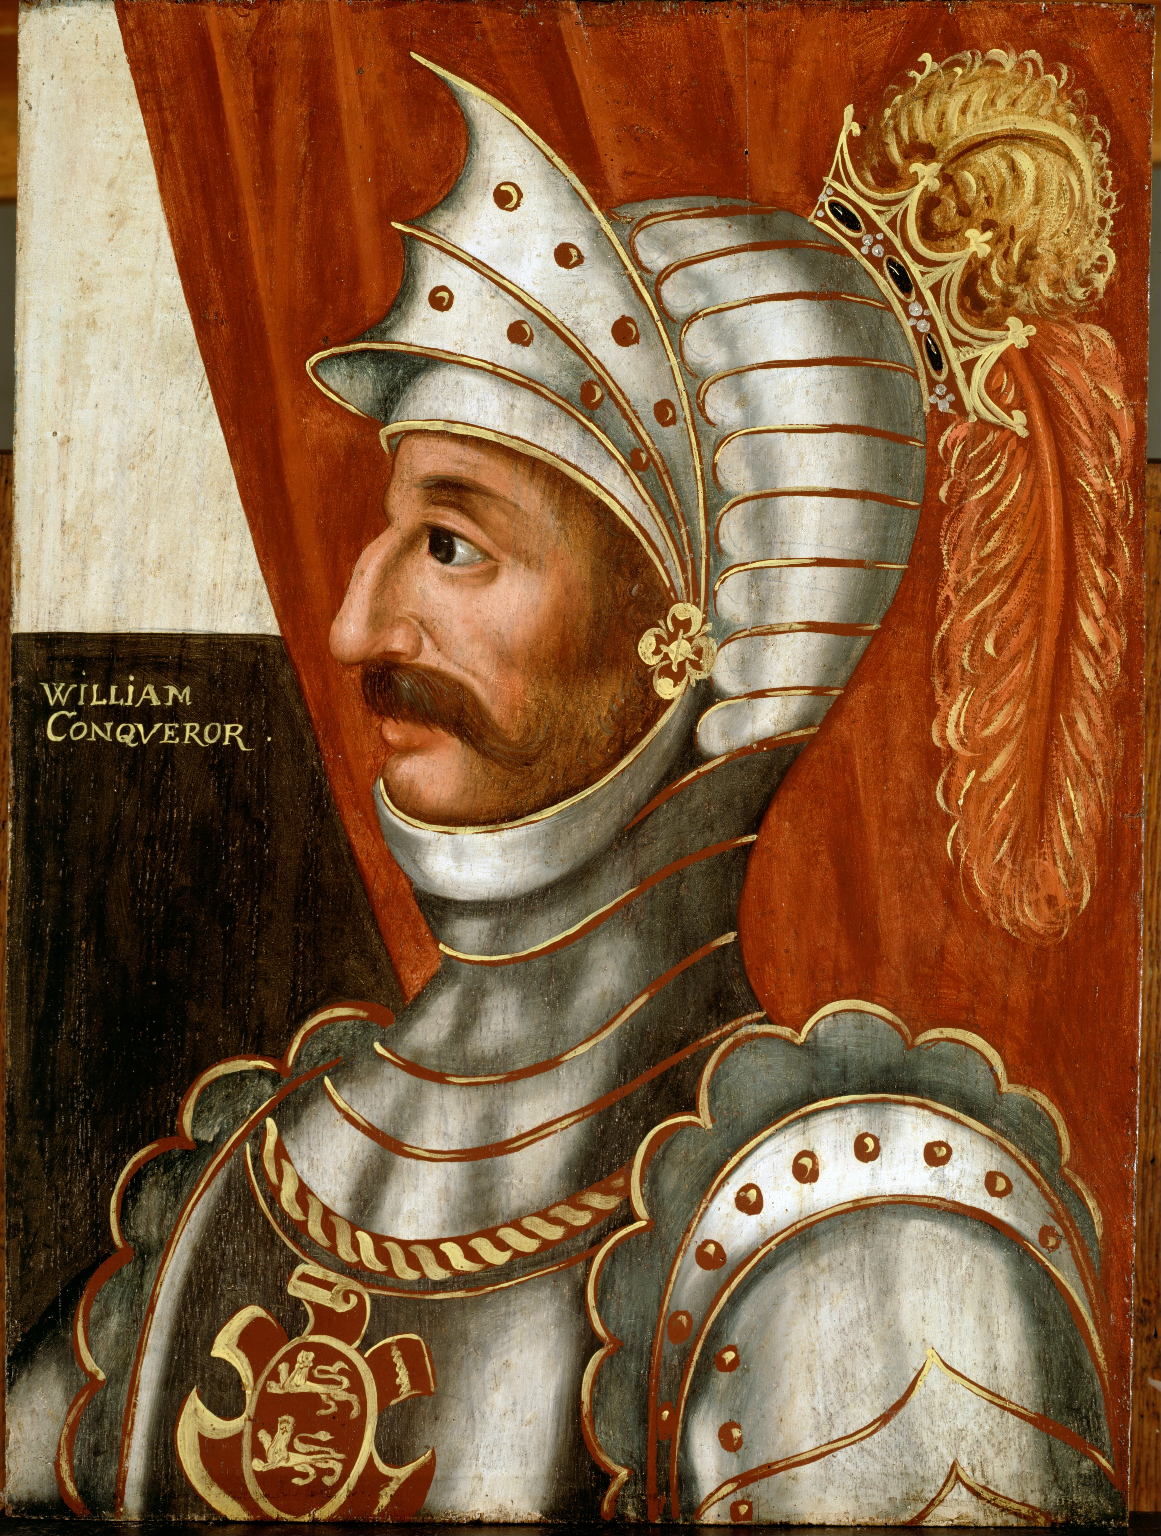
William the Conqueror, blessed by the Pope to deliver the English Church, but denied fealty once he was established
This Photo by Unknown Author is licensed under CC BY-SA

Slide 20
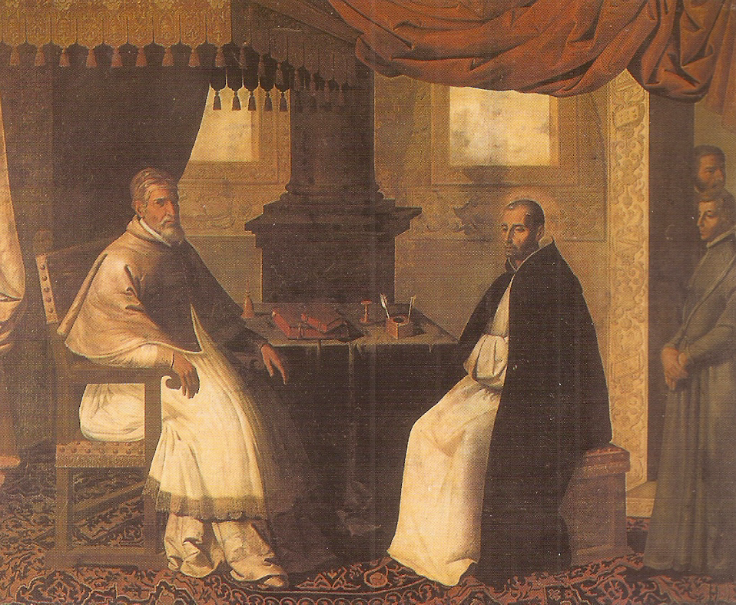
Pope Urban II recognized St Anselm as the Pope of the English Jurisdiction at the Council of Bari in 1098
This Photo by Unknown Author is licensed under CC BY-SA

Slide 21
The first provision of the Magna Carta issued in 1215
“The Church of England shall be free and hold her rights entire and her liberties inviolate”

Slide 22
Overview
What is Anglicanism
Part 3
History
Polity
Theology
Common Prayer

Slide 23
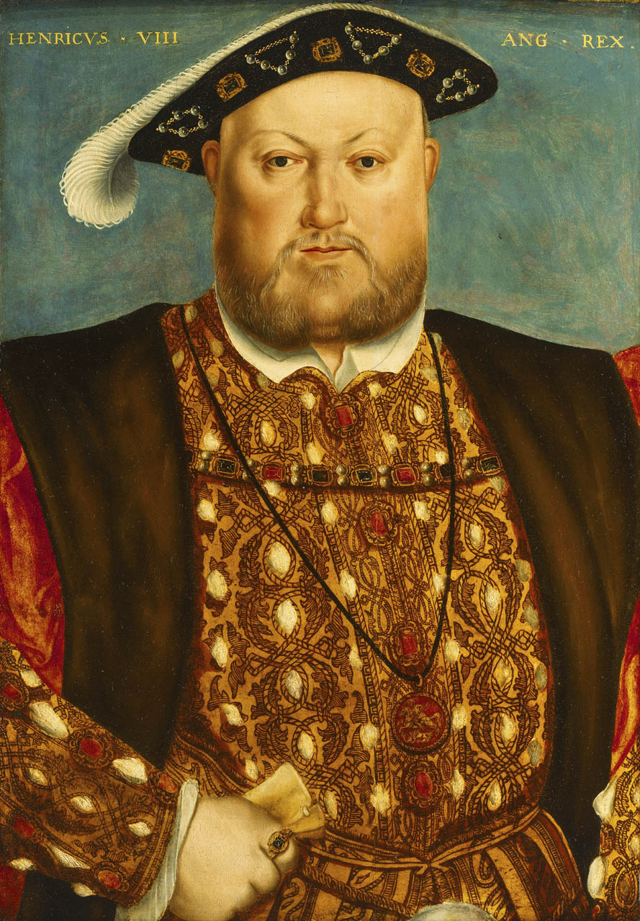
Henry the VIII
Finally
Defender of the Faith by Pope Leo X for defense against Luther
No Protestant revolt in England ( and few deaths), instead a Reformation
Premuniere – asserted excommunication to anyone going to the Pope and forfeiture of their lands
The right to an heir – the danger to society of a monarchial grab
This Photo by Unknown Author is licensed under CC BY-SA

Slide 24
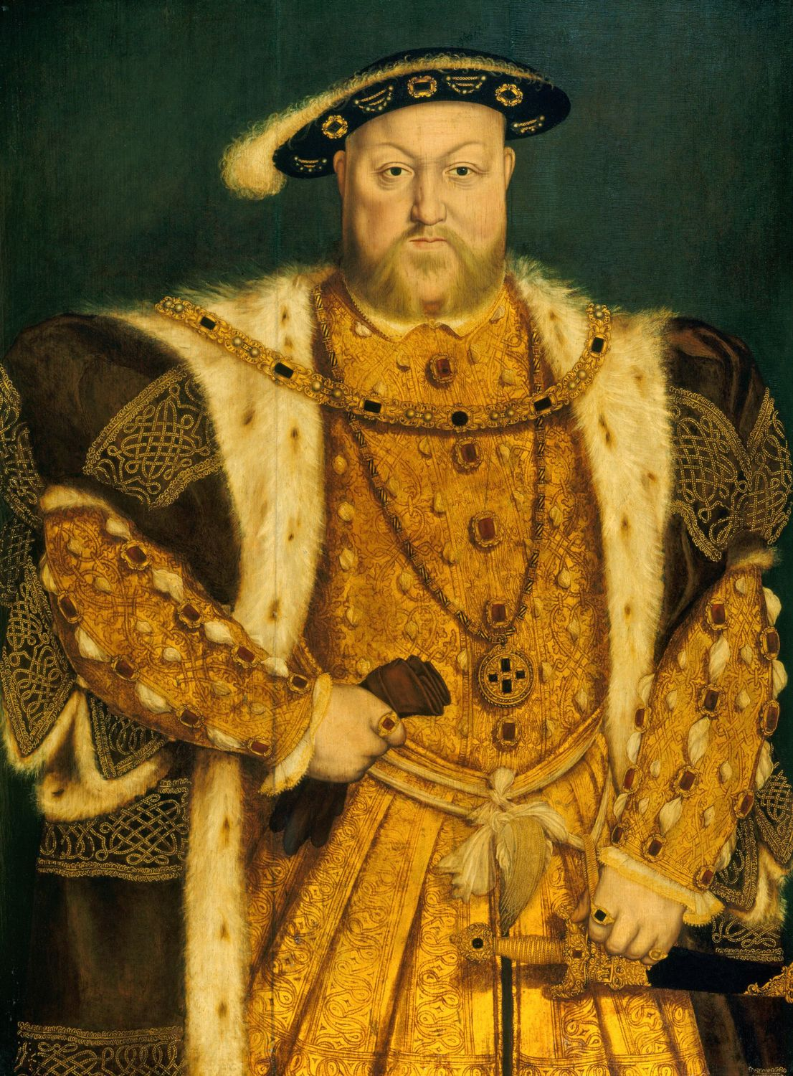
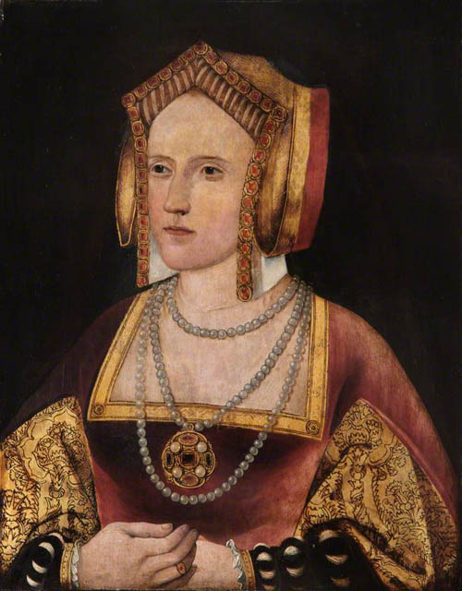
Henry VIII and Catherine of Aragon
A United Christian Kingdom becomes divorce and alienation
This Photo by Unknown Author is licensed under CC BY-SA

Slide 25
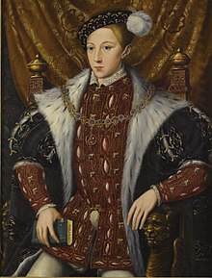
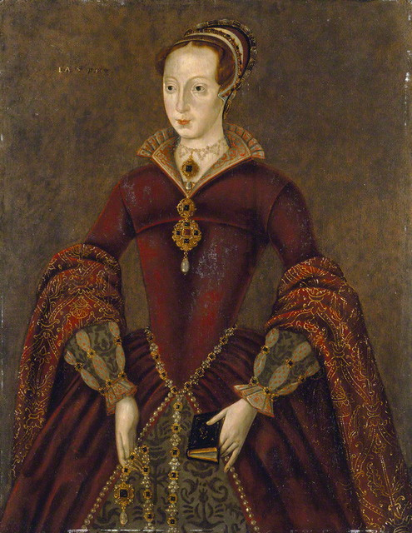
The Seesaw of Henry’s Children
Edward VI Protestant and young under Reagent most of his rule
Mary Tudor, Known as Mary I, or also Bloody Mary Catholic, overthrew Jane of Scotland

Slide 26
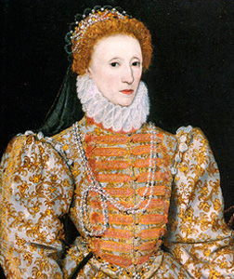
Elizabeth 1 (the Great) author of the Elizabethan Compromise
This Photo by Unknown Author is licensed under CC BY

Slide 27
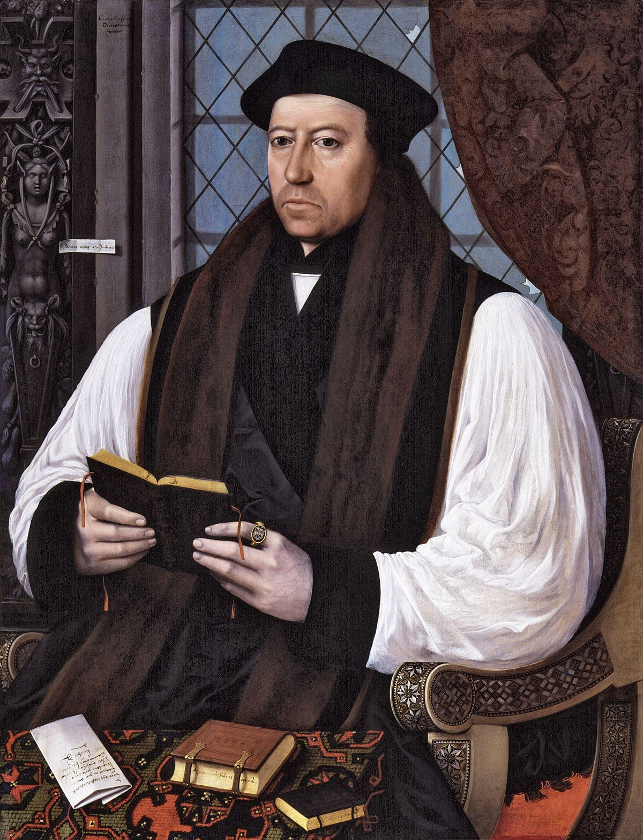
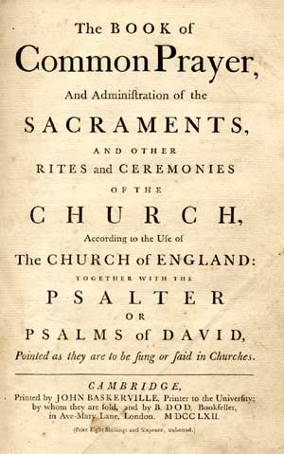
Thomas Cranmer and the Book of Common Prayer
This Photo by Unknown Author is licensed under CC BY-SA
This Photo by Unknown Author is licensed under CC BY-SA

Slide 28
Overview
What is Anglicanism
Part 4
History
Polity
Theology
Common Prayer

Slide 29
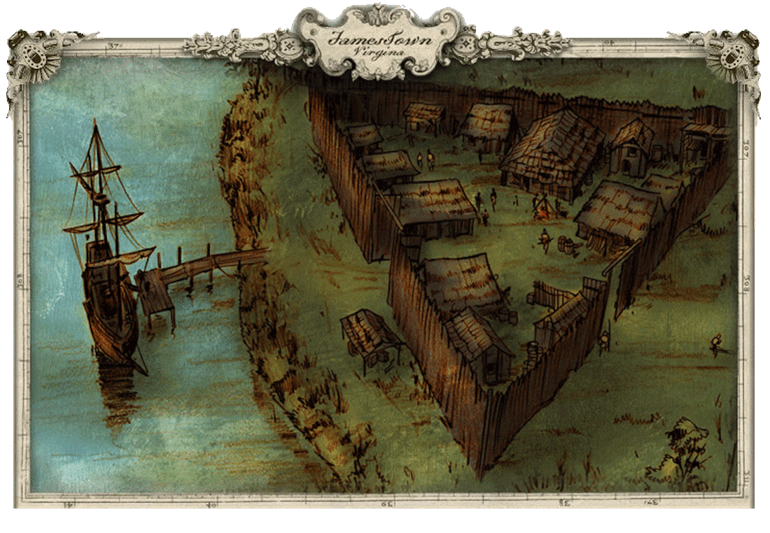
The Anglican Church in America was first established at Jamestown
This Photo by Unknown Author is licensed under CC BY-SA-NC

Slide 30
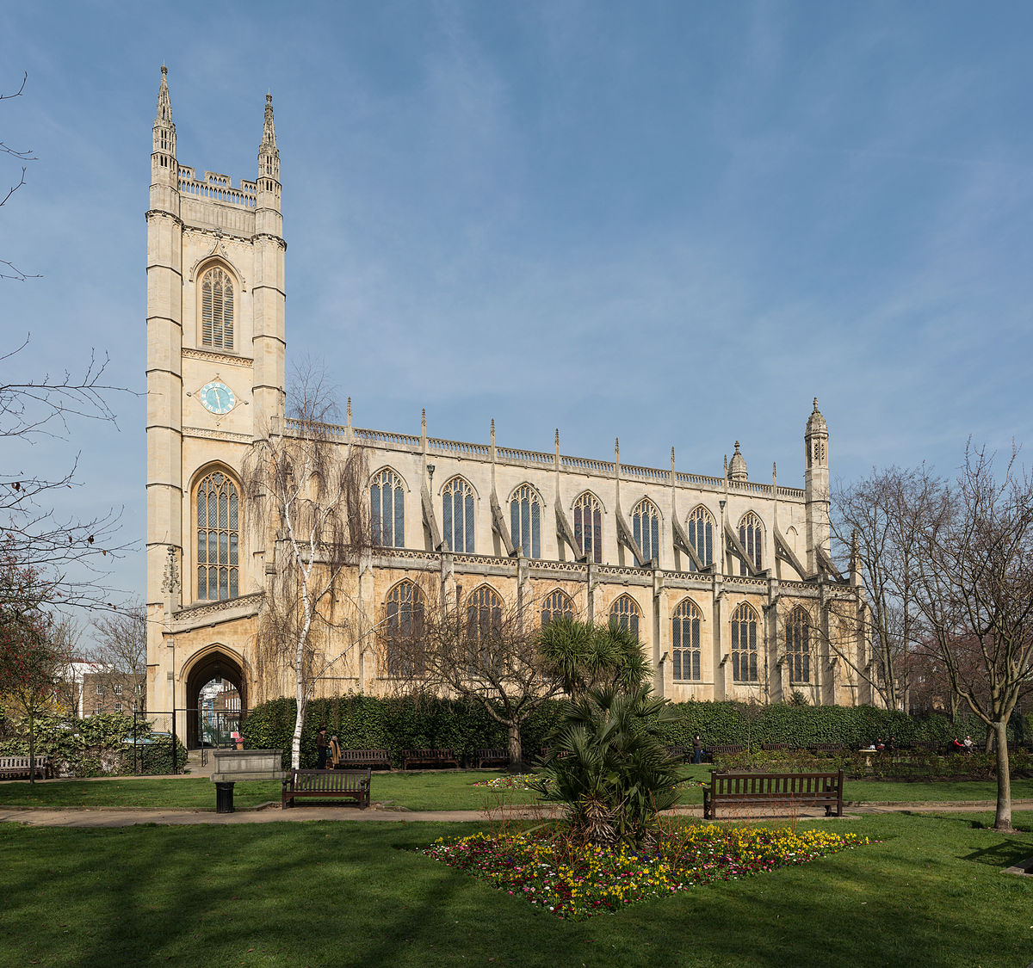
Church of England Practice in America
1662 Prayer Book
Otiginal St Luke’s Richmond VA

Slide 31
History in America
Couldn’t have a Church with allegiance to the King we just overthrew
The King wouldn’t let the English Bishops Ordain
American Church received Episcopal Ordination from the Church of Scotland
  My enemy’s enemy is my friend
Affirmation of St. Louis
  Retain an Orthodox sacramental Life
  Authority of Scripture preserved
  Property inalienable rights reserved to the Laity
Where we stand with Alphabet soup and TAC

Slide 32
The Anglican Church was split through the Revolution
Tories
  Loyal to England
  Supported the English attempts to retain the colonies
  Largely emigrated after the American success
Patriots
  Pro Independence
  Determined to have a more representative church polity
  Left without a Bishop upon the Independence of the US

Slide 33
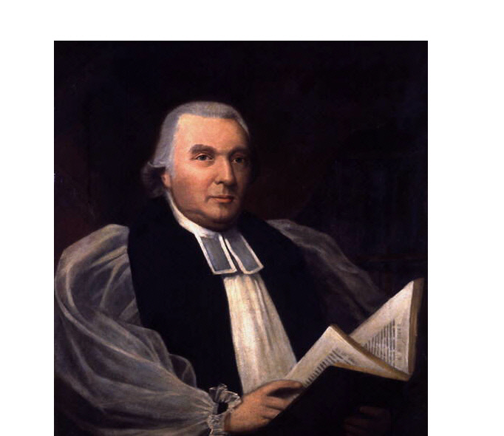
Denied the Episcopate in England; Samuel Seabury was consecrated by the Scottish Bishops ( The enemy of my enemy…..)
This Photo by Unknown Author is licensed under CC BY-SA

Slide 34
Concessions to the Scottish Church and innovations to the Prayer Book
Deletion of Prayers for the King and insertion of Prayers for the President and Governors
Longer Eucharistic Canon favored by the Scottish Church
Consecration of Bishops Abroad Act by Parliament allowed two more Bishops
  William White and Samuel Provost
In 1789, the first non-English Anglican Church was accepted in communion with the Church of England, and the Episcopal Church was established with the 1789 Book of Common Prayer

Slide 35
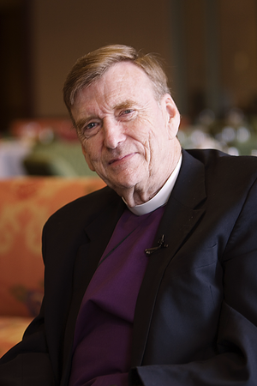
Erosion of Orthodoxy and Morality through the 20th Century led to the Affirmation of St. Louis and establishment of the Continuing Anglican Church
Bishop Albert Chambers

Slide 36
Continuing Church Movement prompted by:
Denial of the authority and truth of Holy Scripture
Departure from the catholic faith and orthodox practice
Introduction of innovations in Sacramental Liturgy (1979 Prayer Book)
Abandoning the Morality of the catholic church
Promotion of abortion and euthanasia
Redefining the sacrament of marriage to include same sex unions
Ordinations of women
Belief in relative truth vs revealed truth
Ordination of actively gay ministers ( deacon, priests and Bishops)
Appropriation of all Church property

Slide 37
Original Goals
Independent province from ECUSA but within the Anglican Communion
Approved by the Office of the Archbishop of Canterbury
Restoration of property to laity in continuing churches
Orthodox practice of the catholic faith and Anglican Tradition

Slide 38
Highlights of the Affirmation of St. Louis
Independence from ECUSA (also the Church of Canada)
Insulation from Modernism (Progression of Man & relative truth)
Continuation of Orthodoxy, catholic faith and Anglican Tradition
Authority, Validity and Truth of Holy Scripture
Holy Orders for Men only, heterosexual or celibate
Marriage between a man and a woman
Condemnation of abortion and euthanasia
Doctrine restricted to the Creeds
Tripartite Synod
1928 Prayer Book as standard of worship
Property in the hands of the Laity
Continuation not Innovation

Slide 39
Overview
What is Anglicanism
Part 5
History
Polity
Theology
Common Prayer

Slide 40
Proliferation of the Alphabet
Sins of Men affect the Administration of Church but are not obstacles to the Church as the vessel of grace to Christ’s people
Simple Pride

Slide 41
Reeling in the Alphabet
Joint Synods and organic Communion established in 2017 between ACA, APA, ACC and Holy Cross (G-3)
Continued discussions with other Orthodox jurisdictions
Ongoing conversation with groups that are largely Orthodox (for example, the Reformed Episcopal Church and the ACNA)

Slide 42
Overview
What is Anglicanism
Part 6
History
Polity
Theology
Common Prayer

Slide 43
Overview
What is Anglicanism
Part 7
History
Polity
Theology
Common Prayer

Slide 44
Polity
How the Church Is Run
Based on English Common Law rather than Imperial Law
Interpretation over definition
  Precedent rather than unchangeable
Broad spectrum of Worship
Based on Reconciliation rather than Condemnation
Freedom to address personal situations and moral dilemmas
Non- Exclusive and Inclusive

Slide 45
Overview
What is Anglicanism
Part 8
History
Polity
Theology
Common Prayer

Slide 46
Theology
Why the
Little “C “
is Bigger than the
Big “C”

Slide 47
Overview
What is Anglicanism
Part 9
History
Polity
Theology
Common Prayer

Slide 48
Overview
What is Anglicanism
Part 10
History
Polity
Theology
Common Prayer

Slide 49
Theology
Council of Nicea - Creed What was believed by all people, all time in all places
All that is necessary for Salvation in the Bible and Sacraments
  Why necessarily “and sacraments”
Sacramental Life
2 sacraments and 5 “so called” sacraments
3 Legged Stool and Via Media
  Tradition, Reason & Scripture
  The Middle Way Not compromise, but Moderate
Pieties, Creedal Statements and Traditions
  Applied to Infallibility, Immaculate Conception, Real Presence, Ever Virgin, Saints
  Personal or group piety rather than catholic belief
  Protection from too stringent and too loose interpretations

Slide 50
Common Prayer
Responsibility for Prayer is held by the Community
  Clergy and people
  Common prayer, not lowly but held in Communion
Elizabethan Compromise and the 1662
Alternative to religious wars on the Continent
Thomas Cranmer 2nd to Shakespeare but closest to God
Book of Common Prayer as an extension of Scripture 80%+
Daily Life and Sacramental Seasons
  Morning and Evening Prayer
  Birth to death; Advent to Trinity

Slide 51
1928 Book of Common Prayer
1662 of England as the Gold Standard
All local BCP’s based on it
Americanized and updated in the 1928 Prayer Book
Biblically based
Morally Orthodox
Orthodox in language
A guard against relative morality and presumption
The Basis of Anglican parishes, even Missal parishes

