Slide 1
Acoustic MyoGraphy – CURO System and ESTiTM Score

Slide 2
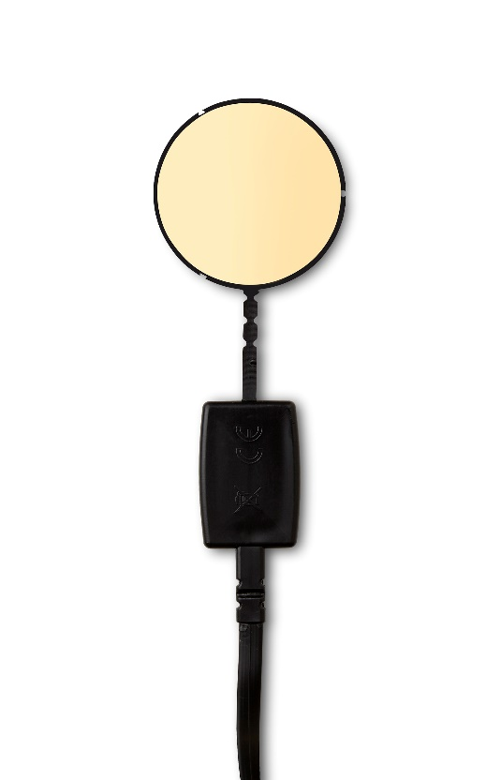
1
2
3
Apply gel to the gold side of the sensor
Rub gel into the muscle site
(approx. 4 cm diameter)
Place the sensor on the muscle
site and secure with bandage
+
+

Slide 3
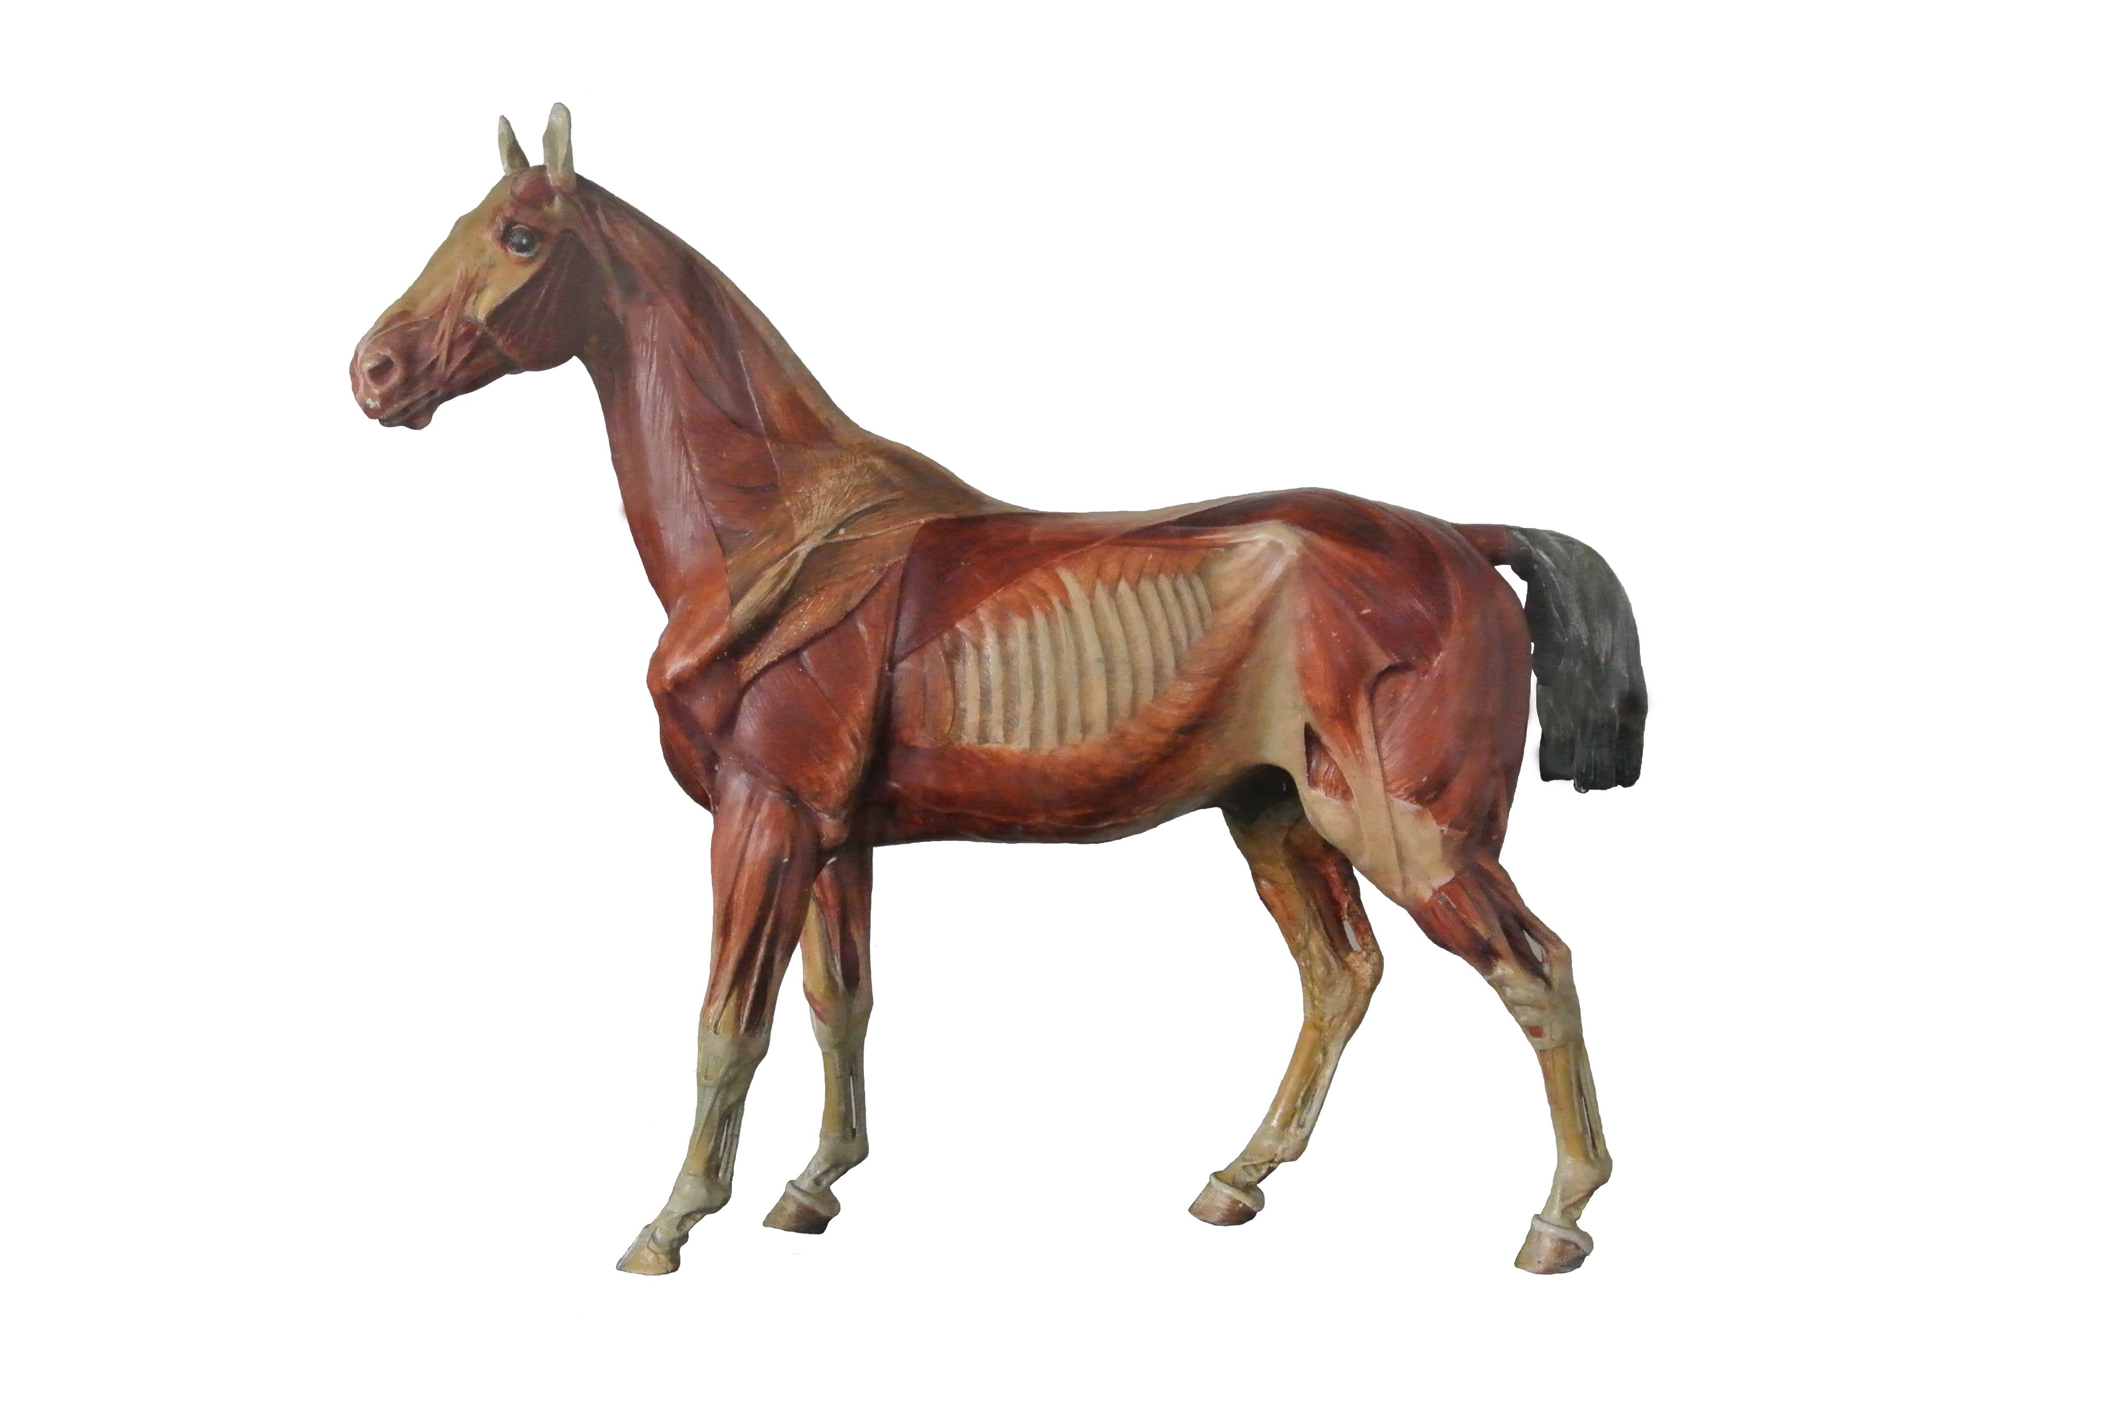
11. TZ - CRA
13. LAD
9. TZ -CAU
3.LL
1.GM
2.GS
12. DE
5.ST
Gluteus medius (GM)
Gluteus superficialis (GS)
Longssimus lumborum (LL)
Tensor fasciae latae (TFL)
Biceps femoris (BF)
Semitendinousus (ST)
Triceps longhead (TC LO)
Triceps lateralhead (TC-LA)
Trapez caudalis (TZ- CAU)
Biceps brachiii (BB)
Trapez cranialis (TZ-CRA)
Deltoideus (DE)
Latissimus dorsi (LAD)
6.BF
10. BB
7.TC -LO
4.TFL
8.TC -LA

Slide 4
Function % Fiber Types Innervation
(GM) Extends hip and abducts limb 14 I 55 IIA 31 IIX cranial gluteal nerve
(GS) Flexes hip and abducts limb 21 I 36 IIA 43 IIX cranial and caudal gluteal nerve
(LL) Extends back and neck, stabilizes vertebral column, spine lateral flexor 10 I 54 IIA 36 IIX dorsal branches of spinal nerves
(TFL) Flexes hip, extends stifle, tenses fascia lata, draws limb forward 49 I 44 IIA 7 IIX cranial gluteal nerve
(BF) Extends hip and stifle, abducts limb (cranial) flexes stifle and abducts limb, extends tarsal joint 16 I 63 IIA 21 IIX caudal gluteal, peroneal, sciatic nerve
(ST) Extends hip, stifle and tarsal durin weight-bearing flexes stifle, draws limb backward,rotates it inward 8 I 66 IIA 26 IIX sciatic and caudal gluteal nerves
(TC LO) Extends Elbow joint and Flexes shoulder 16 I 68 IIA 16 IIX radial nerve
(TC-LA) Extends elbow joint 19 I 77 IIA 4 IIX radial nerve
(TZ- CAU) Draws scapula cranially and abducts it elevates shoulder, draws scapula caudally (abducts it) 32 I 66 IIA 2 IIX dorsal branch of accessory nerves
(BB) Extends shoulder joint, flexes elbow, supports shoulder joint and carpus 30 I 67 IIA 3 IIX musculocutaneous nerves
(TZ-CRA) Draws scapula cranially and abducts it elevates shoulder,draws scapula caudally (abducts it) 32 I 66 IIA 2 IIX dorsal branch of accessory nerves
(DE) Flexes shoulder joint and abducts limb 22 I 54 IIA 24 IIX axillary nerve
(LAD) Flexes shoulder joint 21 I 59 IIA 20 IIX thoracodorsal nerve

Slide 5
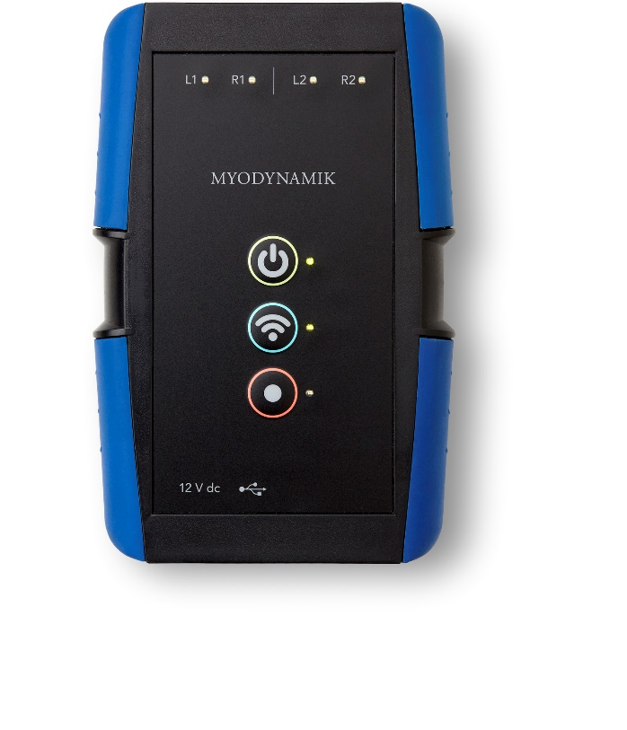
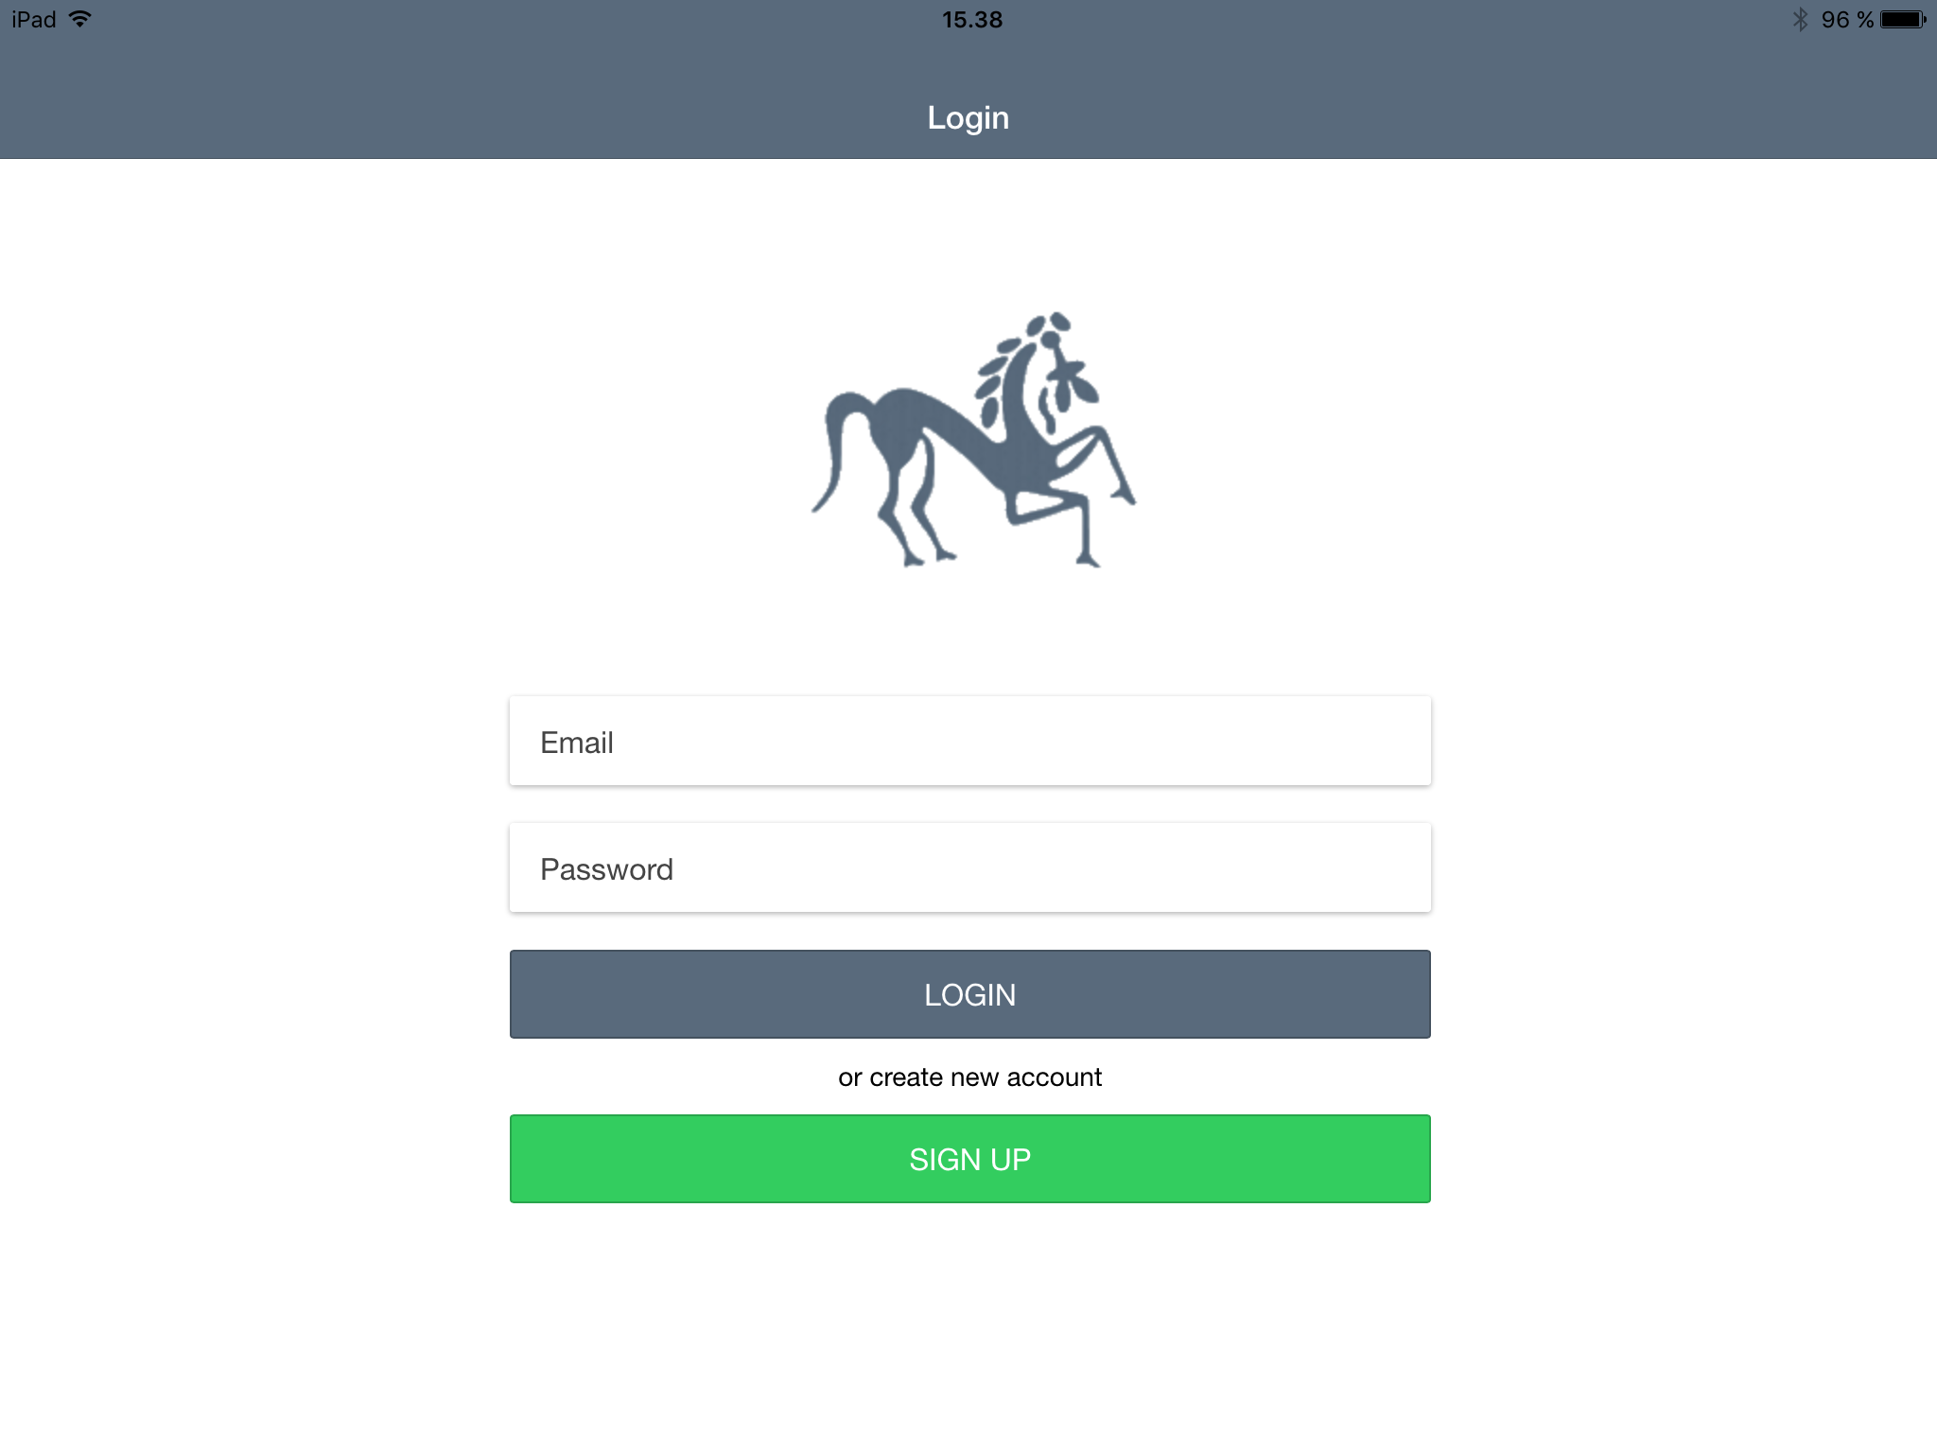
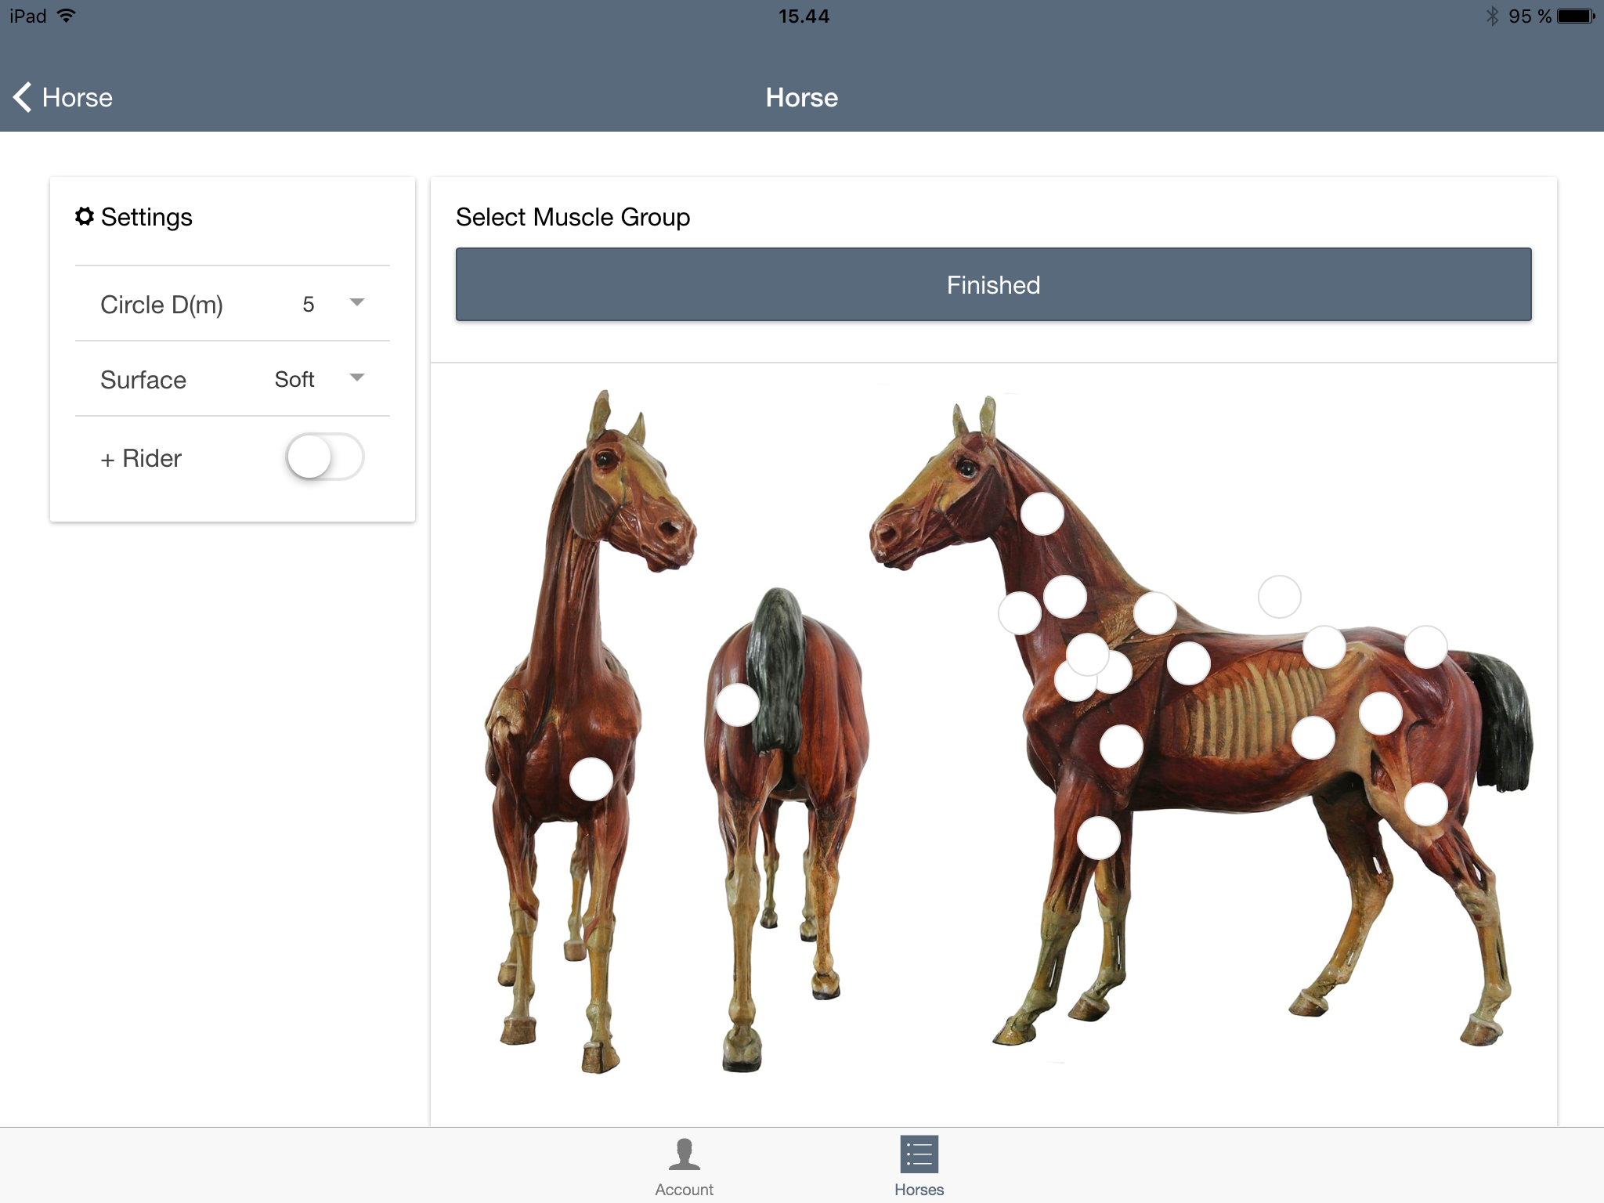
1
2
3
Press the top yellow button
and hold down To START the CURO
Insert the sensors – they will
light up green if
active
Press the middle blue button to start the WiFi connection and the bottom red button to record
4
Proceed to the
iPad APP (CURO Equine)
to follow muscle function
with the ESTiTM-Score

Slide 6
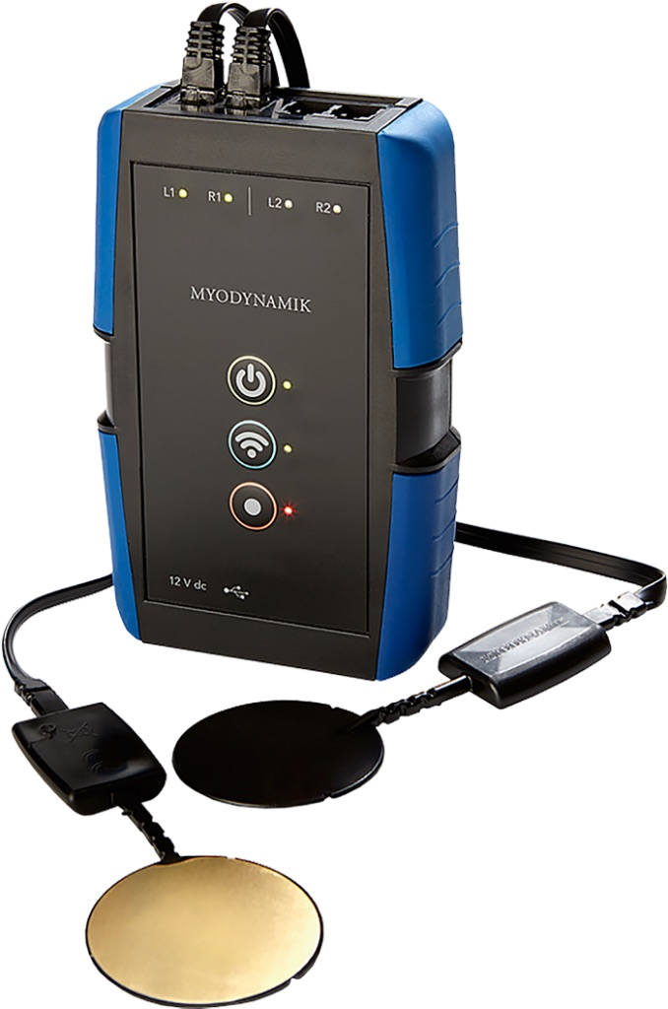
Thorvaldsensvej 19, 2.th, 1871 Frederiksberg C,+45 61462732 myodynamik@myodynamik.com www.myodynamik.com

