Slide 1
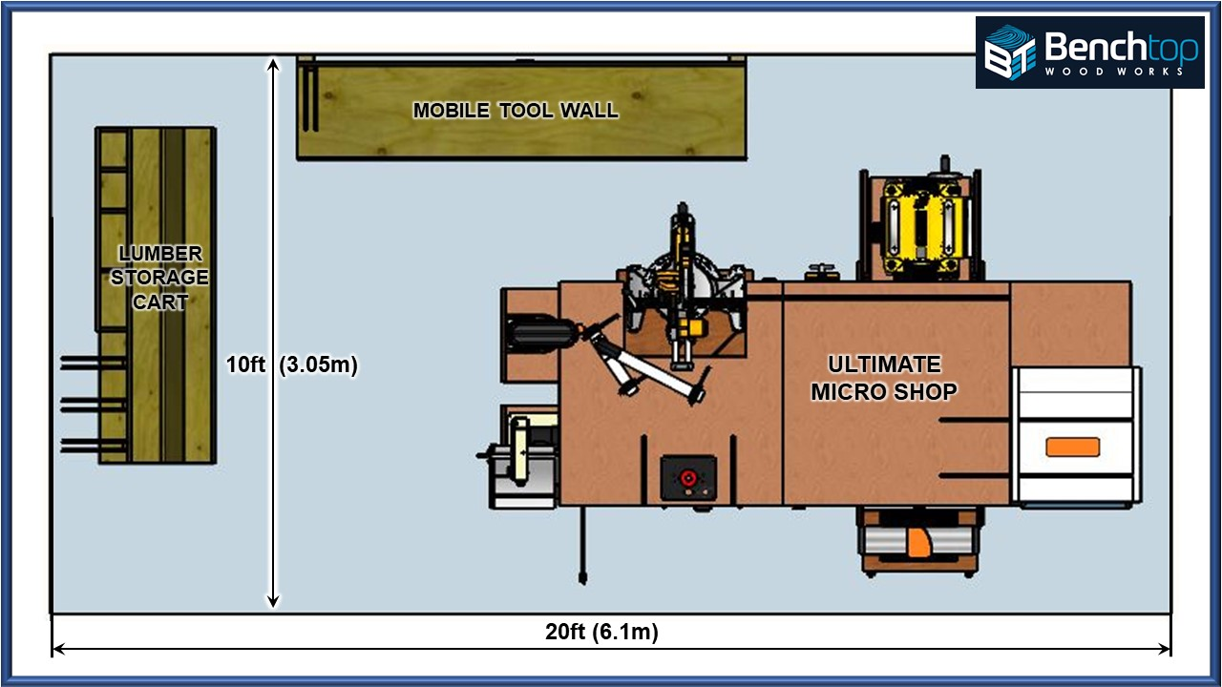
SHOP LAYOUT GUIDE
v8.3 11JUN21
Plan YOUR best shop layout to Maximize Your Shop!
Website

Slide 2
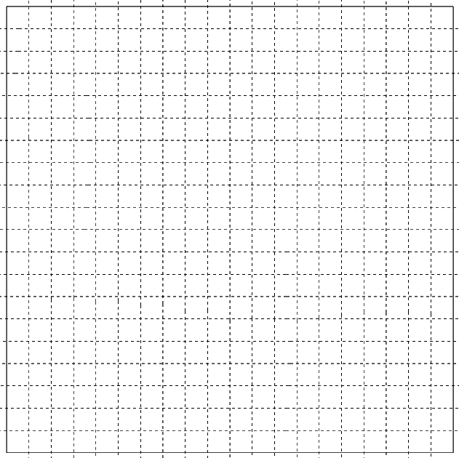


2-Car Garage Shop Template (20ft x 20ft)
MACHINES
4’ x 8’
Plywood Sheet
6” x 8’ Board
13” x 8’ Board
 | Tool | Dimensions
1
2
3
4
5
6
7
8
9
10

Slide 3
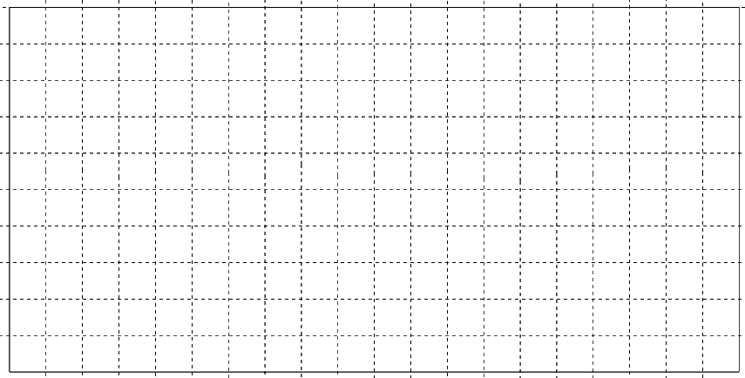
1-Car Garage Shop Template (10ft x 20ft)
MACHINES
 | Tool | Dimensions | Ideal Height
1
2
3
4
5
6
7
8
9
10
4’ x 8’
Plywood Sheet
6” x 8’ Board
13” x 8’ Board

Slide 4
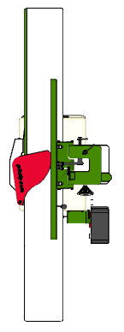
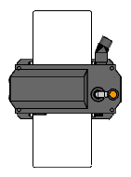
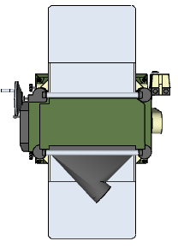

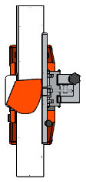
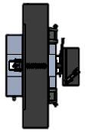
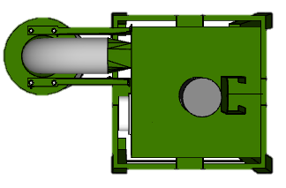
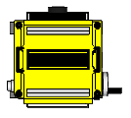
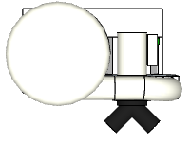




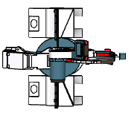
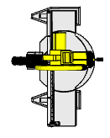
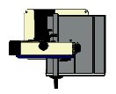



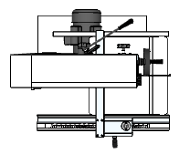

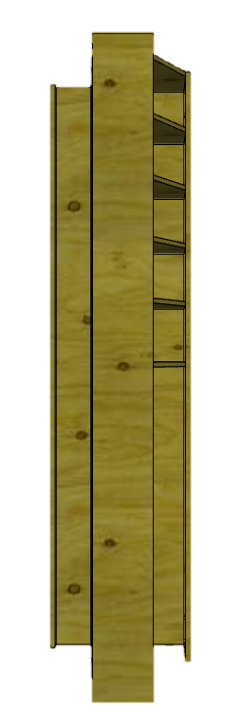
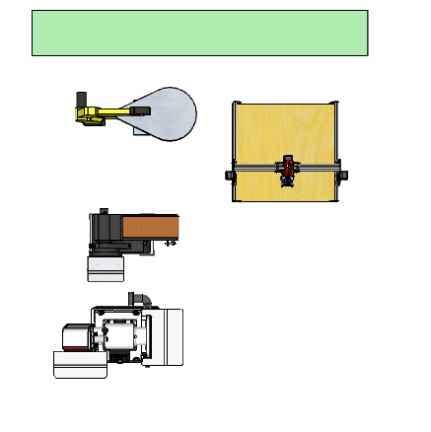
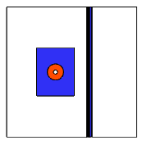
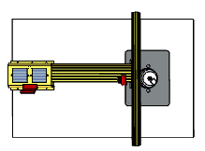
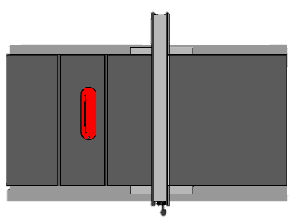
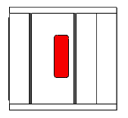
Scale Machine Templates
13”
Planer
20”
Planer
Single-Stage
Dust Collector
2-Stage
Dust Collector
12.5”
Planer
6” Bench Top
Jointer
6”
Jointer
12”
Jointer
Planer
Combo
Bucket
Separator
8”
Jointer
16”
Drum
Sander
Shop Vac
Use these scale machine models to help plan your shop layout to Maximize Your Shop’s Space!
Plan the perfect layout for the tools/machines that you have in your workflow.
See the interferences on paper rather than after you build or move things
Print and cut or arrange digitally
Miter Saw
Dust
Processor
10” Band Saw
Sliding
Miter Saw
Bench Top
Drill Press
2-CAR TEMPLATE
1-CAR TEMPLATE
Cabinet
20”
Bandsaw
Bench Top
Drill Press
Router Table
or Shaper
(32” x 32”)
6” Bench Top
Belt/Disk
Sander
Floor
Drill Press
Router Table
(25” x 38”)
28” x 28”
CNC
28” x 30”
Contractor’s Saw
36” x 72”
Cabinet Saw
8ft Mobile Lumber Storage & Clamp Rack
20”
Scroll Saw
8” Belt/Disk Sander
4

Slide 5
Workflow Arrows Template
Planer Workflow (13”)
Deadspace
Drill Press
Miter Saw Workflow
Table Saw Workflow
Dead Space
Deadspace
Deadspace
Dead Space
Bandsaw Workflow
Dead Space
Router Workflow
Deadspace
Jointer Workflow
2-CAR TEMPLATE
1-CAR TEMPLATE
4’ x 8’
Plywood Sheet
Use these Arrows to Analyze your workflow, capacities and Dead-Space for each machine
13” x 8’ Board
6” x 8’ Board

Slide 6
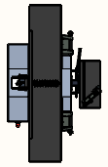

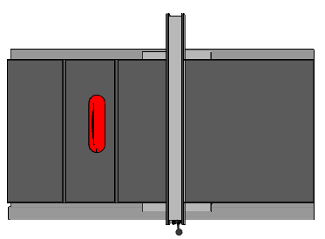
Scale Machine Templates
(HALF SCALE FOR 58’x39’ Shop Template)
20”
Planer
Single-Stage
Dust Collector
2-Stage
Dust Collector
8”
Jointer
12.5”
Planer
6” Bench Top
Jointer
6”
Jointer
13”
Planer
16”
Drum
Sander
12”
Jointer
Planer
Combo
Shop Vac
Bucket
Separator
Use these scale machine models to help plan your shop layout to Maximize Your Shop’s Space!
Plan the perfect layout for the tools/machines that you have in your workflow.
See the interferences on paper rather than after you build or move things
Print and cut or arrange digitally
Dust
Processor
Miter Saw
10” Band Saw
Sliding
Miter Saw
Bench Top
Drill Press
SHOP TEMPLATE
Floor
Drill Press
28” x 28”
CNC
20”
Bandsaw
Bench Top
Drill Press
48” x 96”
CNC
6” Bench Top
Belt/Disk
Sander
Router Table
or Shaper
(32” x 32”)
Router Table
(25” x 38”)
56” x 56”
CNC
28” x 30”
Contractor’s Saw
8” Belt/Disk Sander
Cabinet
36” x 72”
Cabinet Saw
20”
Scroll Saw
Mobile Lumber Storage & Clamp Rack
6

Slide 7

Generic Shop Template (58ft x 39ft)
MACHINES

Slide 8
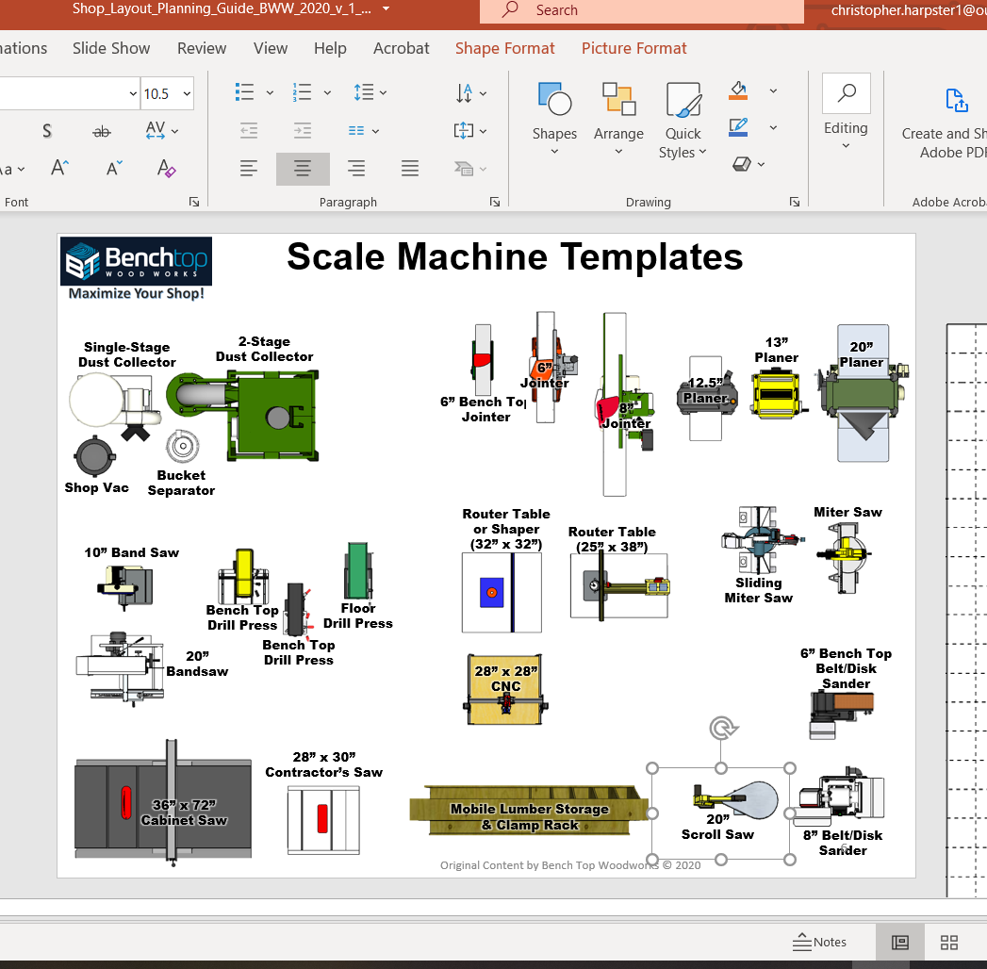
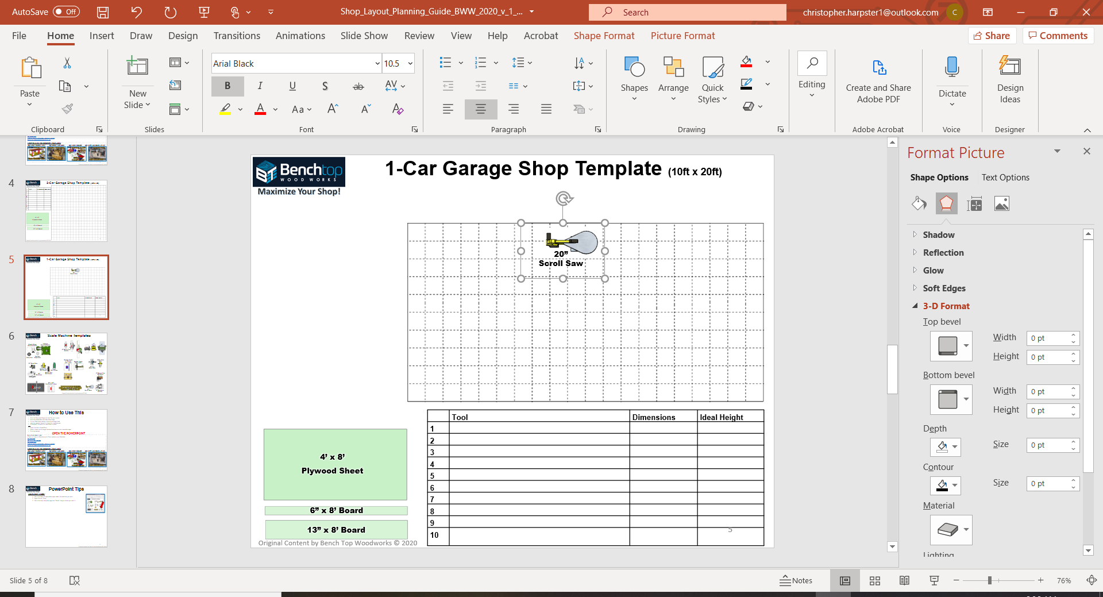
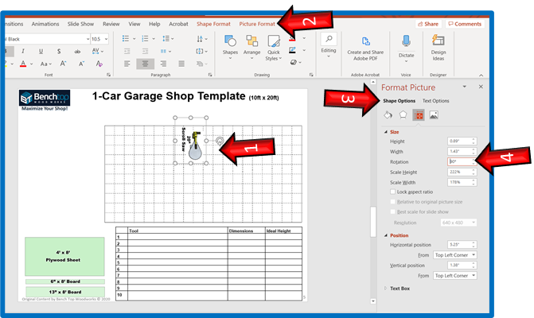
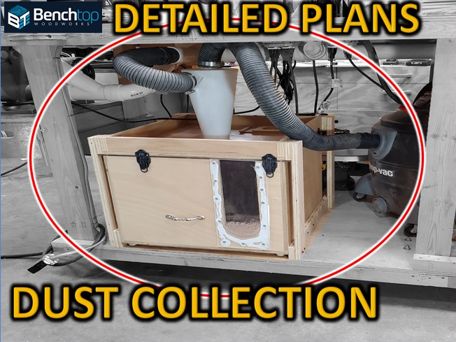
PowerPoint Editing Tips
How to move & rotate:
Go to the machine templates page, select the machine you want.--------------------------------------------------------
Right Click & “Copy” (“CTRL-C”)
Go to the shop template page and “Paste”, (“CTRL-V”) drag to where you want it.
To precisely rotate: Select the item> format picture or shape > Shape Options > Dimension icon > Size > Rotation
To remove text: select the machine area (both text and machine will select), click a 2nd time directly on the text, edit delete the text as needed.
Add Shapes to represent the other benches, cabinets and machines not included. You can also re-size machines to suit your actual machine.

