Slide 1



AN OVERVIEW ON SOIL EROSION
IN THE BASILICATA REGION:
RELATIONSHIPS BETWEEN GEOMORPHOLOGY, PEDOLOGY, AGRICULTURAL ECONOMICS
AND CLIMATIC TRENDS
Antonella DIMOTTA^{1,2}, Maurizio LAZZARI², Severino ROMANO¹
SAFE - School of Agricultural, Forestry, Food and Environmental Sciences – University of Basilicata, Italy
2. CNR IBAM – Italian National Research Council – Institute for Archaecological and Monumental Heritage, Italy

Slide 2
RESEARCH ACTIVITY OVERVIEW – 2016-2018:
GOALS & RELATIONSHIPS IN THE BASILICATA REGION
APPLIED GEOMORPHOLOGY (Dimotta et al., 2016)
SOIL EROSION ASSESSMENT METHOD APPLICATION:
USPED Method application (2012) at a regional scale;
SOIL EROSION INCIDENCE ASSESSMENT (USPED)
(municipal and regional scale);
GEOMORPHOLOGY vs AGRICULTURAL ECONOMICS (Dimotta et al., 2016):
SOIL LOSS ASSESSMENT: on-site impacts assessment evaluated for the three typical regional croplands: arable cereals land, vineyards, olive-growing lands.
ON-SITE ECONOMIC IMPACTS ASSESSMENT: Potential Economic Soil Loss Assessment Method (PESLAM, Dimotta et al., 2016)
GEOMORPHOLOGY vs PEDOLOGY (Dimotta et al., 2017):
SOIL EROSION (USPED) vs SOIL TYPES:
soil erosion-exposed municipalities and soil types
SOIL TYPES vs LAND USE,
CaCO3 (%), soil organic matter (SOM, %)
GEOMORPHOLOGY vs CLIMATOLOGY (Dimotta et al., 2018 – in peer-review)

Slide 3
APPLIED GEOMORPHOLOGY: how does it work for soil erosion in the Basilicata region?

Slide 4
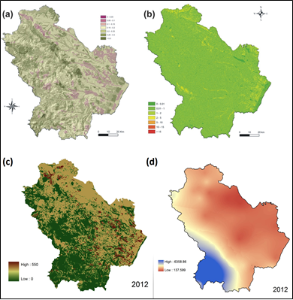
SOIL LOSS, PRODUCTIVITY AND CROPLAND VALUES
GIS-BASED ANALYSIS AND TRENDS IN THE BASILICATA REGION
(SOUTHERN ITALY) FROM 1980 TO 2013 (Dimotta et al., 2016)
MATERIALS & METHODS (1)
USPED Model – Unit Stream Power Erosion and Deposition model
Basic model structure of the USLE and RUSLE method
A = R * K * (LS) * C * P
A = computed site soil loss [Mg/ha/y]
R = rainfall erosivity factor [MJ mm/ha/h/y]
K = soil erodibility factor [Mg h/MJ/mm]
L = slope-lenght factor combined with S (slope steepness factor)
LS: dimensionless terrain factor
C = vegetation cover (dimensionless)
P = erosion control practice factor (dimensionless)
USPED ELABORATIONS:
(a) - Soil erodibility factor map in the Basilicata region in 2012 (K factor);
(b) Topographic Index Map, 2012;
(c) Land cover and management factor map (C factor), 2012;
(d) Erosivity map (R factor), 2012.

Slide 5
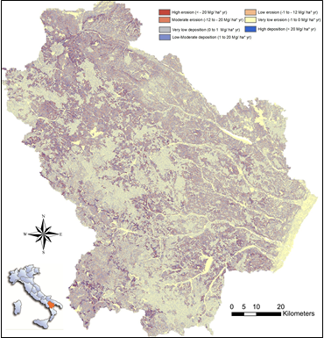
SOIL LOSS, PRODUCTIVITY AND CROPLAND VALUES
GIS-BASED ANALYSIS AND TRENDS IN THE BASILICATA REGION
(SOUTHERN ITALY) FROM 1980 TO 2013 (Dimotta et al., 2016)
MATERIALS & METHODS (2)
USPED Model – Unit Stream Power Erosion and Deposition model
EROSION AND DEPOSITION MAP IN THE BASILICATA REGION IN 2012
Potential eroded surface [ha] obtained through USPED method
by considering only the first three erosion classes in relation to
the following range:
< – 20 Mg ha⁻¹ y⁻¹ ÷ < – 1 Mg ha⁻¹ y⁻¹
from high erosion to low erosion

Slide 6
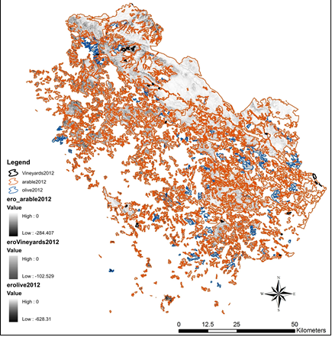
SOIL LOSS, PRODUCTIVITY AND CROPLAND VALUES
GIS-BASED ANALYSIS AND TRENDS IN THE BASILICATA REGION
(SOUTHERN ITALY) FROM 1980 TO 2013 (Dimotta et al., 2016)
RESULTS: USPED OUTPUTS (1)
USPED Model – Unit Stream Power Erosion and Deposition model
EROSION AND DEPOSITION MAP IN THE BASILICATA REGION IN 2012 SPATIAL DISTRIBUTION OF THE THREE CROPLANDS IN COMBINATION WITH THE USPED MODEL (2012)

Slide 7
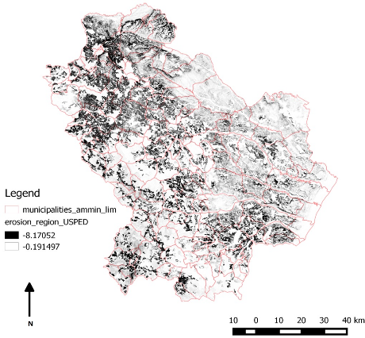
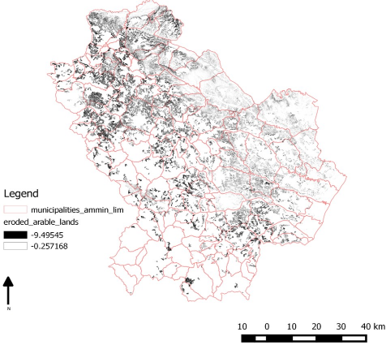
SOIL LOSS, PRODUCTIVITY AND CROPLAND VALUES
GIS-BASED ANALYSIS AND TRENDS IN THE BASILICATA REGION
(SOUTHERN ITALY) FROM 1980 TO 2013 (Dimotta et al., 2016)
RESULTS: USPED OUTPUTS (2)
USPED Model – Unit Stream Power Erosion and Deposition model
POTENTIAL TOTAL ERODED LANDS AT A REGIONAL SCALE POTENTIAL ERODED ARABLE LANDS AT A REGIONAL SCALE

Slide 8
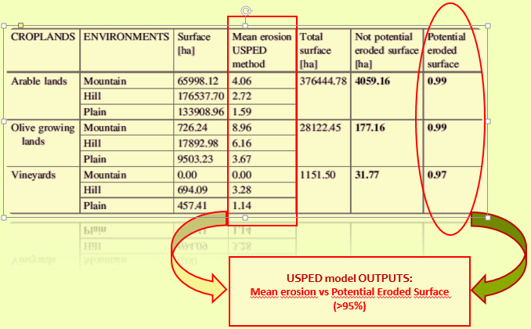
SOIL LOSS, PRODUCTIVITY AND CROPLAND VALUES
GIS-BASED ANALYSIS AND TRENDS IN THE BASILICATA REGION
(SOUTHERN ITALY) FROM 1980 TO 2013 (Dimotta et al., 2016)
RESULTS: USPED OUTPUTS (3)
USPED Model – Unit Stream Power Erosion and Deposition model & Calculations
CHARACTERIZATION OF THE ENVIRONMENTS RELATED TO THE CROPLANDS IN RELATION TO THE USPED APPLICATION

Slide 9
GEOMORPHOLOGY vs
AGRICULTURAL ECONOMICS:
How does soil erosion affect the agricultural productivity in the Basilicata region?
(Dimotta et al., 2016)

Slide 10
SOIL LOSS, PRODUCTIVITY AND CROPLAND VALUES
GIS-BASED ANALYSIS AND TRENDS IN THE BASILICATA REGION
(SOUTHERN ITALY) FROM 1980 TO 2013 (Dimotta et al., 2016)
DATA ANALYSIS & METHODOLOGY
PRODUCTIVITY AND CROPLANDS VALUES (1)
Land Values Trend Assessment (1980-2013)
Productivity Values Trends Assessment (1999-2013)
QUANTITATIVE GEOMORPHOLOGICAL ANALYSIS (2)
Soil Loss Assessment (USPED application, 2012)
Potential eroded surface in relation to the three croplands (cereals, vineyards, olive trees)
ECONOMIC IMPACT
OF SOIL EROSION (3)
Potential Soil Loss Assessment Method (PESLAM, Dimotta et al., 2016)
Croplands: Average Agricultural Value
Vineyards
Olive-growing lands
Arable cereals land

Slide 11
SOIL LOSS, PRODUCTIVITY AND CROPLAND VALUES
GIS-BASED ANALYSIS AND TRENDS IN THE BASILICATA REGION
(SOUTHERN ITALY) FROM 1980 TO 2013 (Dimotta et al., 2016)
1. DATA ANALYSIS & RESULTS – LAND VALUES TREND (CAP Reform, 1980-2013)
From 1980 to 1992 – McSharry’S Reform
> Land Values land = production factor
3.261 €/ha → 4.592 €/ha → 4.850 €/ha
1993 – Multifunctional Concept = Agricultural Enterprise
2000 – Agenda 2000 Land Values = 6.034 €/ha
2003 – Fischler’s Reform Land Values = 6.331 €/ha
Environmental Issues: Reg. (CE) n° 1782/2003 (All. 4)
2008 – Health Check Land Values = 6.966 €/ha
Reg. (CE) n° 72/2009 – Marketing Tools
Reg. (CE) n° 73/2009 – Direct Payments
Reg. (CE) n° 74/2009 – Rural Development Policy
2007-2013 – New CAP
Land Values = 7.000 €/ha → 7.043 €/ha

Slide 12
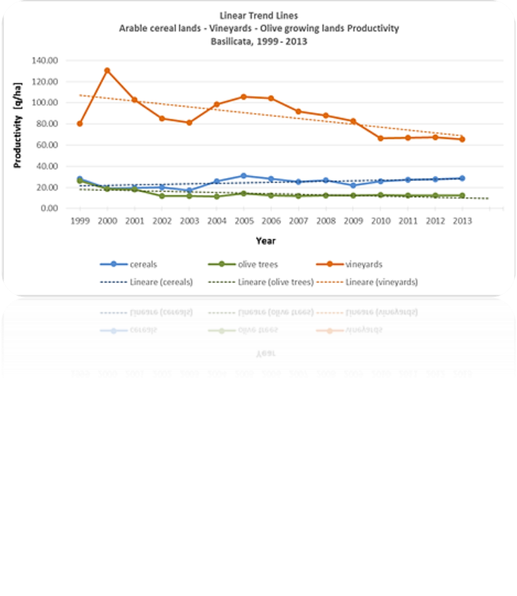
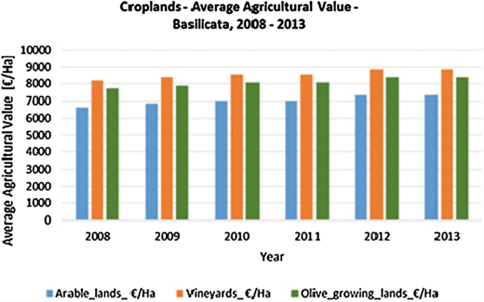
SOIL LOSS, PRODUCTIVITY AND CROPLAND VALUES
GIS-BASED ANALYSIS AND TRENDS IN THE BASILICATA REGION
(SOUTHERN ITALY) FROM 1980 TO 2013 (Dimotta et al., 2016)
1. DATA ANALYSIS & RESULTS: CROPLANDS PRODUCTIVITY (1999-2013) vs AVERAGE AGRIC. VALUE
TREND (2008-2013)

Slide 13
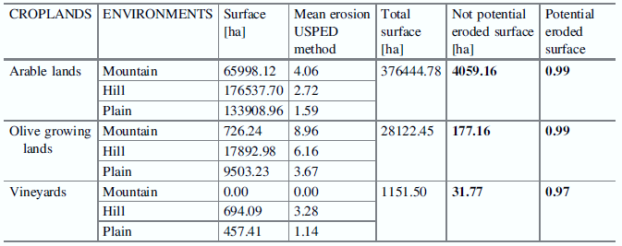
SOIL LOSS, PRODUCTIVITY AND CROPLAND VALUES
GIS-BASED ANALYSIS AND TRENDS IN THE BASILICATA REGION
(SOUTHERN ITALY) FROM 1980 TO 2013 (Dimotta et al., 2016)
2. GEOMORPHOLOGY (USPED application) RESULTS: Mean erosion & Potential eroded surface
USPED model OUTPUTS:
Mean erosion vs Potential Eroded Surface (>95%)

Slide 14
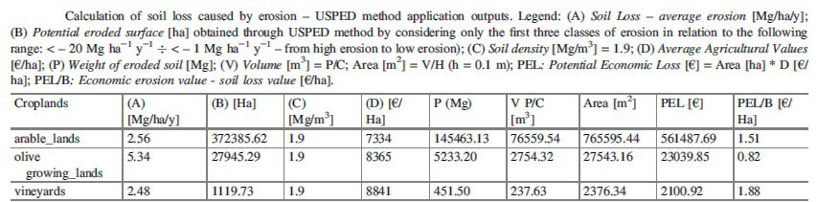
SOIL LOSS, PRODUCTIVITY AND CROPLAND VALUES
GIS-BASED ANALYSIS AND TRENDS IN THE BASILICATA REGION
(SOUTHERN ITALY) FROM 1980 TO 2013 (Dimotta et al., 2016)
3. AGRICULTURAL ECONOMICS RESULTS: METHODOLOGY & RESULTS
SOIL LOSS ASSESSMENT
A = Soil loss amount: average value
[Mg/ha/y]
B = Potential eroded surface [ha] ECONOMIC IMPACT OF SOIL EROSION
ASSESSMENT: on-site costs
PEL = Potential Economic Loss [€]
ON-SITE COSTS PEL/B = Economic Erosion Value [€/ha]
How much would the croplands lose?

Slide 15
SOIL LOSS, PRODUCTIVITY AND CROPLAND VALUES
GIS-BASED ANALYSIS AND TRENDS IN THE BASILICATA REGION
(SOUTHERN ITALY) FROM 1980 TO 2013 (Dimotta et al., 2016)
3. GEOMORPHOLOGY vs AGRICULTURAL ECONOMICS: Final Remarks
EROSION-PRODUCTIVITY RELATIONSHIPS:
Topsoil removal may often result in a nutrient deficit
Erosion may also lead to physical hindrance to root growth
Erosion reduces productivity so slowly that the reduction might not be recognized until crop production
is no longer economically viable
[Bakker et al., 2004].
GEOMORPHOLOGY vs AGRICULTURAL ECONOMICS - SOIL LOSS BY EROSION: IMPACTS & CONSEQUENCES
soil loss by erosion tends to increase the production costs in the medium and long-term, with an increasing demand for liming and fertilizer applications.
Soil erosion has evident effects both on- and off production sites → all that has economic consequences on agriculture and land use policy.
RESEARCH APPLICATION ON EROSION CONTROL TECHNIQUES:
Soil management techniques able to improve infiltration rate
Runoff management techniques that permit safe management/removal of surplusrunoff
Conservation tillage and use of cover crops to restore productivity and degraded soil.
.

Slide 16
APPLIED GEOMORPHOLOGY vs
PEDOLOGY:
Let’s see what soil types are more prone to erosion in the Basilicata region…
(Dimotta et al., 2017)

Slide 17
SOIL EROSION MODELLING ON ARABLE LANDS AND SOIL TYPES IN BASILICATA,
SOUTHERN ITALY (Dimotta et al., 2017)
MAIN GOALS
USPED METHOD APPLICATION
Potential Soil Loss by erosion affecting the arable lands
INCIDENCE
OF SOIL EROSION
Function correlation among soil types – Land Use – CaCO3 (%) – soil organic matter (SOM, %)
Soil erosion-exposed areas in f(SOM, CaCO3, Land Use)
ENVIRONMENTAL EVALUATION AND A POSSIBLE MITIGATION STRATEGY
Land Use Management
Soil Resilience Approach = Sustainable Mitigation Strategy: Resilience | Restoration | Rehabilitation

Slide 18
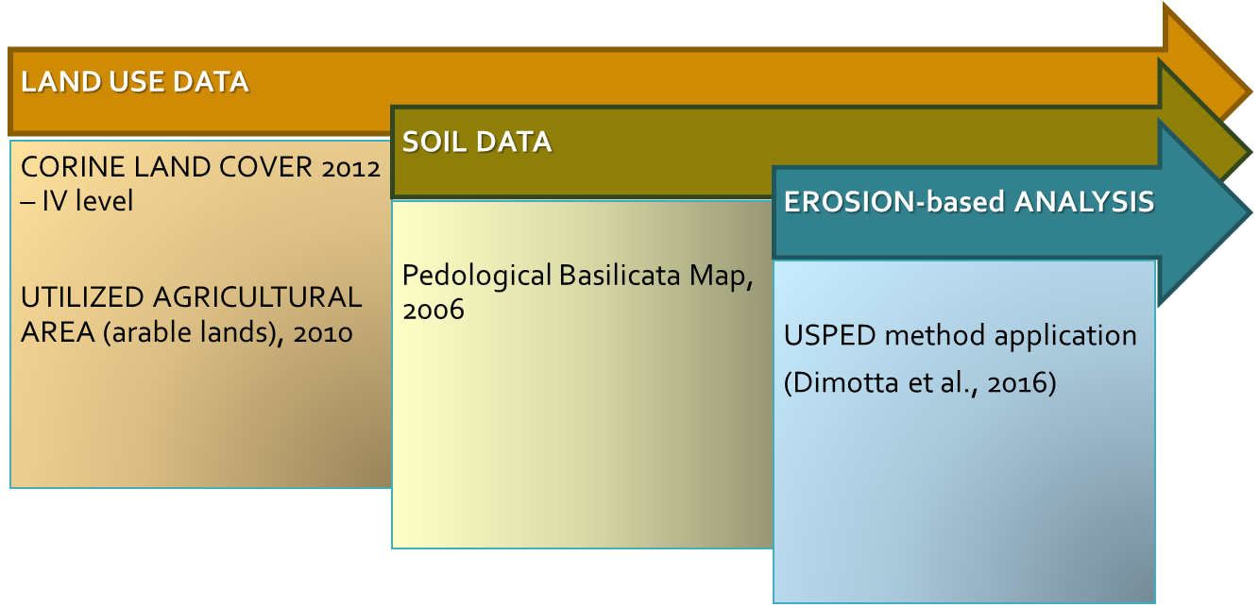
SOIL EROSION MODELLING ON ARABLE LANDS AND SOIL TYPES IN BASILICATA,
SOUTHERN ITALY (Dimotta et al., 2017)
DATASETS

Slide 19


SOIL EROSION MODELLING ON ARABLE LANDS AND SOIL TYPES IN BASILICATA,
SOUTHERN ITALY (Dimotta et al., 2017)
USPED OUTPUTS (regional scale, 2012):
1. Erosion + Deposition; 2. Potential Total eroded lands;
3. Potential eroded arable lands

Slide 20
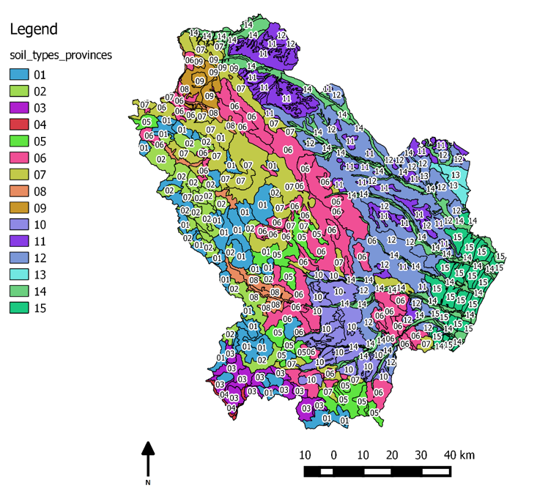
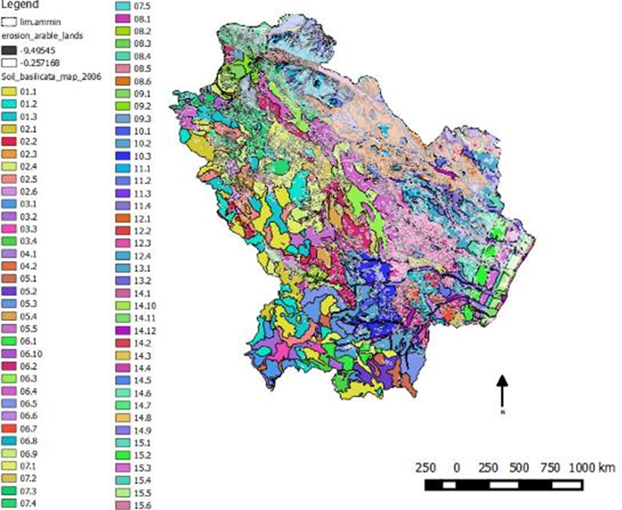
SOIL EROSION MODELLING ON ARABLE LANDS AND SOIL TYPES IN BASILICATA,
SOUTHERN ITALY (Dimotta et al., 2017)
GEOMORPHOLOGY vs PEDOLOGY:
1. Soil Types scenario: pedological provinces of the Basilicata region (2006);
2. USPED (2012) + Pedological Map (2006) = Spatial distribution of erosion affecting the arable lands;

Slide 21
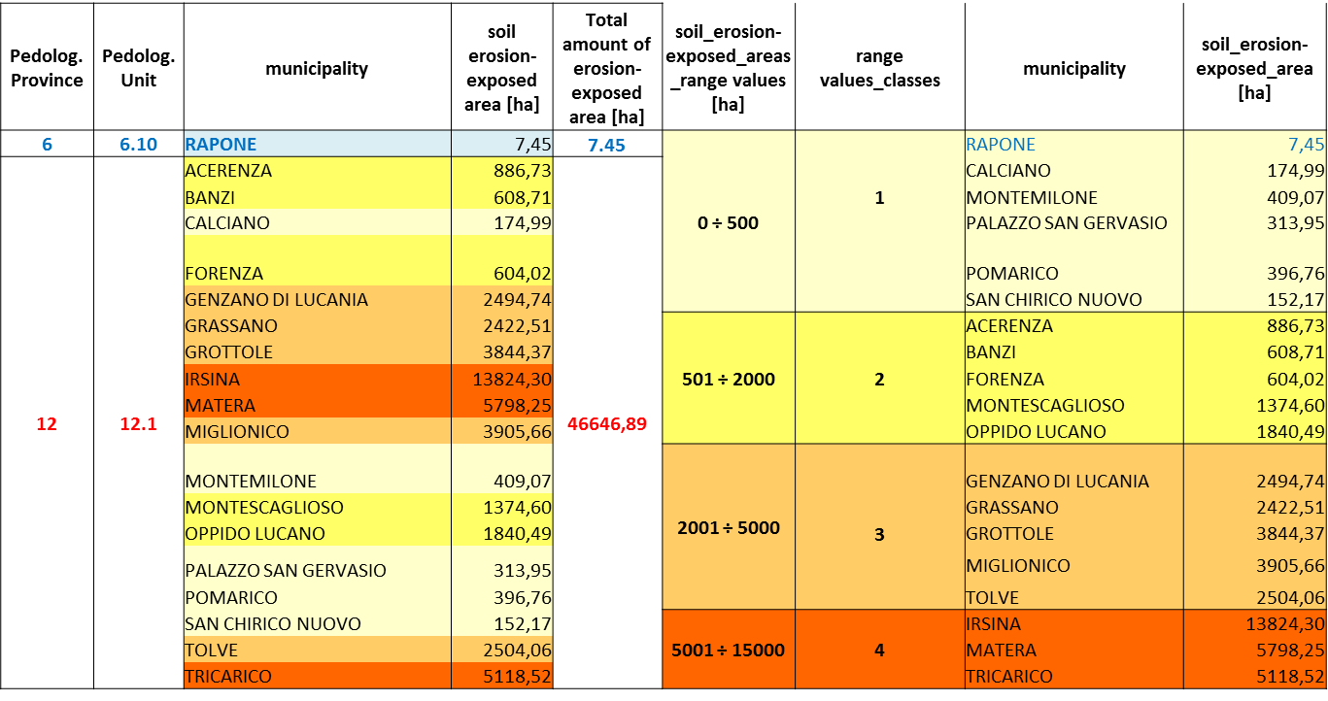
SOIL EROSION MODELLING ON ARABLE LANDS AND SOIL TYPES IN BASILICATA,
SOUTHERN ITALY (Dimotta et al., 2017)
GEOMORPHOLOGY vs PEDOLOGY:
Pedological characterization: soil erosion-exposed municipalities in f(soil types)

Slide 22
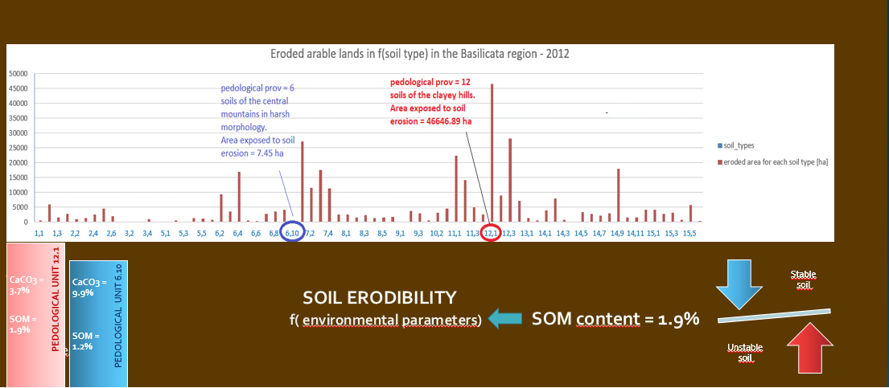
SOIL EROSION MODELLING ON ARABLE LANDS AND SOIL TYPES IN BASILICATA,
SOUTHERN ITALY (Dimotta et al., 2017)
SOIL EROSION vs SOIL TYPES – RESULTS: the most erosion-exposed soil type and the less one…
Let’s evaluate them!

Slide 23

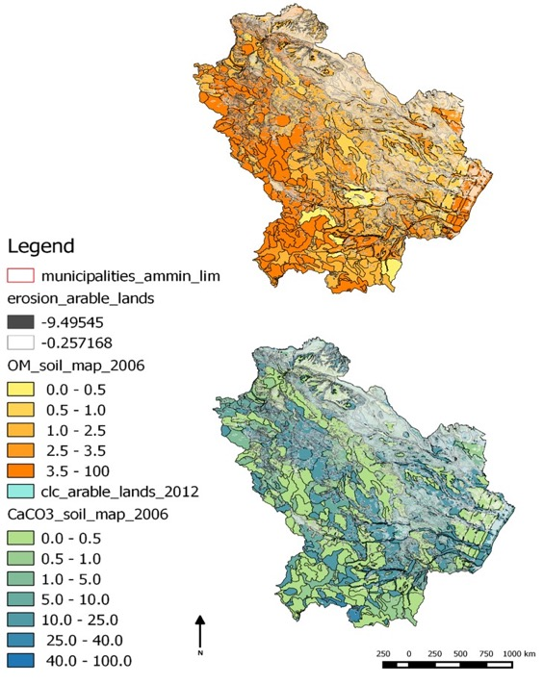
SOIL EROSION MODELLING ON ARABLE LANDS AND SOIL TYPES IN BASILICATA,
SOUTHERN ITALY (Dimotta et al., 2017)
GEOMORPHOLOGY vs PEDOLOGY:
1. USPED OUTPUT: Spatial distribution of the potential eroded arable lands at a reg. scale (2012)
2. USPED (2012) + SOM (%) vs USPED (2012) + CaCO3 (%)

Slide 24
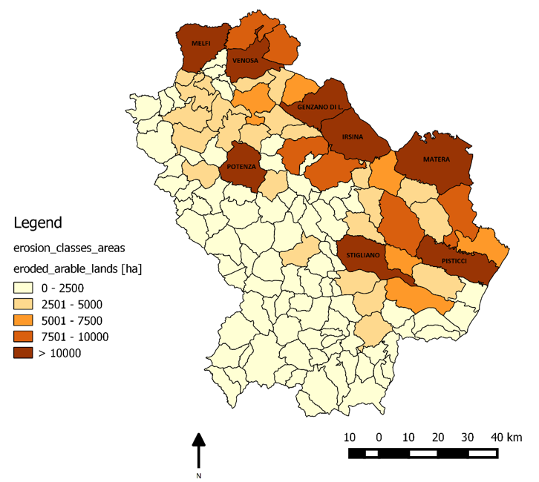
SOIL EROSION MODELLING ON ARABLE LANDS AND SOIL TYPES IN BASILICATA,
SOUTHERN ITALY (Dimotta et al., 2017)
SOIL EROSION vs MUNICIPALITY AREA – RESULTS: the most erosion-exposed municipality and the less one…
Let’s evaluate them!
THE MOST SOIL EROSION-EXPOSED MUNICIPALITY…
Potenza
25515.03 ha
THE LESS SOIL EROSION-EXPOSED MUNICIPALITY
Maratea
32.90 ha

Slide 25
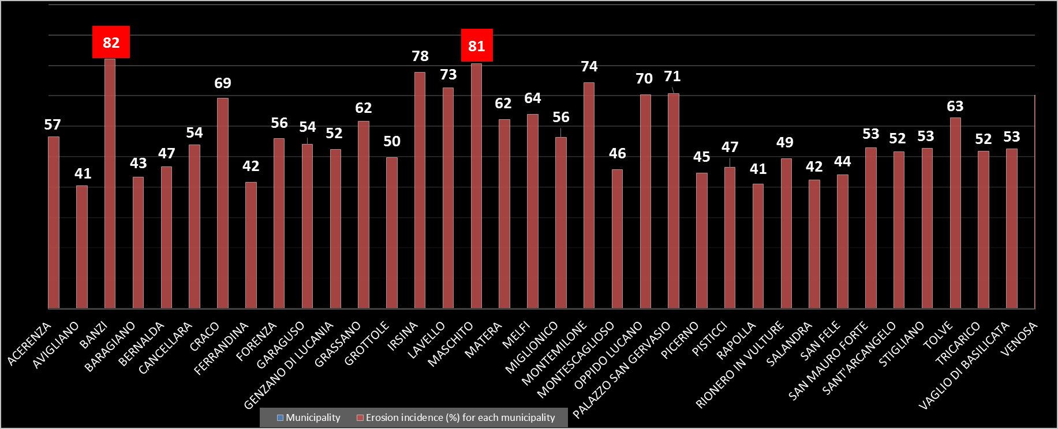
SOIL EROSION MODELLING ON ARABLE LANDS AND SOIL TYPES IN BASILICATA,
SOUTHERN ITALY (Dimotta et al., 2017)
INCIDENCE OF SOIL EROSION vs MUNICIPALITIES – RESULTS (incidence > 40%):
Soil erosion-exposed areas in municipalities with > 80%: BANZI (82%) & MASCHITO (81%)

Slide 26
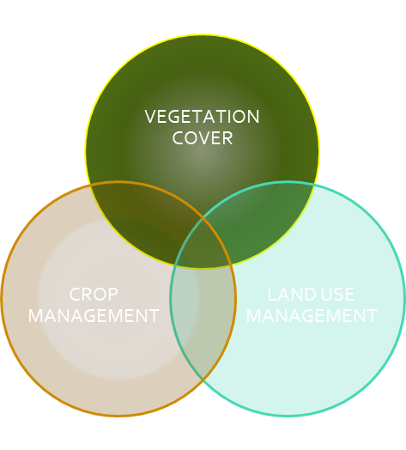
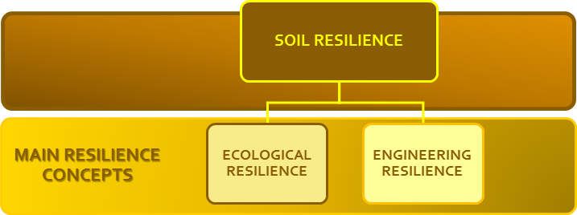

SOIL EROSION MODELLING ON ARABLE LANDS AND SOIL TYPES IN BASILICATA,
SOUTHERN ITALY (Dimotta et al., 2017)
DISCUSSION & FINAL REMARKS:
THEORY FOR SUSTAINABLE MITIGATION STRATEGY: SOIL RESILIENCE APPROACH

Slide 27
APPLIED GEOMORPHOLOGY vs
CLIMATOLOGY:
Let’s see what happens between soil erosion and climatic trends from 1926 t0 2025 at a global scale
(Dimotta et al., 2018)
…next submission…

Slide 28
GLOBAL SOIL EROSION MODELS vs GLOBAL CLIMATE SCENARIOS FROM 1926 TO 2025:
A CRITICAL REVIEW (Dimotta et al., 2018 - in peer-review)
GLOBAL DISTRIBUTION OF SOIL EROSION MODELS (SEMs) DEVELOPMENT from 1936 to 2016
141 Total SEMs developed over time
SOIL EROSION MODELS OVERVIEW
Global distribution
from 1936 to 2016
Model Typologies (6):
Conceptual
Empirical | Semi-empirical
Physical | Semi-phyisical
Process-based
CLIMATE SCENARIOS by
Köppen-Geiger
1926-2025
Relationships between SEMs and Climate zones through a data crossing survey for every climate shift:
1st 1926 – 1950
2nd 1951 – 1975
3rd 1976 – 2000
4th 2001 – 2025
What are
the climate zones much more soil erosion-prone from 2001 to 2025?

Slide 29
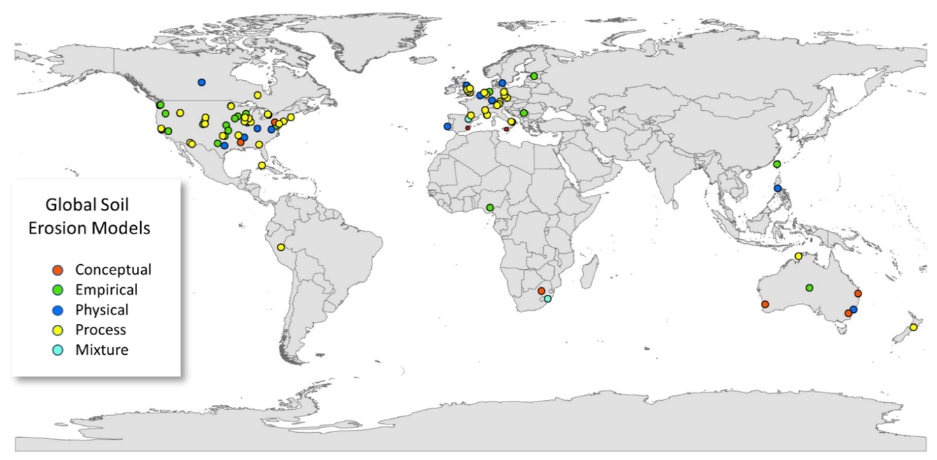
GLOBAL SOIL EROSION MODELS vs GLOBAL CLIMATE SCENARIOS FROM 1926 TO 2025:
A CRITICAL REVIEW (Dimotta et al., 2018 - in peer-review)
GLOBAL DISTRIBUTION OF SOIL EROSION MODELS (SEMs) DEVELOPMENT from 1936 to 2016
141 Total SEMs developed over time

Slide 30
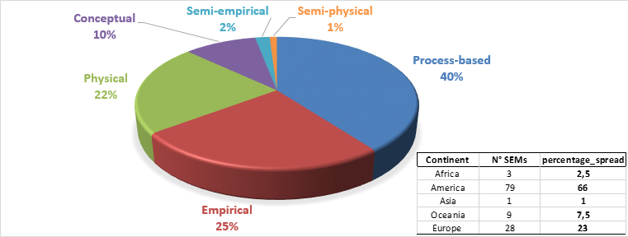
GLOBAL SOIL EROSION MODELS vs GLOBAL CLIMATE SCENARIOS FROM 1926 TO 2025:
A CRITICAL REVIEW (Dimotta et al., 2018 - in peer-review)
SOIL EROSION MODELS (SEMs) from 1930s to 2016
Percentage of the global distribution of the developed SEMs typologies in the five continents

Slide 31
GLOBAL SOIL EROSION MODELS vs GLOBAL CLIMATE SCENARIOS FROM 1926 TO 2025:
A CRITICAL REVIEW (Dimotta et al., 2018 - in peer-review)
Description and applied criteria for the climate classification by Köppen-Geiger (Kottek et al., 2006)
MAIN CLIMATE CLASSES
Equatorial climate
arid climate
warm temperate climate
snow climate
Polar climate

Slide 32
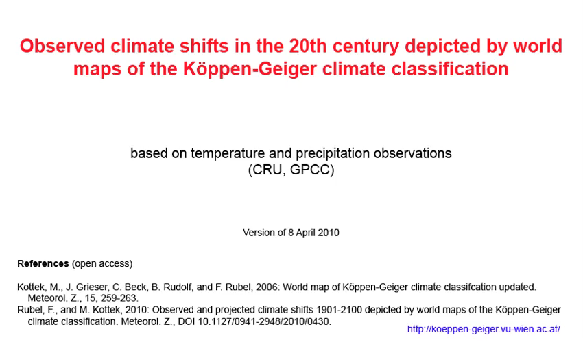
GLOBAL SOIL EROSION MODELS vs GLOBAL CLIMATE SCENARIOS FROM 1926 TO 2025:
A CRITICAL REVIEW (Dimotta et al., 2018 - in peer-review)
VIDEO: World map of observed climate shifts from 1901 to 2000
(Kottek et al., 2006; Rubel & Kottek, 2010)

Slide 33
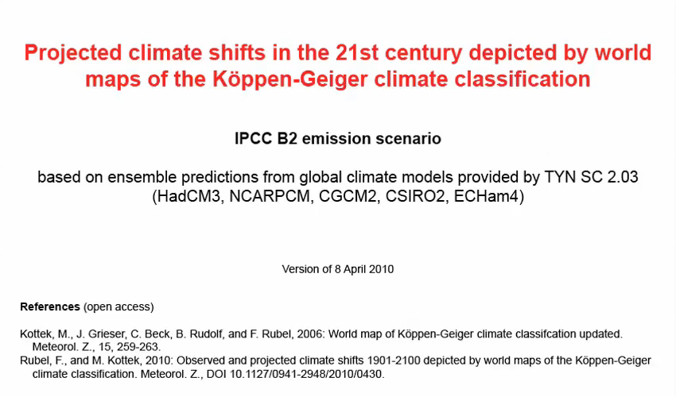
GLOBAL SOIL EROSION MODELS vs GLOBAL CLIMATE SCENARIOS FROM 1926 TO 2025:
A CRITICAL REVIEW (Dimotta et al., 2018 - in peer-review)
VIDEO: World map of projected climate shifts from 1976 to 2100 – B2 emission scenario
(Kottek et al., 2006; Rubel & Kottek, 2010)

Slide 34
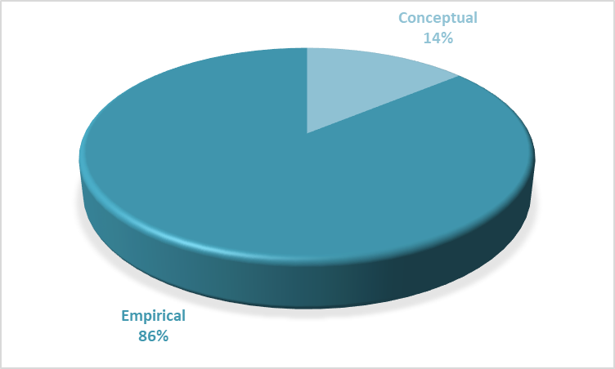
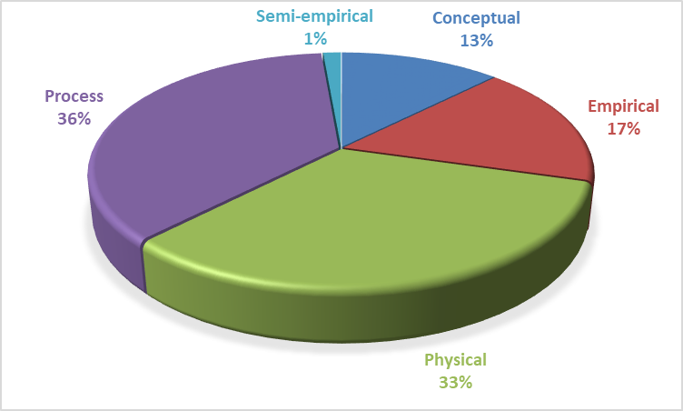
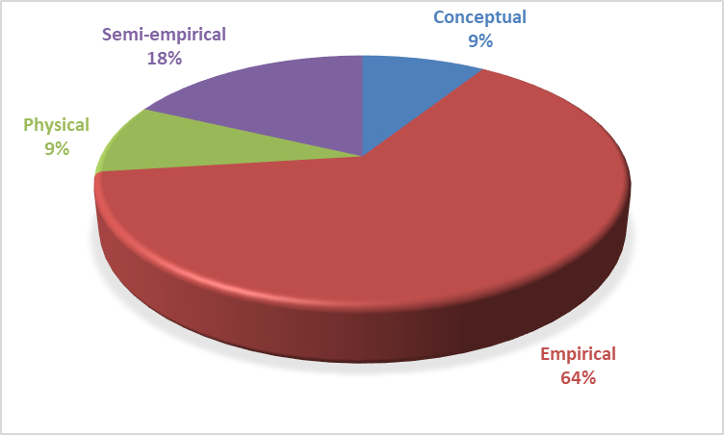
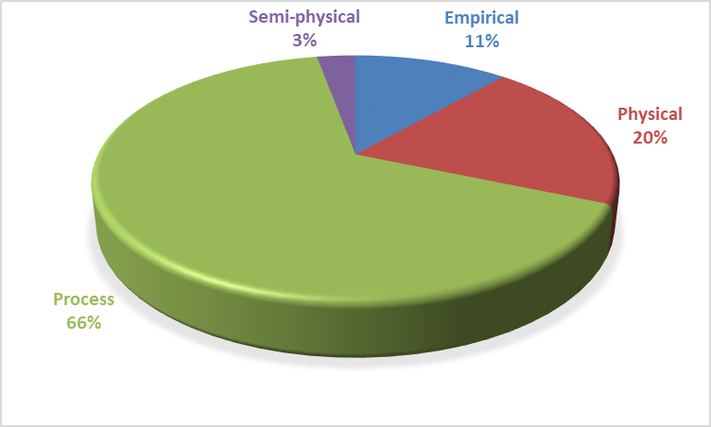
GLOBAL SOIL EROSION MODELS vs GLOBAL CLIMATE SCENARIOS FROM 1926 TO 2025:
A CRITICAL REVIEW (Dimotta et al., 2018 - in peer-review)
RESULTS:
Percentage of SEMs types development VS climate shifts: 1926-1950; 1951-1975; 1976-2000; 2001-2025

Slide 35
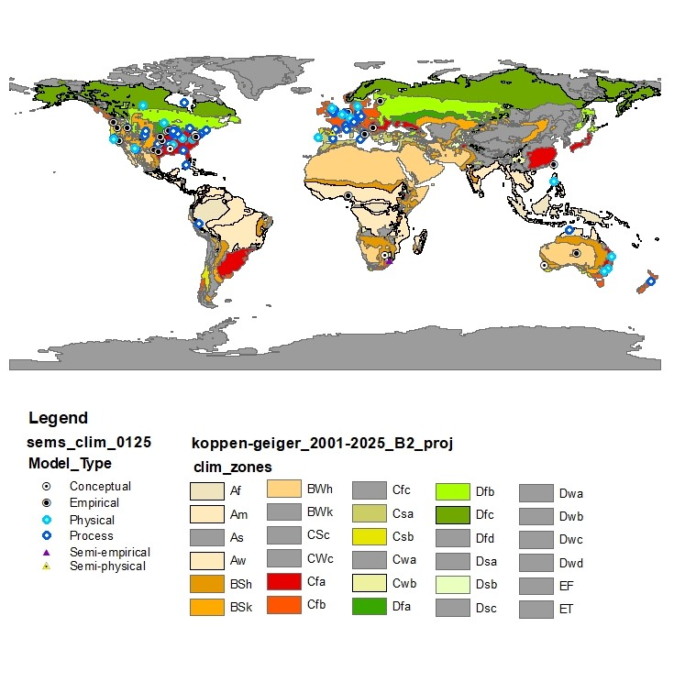
GLOBAL SOIL EROSION MODELS vs GLOBAL CLIMATE SCENARIOS FROM 1926 TO 2025:
A CRITICAL REVIEW (Dimotta et al., 2018 - in peer-review)
RESULTS:
World map of SEMs development sites VS climate zones from 2001 to 2025
DATA CROSSING SURVEY aimed at evaluating
the most characterizing climate zones
exposed to the SEMs development
from 1926 to 2016 with forecasts until 2025.
In relation to the resulting framework,
the CLIMATE ZONES –
by Köppen-Geiger classification –
emerged are:
Cfa =
warm temperate climate, fully humid with hot summer
Cfb =
Warm temperate climate, fully humid with warm summer

Slide 36
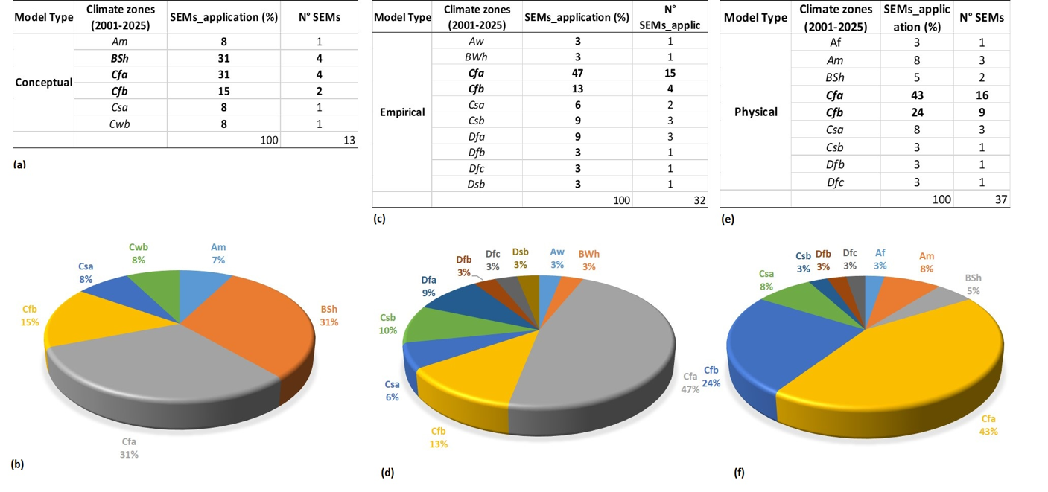
GLOBAL SOIL EROSION MODELS vs GLOBAL CLIMATE SCENARIOS FROM 1926 TO 2025:
A CRITICAL REVIEW (Dimotta et al., 2018 - in peer-review)
DATA CROSSING RESULTS: Soil Erosion Models (SEMs) typologies (1936-2016)
VS climatic trends (2001-2025) by Köppen-Geiger
Climate zones most exposed to the SEMs development

Slide 37
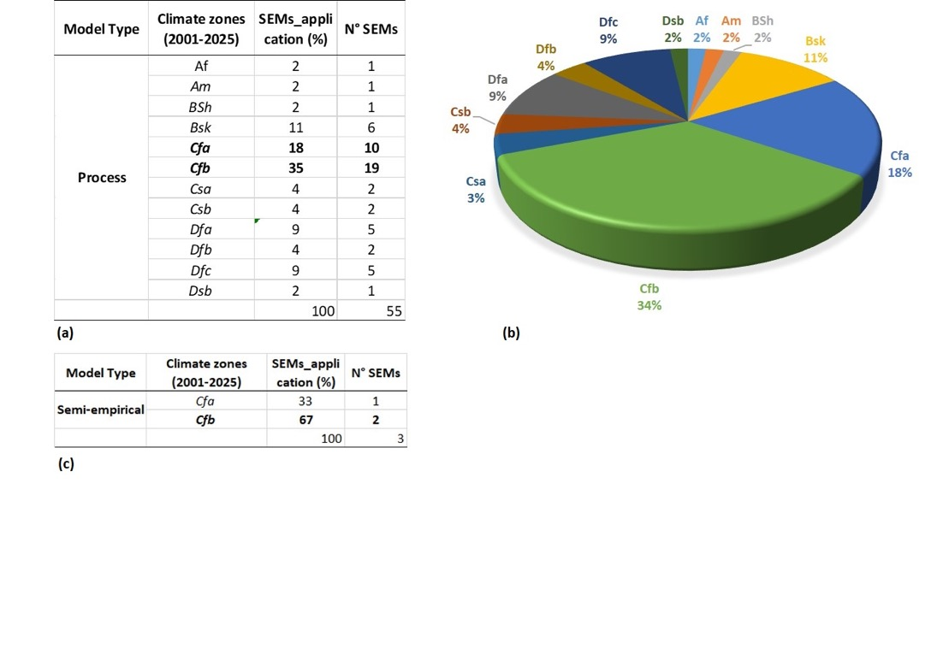
GLOBAL SOIL EROSION MODELS vs GLOBAL CLIMATE SCENARIOS FROM 1926 TO 2025:
A CRITICAL REVIEW (Dimotta et al., 2018 - in peer-review)
DATA CROSSING RESULTS: Soil Erosion Models (SEMs) typologies (1936-2016)
VS climatic trends (2001-2025) by Köppen-Geiger
Climate zones most exposed to the SEMs development

Slide 38
GLOBAL SOIL EROSION MODELS vs GLOBAL CLIMATE SCENARIOS FROM 1926 TO 2025:
A CRITICAL REVIEW (Dimotta et al., 2018 - in peer-review)
DISCUSSION & FINAL REMARKS
SOIL EROSION MODELS
(1936-2016)
Vs CLIMATE SCENARIOS (1930s-2025)
Global distribution
from 1936 to 2016
141 models
(proposed, developed and implemented)
RELATIONSHIPS BETWEEN SEMs and CLIMATIC TRENDS
2001-2025
CLIMATE ZONES interested by SEMs development:
BSh = Steppe climate with hot steppe
Cfa = warm temperate climate with fully humid with hot summer;
Cfb = warm temperate climate, fully humid with warm summer
What are
the climate zones much more soil erosion-prone from 2001 to 2025?
HUMID-SUBTROPICAL CLIMATE
Cfa – Cfb

Slide 39
For Further Insights & References
Dimotta A., Cozzi M., Romano S., Lazzari M. (2016). Soil Loss, Productivity and Cropland Values GIS-Based Analysis and Trends in the Basilicata Region (Southern Italy) from 1980 to 2013. In: Gervasi O. et al. (eds) Computational Science and Its Applications -- ICCSA 2016. Lecture Notes in Computer Science, Part IV, vol 9789. Springer, Cham. https://doi.org/10.1007/978-3-319-42089-9_3
Dimotta A., Lazzari M., Cozzi M., Romano S. (2017). Soil Erosion Modelling on Arable Lands and Soil Types in Basilicata, Southern Italy. In: Gervasi O. et al. (eds) Computational Science and Its Applications – ICCSA 2017. ICCSA 2017. Lecture Notes in Computer Science, vol 10408. Springer, Cham. https://doi.org/10.1007/978-3-319-62404-4_5
Kottek, M., J. Grieser, C. Beck, B. Rudolf, and F. Rubel (2006). World Map of the Köppen-Geiger climate classification updated. Meteorol. Z., 15, 259-263. DOI: 10.1127/0941-2948/2006/0130.
Rubel, F., and M. Kottek, (2010): Observed and projected climate shifts 1901-2100 depicted by world maps of the Köppen-Geiger climate classification. Meteorol. Z., 19, 135-141. DOI: 10.1127/0941-2948/2010/0430.
…NEXT SUBMISSION ON…: N.2 CRITICAL REVIEWS
Dimotta A., Lazzari M., Romano S. (2018). Global Soil Erosion vs Global Climate Scenario from 1926 to 2025: a Critical Review. (in peer-review from supervisor: Dr. Joris de Vente, CEBAS-CSIC, Soil and Water Conservation Group, Murcia (Spain) – next submission on Earth-Science Reviews).
Dimotta A., Lazzari M., Romano S. (2018). Global Soil Erosion Costs of the ON-site and OFF-site Impacts: a Critical Review of Economic Assessment Methods from 1930s to 2016. (next submission on Ecological Economics/Environmental Impact Assessment Review).

Slide 40

THANK YOU VERY MUCH!
antonella.dimotta@unibas.it

