Slide 1
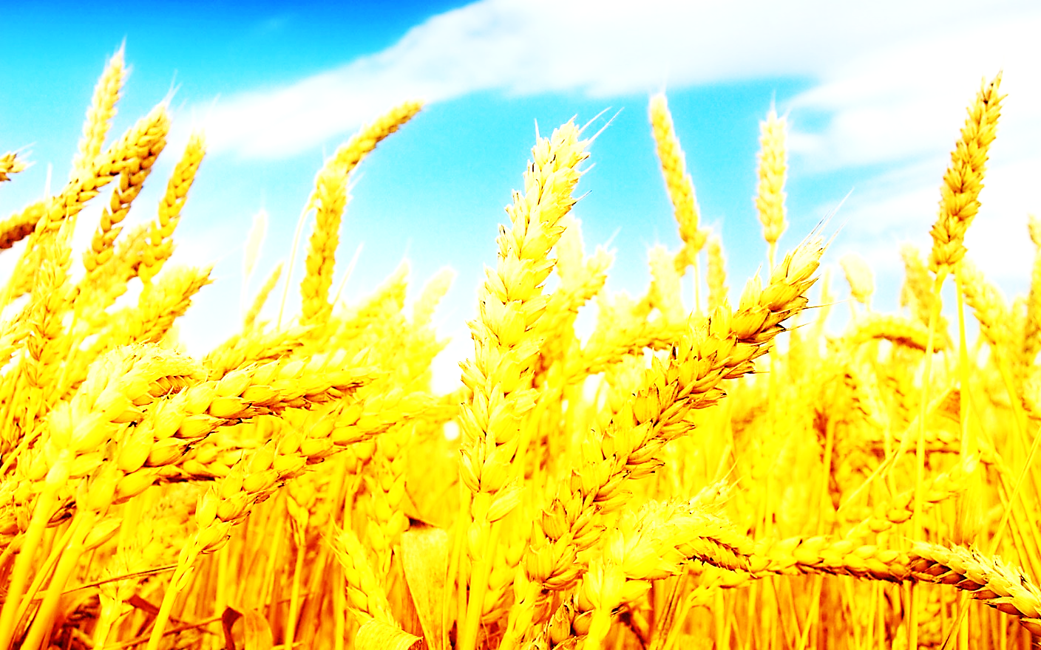
اثرات تغییرات آب و هوای کواترنری پسین بر محصولات زراعی ایران
The effects of the Late Quaternary climate change on Iran’s crops
The Effects of the Late Quaternary climate change on Iran’s crops

Slide 2
Homa Rostami, Ph.D Climatology
Ghasem Azizi, Ph.D Climatology
Sahar Maleki, Ph.D Climatology

Slide 3
Introduction
Climate can be a major factor to change landscapes. Different climatic events in different parts of the world have had different effects. For example, during the cold climatic event of the Younger Dryas, when Europe was affected by long winters and glacial conditions, in southern areas, such as Levant, there were better conditions for living.
Sudden completion of the relatively warm and desirable period of the Pleistocene climate in these regions caused shortages of food supplies.
Hunter gatherer people looked for durable food sources in areas where had enough water and and other food available, so little by little, sedentary life style was developed and then agriculture, and Neolithic cultures arose.
Many plants were domesticated in the same period, domestication of cereals and grains were associated with many changes in appearance, morphology, size, and even DNA.

Slide 4
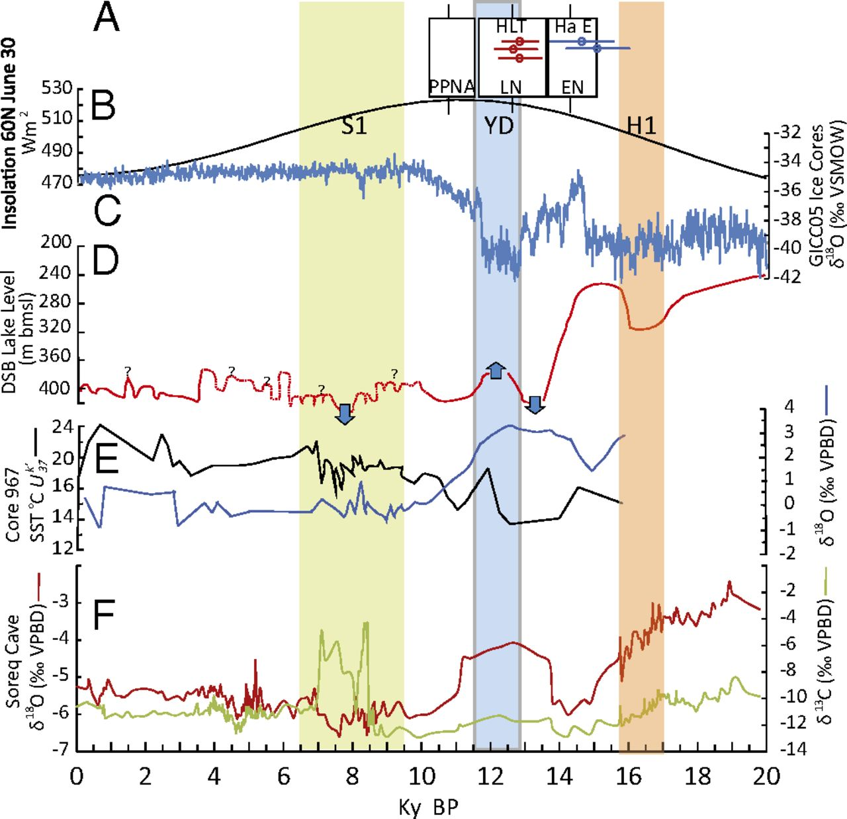
Global and regional paleoclimate records for the past 20,000 y. (A) The chronology of EN, LN, and Prepottery Neolithic A (PPNA) cultures in the southern Levant based on calibrated 14C dates (14); individual calibrated (OxCal13) radiocarbon dates of HLT (red symbols ± 1σ) and HC EN (blue symbols ± 1σ). (B) Calculated Northern Hemisphere insulation at 60°N (22). (C) Composite Greenland ice core oxygen isotope (δ18O) values provide a proxy for paleotemperature (21). (D) DSB lake level reconstruction (24). (E) Eastern Mediterranean reconstruction of SST using alkenone unsaturation ratio (Uk’37) and Globigerinoides ruber δ18O values (23). (F) Soreq Cave speleothem record (3). S2 is a sapropel formation event in the Eastern Mediterranean Sea; YD is the Younger Dryas; and H1 is a Heinrich Event(Hartman et al.2016).

Slide 5
In the past, human beings were aware of the seeds of grasses, which, by collecting them, could save their food in the event of migration, in addition to daily subsistence.
The correct selection of seeds with higher amounts of flour has led to the selection of cereal species.
There is no clear history for each individual cereal, but it's time to start of wheat farming more than 10,000 years ago.
Agriculture was developed in the Fertile Crescent region and reached the rest of the world.
It is accepted that agriculture had multiple ‘centers of origin’ within southwest Asia (Salamini et al. 2002; Fuller et al. 2012; Willcox 2013).

Slide 6
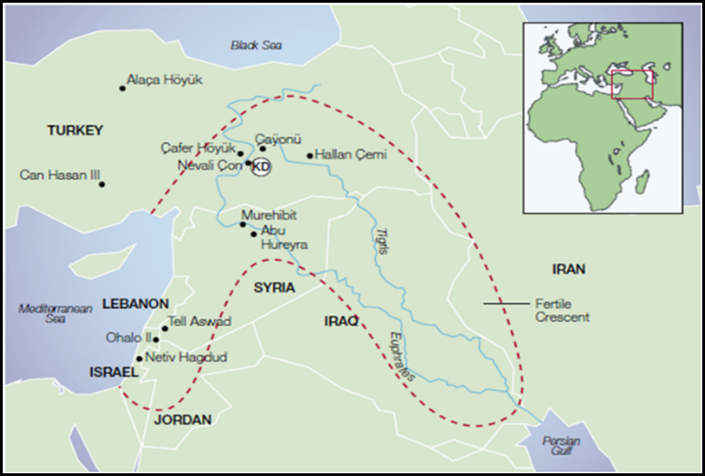
Methods:
In this study we focused on western Iran especially the central Zagros region. Because this region was the main part of Fertile Crescent in Neolithic period.

Slide 7
We investigated 3 main Neolithic sites. The plant macro-remains analyzed for this study were collected from deposits across all trenches.
Identifications were made according to morphological characteristics,
Including: surface texture and size, and verified by comparison to modern reference material.
Archaeological specimens were compared to both modern uncharred and modern charred material wherever possible, to take into account the the potential effects of charring on seed morphology.
Plant remains were quantified using the principle of recording the ‘minimum number of individuals’ (MNI) following Jones (1991). Taxonomy follows modern convention.

Slide 8
Our 3 main sites:
1- Sheikh e Abad
2-Tape Ganj Darreh
3- tape Alikosh
Then we recognized the nearby, Hashilan wetland.
We took sedimentary cores for pollen analysis for use in:
vegetation history
paleoclimate reconstruction

Slide 9
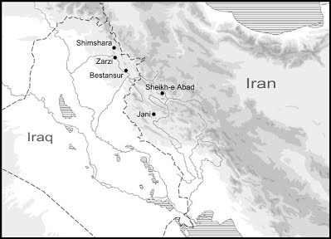
1- Sheikh e abad:
The importance of these sites lies in:
early date and long occupation spanning c. 9800-7600 cal BC
location on the most important route-way through the Zagros, later the Silk Road.
The Zagros mountain region and 'hilly flanks' are of major importance to the study of early sedentism and the origins of agriculture, as a heartland of wild animals and plants that were later domesticated.
Research here in the 1950-60s was seminal in developing theories on the Neolithic transformation (Braidwood 1961).
Principal among these was a proposed 'broad-spectrum revolution' in use of plant and animal resources (Flannery 1969).

Slide 10
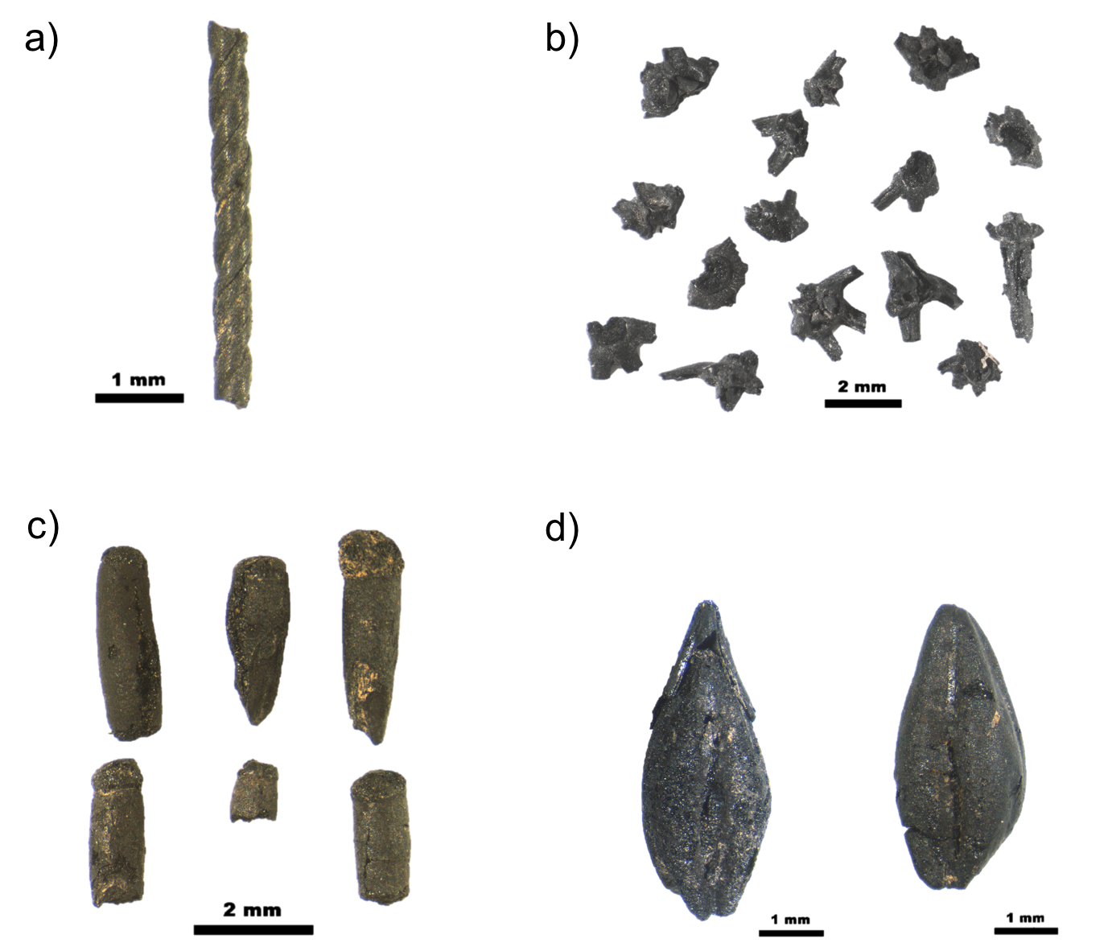
Examples of major wild grass taxa from Sheikh-e Abad as mentioned in text
Stipa awn fragments;
Taeniatherum caput-medusae rachis;
Stipa grains - all showing morphological evidence consistent with being ground for consumption prior to charring,
d) Piptatherum holciforme grains charred in their chaff and showing a distinctive tapering appearance
Refrence: Matthews et al,2016

Slide 11
Tape Ganj Dareh - The oldest settlement remains on the site dated to ca. 10,000 years ago, and has yielded the earliest evidence for goat domestication in the world.
Ganj Dareh -located in the Harsin County in east of Kermanshah Province, in the central Zagros Mountains.

Slide 12
Tape Ali Kosh:
Ali Kosh is an archaeological site of the Neolithic period located in Ilam Province in west Iran, in the Zagros Mountains. The site is about 135 m in diameter.
Research has found three phases of occupation of the site over an almost 2,000 period, starting from about 9,500 years ago (7500 BCE), it was occupied by pre-pottery peoples.

Slide 13
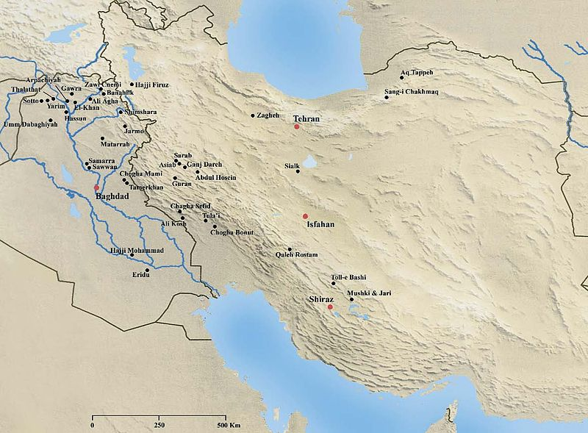
Ganj Dareh
Ali Kosh

Slide 14
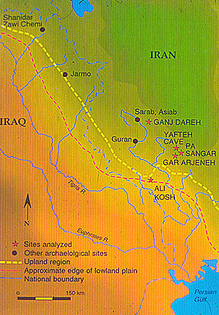

Slide 15
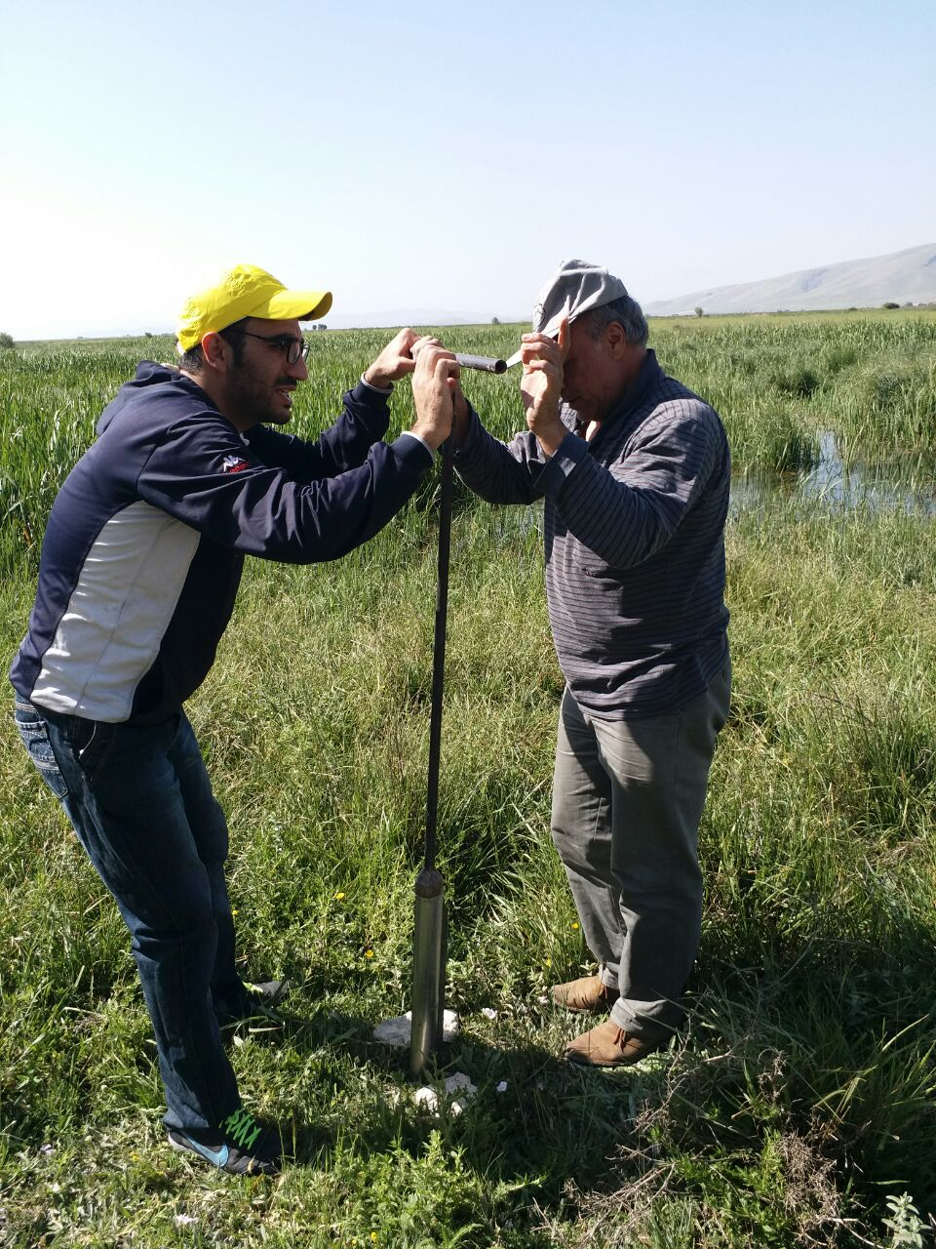
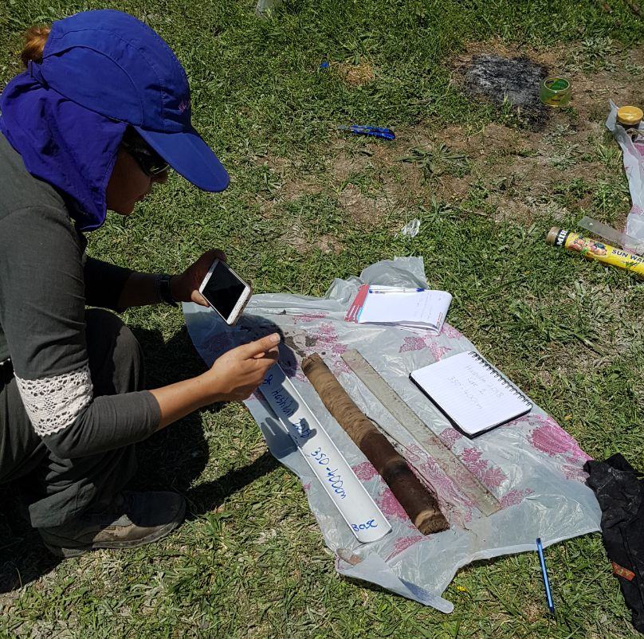
We took sedimentary cores for palynology and paleo- environment reconstruction

Slide 16
Results:
After study of the findings from the three main Neolithic sites and the results of palynological analysis, we find that:
From the Younger Dryas until the late Holocene, grain size, width and thickness of crops has increased, except for wheat. Wild wheat had taller and longer grain seeds than domestic wheat. Domesticated wheat seeds are tighter and harder than wild wheat seeds.
Due to various climatic events, the proportion of grasses and wild plants has been constantly changing.
Barley seeds found in archaeological sites were older than wheat grains.
But wheat seeds were domesticated earlier than barley seeds, suggesting that barley was more important than wheat during the earlier period.

Slide 17
شیخی آباد
این سایت نوسنگی در دشت صحنه در یک دره مرتفع(1430 متر از سطح دریا)،در 60 کیلومتری شمال شرقی کرمانشاه قرار دارد.سن یابی کربن 14 این سایت نشان دهنده قدمت 11800-9600 ساله آن است.بقایای فراوان زغال چوب نشان دهنده وفور درخت و درختچه بوده بیشتر بقایای گیاهی یافت شده علفها و لگوم ها بودند،بقایای جو وحشی در ترانشه 2 و 3 یافت شد،سن یابی کربن 14 در این بخش قدمت 10180-9680 سال دانه های گندم قبل را نشان میدهد. دانه های گندم در ترانشه 2 یافت شد ،وجود حفره و شکافهایی در لگومهای بزرگ احتمالا مبین وجود آفات و بیماریهای غلات است.

Slide 18
During the Anathermal of the Holocene (10000-6000 years ago) precipitation increased.
Gramineae was replaced by Chenopodiaceae and almond and Pistacia atlantica. This change in vegetation indicates an increase in precipitation.
In the Zagros mountains 7000 years ago pistachio trees occurred, which represent dry climate in early Holocene in this area.
During the mid Holocene moisture increased and vegetation changed to Oak-Pistachio forests.
In the early Holocene in western regions of Iran winter rainfall increased, but summers were,
About 6000 years ago during the mid Holocene there was warm and humid climate in this region, and oak forests expanded.
In western Iran, almond and pistachio forests were more abundant than oak forests. This indicates that humidity in spring and summer was greater than other seasons during early Holocene.

Slide 19
During the early Holocene, Artemisia and Chenopodiaceae decreased and Gramineae increased. So we can conclude that humidity in spring and summer have increased but not enough to grow oak trees. However, almond and pistachio trees grew well.
Precipitation required for the growth of almond and pistachio forests is about 300 mm but for oak forest it is 500 mm.
The evidence indicates that climate during the early Holocene in the southern Zagros mountains was dry and hot.
Between 8170 to 7570 years ago Gramineae decreased around Parishan lake and cold resistant plants such as Cousinia, Umbelliferae and Cichorioideae predominated. During this period dry climate predominated and summer precipitation had decreased.
About 7570 to 5600 yeras ago oak forests expanded as well as almond and asparagus trees in the southern Zagros. During this period humid climate predominated.
In western and southern parts of Iran, between 5600 to 2700 years ago the climate was warm and humid.

Slide 20
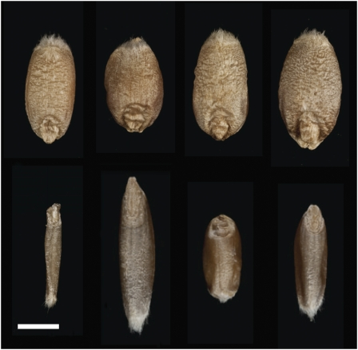
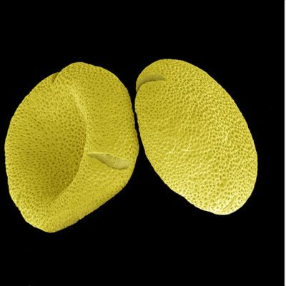
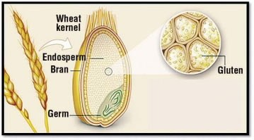
Thank You

