Slide 1
ARCHAEOLOGICAL SURVEY DATA FOR ASSESSMENT OF PAST LAND USE: Archaeological Survey of the Upper Basentello Valley – The Iron Age Record
¹McCallum, Myles and Peter Wigand^{2,3,4.5} ¹Associate Professor in the Department of Modern Languages and Classics at Saint Mary's University in Halifax, Canada;
²Research Faculty, Graduate Program of Hydrological Sciences, and Graduate Faculty, University of Nevada, Reno, USA;
³Affiliate Associate Research Professor, Division of Ecosystem and Earth Sciences, Desert Research Institute, Reno, Nevada, USA;
⁴Graduate Faculty, California State University, Bakersfield, California, USA;
⁵Affiliate Graduate Faculty, Department of Anthropology, University of Nevada, Las Vegas, USA

Slide 2
BACKGROUND
Data on human activity has largely been obtained through traditional archaeological excavation and extensive regional survey. To date, excavations carried out at Monte Serico (Ciriello et al.), Vagnari (Small; Prowse; Carroll), and San Felice (McCallum, vanderLeest, et al.), alongside regional surveys undertaken on both sides of the Basentello River since the 1960s (Vinson; Small; McCallum and Hyatt), allow for some degree of informed speculation about the region’s settlement history, particularly since the Iron Age, and the types of settlements during these periods.
The most recent of these surveys, directed by the author, will form the basis of most of the subsequent discussion.
This pedestrian survey, part of the Basentello Valley Archaeological Research Project, or ‘BVARP’, was conducted in the summers of 2012 through 2015, and the fall of 2013.

Slide 3
The first part of the survey component is an extensive regional survey.
Extensive survey has been chosen in order to cover a substantial territory and therefore generate a relatively large and robust sample size that can be used to examine regional issues diachronically. In so doing, the team has eschewed artifact-centered methodologies.
The present research is aimed at identifying settlements, settlement densities and hierarchies, site catchments, and, where possible, differential craft and agricultural production. Particular attention is being paid to continuity from the pre-Roman to the Roman period in order to address potential cultural disruption related to the Roman conquest, the Hannibalic War, the Social Wars, and colonization.
In future seasons will include a limited program of intensive survey of previously identified scatters.

Slide 4
Survey Coverage:
Within the survey territory, which covers approximately 190 square kilometers, the aim is for total coverage, although this will not be entirely possible due to the presence of some large structures and a few densely wooded areas, such as the eastern slopes of the massif on which stands the town of Genzano di Lucania.
The goal is to cover all types of terrain during field walking, from valley bottoms to level plateaus and the steep sides of hills and ravines, and to survey all fields.
Where there is some degree of surface visibility, areas will be covered that are not regularly subject to plowing and that might be covered with vegetation.

Slide 5
For the moment, four categories of evidence are focus of our attention during the analysis of our preliminary results. They are as follows:
Artifact densities/Change in densities between periods; Densities are a proxy for understanding demographic change over time.
Total area of scatters/number of collection units per period; This will provide information about possible population size at sites or the greater the level of consumption.
The average and range of areas of scatters per period; This is important in creating a regional site hierarchy.
The range (functional and chronological) of artifactual material present within each scatter. This is a potential indicator of site function and may permit the assignment of function to differently sized sites during specific periods.

Slide 6
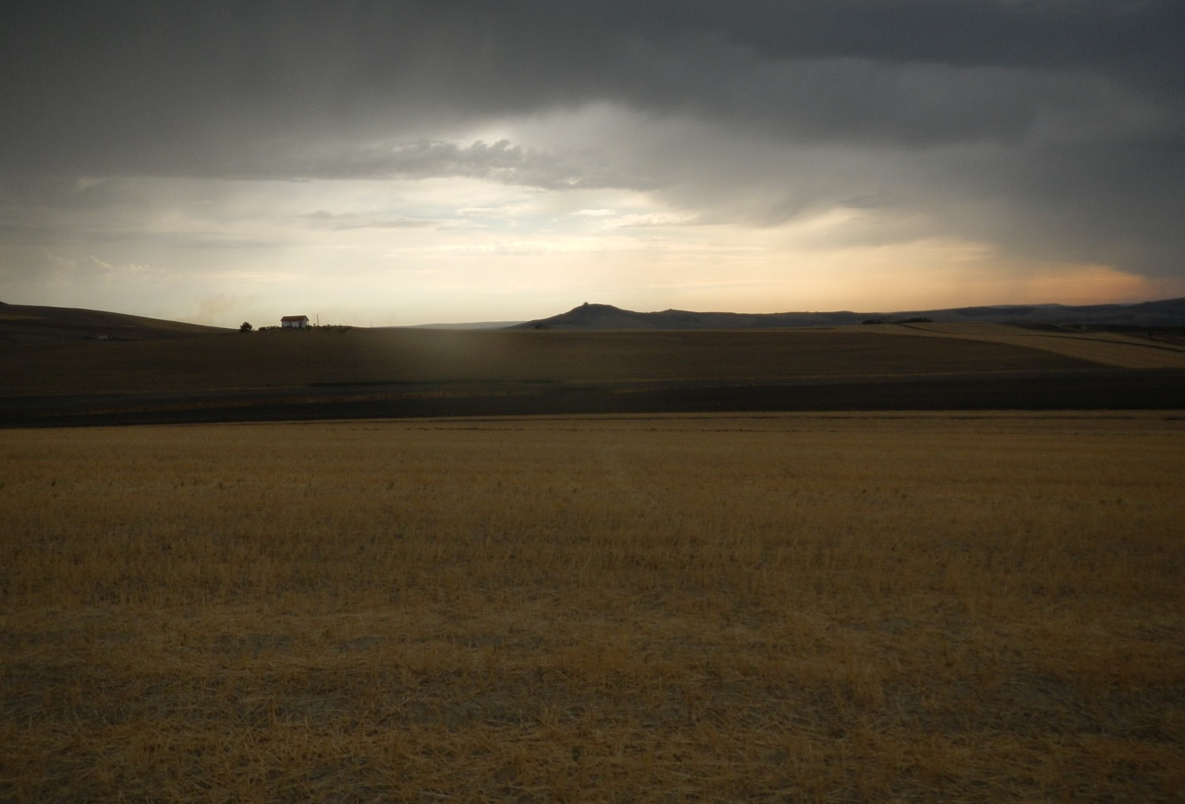
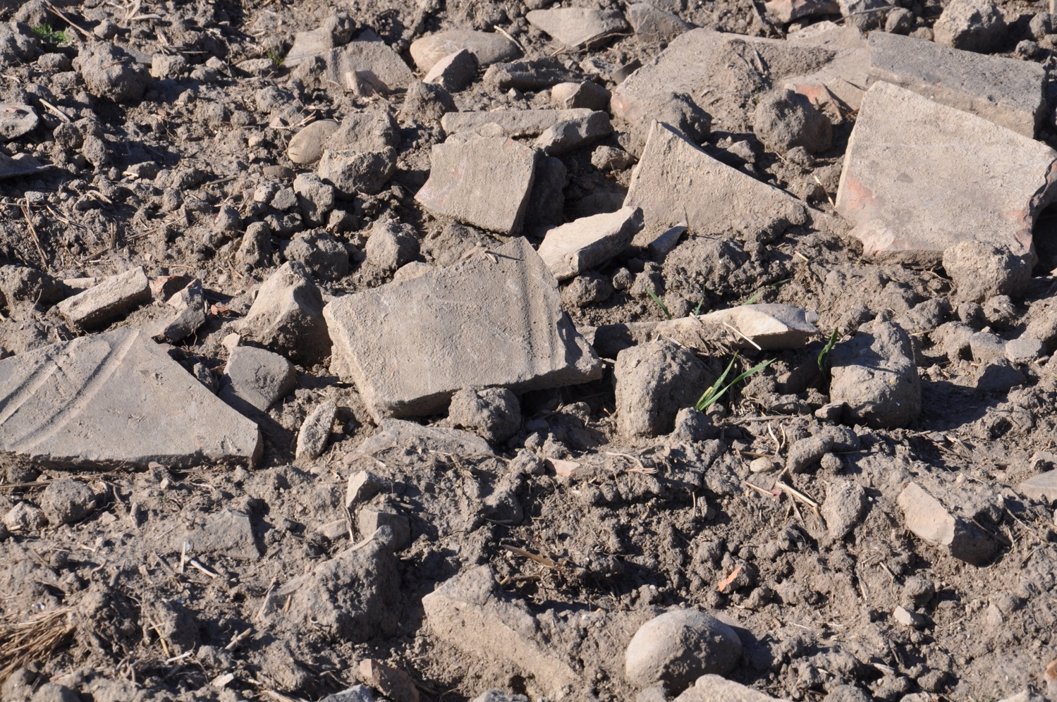
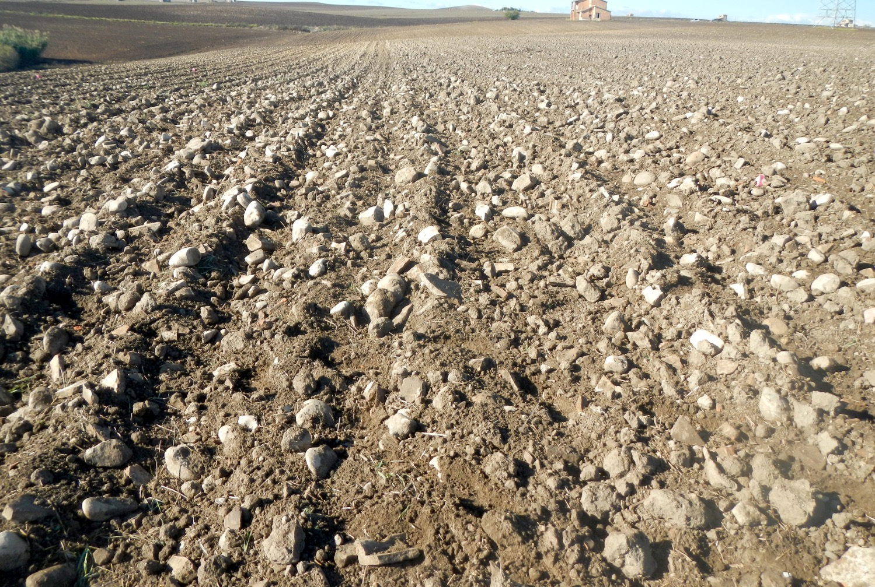
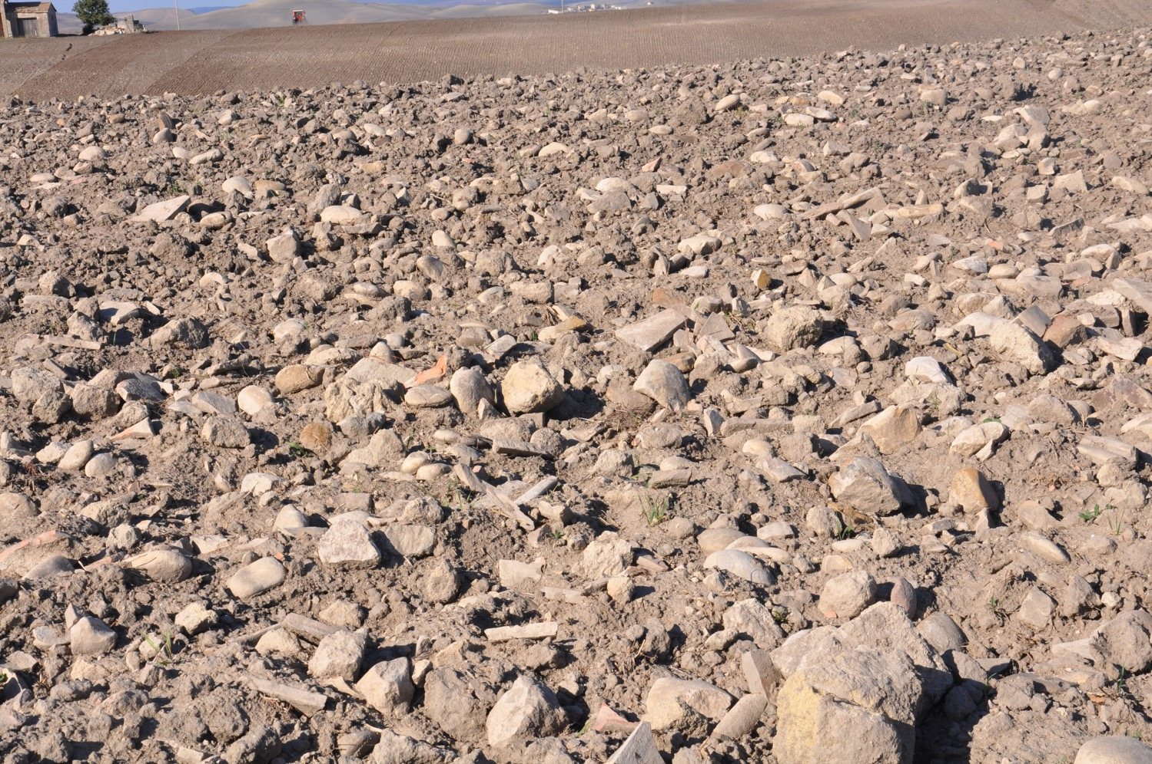
Increased Occupation with the Iron Age.

Slide 7
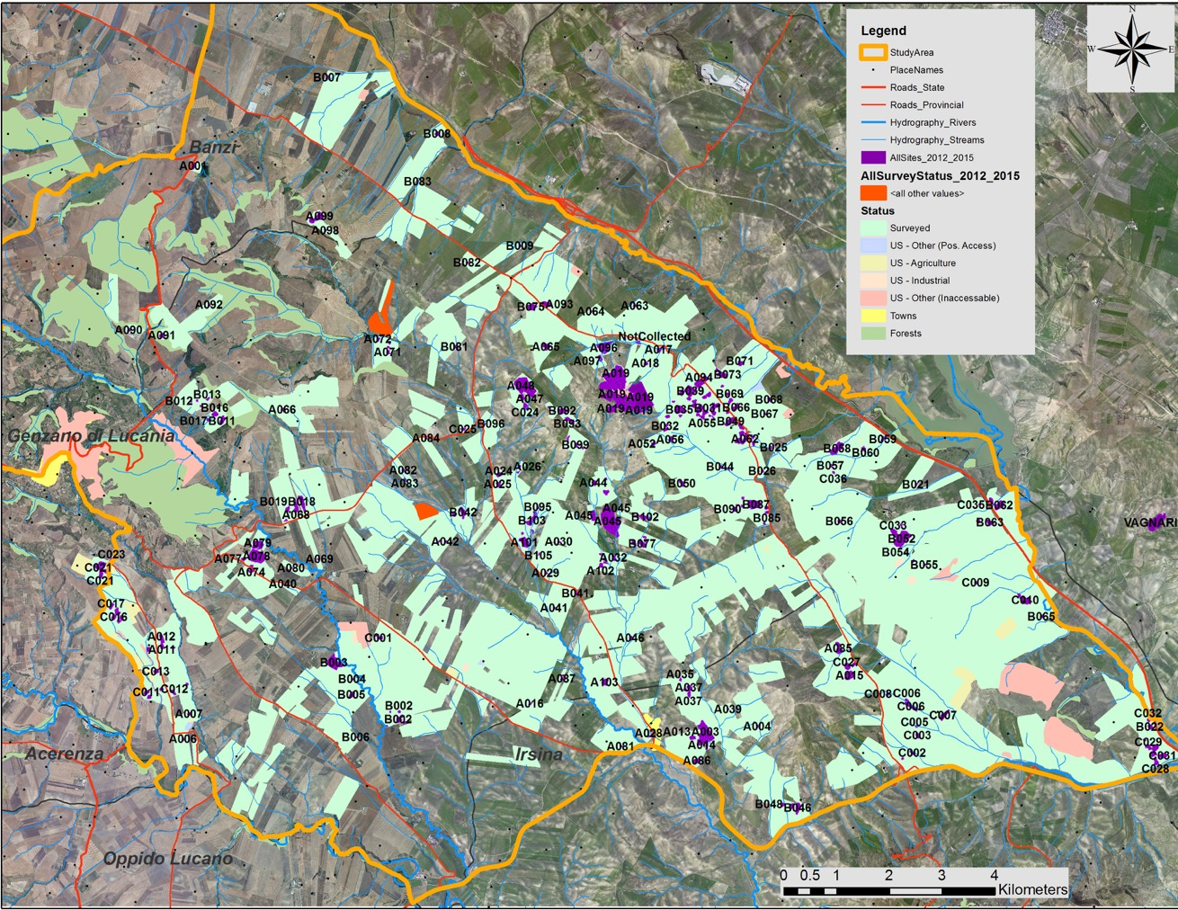
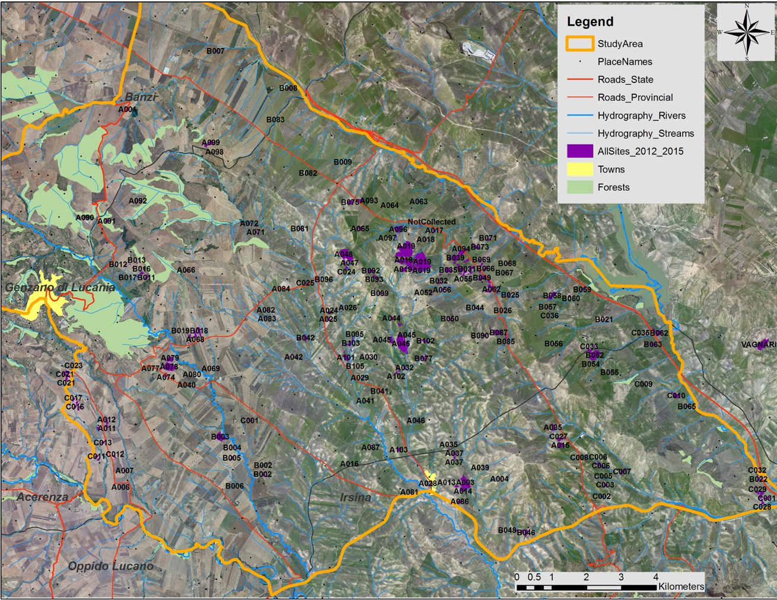
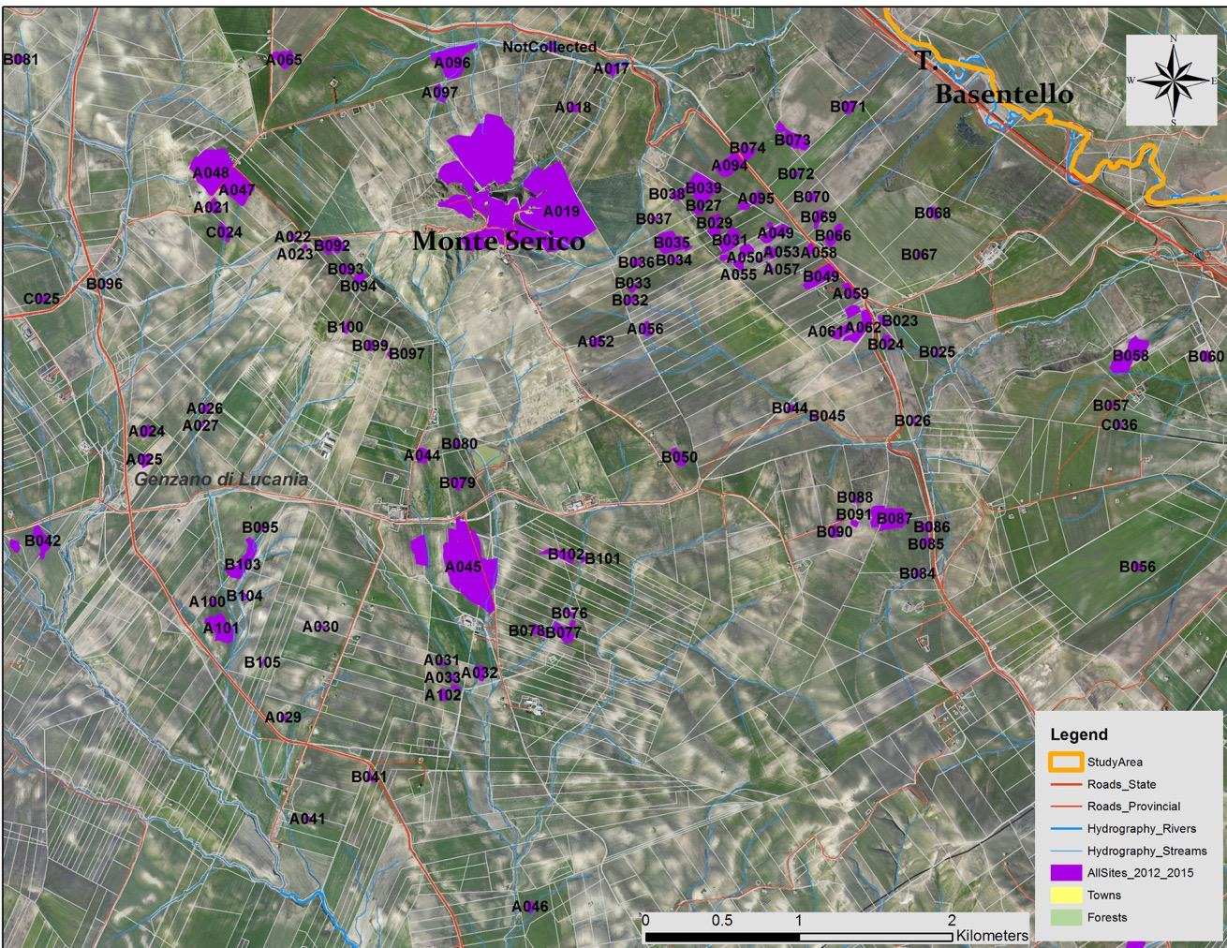
Basentello Archaeological Survey

Slide 8
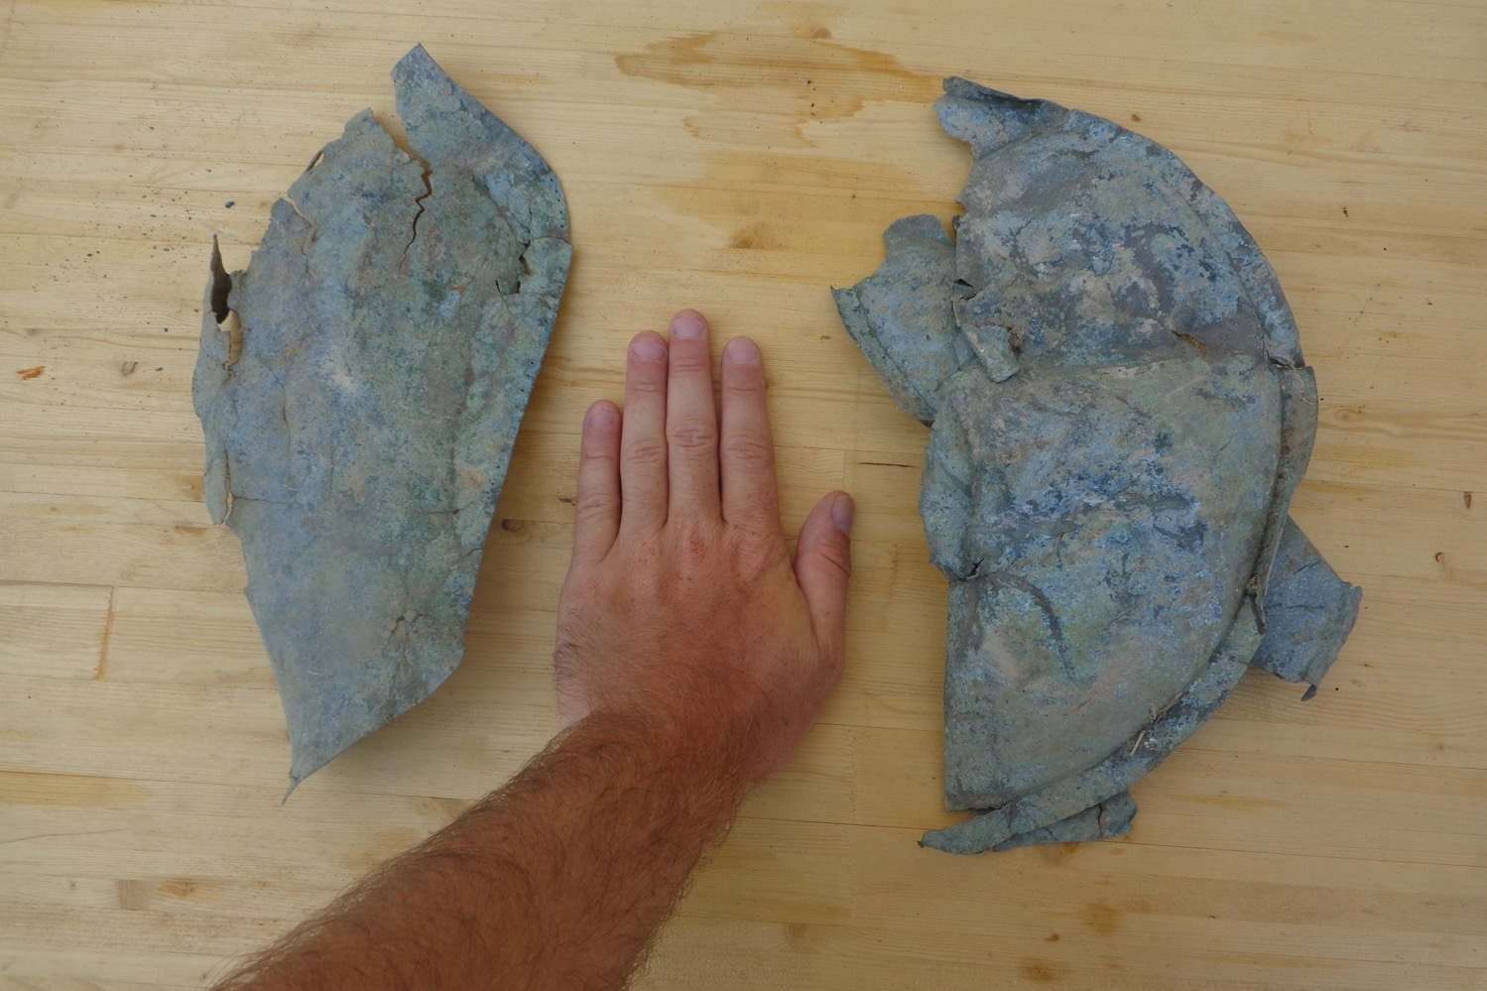
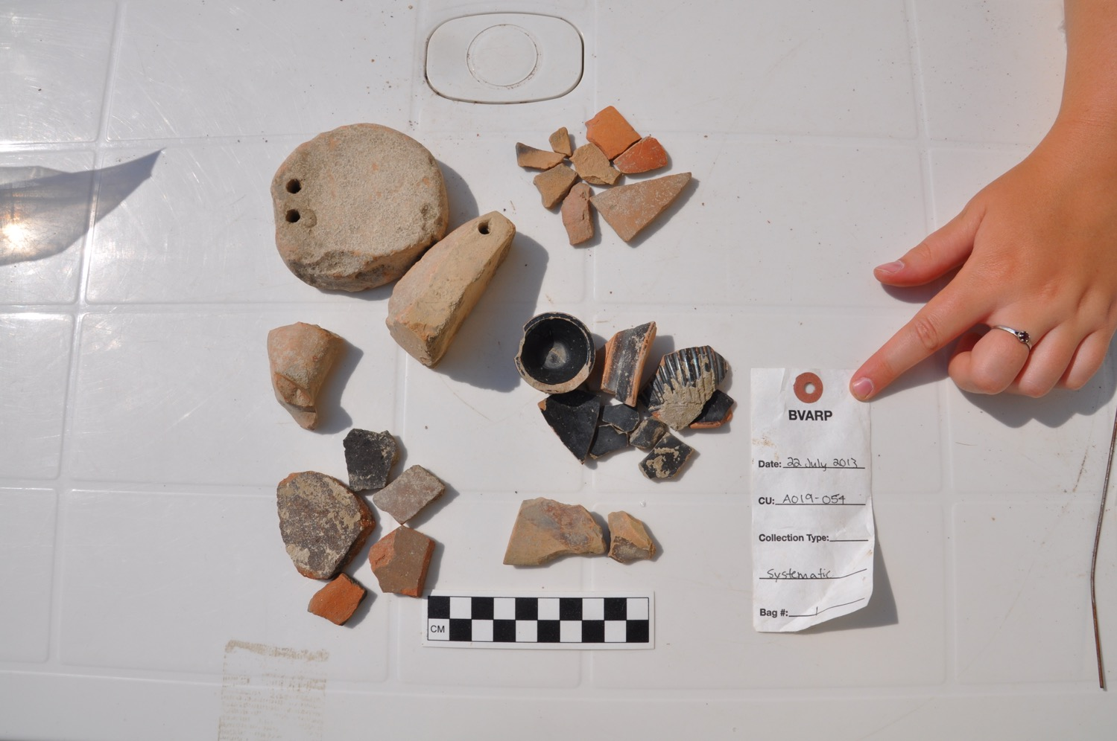
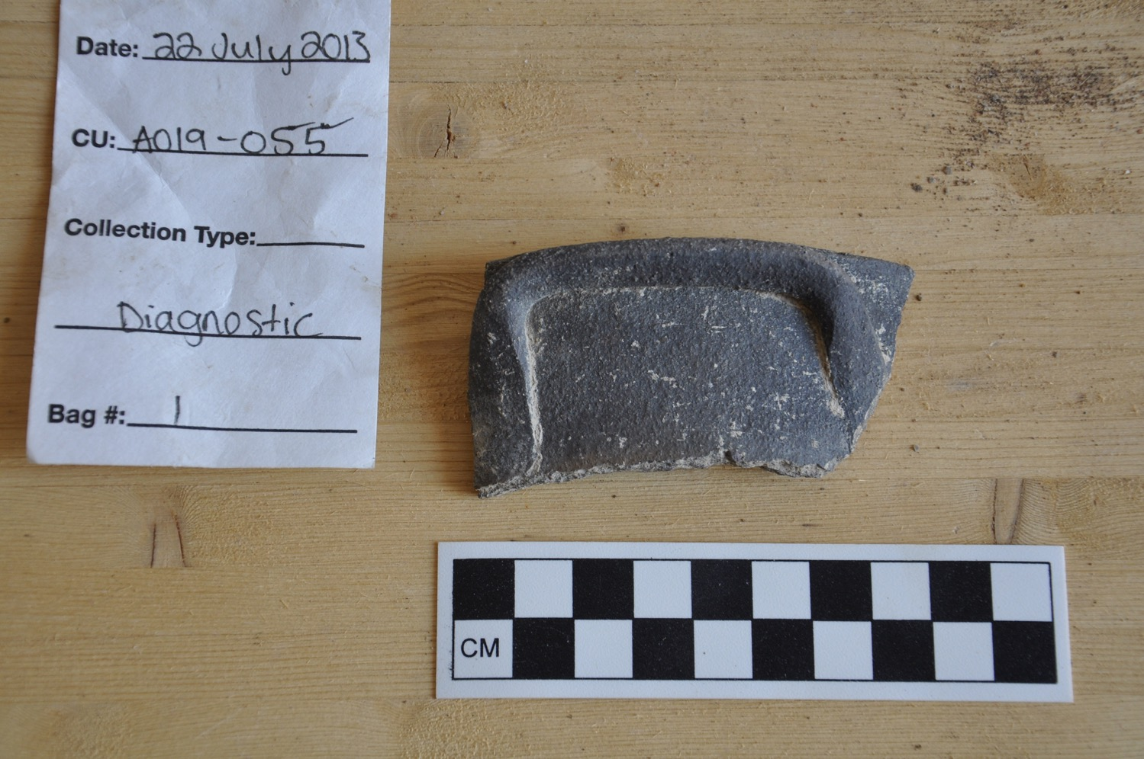
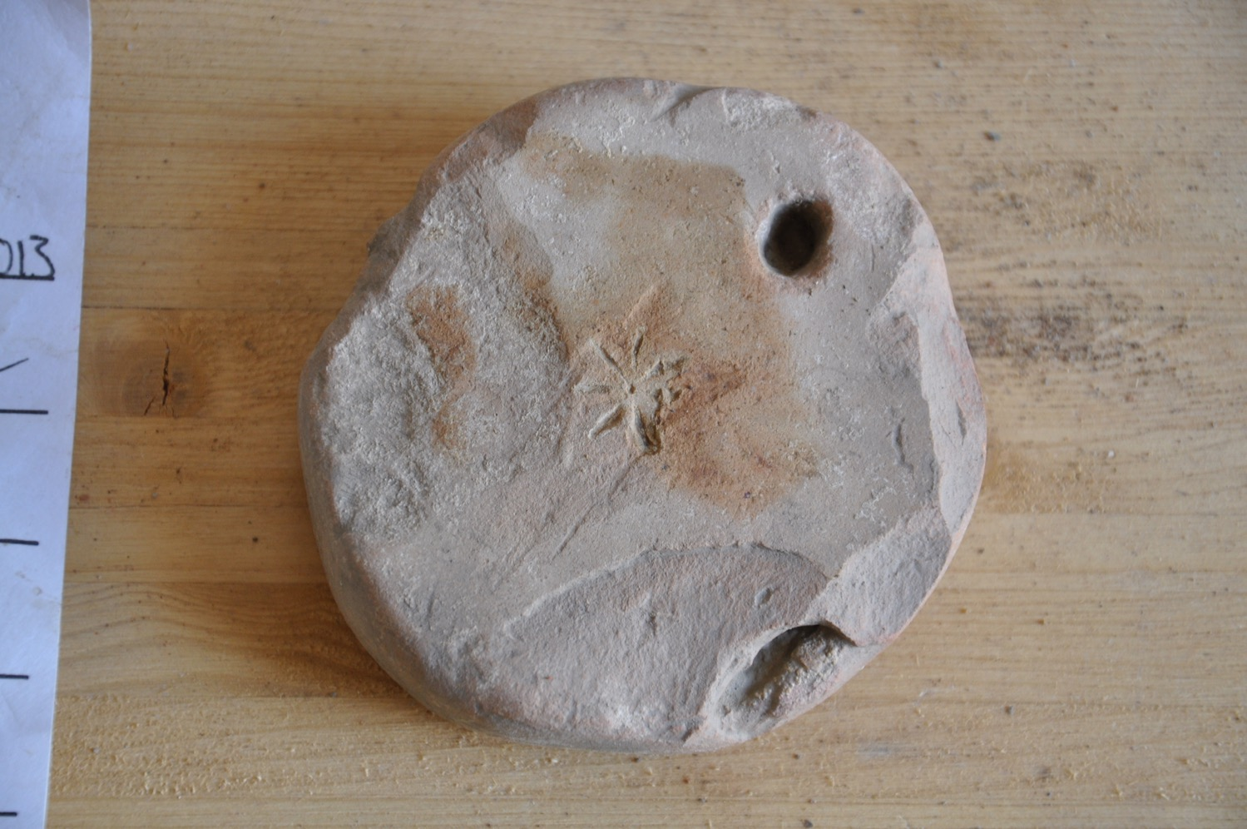
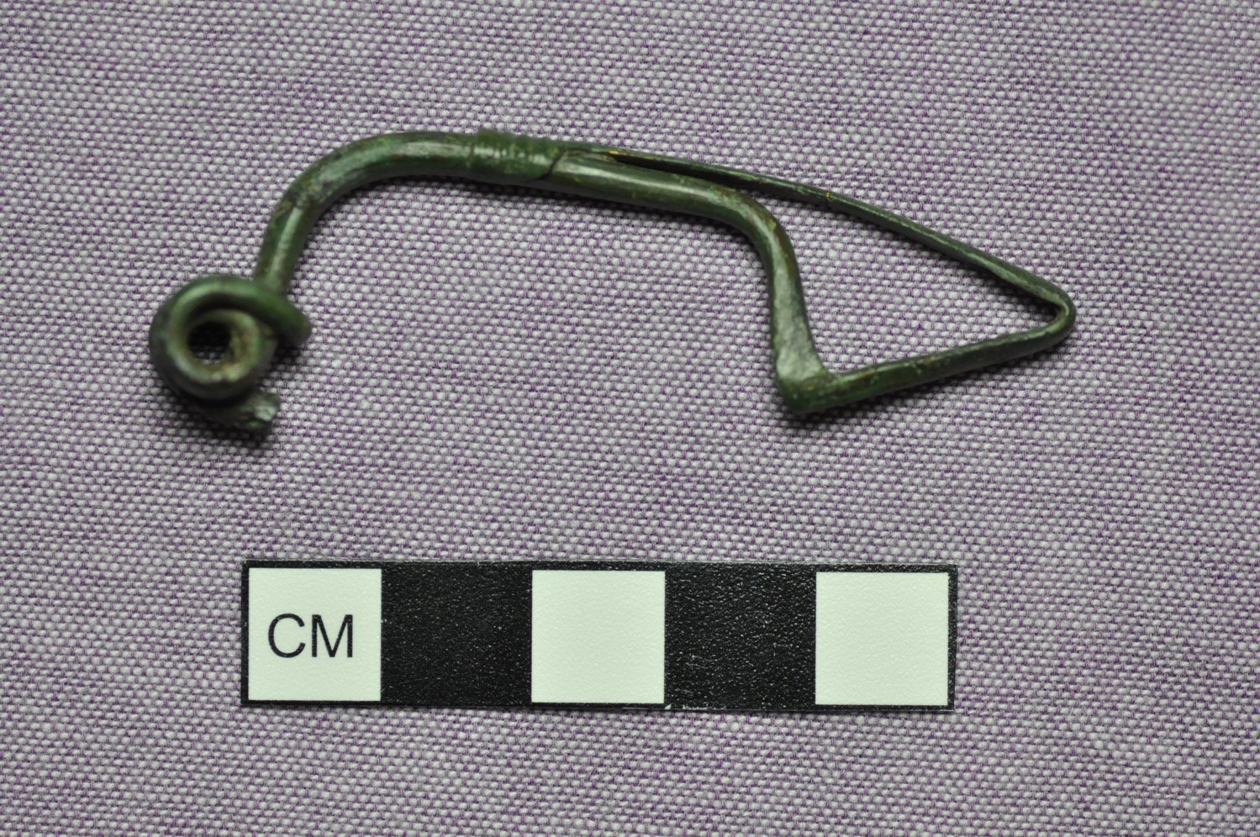
Diagnostic Artifacts

Slide 9
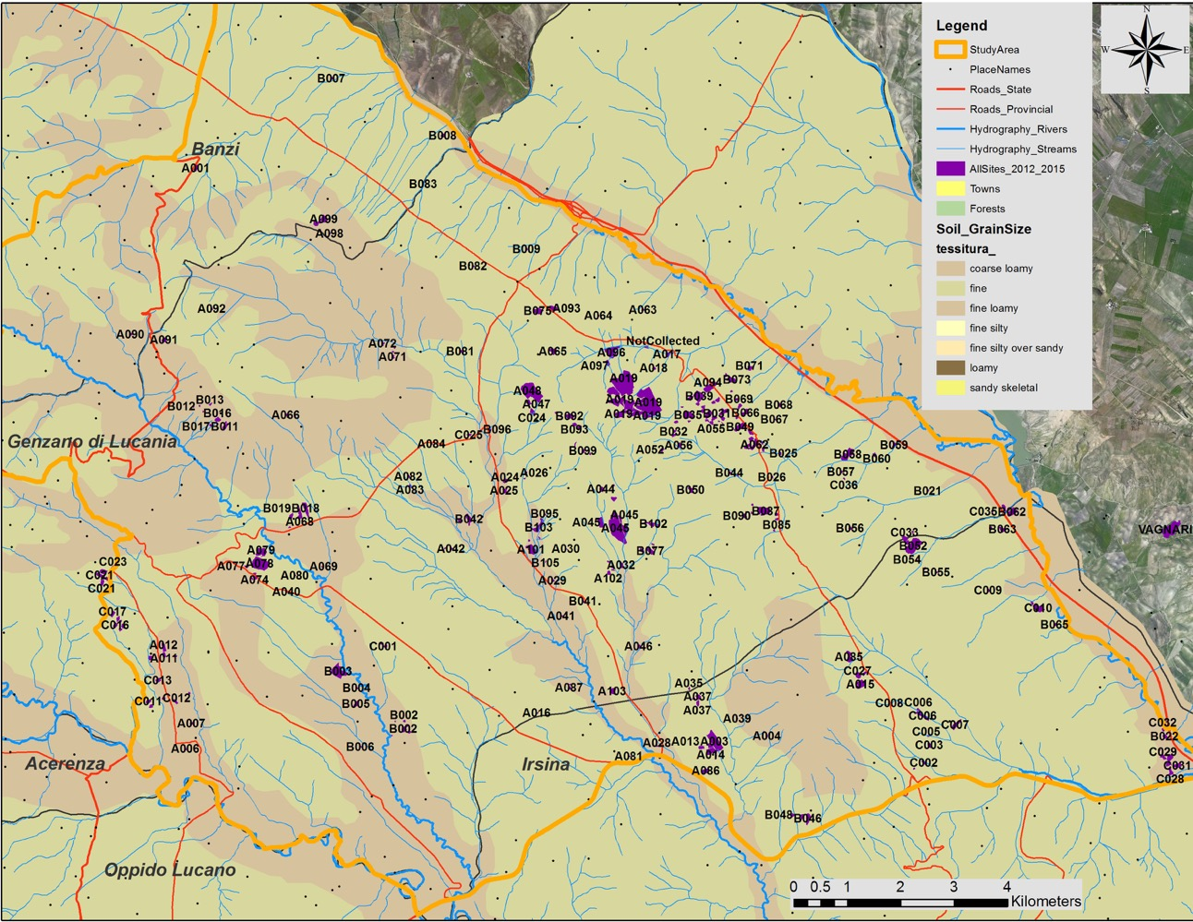
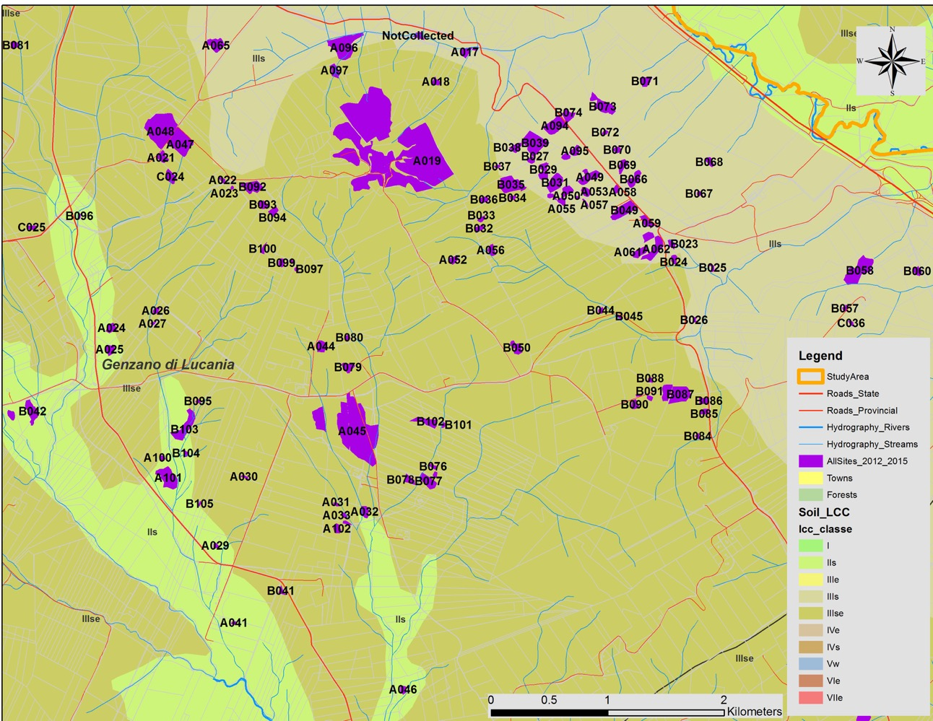
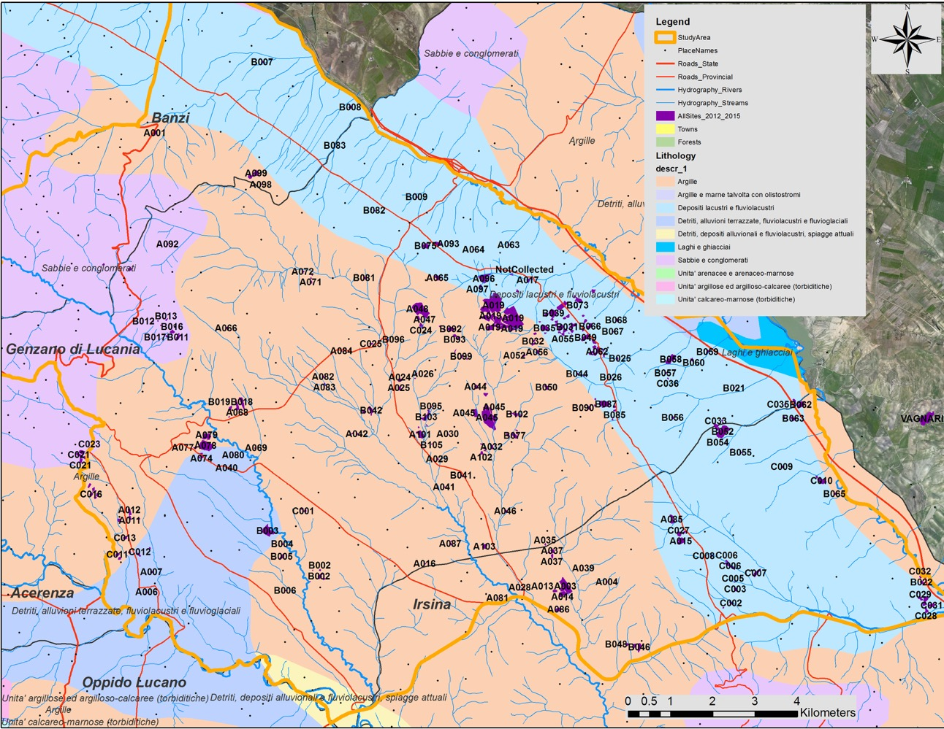
Site Loation with Respect to Soils

Slide 10
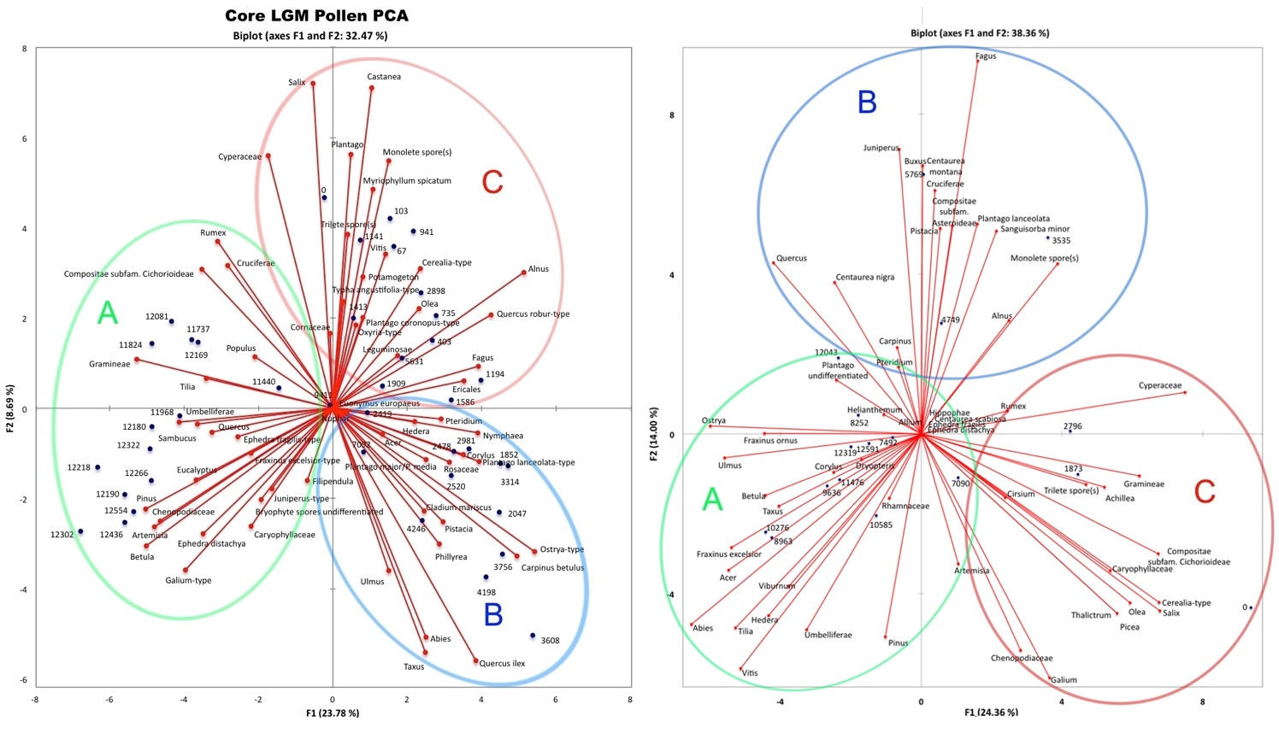
Holocene Pollen from Lago Grande Monticchio
Principle component analysis of the pollen from two cores taken from Lago Grande Monticchio for the last 12,500 years results in the formation of three statistically significant groups. The time spans of these three groups coincide with the three major breaks in Holocene climate revealed in the MCM reconstruction of Gioia dell Colle climate, 1) 12,500-10,000; 2) 10,000-5,500; 3) 5,500-present.

Slide 11
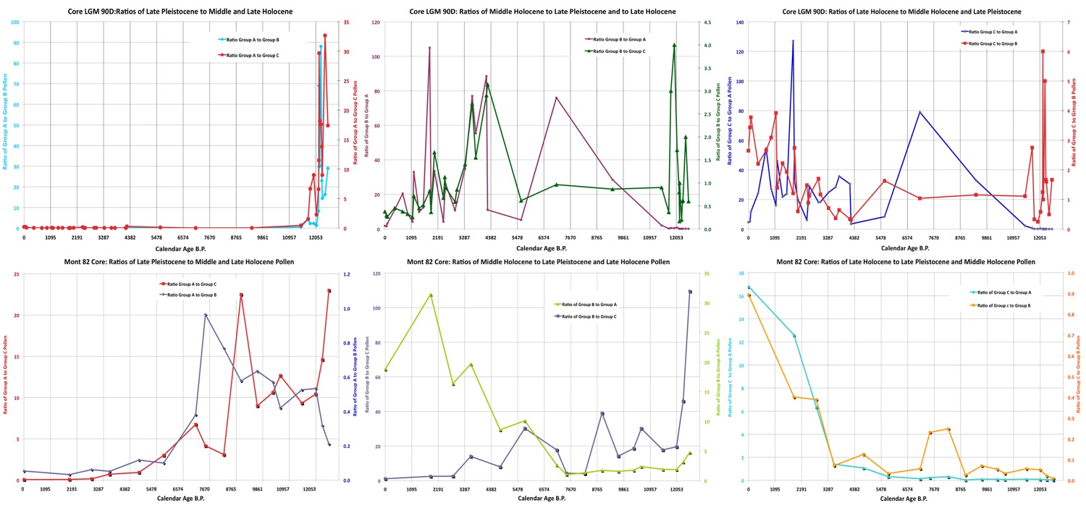
Holocene Pollen from Lago Grande Monticchio
When we construct ratios of the pollen included in the three groups for each of the two cores, the three part division of the Holocene pollen record becomes even more obvious. Also the differences between the two cores due to their location in the lake also is obvious. The impact of human activity is also clear from the pollen record. The pollen included in Group three (the late Holocene) include pollen of cereal grasses, olive, and in the case of the LGM 90 core, vitis (grape). The dominance of Group C pollen increases dramatically during the last 3,000 years. This increase partly tracks the increase in Summer precipitation events, but it increases at rates greater than the increase in Summer precipitation. The probable explanation for this is the impact of human populations. The two diagrams on the right in which late Holocene pollen is plotted against both Middle Holocene and late Pleistocene pollen not only show the difference of the pollen during this period, but the increasing impact.

Slide 12
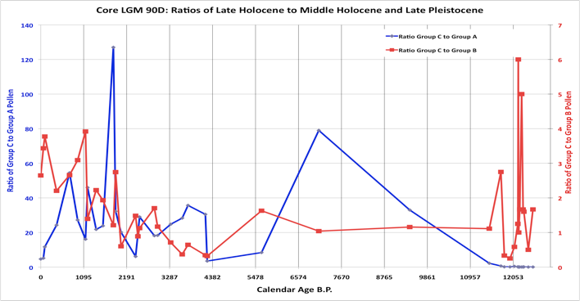
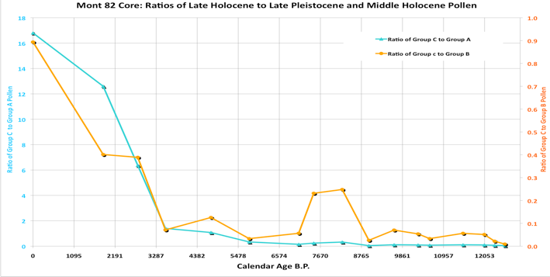
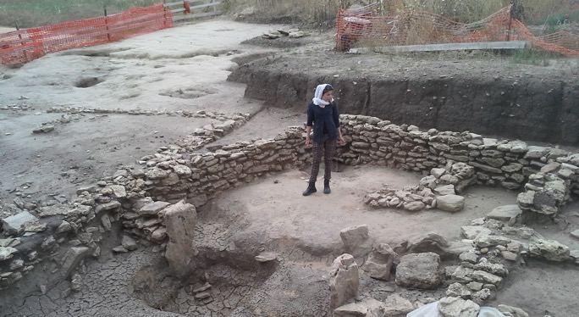
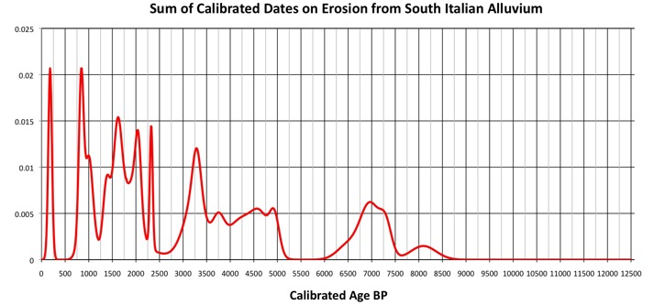
Evidence of Increasing Human Impact
Evidence of increasing late Holocene impact of human populations in southern Basilicata is clear in both the pollen and alluvial records. The magnitude and duration of erosion episodes increases after 2,500 years ago, and the dominance of pollen types that include the pollen of domesticated and weed pollen increases as well. Both lines of evidence indicate the growing influence of people from the early Iron Age onward upon the landscape of the southern Basilicata region.
Iron Age site dating to ~2,500 cal B.P. near San Felice.

Slide 13
IN CONCLUSION
Initially, hilltop settlements and the areas that people utilized from these sites were, in most cases, located on flat-lying, weakly cemented sandstones or sandy siltstone, and often weakly cemented conglomerates. Although impacted by land use these areas where not very sensitive to erosion.
There is a marked movement to form larger settlements or an agglomeration of sites beginning in the third century B.C., and accelerated during the first century A.D., and again in the third/fourth century A.D.
Throughout this time there are almost no sites located on the bottoms of valleys. This may reflect an avoidance of those areas due to the prevalence of disease there.
Large rural sites do not really appear until the Roman period (the first through fourth centuries AD), and they seem to have been at their largest during the early fourth century AD. The village at Vagnari seems to conform to this model.

