Slide 1
Global Warming and Human Impact Upon Desert Lakes
Peter E. Wigand pewigand@gmail.com
Affiliate Research Professor, Division of Earth and Ecosystem Sciences,
Desert Research Institute, Reno, Nevada and
Graduate Faculty, Department of Geology,
California State University, Bakersfield, California and
Graduate Faculty, Department of Geography and Research Faculty Hydrology Program
University of Nevada, Reno, Reno, Nevada and
Sole Proprietor and Chief Scientist
Great Basin & Mojave Paleoenvironmental Consulting and
Affliliate Graduate Faculty, Department Anthropology,
University of Nevada, Las Vegas, Nevada

Slide 2
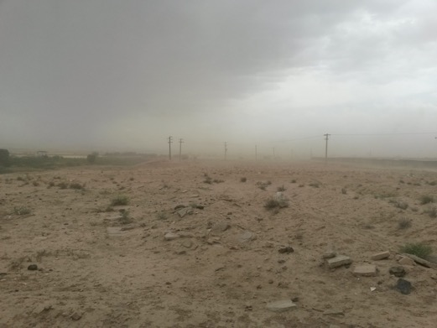
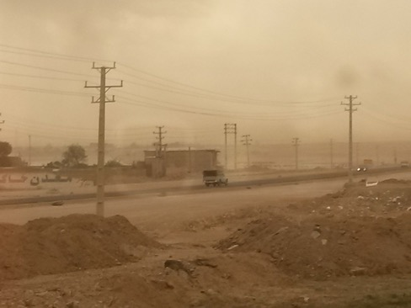
Savah 21 May 2015
Climate change brings many terrible consequences for the earth. In May of 2015 I was in Savah during a dust storm that stretched from Iraq to beyond Tehran. This is a global problem.

Slide 3
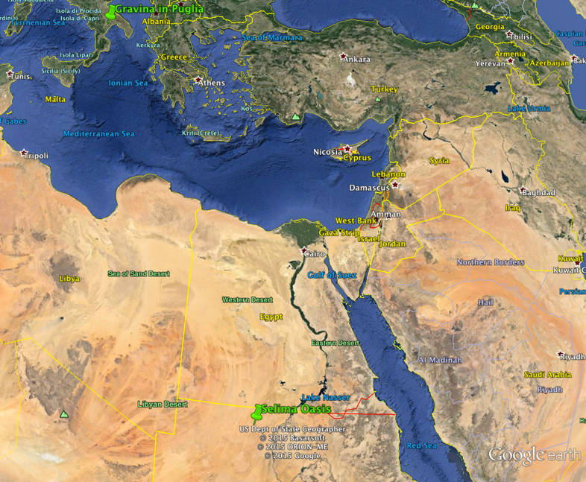

Slide 4
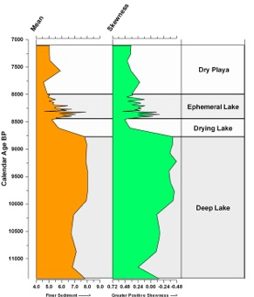
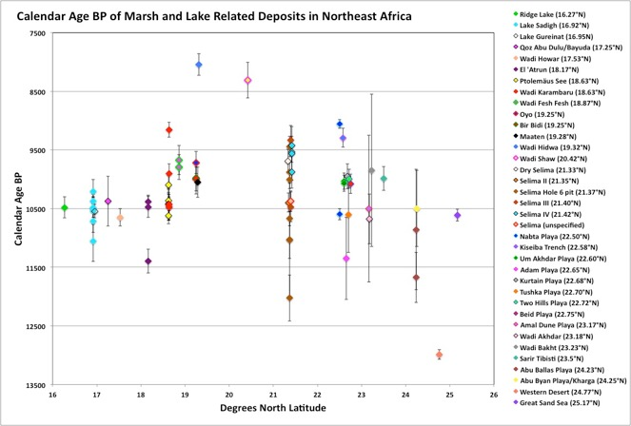
Comparison of Dates on Lake & Marsh Deposits from Northeast Africa and Diagnostic Sediment Parameters from Selima Oasis, Sudan
Finer Sediments = Deeper Lake
Sediment fining in the basins of northeast Africa provide information on both lake depth and distance from shore. This record also indicates that when climates changed in the region, it was rapid.

Slide 5
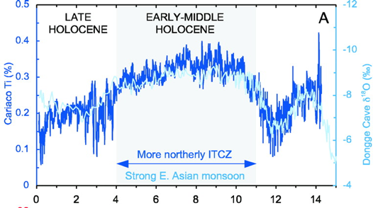
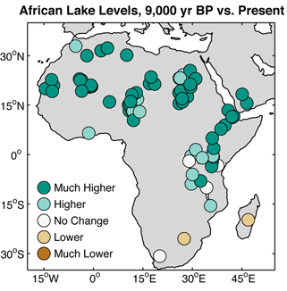
Evidence for northward movement of the Inter Tropical Convergence Zone in northeast Africa

Slide 6
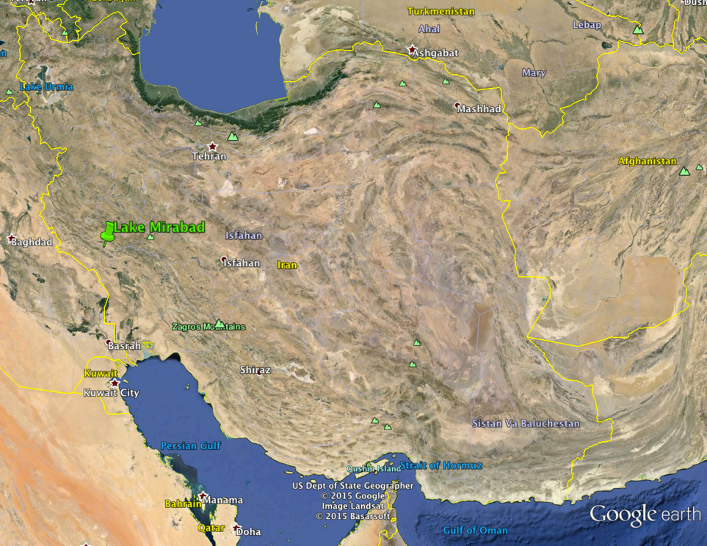

Slide 7
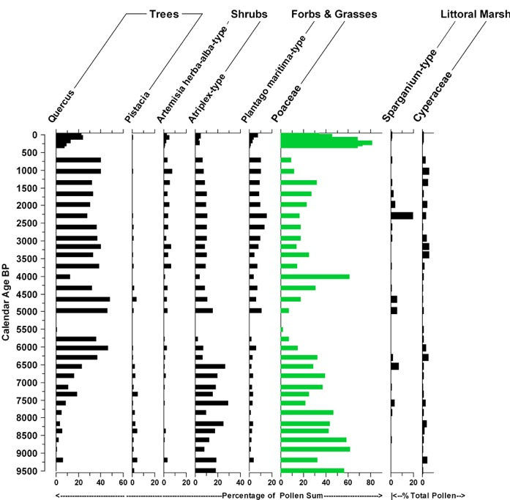
Lake Mirabad: Summary Diagram of Major Pollen Types (van Zeist 1967)

Slide 8
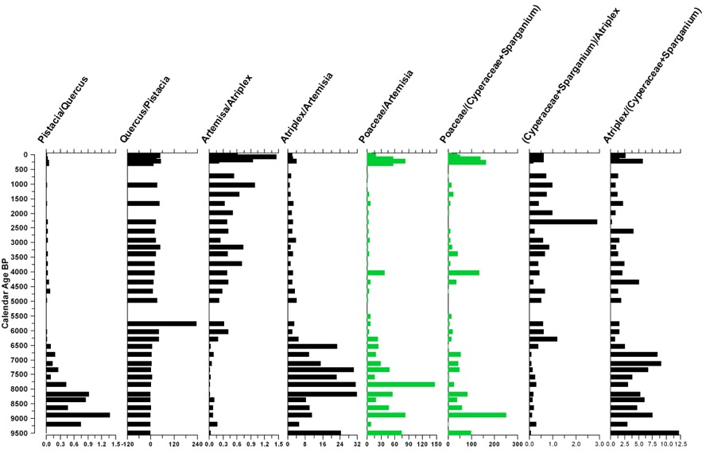
Lake Mirabad: Diagram of Ratios of Major Pollen Types (van Zeist 1967)

Slide 9
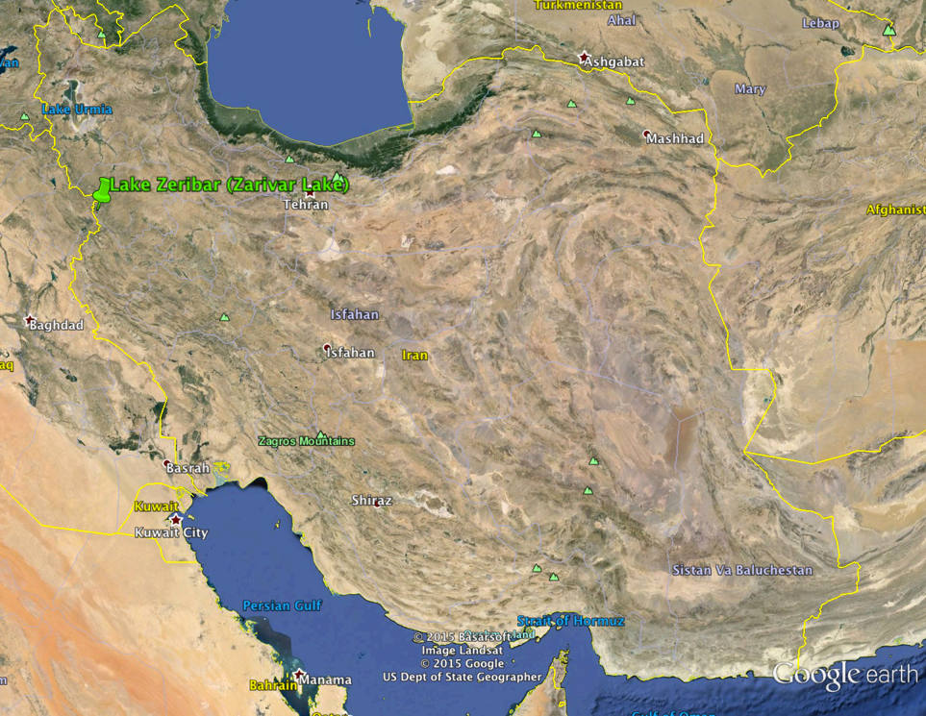

Slide 10
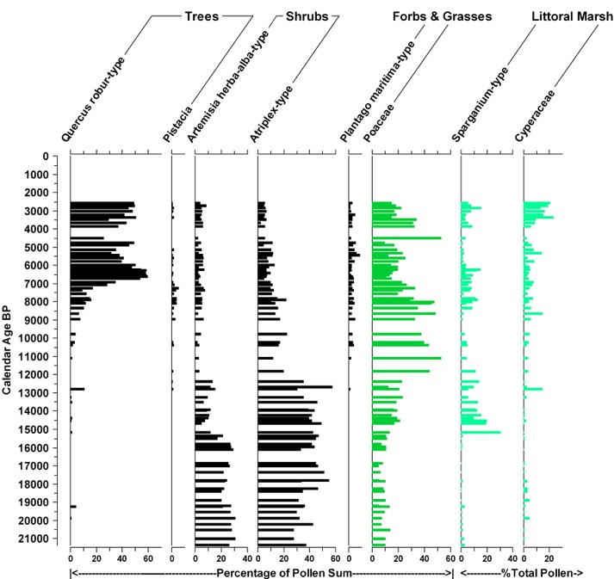
Lake Zeribar: Summary Diagram of Major Pollen Types (van Zeist 1967)

Slide 11
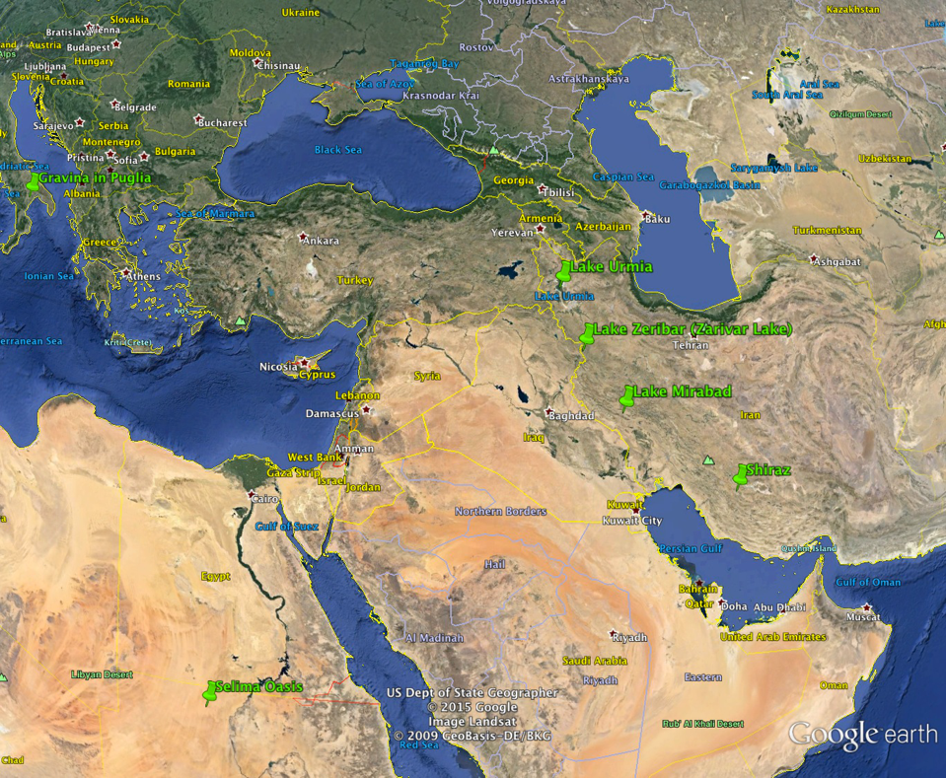

Slide 12
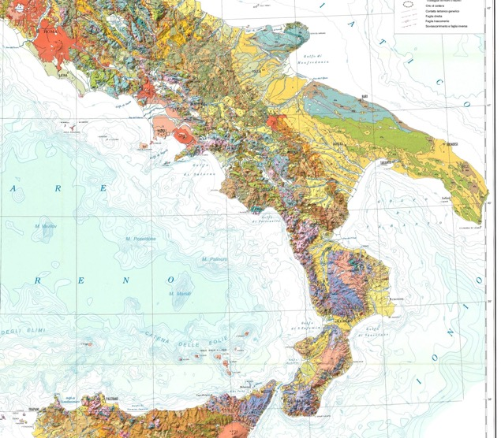
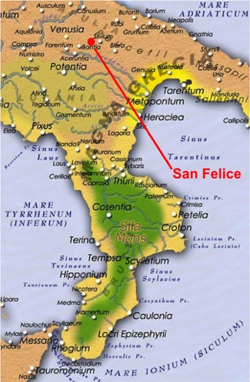
Study Area:
Regional Geology & Early Imperial Setting
Gravina
Most of the Basilicata and Puglia region is part of the Bradanic Foredeep,
an area that was a shallow sea until the end of the Pliocene. The geology
in the area is comprised of Pliocene marine marls overlain by lower
Pleistocene weakly cemented coastal sands and conglomerates. The whole region has been uplifted on the northwest by 300 to 500 m, and plunges beneath the Gulf of Taranto at Metaponto Our study area lies on what was the boundary between Italic and Messapian language speakers and Magna Graecia 2,000 years ago. Later it was the boundary between the Byzantine and Lombardi controlled areas, and later ruled by the Normans.

Slide 13
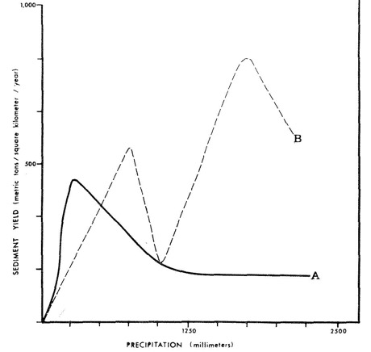
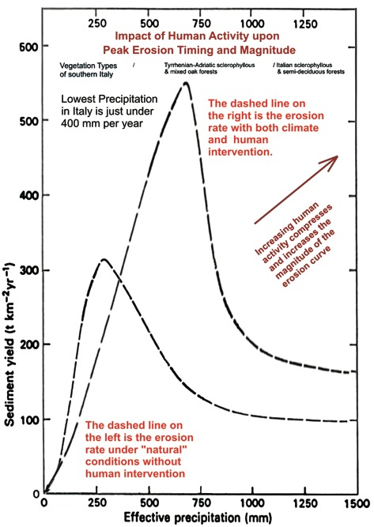
Erosion Models: Langbein & Schumm versus Wilson
Some have suggested that the Langbein and Schumm Model has limited spatial application. Lee Wilson proposed another model for a stream in the American Southwest (above “B”). Higher precipitation values occur in this model, and land use probably has had a significant impact upon erosion as well. Wilson’s model does provide clues regarding how the Langbein & Schumm model can be adjusted as vegetation cover is decreased by forest clearance and land use, but without any decrease in precipitation. The erosion curve will be displaced to the right and upward. This means that under human impact erosion rates can increase without a change in precipitation, because the protective vegetation is removed. My model for Italy is on the right.

Slide 14
The Bryson MCM Climate Model
Macrophysical Climate Modeling (MCM), was developed in the mid-1990s by Reid and Robert Bryson to produce results at a spatial and temporal scale useful to social, natural, and earth sciences. The MCM takes a top-down approach to model building.
The MCM is a heat-budget model predicated on orbital forcing, variations in atmospheric transparency, and the principles of synoptic climatology. The locations of the centers of action are derived from the temperature gradient of the hemisphere, which is derived from the incoming and effective solar radiation. Thus, the initial steps of the construction of the model focus on the determination of the incoming radiation from the sun (at the top of the atmosphere) and how much of that radiation reaches the surface of the earth (the effective radiation).
Calculation of the locations of the centers of action requires the horizontal (meridional) and vertical (lapse rate) temperature gradients, that is, the difference in temperatures from the pole to the equator (the horizontal and vertical components). The horizontal temperature gradient can be derived from the modern atmospheric thickness gradient and the modern monthly hemispheric temperatures, while the vertical temperature gradient, a function of the season, is determined using the modern values (Bryson 1992). The locations of the centers of action (the highs and the jet stream) are then calculated using the equations of Smagorinsky (1963) as applied by Flohn (1965) and verified by Bryson (1992). The location of the ITC is calculated directly from the latitude of the subtropical highs (Bryson 1973, 1993). The modeled locations for the past 40,000 years are then saved separately as the modules.
Bryson, R.A.
1973. Drought in Sahelia, Who or What is to Blame? Ecologist 3(10):366-371.
1992. A Macrophysical Model of the Holocene Intertropical Convergence and Jetstream Positions and Rainfall for the Saharan Region. Meteorology and Atmospheric Physics 47:247-258.
1993 Simulating Past and Forecasting Future Climates. Environmental Conservation 20(4):339-346.
Bryson, R. A. and R. U. Bryson. 1997. High Resolution Simulations of Regional Holocene Climate: North Africa and the Near East. In Third Millenium BC Climate Change and Old World Collapse, edited by H. N. Dalfes, G. Kukla and H. Weiss, pp. 565-593. vol. I 49. NATO ASI Series, Berlin.
Flohn, H. 1965. Probleme der theoretischen Klimatologie. Naturwissen-schaftliche Rundschau 10:385-392.
Smagorinsky, J. 1963. General Circulation Experiments with the Primitive Equations, I: The basic experiment. Monthly Weather Review 91:9-164.

Slide 15
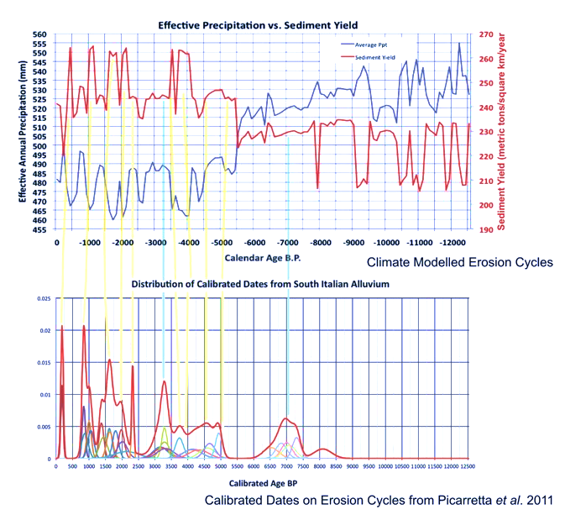
Correlation of Model with Alluvial History
When the model of predicted erosion is compared with the sum of the record of calibrated ages B.P of erosion cycles in the Mezzogiorno (southern Italy) collected by Piccarata et al. (2011), the correspondence is clear. Events connected with yellow lines are climate based, whereas with blue lines are caused by intensified land use and not by climate change.

Slide 16
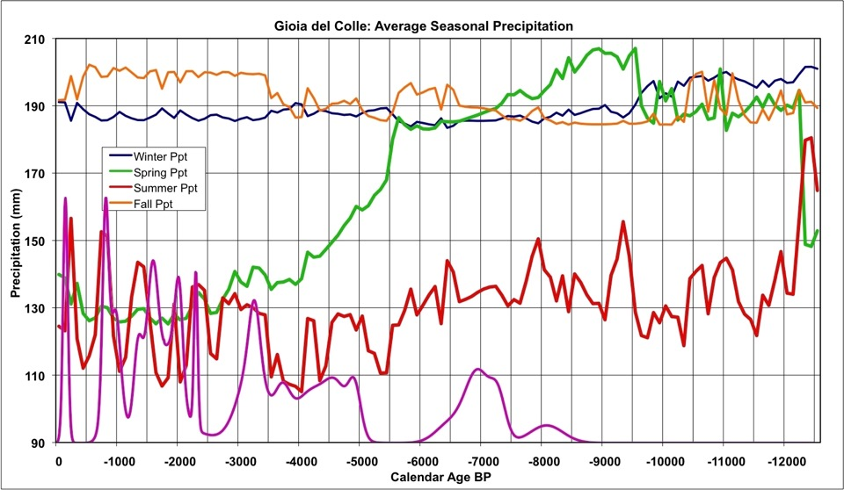
Bryson MCM Physical Climate Model: Role of Seasonal Precipitation
MCM modeled seasonal precipitation for the last 12,500 years. Fall and Winter precipitation have not varied as much as Spring and Summer precipitation.

Slide 17
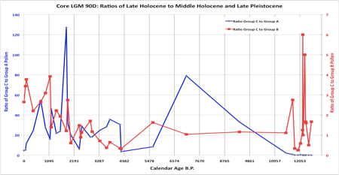
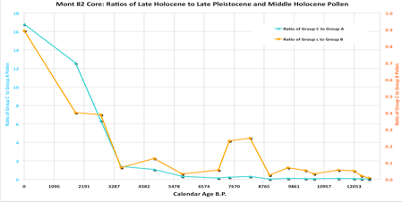
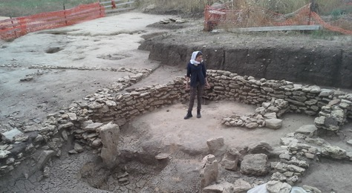
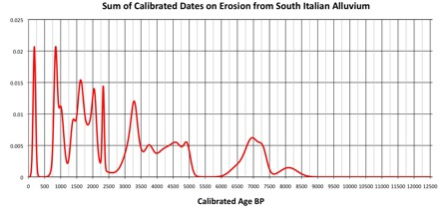
Evidence of Increasing
Human Impact
Evidence of increasing late Holocene impact of human populations in southern Basilicata is clear in both the pollen and alluvial records. The magnitude and duration of erosion episodes increases after 2,500 years ago, and the dominance of pollen types that include the pollen of domesticated and weed pollen increases as well. Both lines of evidence indicate the growing influence of people from the early Iron Age onward upon the landscape of the southern Basilicata region.
Iron Age site dating to ~2,500 cal B.P. near San Felice.

Slide 18
Application of the Erosion Model to the Holocene History of Lake Orümiye Lake Basin

Slide 19
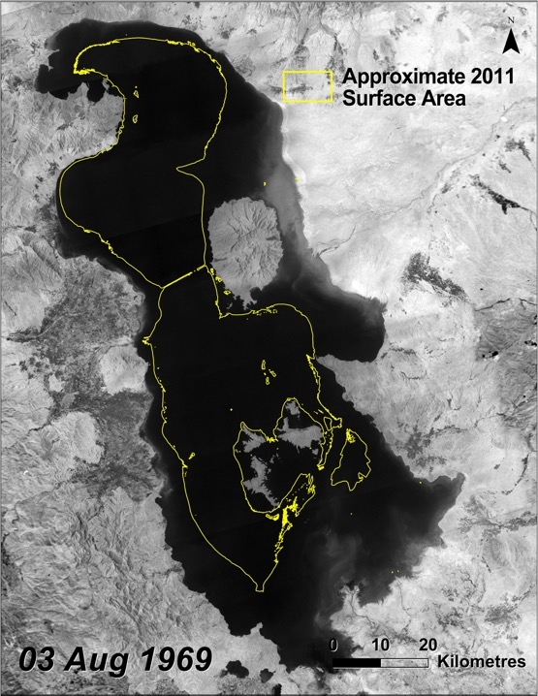

Slide 20
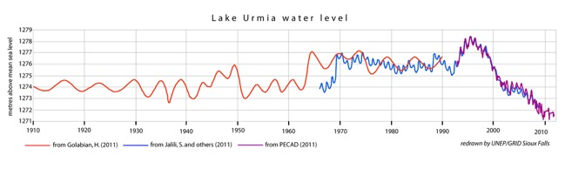
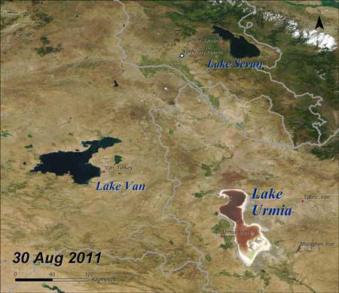

Slide 21
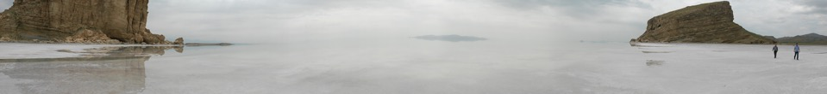
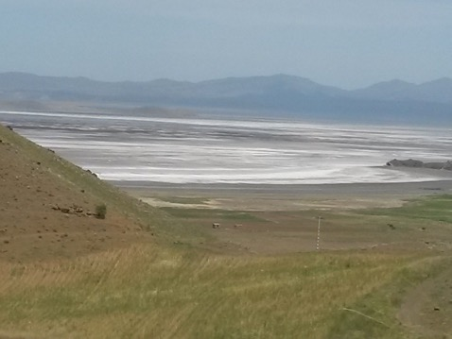
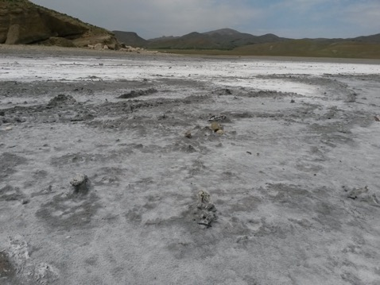
Lake Orūmiye in June of 2015
north of the city of Orūmiye southeast of the city of Salmas
The lake was nearly dry here with only a centimeter or less of water overlying the salt crust. In places there were holes in the salt crust indicating that it was well over a meter thick, even near shore. As the salt crystalized polygons had formed with pressure ridges between the polygons

Slide 22
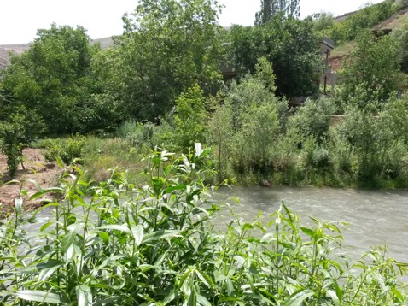
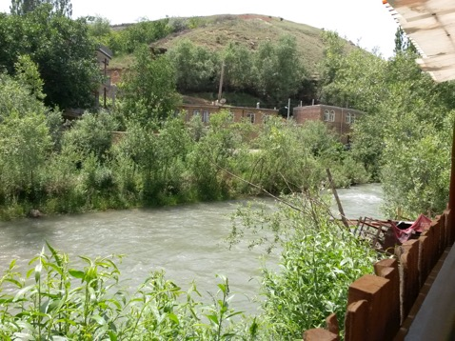
The Shahar Chay (City River)
West of the city of Orūmiye the Shahar River was still full to the top of its banks in June 2015, but east of Orūmiye it was dry. The color of the river indicates that it is clearly full of sediment, whether from the distant mountains or from more local contributions. The color of the streams in southern Italy was similar, except there it was due to the substantial load of eroded Pliocene marine marl. The sediment load from these streams has been significant throughout the last 40,000 years, but slope wash along the shores of Lake Orūmiye has also been important.

Slide 23
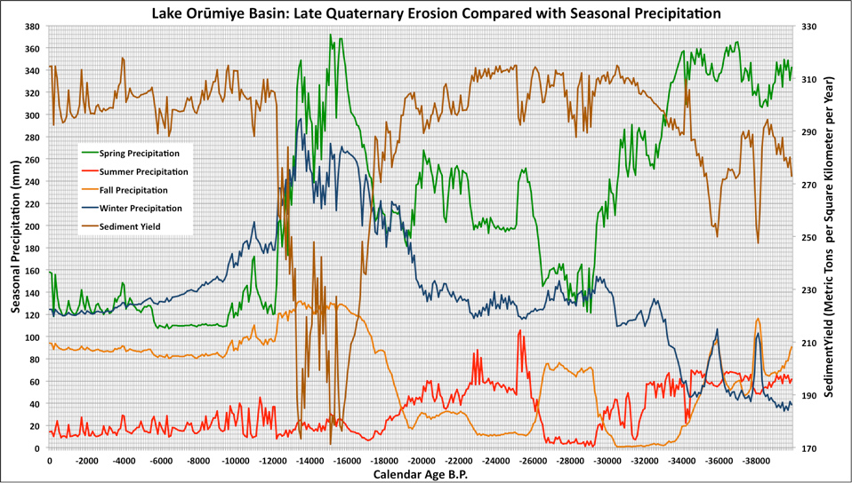
Relationship of Seasonal Precipitation to Erosion in the Lake Orūmiye Basin
This and the following diagrams are a combination of Bryson MCM climate plots and the erosion model devised in southern Italy and described above. Here the seasonal distribution of precipitation is plotted against modeled erosion for the last 40,000 years. The high winter precipitation at Orūmiye between 18,000 and 13,000 years ago resulted in high vegetation cover and precluded significant erosion.

Slide 24
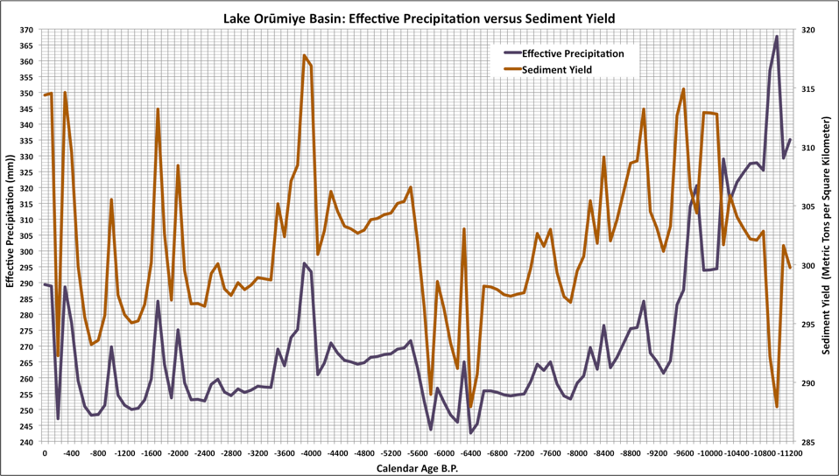
Relationship of Effective Precipitation to Erosion in the Lake Orūmiye Basin
During the last 11,200 years the Holocene record is significantly different from that of the Pleistocene. Because vegetation cover is much more sparse, increases in precipitation result in significant increases in erosion. Since 9,400 years ago when vegetation cover reached a critical low, each increase in effective precipitation has also resulted in an increase in erosion.

Slide 25
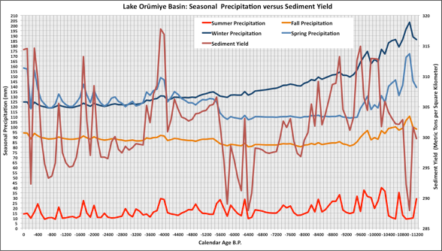
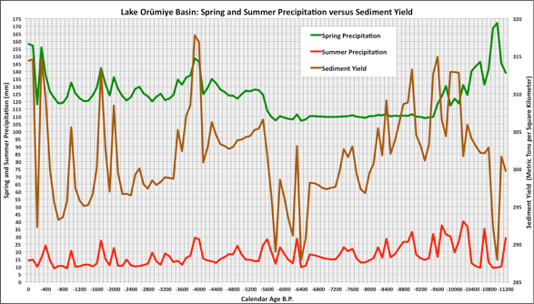
Relationship of Seasonal Precipitation to Erosion in the Lake Orūmiye Basin
A comparison of seasonal precipitation with sediment yield (erosion) suggests that both Spring and Summer precipitation may be the drivers of erosion in the Lake Orūmiye Basin. This will become clear in the following diagrams.
A closer examination of cycles of Spring and Summer precipitation and their correspondence with sediment yield (erosion) suggests that both Spring and Summer precipitation show significant correspondence with episodes of erosion. The question remains in what way(s)?

Slide 26
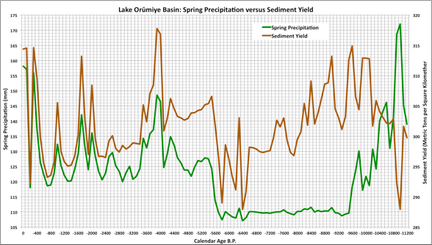
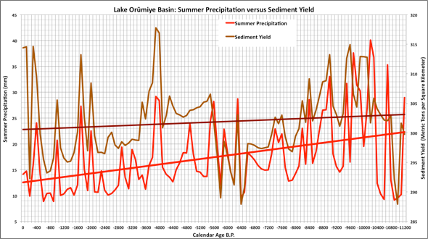
Relationship of Spring and Summer Precipitation to Erosion in the Lake Orūmiye Basin
During the last 5,500 years the correspondence between MCM increases in Spring precipitation and erosion is clear. Because during most of the last 9,000 years effective precipitation at Orūmiye lies at the point on the Langbein and Schumm erosion curve where erosion is greatest, any increase in precipitation results in erosion increase as well.
More significant for erosion at Orūmiye is Summer precipitation. In most cases, increased Summer precipitation seems to result in increased erosion. Again this relates to increased precipitation at a time in the year when there is a lack of significant vegetation cover. We saw this in Italy as well for the Holocene.
Despite the high variability in Summer precipitation a trend line for Summer precipitation indicates that it has been on the decline since 10,000 year ago, a decline of about 15 mm with high precipitation events during the last few hundred years being almost half of what they were during the early Holocene. Erosion has also declined, but much less.
Erosion Trend line
Summer Precipitation Trend line

Slide 27
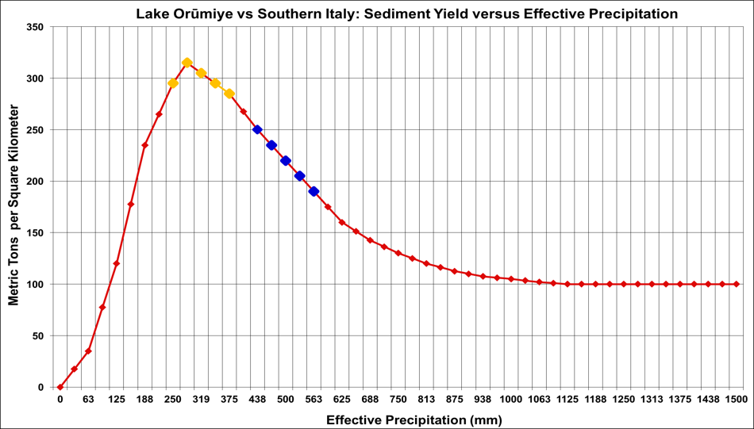
Holocene Relationship Between Effective Precipitation and Erosion: Lake Orūmiye
Current limits for precipitation and erosion at Orūmiye, West Azerbaijan, Iran
Current southern Italian erosion range
About 16,500 to 17,000 years ago effective precipitation in the Lake Orūmiye Basin reached about 600 mm per year.
When the distribution of effective precipitation is plotted against sediment yield at Orūmiye for the Holocene, they seem to cover a relatively small portion of the Langbein and Schumm model curve. However, it lies at a very critical portion of the curve where it crosses the thresh hold between where decreasing precipitation causes erosion, to where precipitation is so much reduced that it becomes an ineffective cause of erosion.

Slide 28
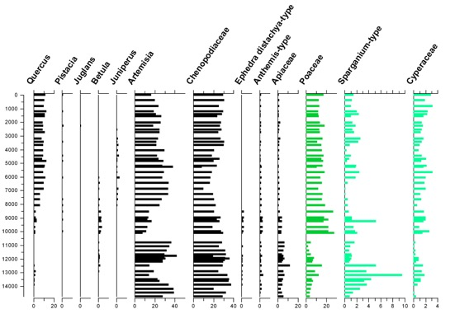
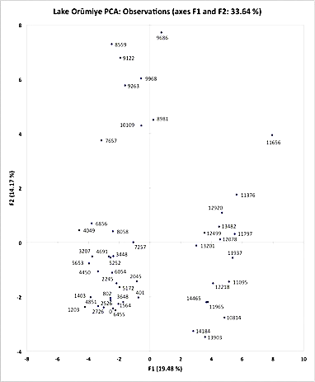
Lake Orūmiye Pollen Record
Examination of the pollen research conducted at Lake Orūmiye by the Turkish palynologist S. Bottema (1986) indicates significant changes in the vegetation history of the basin ~ 8,000 cal B.P. (diagram at right). Not only does oak (Quercus) appear, but sagebrush (Artemisia) and saltbushes (Chenopodiaceae) are extremely high comprising over 60% of the terrestrial pollen recovered. Grasses are high as well reflecting both Spring and Summer precipitation.
B
At the left are the groupings of the pollen samples by age resulting from principal component analysis of Bottema’s pollen counts from Lake Orūmiye. This analysis clearly reveals the break between much wetter climates in A) the latest Pleistocene and earliest Holocene between 14,200 and 10,800 cal B.P., B) the transition period in the early Holocene between 10,100 and 8,000 cal B.P., and C) the very similar assemblage of pollen samples since ~8,000 cal B.P.. You can see in the lower left hand corner of the diagram that middle and late Holocene pollen samples form a very tightly clustered group that coincides with the Holocene since the beginning of increased erosion rates, in particular the last 4,000 years.
A
C

Slide 29
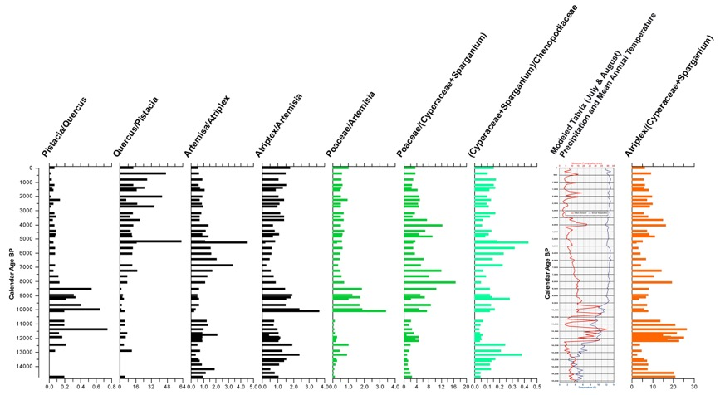
Lake Orūmiye Pollen Record:
Pollen Ratios
The ratios of pollen types from Lake Orūmiye are particularly revealing. Saltbush (Atriplex) pollen abundance has increased with respect to sagebrush (Artemisia) pollen abundance during the last 6,000 years suggesting drier climate. And the ratio of Atriplex to sedges suggest that more saline conditions have prevailed near the lake itself. That shift occurs ~6,000 years ago. The increase in Spring precipitation at that time had a dramatic impact upon both saltbush (Atriplex) communities and erosion rates. And perhaps it also may have played a role in the increase in salts being swept into the lake, and changing the water chemistry enough to severely restrict freshwater marsh habitats. Finally….saltbush (Atriplex) blooms in the late Spring and early Summer, while sagebrush (Artemisia) is a late Summer and early Fall bloomer. The increase in Spring rainfall would favor saltbushes (Atriplex), but do little for sagebrush (Artemisia). The Bryson MCM climate reconstruction for July and August precipitation clearly mirrors some of the changes that we see in the saltbush community with respect to salinization of Lake Orūmiye and destruction of the marshes.

Slide 30
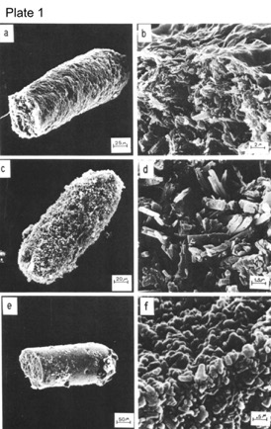
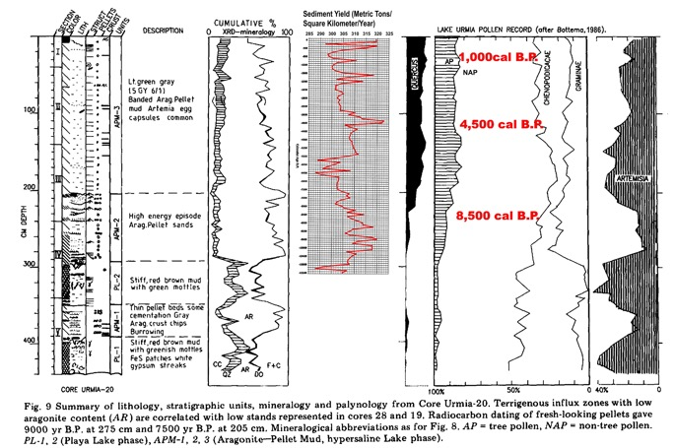
Lake Orūmiye Artemia Record
Figure 9. of Kelts and Shahrabi 1986 details the relationship between the stratigraphy, mineralogy and pollen of Lake Orūmiye. Increased salinization of Lake Orūmiye is clearly evidenced by the record of the brine shrimp, Artemia urmiana Günther fecal pellets. Keeping in mind that the Kelts and Shahrabi diagram is plotted by depth (calibrated dates in red), I have placed the modeled erosion rate from this study into this diagram for comparison. Modeled erosion increases dramatically about 10,000 years ago at the same time as a dramatic increase in aragonite, and Artemia fecal pellet abundance. Especially the upper 7,000 years of Bottema’s core is filled with Artemia fecal pellets suggesting a great increase in Artemia abundance. The correspondence between increased erosion, aragonite and Artemia, suggests that increasing erosion in the Orūmiye Basin may have been responsible for increasing salinization of the lake as well.

Slide 31
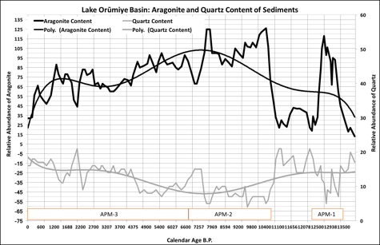
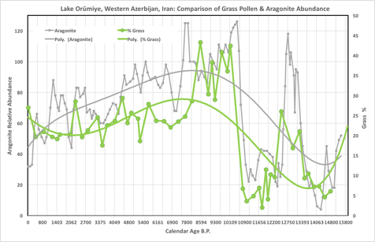
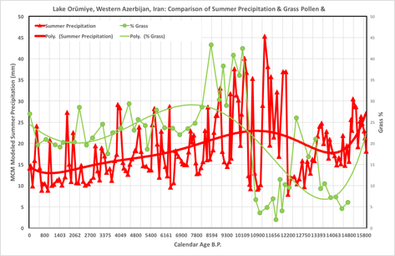
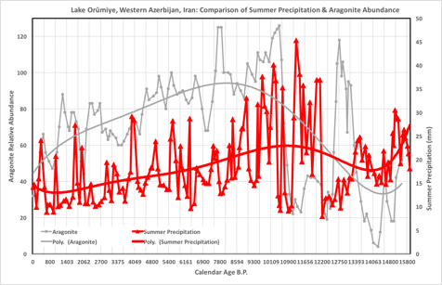

Slide 32
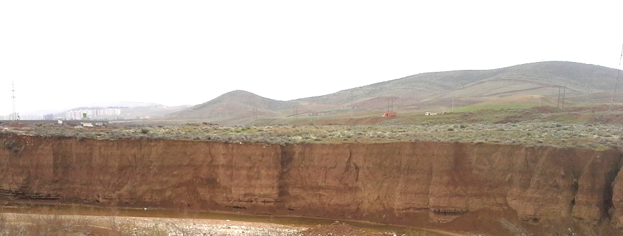
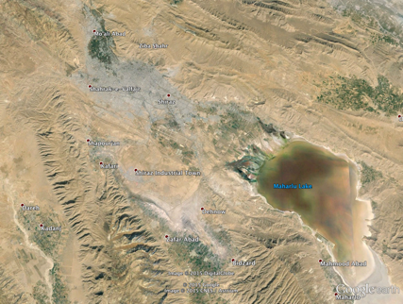
Shiraz, Iran and Lake Maharlou
Alluvial sequence along the Rudkhaneye Khoshk, which flows through the northern part of Shiraz and on into Lake Maharloo.
Paleosols: the upper and lowest may correspond to ones dated in southern Italy to ~2,100 cal B.P. and ~8,500 cal BP or slightly earlier

Slide 33
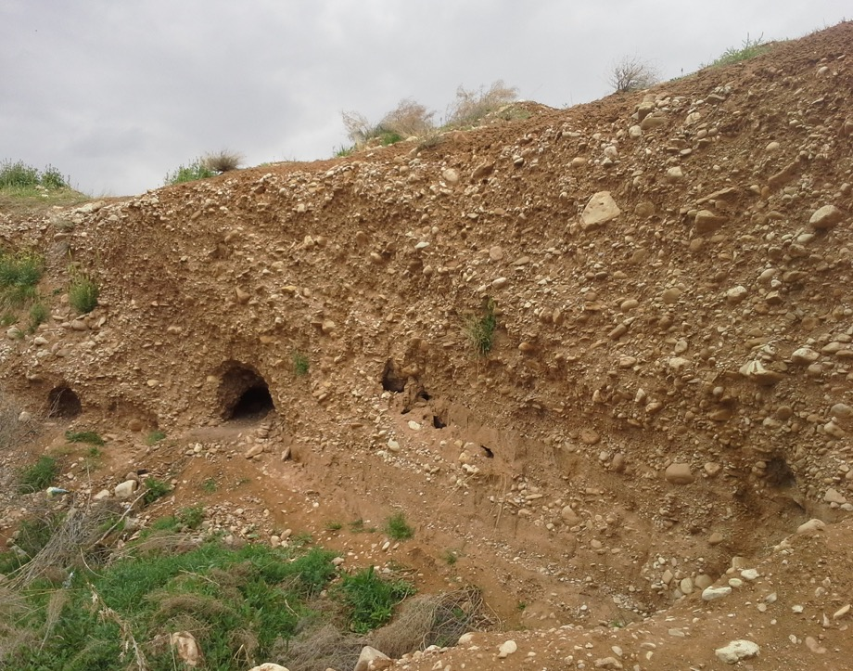


Pleistocene Alluvial Terrace along the Roodkhaneye Khoshk (Dry River) into which a finer Holocene alluvial sequence has been deposited. The size of these gravels is larger than any fluvial deposits that are younger in age.
17,200±2.8 SABZ-IR-1
Holocene deposits enclosed by the Pleistocene gravels are much finer consisting of sands, silts and clays.

Slide 34
Bryson Meso Scale Climate Model Plot for Shiraz
Age of large gravel deposits along the Roodkhaneye Khoshk
Clearly the Bryson model indicates that all seasonal precipitation reached a maximum at the time when the gravel units were being deposited in the Roodkhaneye Khoshk. The Hjulström model provides additional evidence that stream flow was of high velocity, because of the size of the gravels. This correspondence between the age of deposits of large gravels and modeled high precipitation is strong validation for the Bryson MCM model in western Iran.

Slide 35
Since 1950 the difference between temperature and precipitation has increased. This has resulted in reduced effective precipitation. For each degree centigrade increase in temperature, effective precipitation decreases by 10%. The temperature and precipitation record from Tabriz follows the same trends.

Slide 36
Since 1980, seasonal temperatures have been increasing, potentially increasing evaporation rates in Lake Orūmiye.

Slide 37
Average precipitation, in all seasons except for Fall, have been on the decline, resulting in as much as a 70 mm decrease in annual rainfall since 1951.

Slide 38
Effective precipitation, which is slightly less than 75% of actual precipitation has declined by as much as 14% since 1951. The potential impact upon not only lake depth, but lake extent is clear.

Slide 39

Lake Orūmiye in the July of 1998 and June of 2014
In the Summer of 2015 Lake Orūmiye was almost totally dry providing a significant source of dust. As global and local temperatures continue to rise, the duration of seasonal flooding will decrease, exposing the lake bottom to aeolian erosion for longer periods of time. Dust laden with arsenic, lead, mercury and radionuclides threaten the health of millions of people downwind of the lake. This is not only an issue that the people of northern Iran face, but all the lakes of Iran are threatened, and all of the people of Iran face the same health risks. It is even possible to detect lung cancer clusters in Iran using GIS and statistical analysis (M. Sadi Mesgari, Zohreh Massoomy 2006). Continued monitoring may prove unsettling to say the least.

Slide 40

Holocene Relationship Between Effective Precipitation and Erosion: Iran vs. Southern Italy
Orūmiye, West Azerbaijan, Iran
About 16,500 years ago effective precipitation in the Lake Orūmiye Basin reached about 600 mm per year. That is the same time as the gravel deposits at Shiraz.
Gioia del Colle, Puglia, Italy
Projected erosion rates during the next thirty to forty years
Under a scenario of global temperature increase we might expect a 2 to 3 degree increase in temperature. This translates into a reduction of effective precipitation by 20 to 30%. Such a decrease for the Lake Orūmiye Basin will have little impact upon the already high erosion rates characterizing the basin. Because of damming most of the sediment coming from outside the basin to the west has been reduced considerably, however, within the basin slope erosion, that is colluvium becomes a significant factor in sediment contribution to the lake bottom. Projected values of effective precipitation and erosion of the Lake Orūmiye Basin lie on the steep down slope of the Langbein and Schumm model curve above near previous Holocene erosion rates. Under this scenario erosion rates may decline slightly. However, any new sediment added to the lake bottom is loosely compact and easily eroded. However, with seasonal wetting and drying of the lake bottom a new danger arises.

Slide 41

Parishan Lake February 2007

Slide 42

Parishan Lake Feb 2007 June 2009

Slide 43

Shiraz Precipitation Trends of the Last 50 Years
Asadi and Heidari, 2009

Slide 44


Effective Precipitation and Parishan Lake Levels

Slide 45


Climatic Optimum Rainfall Patterns for the Near East
?
9,000 years ago
?
6,000 years ago

Slide 46


Slide 47


Inter Tropical Convergence Zone

Slide 48


Shiraz Meso-scale Climate Model

Slide 49

Hjulström-Sundborg Diagram
Relates:
Erosion
Transport
Deposition
To:
Particle size
Fluid velocity
Clays = < .004 mm; Silts = .004-.0625 mm;
Sands = .0625-2 mm;
Gravels = >2mm
The curve was in 1956 expanded by Hjulström's disciple and successor as professor, Åke Sundborg. He significantly improved the level of detail in the cohesive part of the diagram, and added lines for different modes of transportation. The result is called the Sundborg diagram, or the Hjulström-Sundborg Diagram.

Slide 50

The Affect of Human Activity on Schuum’s
Curve
Peak erosion will occur under higher rainfall regimes, because the vegetation cover has been disturbed. In addition, erosion rates will be magnified.

Slide 51
THE ISSUE OF DUST:
FACTORS OF
SEDIMENT TRANSPORT
Desert winds are the greatest sediment transporting agent on Earth (Cooke et al., 1993)
Wind is a much stronger moving agent in deserts than water

Slide 52

Relationship between wind velocity and sediment size

Slide 53
Controls on Aeolian Processes
Moisture
  Even slight amounts of moisture (4% by weight) can inhibit motion
  Increase of velocity of 7.5 cm sec⁻¹ for every 1% increase in moisture (Hotta, 1984)
  Not as important once saltation begins

Slide 54


Vegetation Cover
Moisture promotes vegetation cover which directly effects wind velocity

Slide 55
Controls on Aeolian Processes
Surface Roughness
  Coarse material protects intervening fine grains
  Formation of pavements
Salts
  Aggregate soil/sediment particles
Crusts
  Only have to 3 mm thick to preclude almost all erosion
  Can be broken up by bombardment

Slide 56


Climate of Iran
Azerbaijan
Steppe
Biotypes of Iran
Desert
Caspian
Lowlands
Rainfall in millimeters
Kopet
Semi-Desert
Eastern
Anatolian Forest
Steppe
Kopet Dag Forest
Hyrcanian Caspian Forests
Middle East
Steppe
Alborz Forest Steppe
Mesopotamian
Desert
Central Persian
Desert Basin
Forest
Steppe
Central Afghan
Woodlands
Tigris-Euphrates
Alluvial Salt-marshes
North Pakistan
Sandy Desert
Arabian
Desert
Persian Gulf
Desert
South Persian
Desert and Semi-Desert
Baluchistan
Woodlands
Oman Gulf
Desert and Semi-Desert

Slide 57

Location of the State of Nevada in the USA

Slide 58


The Sierra Nevada Mountains and the Mojave Desert in California and Nevada bares striking similarity to Western Iran
Mojave Desert lakes lie in the rain shadow of these Mountains. Their age is debated estimates range from 27 million to 2.5 million years. Increasing drought and water diversion to Los Angeles through aqueducts has resulted in the demise of these lakes.

Slide 59


Slide 60

Owens Lake Dust

Slide 61
Mojave Desert Playa Dust
A study conducted in the Mojave Desert by a team of scientist from the US Geological Survey determined…”The interactions between playa hydrology and playa-surface sediments are important factors that control the type and amount of dust emitted from playas as a result of wind erosion. The production of evaporite minerals during evaporative loss of near-surface ground water results in both the creation and maintenance of several centimeters or more of loose sediment on and near the surfaces of wet playas. Observations that characterize the texture, mineralogic composition and hardness of playa surfaces…indicate that these kinds of surface sediment are highly susceptible to dust emission. The surfaces of wet playas are dynamic — surface texture and sediment availability to wind erosion change rapidly, primarily in response to fluctuations in water-table depth, rainfall and rates of evaporation. In contrast, dry playas are characterized by ground water at depth. Consequently, dry playas commonly have hard surfaces that produce little or no dust if undisturbed except for transient silt and clay deposited on surfaces by wind and water. Although not the dominant type of global dust, salt-rich dusts from wet playas may be important with respect to radiative properties of dust plumes, atmospheric chemistry, windborne nutrients and human health.” (Richard L. Reynolds, James C. Yount, Marith Reheis, Harland Goldstein, Pat Chavez, Jr., Robert Fulton, John Whitney, Christopher Fuller and Richard M. Forester. 2007)

Slide 62


The Los Angeles Aqueduct built in the 1930s carried water to Los Angeles and drained both Owens and Mono lakes.
Today an agreement between the people of Owens Valley and Los Angeles retains some water on the lake floor to keep dust erosion minimal and and is actually restoring Mono Lake.

Slide 63

Owens Lake, Mojave Desert, California
Attempts by the Desert Research Institute in Reno, Nevada to stabilize the floor of Owens Lake, one of the most impacted of the Mojave Desert Lakes, has been partially successful though very expensive. Mats made of synthetic materials provide a foot-hold for aquatic plants. This has been aided by reducing the withdrawal of water from the lake by Los Angeles, allowing seasonal flooding of the lake to persist longer. This had considerably reduced the deflation of dust from the lake bottom. Last Spring when I passed the lake with a field class we noted that in the area not yet treated with the matting, significant dust was being deflated by the wind. You can see this at the right side of the photo near the far shore of the lake.
Dust plumes from the lake bottom

Slide 64


Drying lakes and the health issues raised by the dust generated by these lakes is not simply a problem limited to a few regions in the Middle East or Africa. Large regions of the earth are being affected by dramatic drying of pluvial lakes.
Winnemucca Lake near Reno, Nevada, in the US dried as a result of water diversion to a large irrigation project in the Carson Desert. The dry lake was once a prolific fishing grounds for Lahontan cutthroat trout. Today they are restricted to Pyramid Lake (map above) and a few streams that enter the lake. The ph to held by the Native American shows his great grandfather fishing in Lake Winnemucca in about 1912. Winnemucca playa, and the Carson Desert and other basins left after the drying of Pluvial Lake Lahontan are significant sources of dust.

Slide 65

In this photo areas that are being farmed using irrigation along the lower Humboldt River (below) contrast with the Carson Desert playa across the West Humboldt Range (above) where dust is being deflated. I took this photo in June this year as I was flying from Reno to Chicago, and on to my research area in Italy. The dust followed us to the Rocky Mountains hundreds of kilometers away, and reached the same elevations that we were flying at over 9,000 meters.
Conclusions:
The Lake Orūmiye Basin has some of the highest rates of erosion possible under the Langbein and Schumm model
These are accentuated through human land use
Under the scenario of future decreased effective precipitation, we can expect a slight decrease in surface erosion in the Lake Orūmiye Basin
However, increased seasonal exposure of the floor of Lake Orūmiye with annual episodes of wetting and drying will keep surface sediments loose and provide an abundant source for aeolian deflation
With increased transport of toxic dust we can also expect that the incidence of respiratory diseases will increase, and lung cancer clusters will continue to grow
Only by addressing this issue globally can we hope to achieve any success

Slide 66
How do we transfer what we Learn to the Modern World?
Meet with the affected people to inform them of the problem
Ask them for ideas
Give them low cost solutions
Always consult with those people who are affected by the problem (farmers, herding peoples) and those who can solve the problem (city and provincal officials).
Remember that it takes time

Slide 67
Dr. Peter Ernest Wigand
pewigand@gmail.com
Graduate Faculty, Department of Geography, University of Nevada, Reno, Reno, NV 89557-0154
&
Research Faculty, Graduate Program of Hydrological Sciences, University of Nevada, Reno, Reno, NV 89557-0154
https://www.unr.edu/geography/people/peter-wigand
http://www.hydro.unr.edu/people/research_details.aspx?f55kjhGf2H44gf=826&Njhu789Skjh54Elfjk=120
&
Affiliate Associate Research Professor, Division of Earth and Ecosystem Sciences, Desert Research Institute
2215 Raggio Parkway, Reno, NV 89512
http://www.dri.edu/images/directory/resume-1563.pdf
&
Associate Graduate Faculty, Department of Anthropology, University of Nevada, Las Vegas
4505 S. Maryland Parkway, Las Vegas, NV 89154-5003
&
Graduate Faculty, Department of Geology, California State University, Bakersfield, Bakersfield, CA 93311-1022
http://www.csub.edu/~dbaron/Wigand_talk.pdf
&
Great Basin & Mojave Paleoenvironmental Consulting& Research, Reno, NV 89506
http://web2.greatbasin.net/~wigand/petespaleo/Wigand.htm
https://www.researchgate.net/profile/Peter_Wigand
http://www.linkedin.com/pub/peter-wigand/35/90/764
http://4d.proclim.ch/4dcgi/all/en/Detail_Person?wigandp.reno
http://www.worldcat.org/identities/lccn-no99090280/
https://www.facebook.com/ernest.wigand
https://scholar.google.com/citations?user=4XdKCSIAAAAJ&hl=en&cstart=40&pagesize=20

