Slide 1
Middle to late Holocene Landscape and Human Dynamics in the Apulian-Lucanian Border Area of the Southern Italian Interior: Analogues for Current Trends in Human Disturbance and Landscape Deterioration
^{1,2,3,4}Wigand, Peter E., Myles McCallum⁵, and Hakimeh Bargahi⁶
¹Department of Geography, University of Nevada, Reno, NV, USA;
²Division of Earth and Ecosystem Sciences, Desert Research Institute, Reno, NV. USA;
³Department of Geology, California State University, Bakersfield, CA, USA;
⁴Affiliate Graduate Faculty, Department of Anthropology, University of Nevada, Las Vegas, USA ; email: pewigand@gmail.com;
⁵Department of Modern Languages and Classics, Saint Mary’s University, Halifax, Nova Scotia, Canada; email: mylescmccallum@gmail.com
⁶Great Basin & Mojave Paleoenvironmental Research & Consulting; email: haki.bargahi@gmail.com;

Slide 2
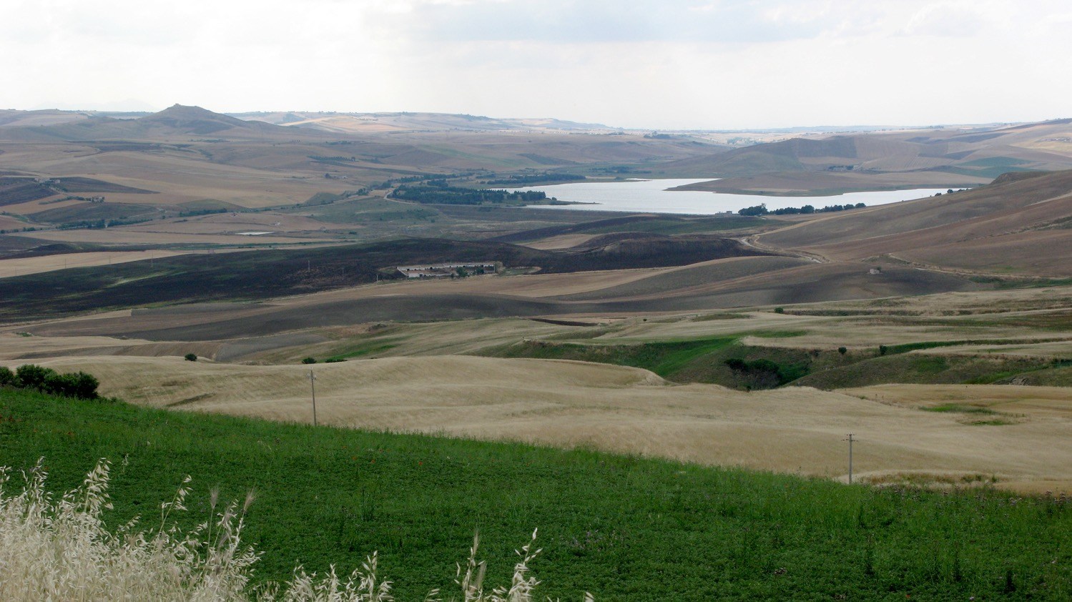
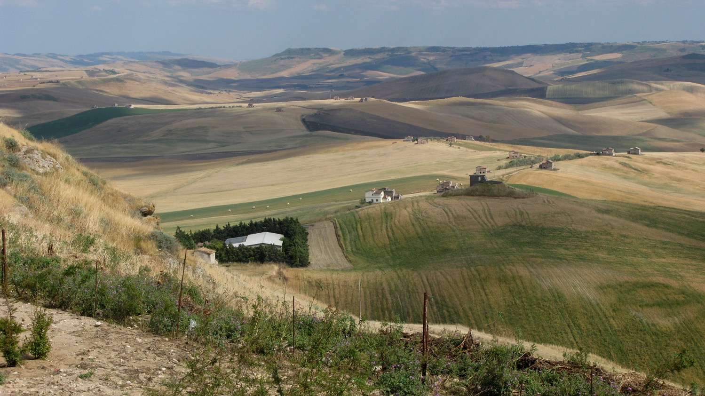
The Mezzogiorno, the south of Italy,
a land on the verge of disaster: Using Geomorphology and Archaeology as tools in Global Warming Research

Slide 3
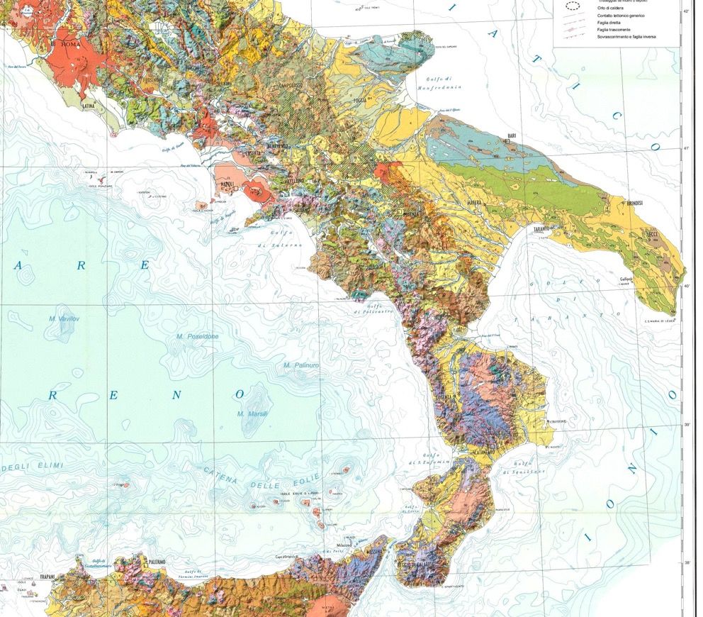
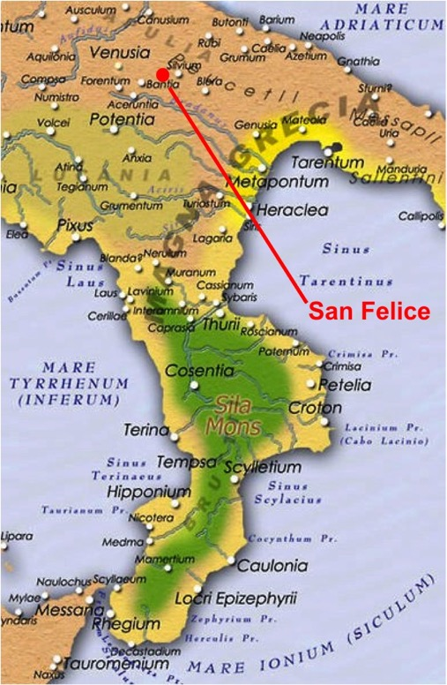
Study Area:
Regional Geology & Early Imperial Setting
Gravina
Most of the Basilicata and Puglia region is part of the Bradanic Foredeep,
an area that was a shallow sea until the end of the Pliocene. The geology
in the area is comprised of Pliocene marine marls overlain by lower
Pleistocene weakly cemented coastal sands and conglomerates. The whole region has been uplifted on the northwest by 300 to 500 m, and plunges beneath the Gulf of Taranto at Metaponto Our study area lies on what was the boundary between Italic and Messapian language speakers and Magna Graecia 2,000 years ago. Later it was the boundary between the Byzantine and Lombardi controlled areas, and later ruled by the Normans.

Slide 4
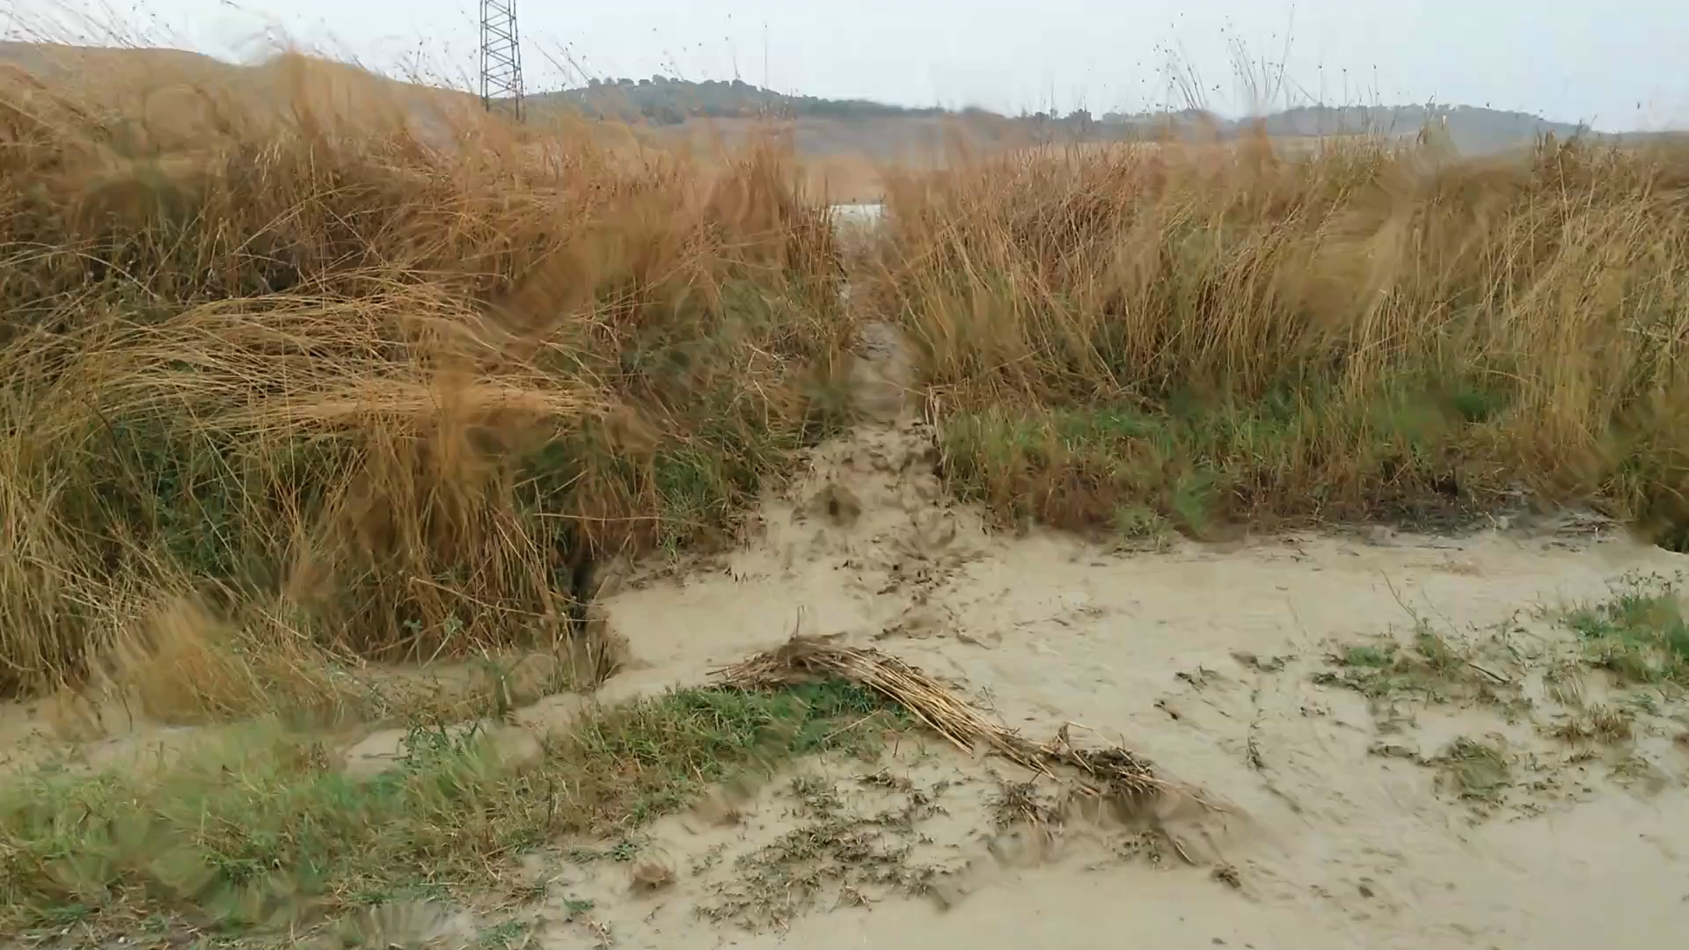
Torrential Summer rains following wheat harvest, chaff burning, and plowing in Italy in July 2015 carry sediment in a low- scale debris flows downslope. Sediment was carried into streams feeding the Bradano and directly into the Gulf of Taranto. The years 2013, 2014 and 2015 were especially bad for flooding and erosion. The shift in southern Italy from winter rainfall to high intensity Summer storms is resulting in significant erosion of hillsides and the exposure of underlying last interglacial rubified soils, and in many place Pliocene marine marls. The creation of infertile badlands threatens this important wheat growing region.

Slide 5
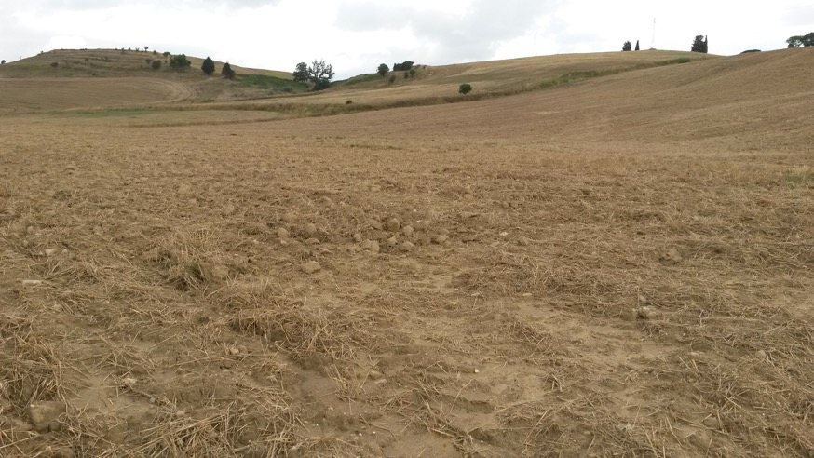
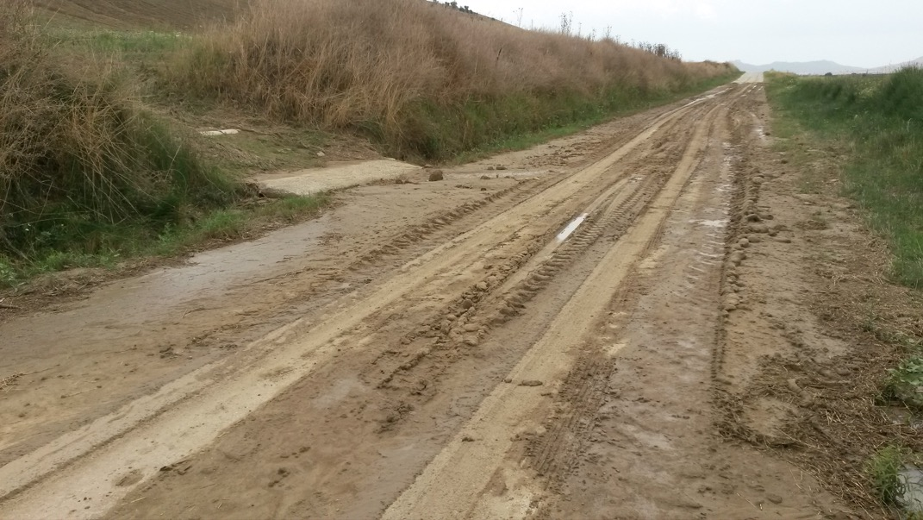
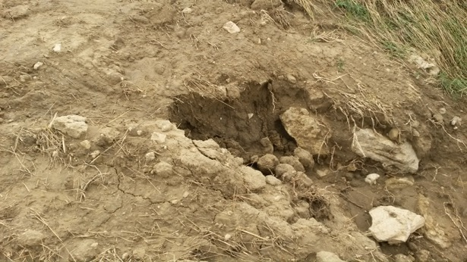
Results of a Single Storm
In summer of 2014, a week and a half after the wheat harvest, field burning, and plowing, the region was hit by numerous torrential rainstorms. This has been the pattern the last decade or more. It is a pattern that is to increase under the senereo of global warming. The Summer of 2016 the mud of this storm was still evident on the road.

Slide 6
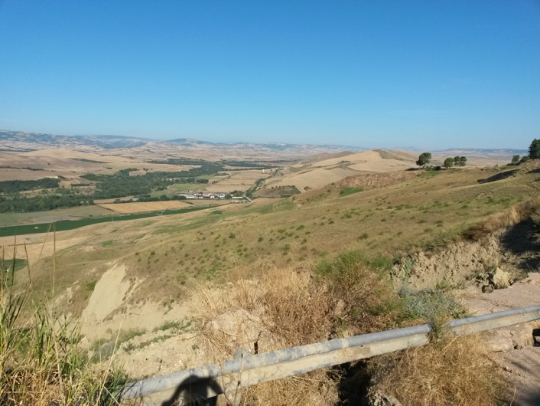
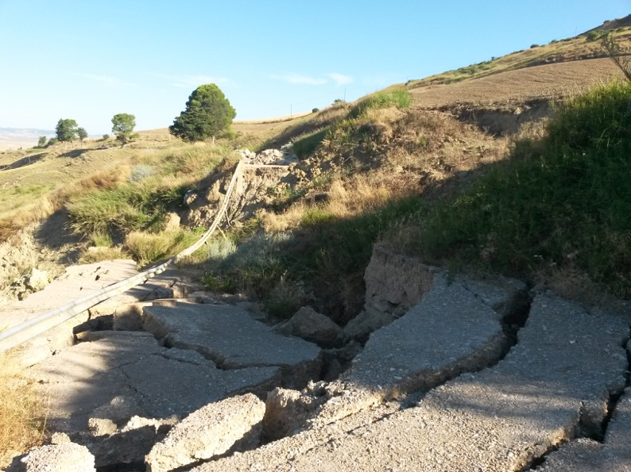
Environmental Imperative
Resulting Deteriorating Landscape:
1) Accelerating destruction of agricultural land resulting from climate change and poor agricultural practices, and the pressure from absentee landlords to maximize production by farming extreme locations
2) Destruction of local infrastructure, in particular road, which are not being repaired because there is little money coming from the government for this repair. I have traveled damaged roads which have been untouched for five years.

Slide 7
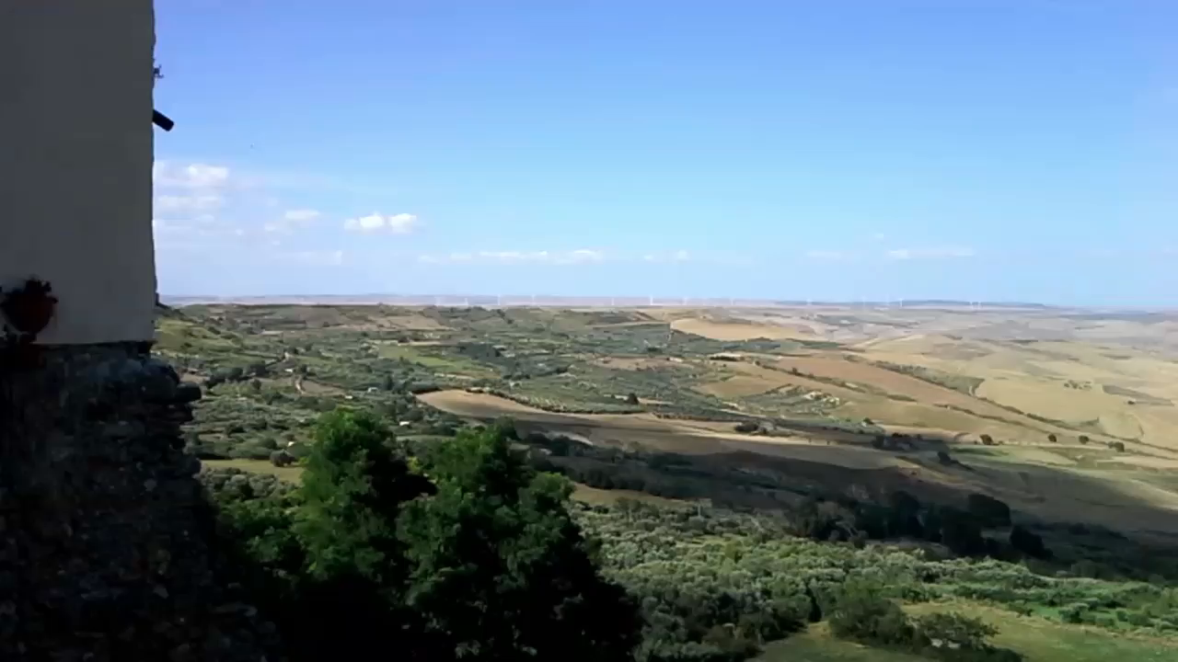
Study Area: Basentello/Bradano River Valley
The flat-lying country side of the Bradanic Foredeep is incised by small streams that have cut through the weakly cemented coastal sands and conglomerates and have exposed the easily erodible marine marls. In this view to the northeast and east from Irsina, the 200 m fault scarp east of Spinazzolla is evident. The immediate plateau is about 300 m above sea level.

Slide 8
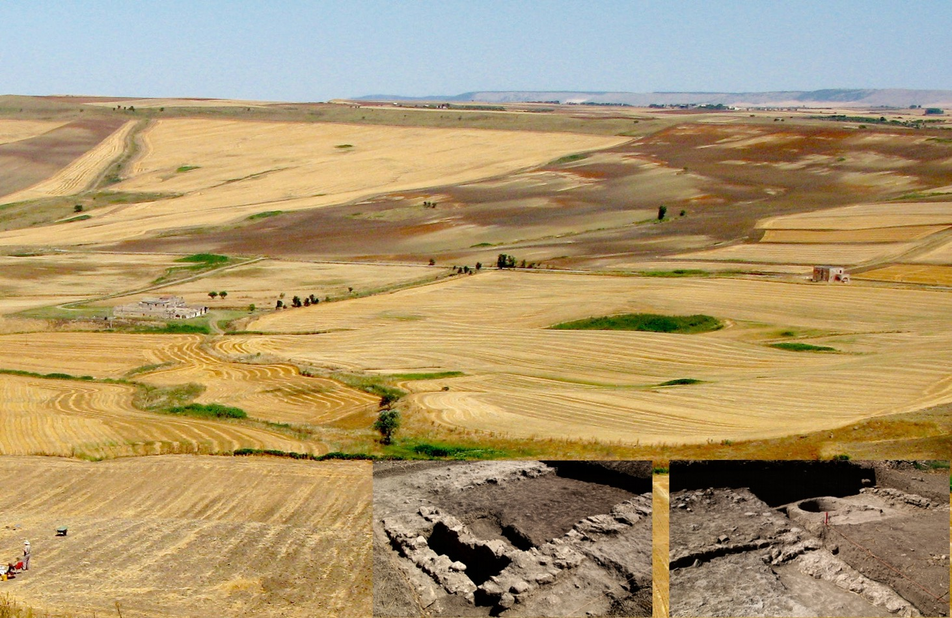
Soil Erosion in the Basentello Valley
Last interglacial rubified soils exposed above the Basentello River near the San Felice villa site (people at left and insets). The Spinazzola fault scarp is visible in the distance. The Vignari Masseria is in the valley at the left.

Slide 9
Proxy Data Collection
  Geomorphology
    Sedimentary Structures and Grain Size Analysis for Determining Stream Velocity
    Landforms for Sequencing Erosion and Deposition Events
  Soils
    Radiocarbon Ages on Soil Formation Episodes
    Strength of Soil Development for Duration of Events
  Springs
    Radiocarbon Ages of Timing, Magnitude and Duration of Discharge Events
  Vegetation
    Pollen of Local Vegetation to Document Changes in Community Structure

Slide 10
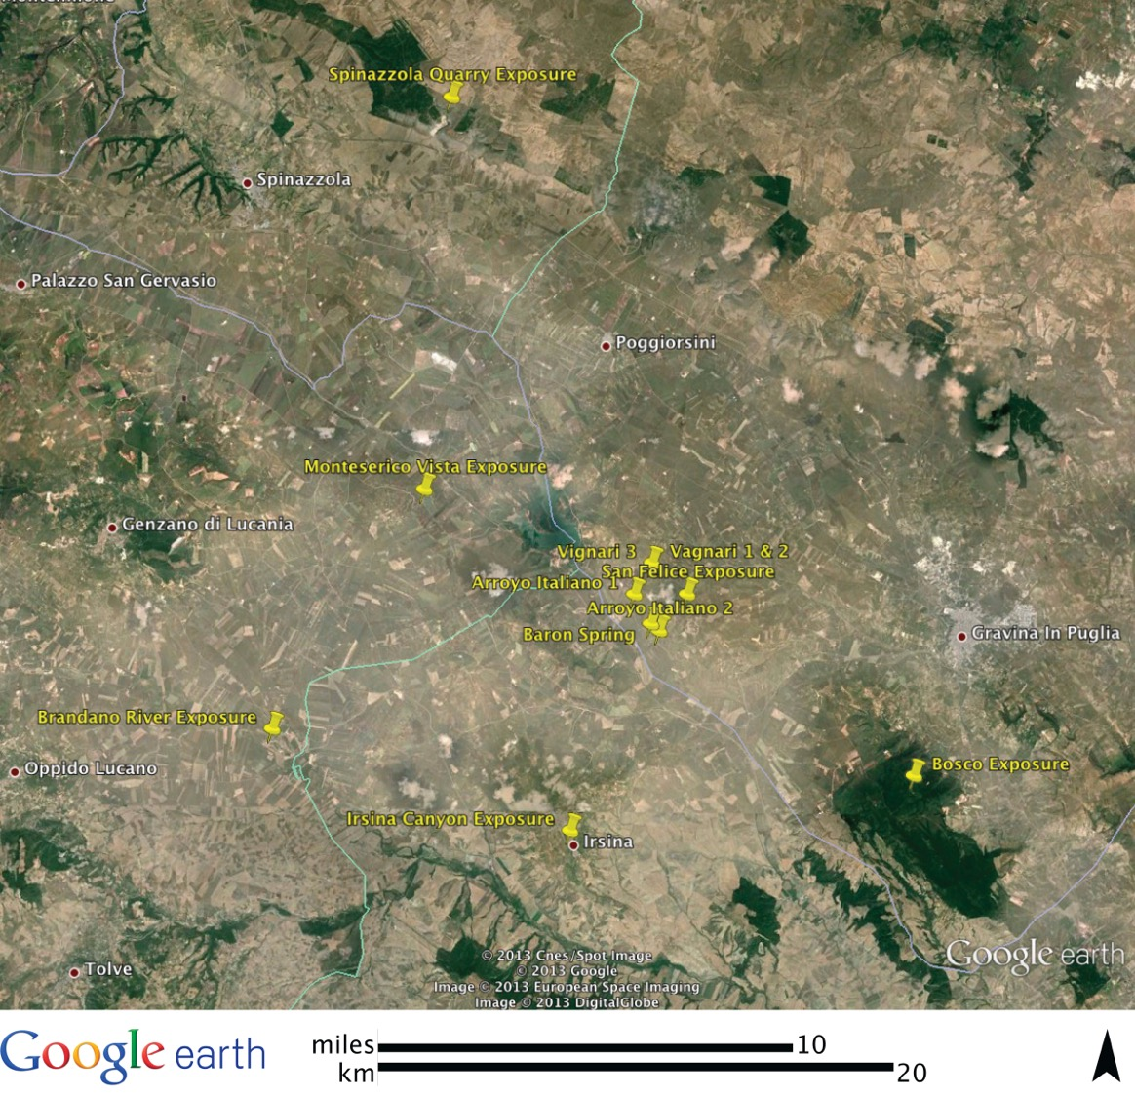
Sites
PRE-HOLOCENE
Spinazzola Quarry Exposure - 563 m
Brandano River Exposure – 259 to 276 m
Bosco Exposure - 439 m
Irsina Exposure - 539 m
San Felice Exposure
481 m
Castello de Monteserico
Vista Exposure - 363 m
Vagnari 3 Exposure
336 m
HOLOCENE
Vagnari 1 & 2 Exposure
336 m
Arroyo Italiano 1
Exposure - 259 m
Arroyo Italiano 2
Exposure - 252 m
Baron Spring - 252 m

Slide 11
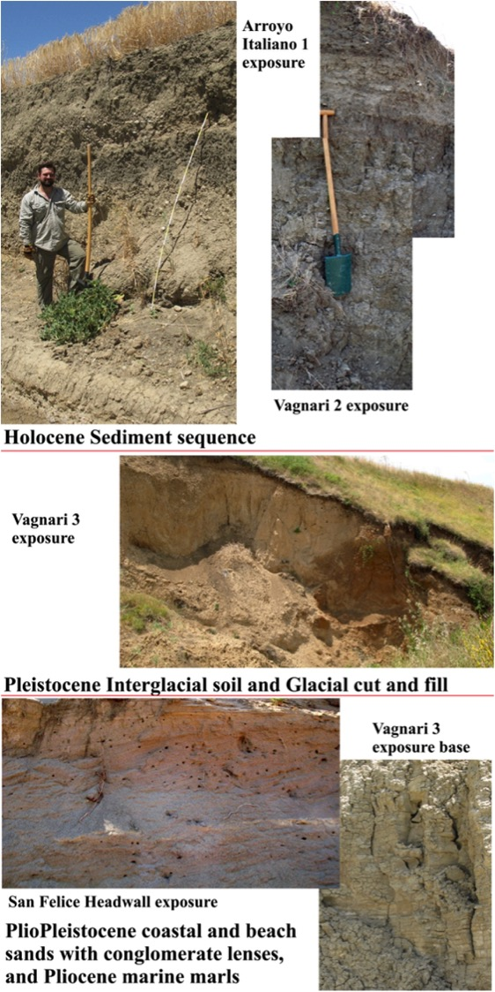
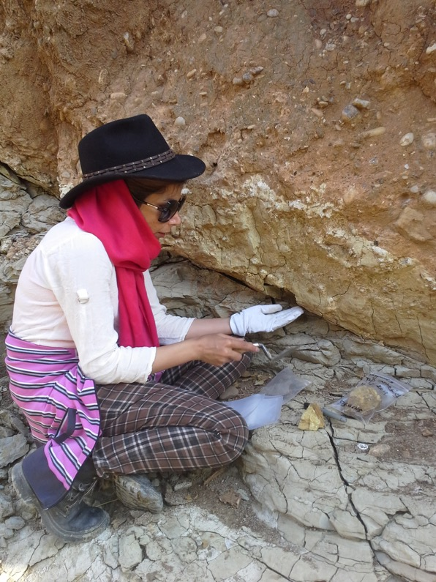
Sedimentary Units in the San Felice Area
The general regional stratigraphy is summarized on the left. In general the plateau tops are characterized by lower Pleistocene coastal deposits over lying Pliocene marine deposits. Stream valleys are comprised of Middle
Pleistocene through
recent alluvium and
slope colluvium. On
the right is the base
of an alluvial
channel cut into the
Pliocene marine
marls and filled with
carbonate cemented
gravels. A second cut
into this contains the
last Interglacial rubified
alluvium. The direction
of this channel is at a
right angle to the
Holocene channel.
Since the last
Interglacial there has
been about 80 m of
regional uplift.

Slide 12
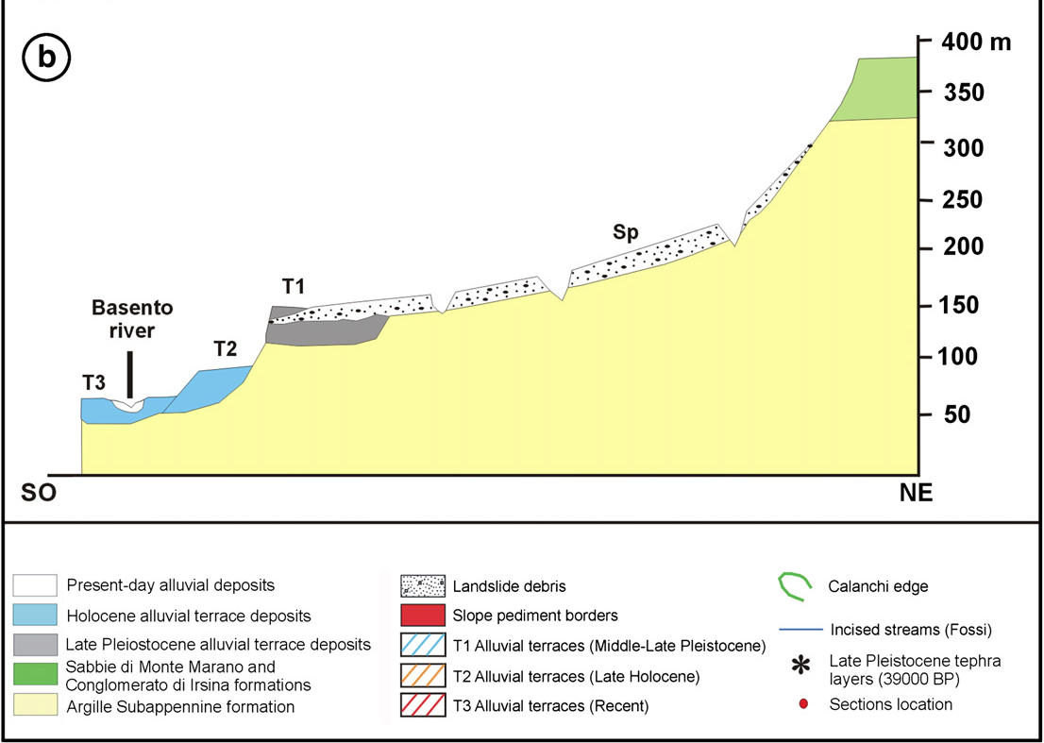
Summarized Regional Geological Stratigraphy
Diagram from F. Boenzi et al. / Geomorphology 102 (2008) 297–306 Fig. 2b. Schematic geomorphological profile (b).

Slide 13
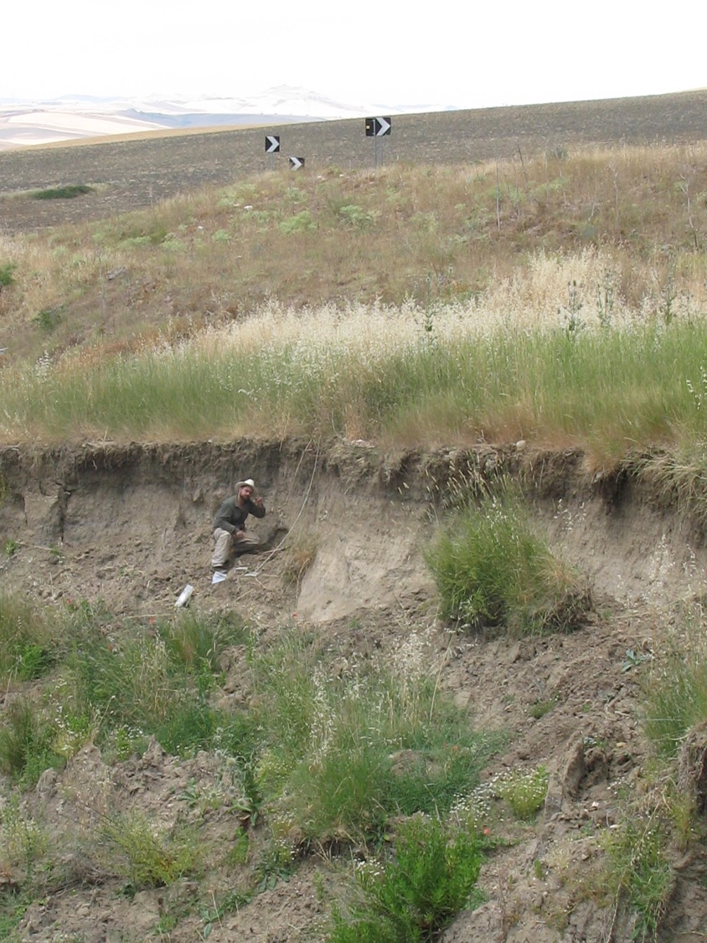
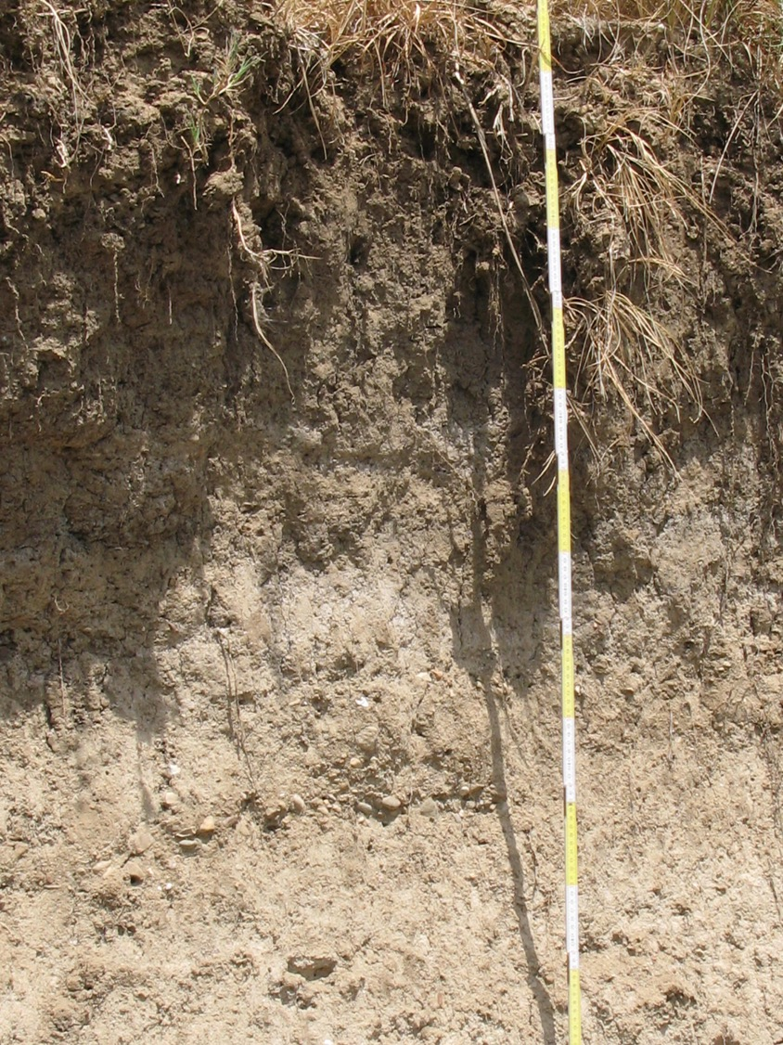
Vagnari 1 Exposure – ~1,400 years exposed with soil at the top
Don Antonio…our American graduate student

Slide 14
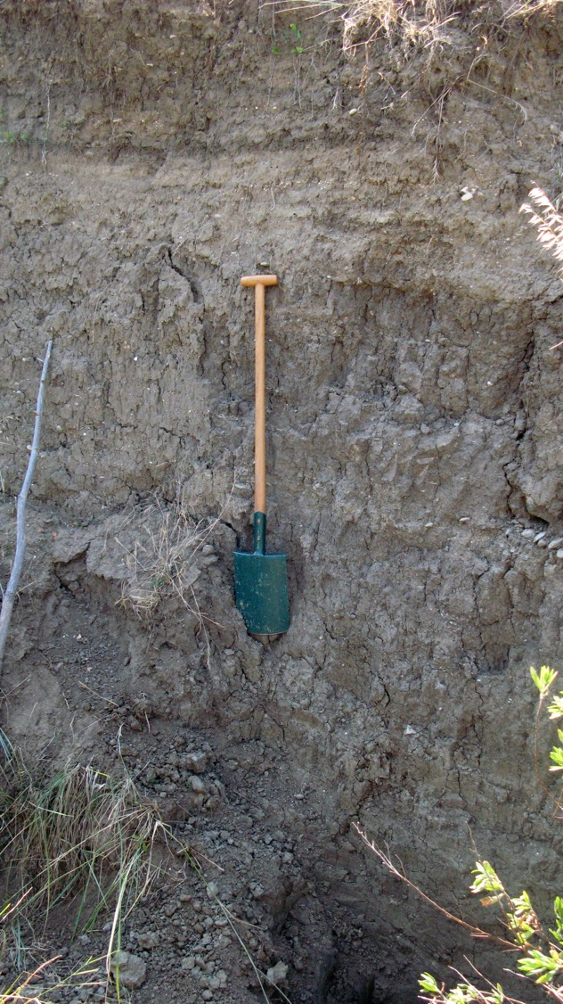
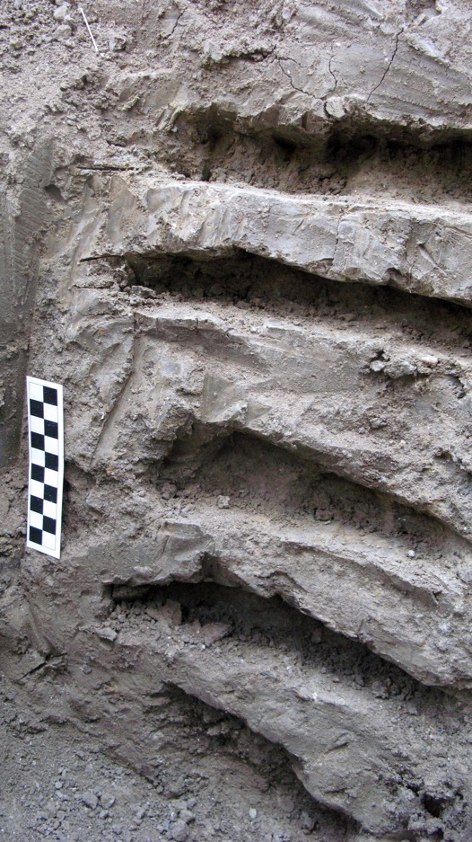
Vagnari 2 Exposure
This exposure reveals >8,500 years of alluvium. Depositional units are evident as well as occasional weathering profiles related to soil formation. The weathering profile level with the top third of the shovel is a 2,100 cal B.P. soil that can be traced regionally in all of our exposures as well as in the profiles of archaeological sites in the area. At the base of the profile is a gleyed unit containing snail shells suggesting ponding. This can also be traced in other exposures.

Slide 15
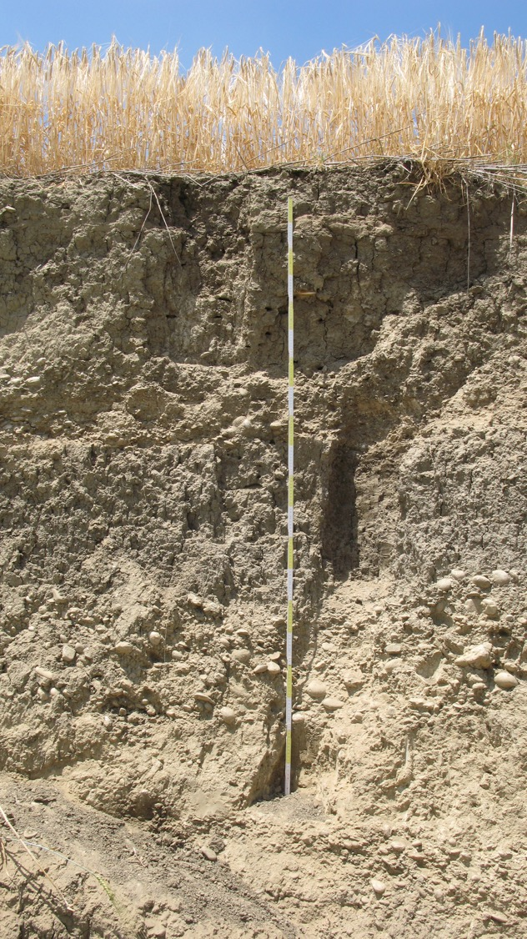
Arroyo Italiano 1
Upper two meters of stream cut exposing three cycles of sediment deposition.
Each cycle is initiated by a cutting event followed by deposition of poorly sorted gravels followed by finer and finer sediments.
In most cases the fine sediments have soil development of variable degree.
This exposure reveals about four major events, much fewer than the number of units exposed upstream. These units have been destroyed by larger flood events in the lower portions of streams.

Slide 16
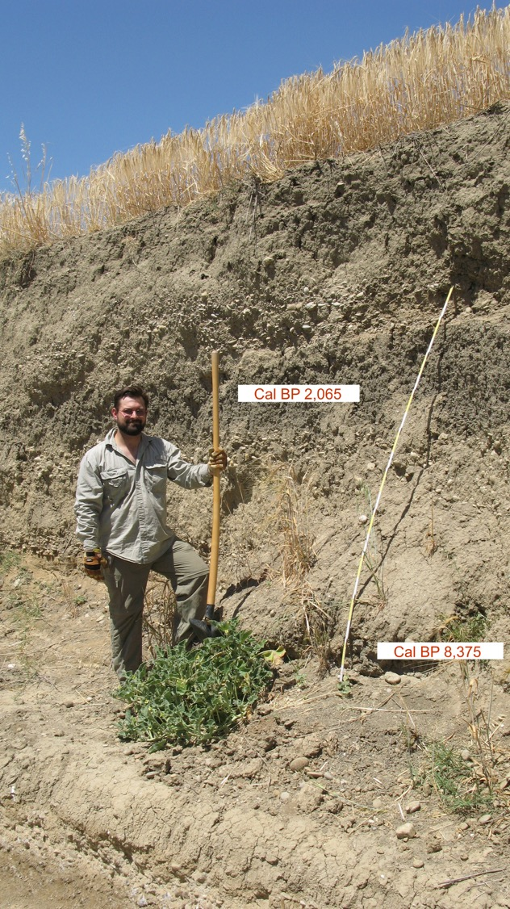
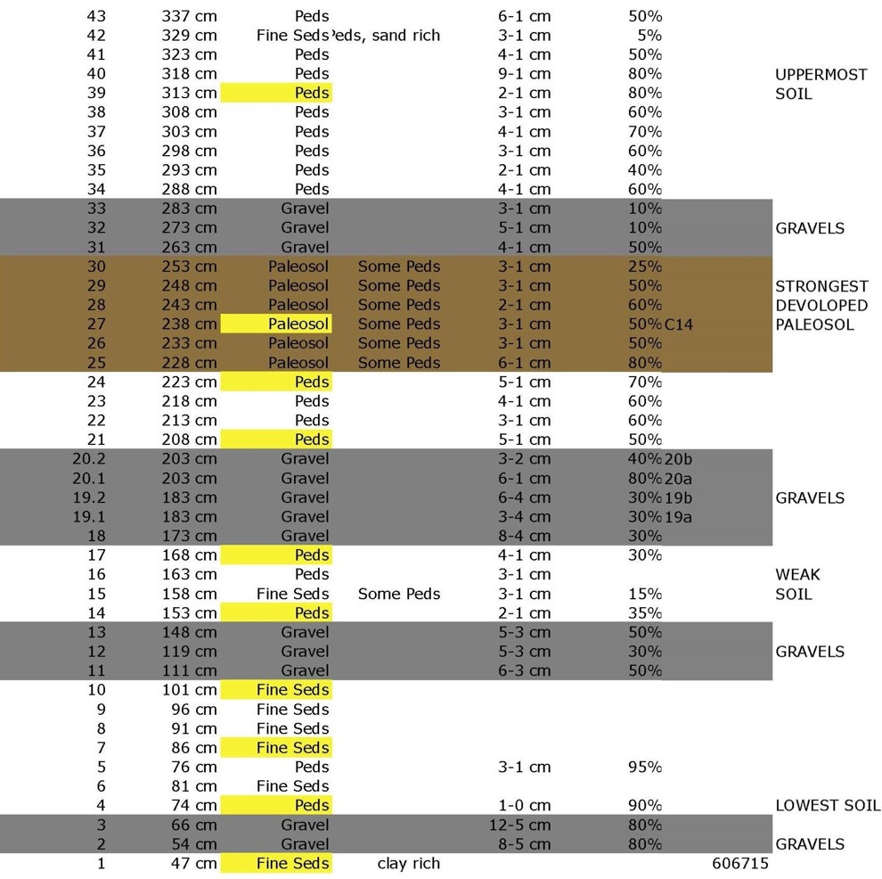
Arroyo Italiano 1 Stratigraphy
Stratigraphic description is aligned with the profile, AMS dates are placed in the profile where they were collected.

Slide 17
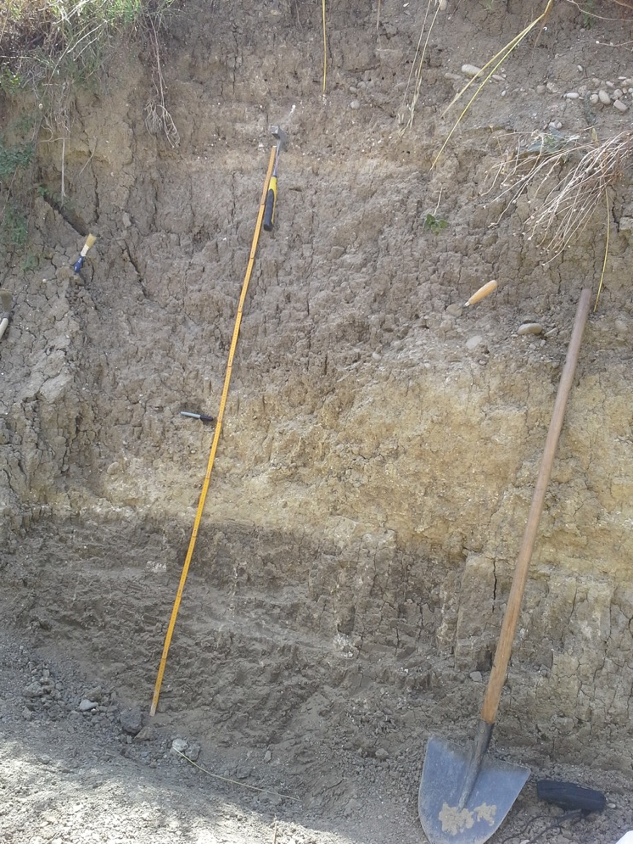
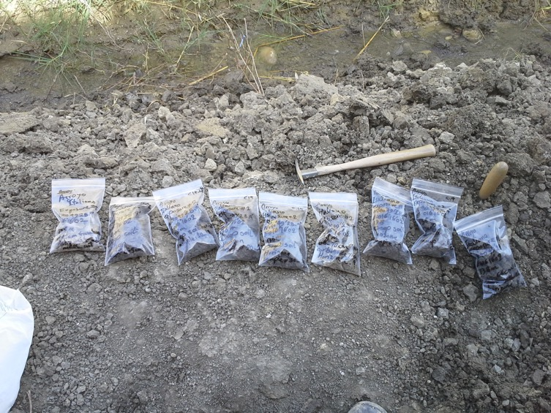
Cleaning & Sampling the Exposures
The cleaned exposure at Arroyo Italiano reveals the two major Holocene soils. The upper at the top 1/3 of the meter stick is 2,100 cal B.P. and the lower soil (the dark unit in the lower 1/3 of the meter stick) is 8,400 cal B.P.
We have collected over 400 sediment samples to be used for grain size and other analysis. We are interested in lead content as an indicator of when people in this region began to fabricate lead artifacts.

Slide 18
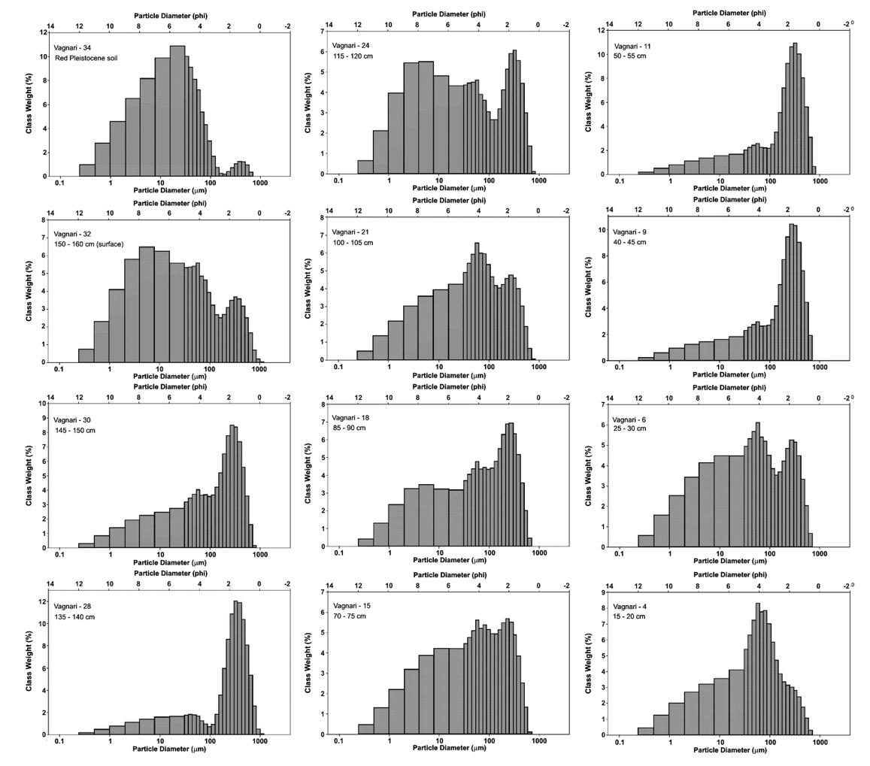
Vagnari 1: Initial Sediment Analyses
Mastersizer grain size analyses of Vagnari alluvial exposure. Upper left sample is from underlying channel fill that has dates to the last interglacial and has been rubified. Sample 34 is near top of Holocene alluvial section, and sample 4 is near the base of the profile.

Slide 19
Vagnari Sediment Analysis: Revealing Episodic Events
Measurement from Base of Exposure (cm)
finer grain size →
Finer Skewness →

Slide 20
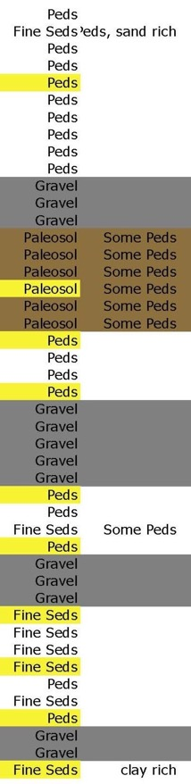
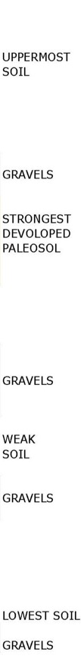
Arroyo Italiano 1: Grain Size Parameters
Mesokurtic to Leptokurtic →

Slide 21
Arroyo Italiano 1: Mean vs. Sorting
Sand---------------|Silt------------==---|Clay--------->
Red indicates samples from soils
Samples are numbered from the base of the exposure, 1 -43
More poorly sorted --------------------------------------------------------------------------->

Slide 22
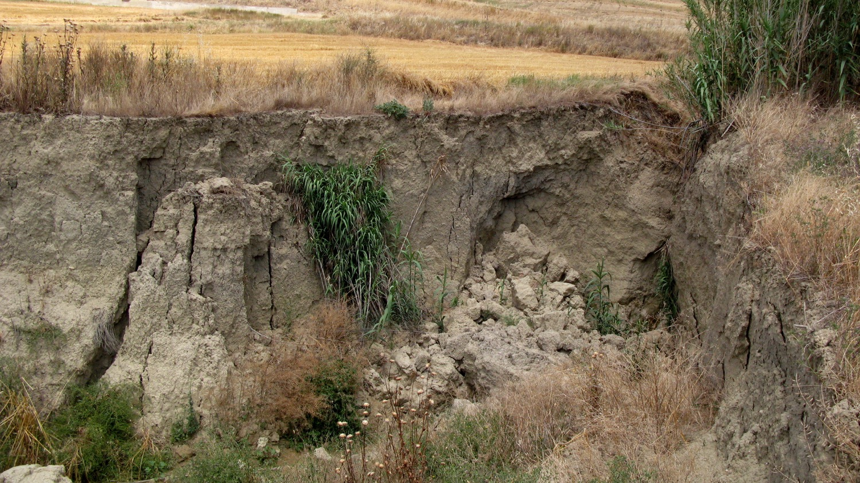
Arroyo Italiano 2 Exposure
This exposure lies close to the flood plain of the Basentello River. Gravels and coarse sands have been deposited upstream. Ongoing arroyo cutting is exposing deeper and deeper deposits. In 2013 when this photo was taken about 8,400 years of sediment was exposed.

Slide 23
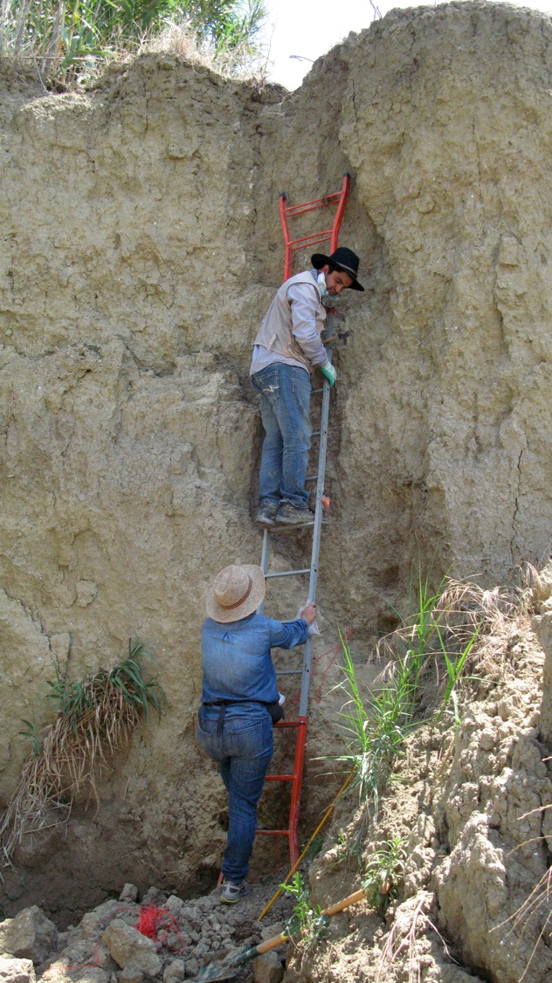
Sampling
Arroyo Italiano 2 the Summer of 2013
The summer of 2013 Arroyo Italiano was sampled, and will be analyzed as funding becomes available. Here my Iranian students are sampling a three meter profile.
The samples that I have taken thus far are from alluvial deposits. Soils that existed on slopes have, in most cases been eroded away. There are hints of weathered sediments that can be correlated with the regional soils are evident.
Another fact that we have noted with these exposures is that in most cases, although there have been erosional cycles, the current cycle of down cutting far exceeds any which has occurred during the last 20,000 years in the Gravina area.

Slide 24
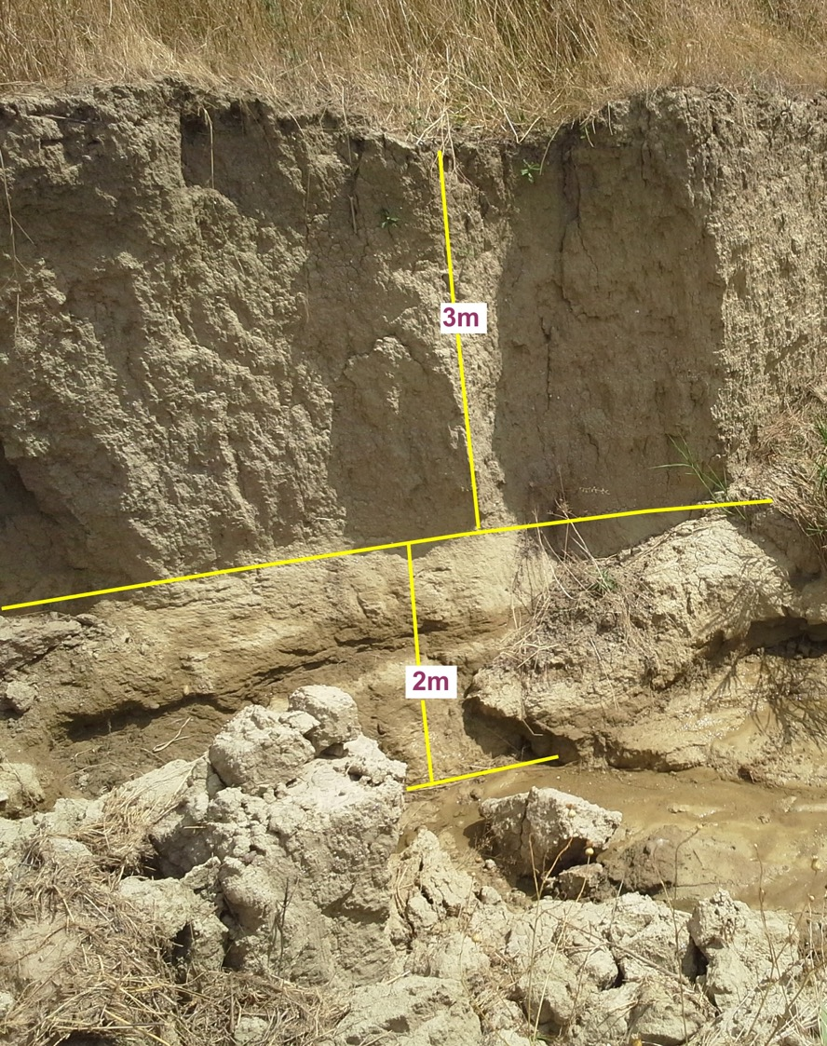
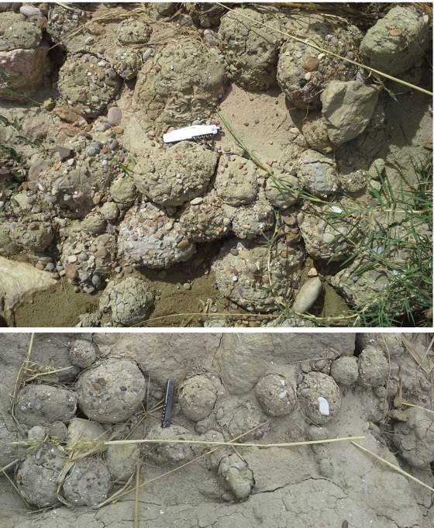
Arroyo Italiano 2 after the Winter of 2013 to 2014 Rains
In the Summer of 2014 an additional 2 meters of profile was exposed for sampling! And the bed was filled with armored mud balls.

Slide 25
Using Mud Balls and Hjulstrom’s Diagram to Determine Flood Velocities
The Hjulström curve is named after Filip Hjulström (1902–1982) who published it in his doctoral thesis, "The River Fyris" in 1935 . It is used by hydrologists to determine whether a river will erode, transport, or deposit sediment. It takes sediment size and water velocity into account and demonstrates the relationships between erosion, transportation, and deposition.
For particle sizes where friction is the dominating force preventing erosion, the curves follow each other closely and the required velocity increases with particle size.
However, for cohesive sediment, mostly clay but also silt, the erosion velocity increases with decreasing grain size, as the cohesive forces are relatively more important when the particles get smaller.
The critical velocity for deposition, on the other hand, depends on the settling velocity, and that decreases with decreasing grain size. The Hjulström curve shows that sand particles of a size around 1 mm require the lowest stream velocity to erode.

Slide 26
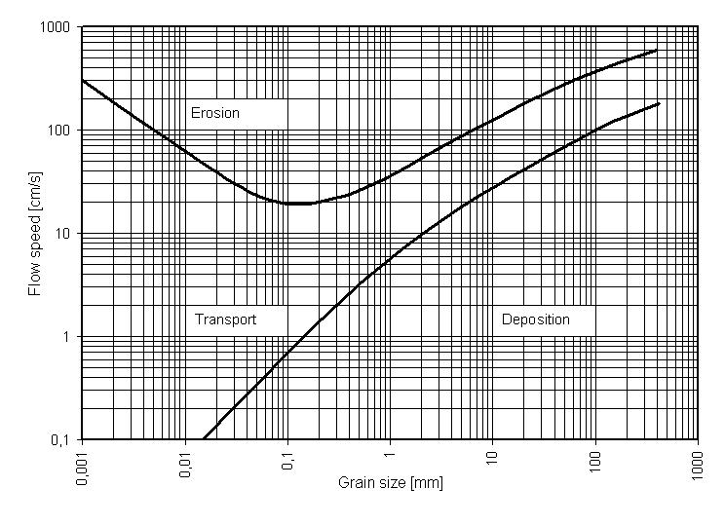
Hjulstrom’s Diagram
The upper curve shows the critical erosion velocity in cm per second as a function of particle size in mm, while the lower curve shows the deposition velocity as a function of particle size. Note that the axes are logarithmic.

Slide 27
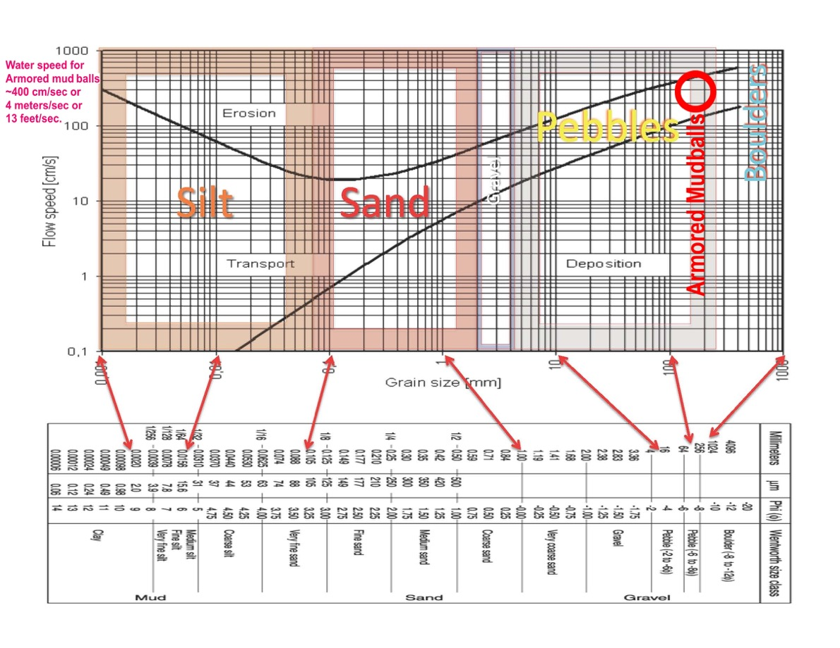
Water Velocity Indicated by Armored Mud balls
The size of the largest armored mud balls lies within the range of the red circle in the diagram. For an object of that size the water velocity is about 4 meters/second. The other possibility is that the flow was very viscous.

Slide 28
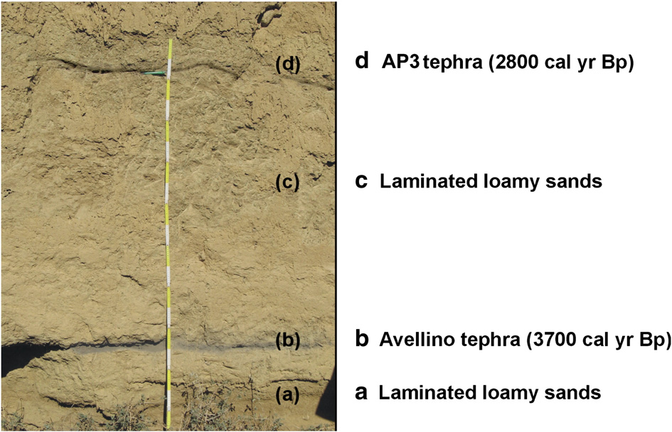
Regionally there are three to four volcanic ashes that have been reported from alluvial exposures. F. Boenzi et al. / Geomorphology 102 (2008) 297–306 report in their Fig. 6. Holocene tephra layers in Fosso La Capriola (CAP 2 succession). We have found none of these so far. Possibly because these have been eroded from our sequences or because they were carried further south, or because units containing them have been destroyed.

Slide 29
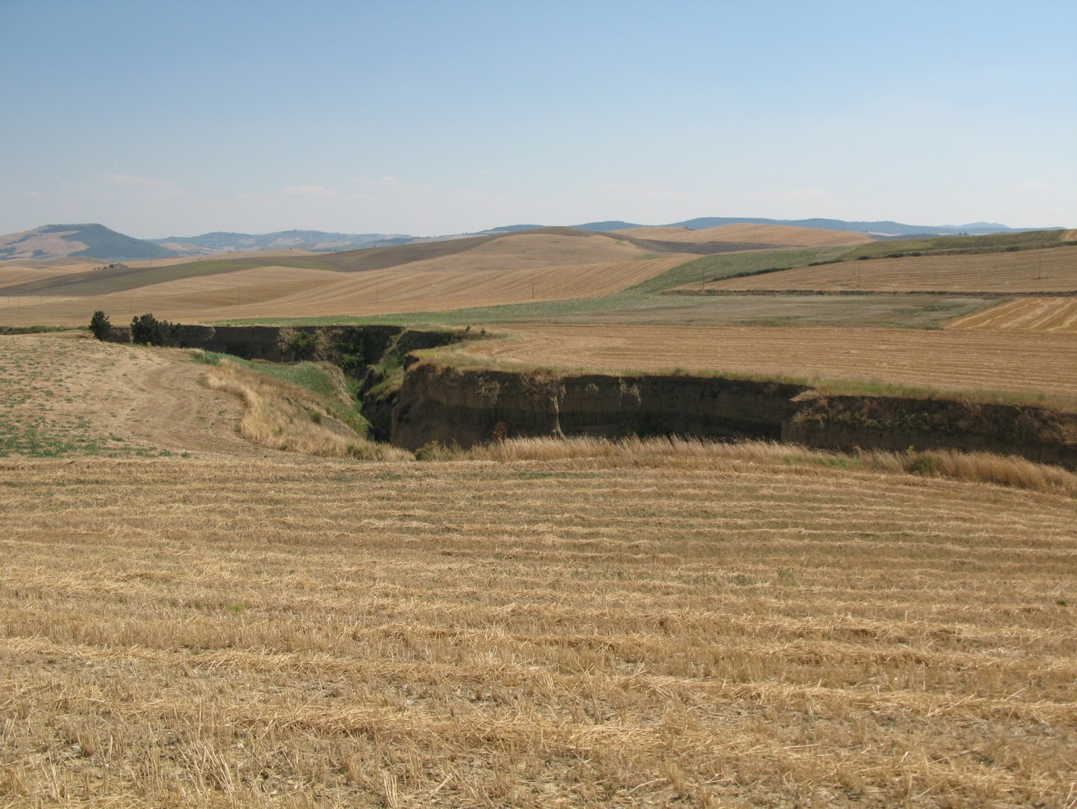
The Irsina Exposure: a newly identified exposure that we are sampling

Slide 30
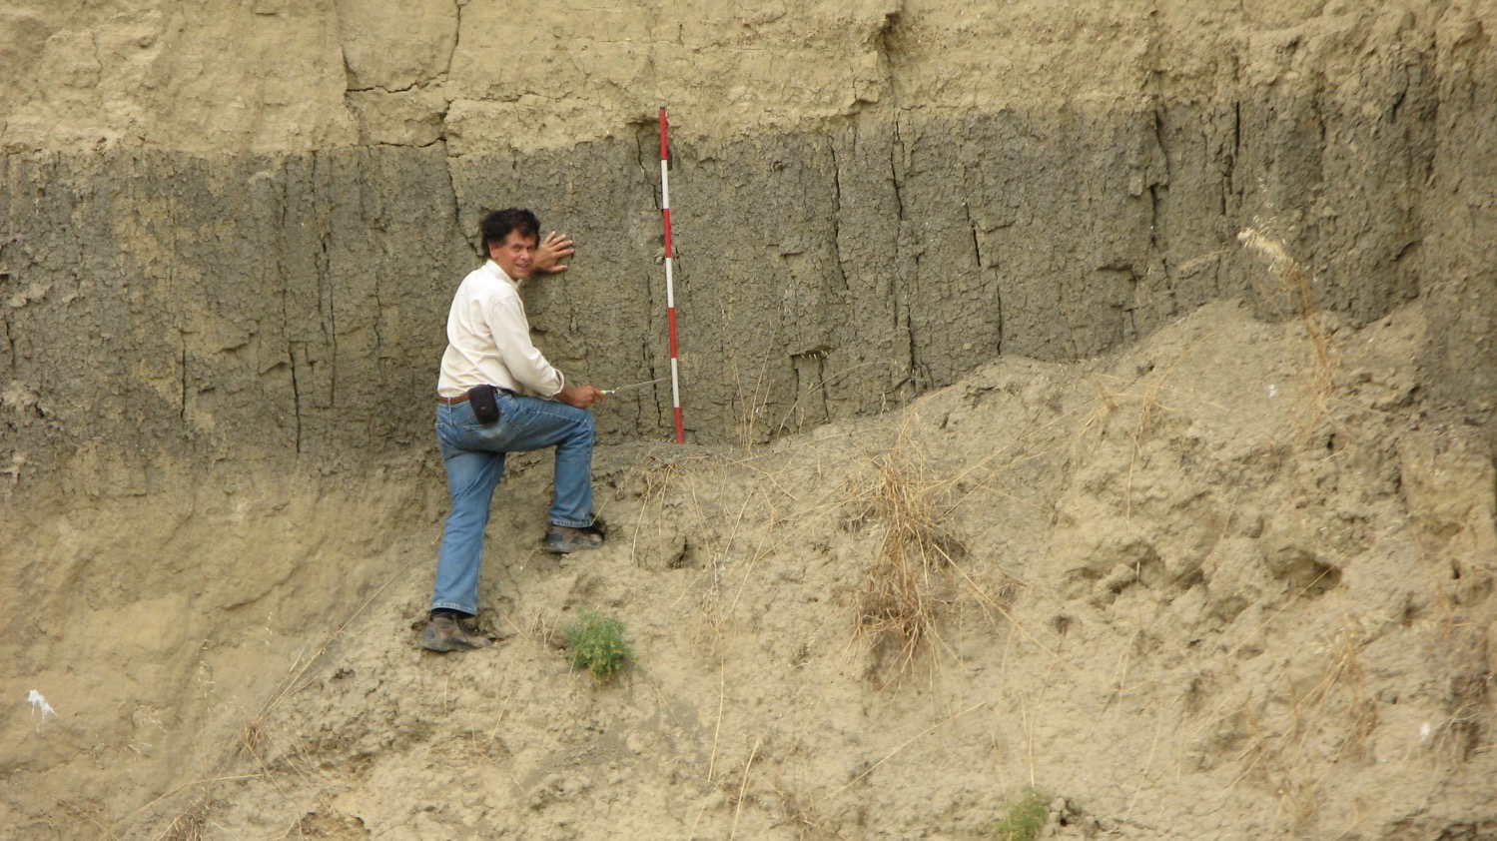
Irsina Exposure
Several soils within this exposure are over 4 m thick. Several are truncated by flood events. There are only a few fine gravel units.

Slide 31
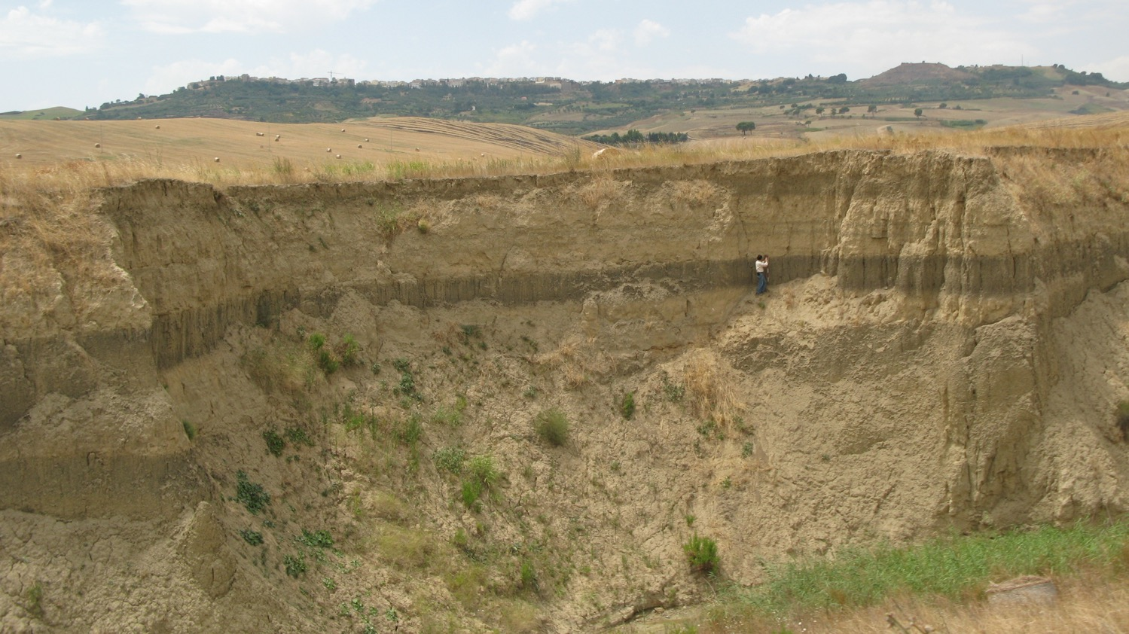
The Exposure with Irsina in the Background
Three soils are clearly visible in this exposure. The lowest one conforms to an ancient channel.

Slide 32
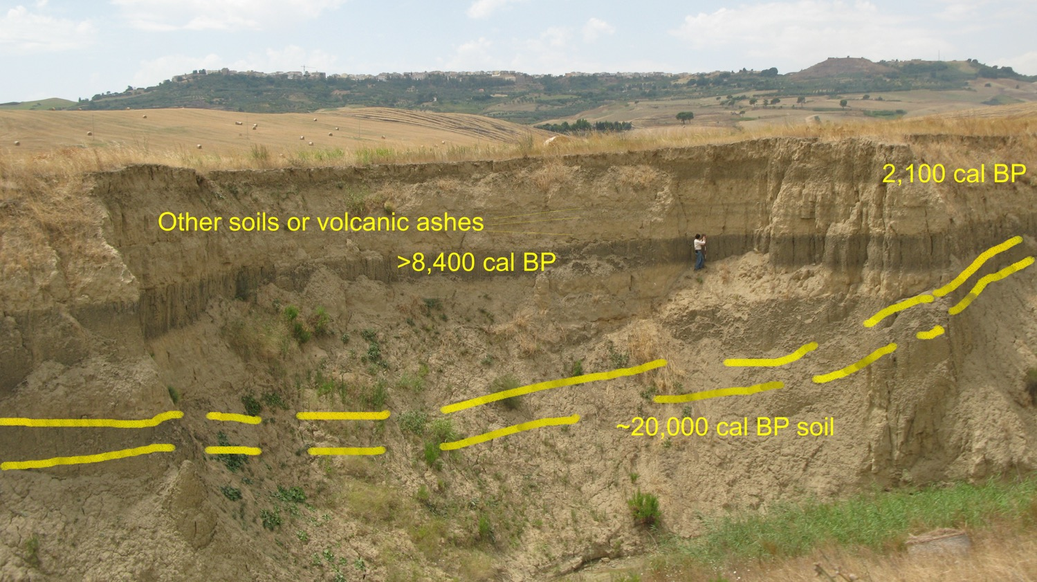
Dated Strata of Irsina Exposure
Based upon correlation with other exposures we have dated in the region there is at least 21,000 years of alluvial history exposed. The current 15 m-deep alluvial cut is unequalled at any time during the last 21,000 years, and is due to current land use practices coupled with the change in precipitation timing and intensity.

Slide 33
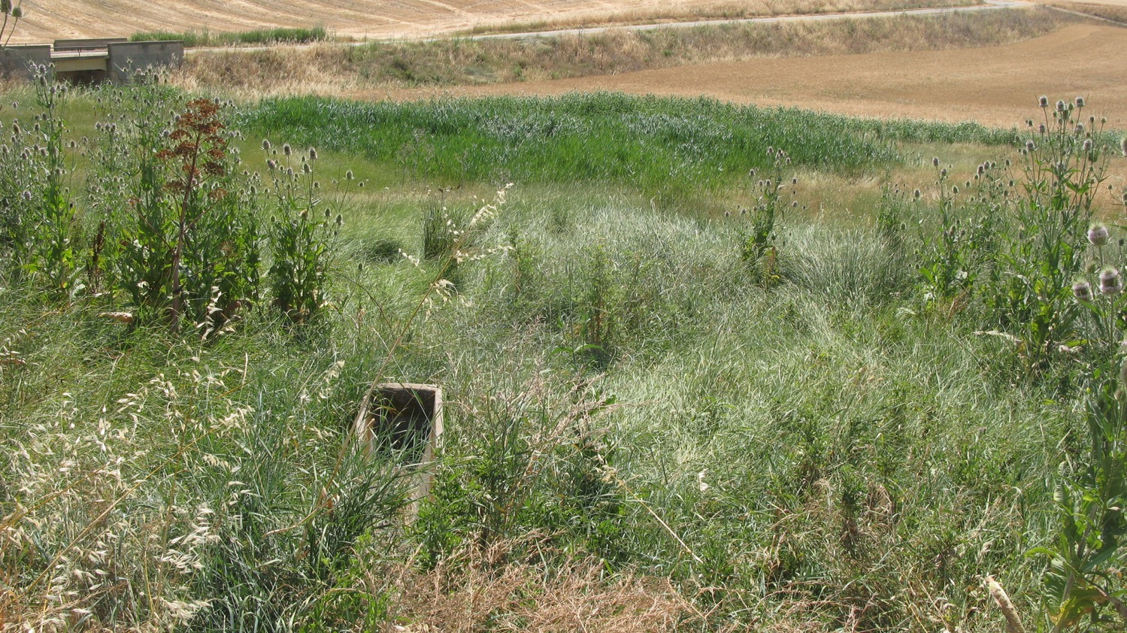
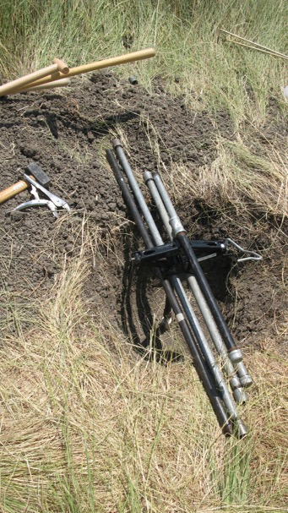
Baron Spring
A 4,000-year record of Spring Discharge contains at least three major increased discharge events, that can be correlated increased rainfall and episodes of soil formation.

Slide 34
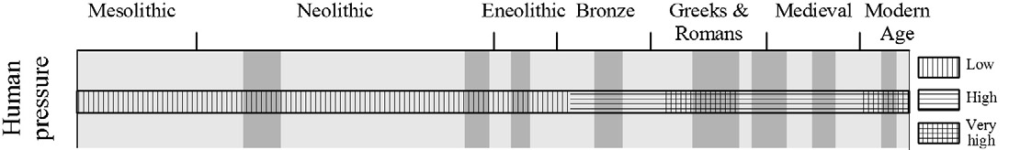
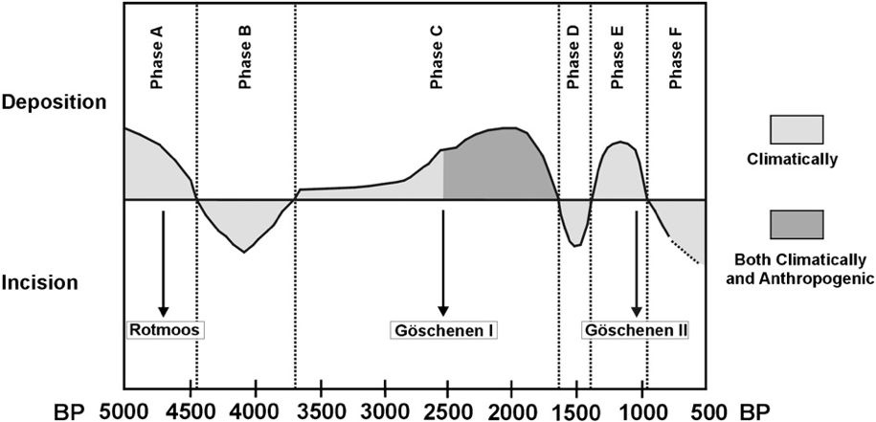
8375 cal BP
3700 cal BP
2065 cal BP
Composite diagram showing the Relationship deposition and erosion stages in Fossa Bradanica and main climatic epochs during the Holocene in Europe (F. Boenzi et al. (2008) 297–306.) Relative human activity for the Holocene in southern Italy (M. Piccarreta et al. (2011) 137–147.)
The cal BP dates at the red lines are dates that we have from alluvial exposures. The blue cal BP date is on the deepest spring discharge event at Baron Spring.

Slide 35
Use of Meso-scale Climate Model to Assess the Impact of Climate Change and Landscape Dynamics
We are pursuing the impact of variations not only of annual precipitation and temperature, but also of their seasonal variation.
  Seasonal variation may result in significant changes in the kind and density of vegetation cover, and landscape processes.
And we are investigating the evidence of human land use and its impact upon the landscape.
  Because the surface geology is extremely sensitive to human activity, we are going to map site locations on the landscape and the geological surfaces that were being impacted.

Slide 36
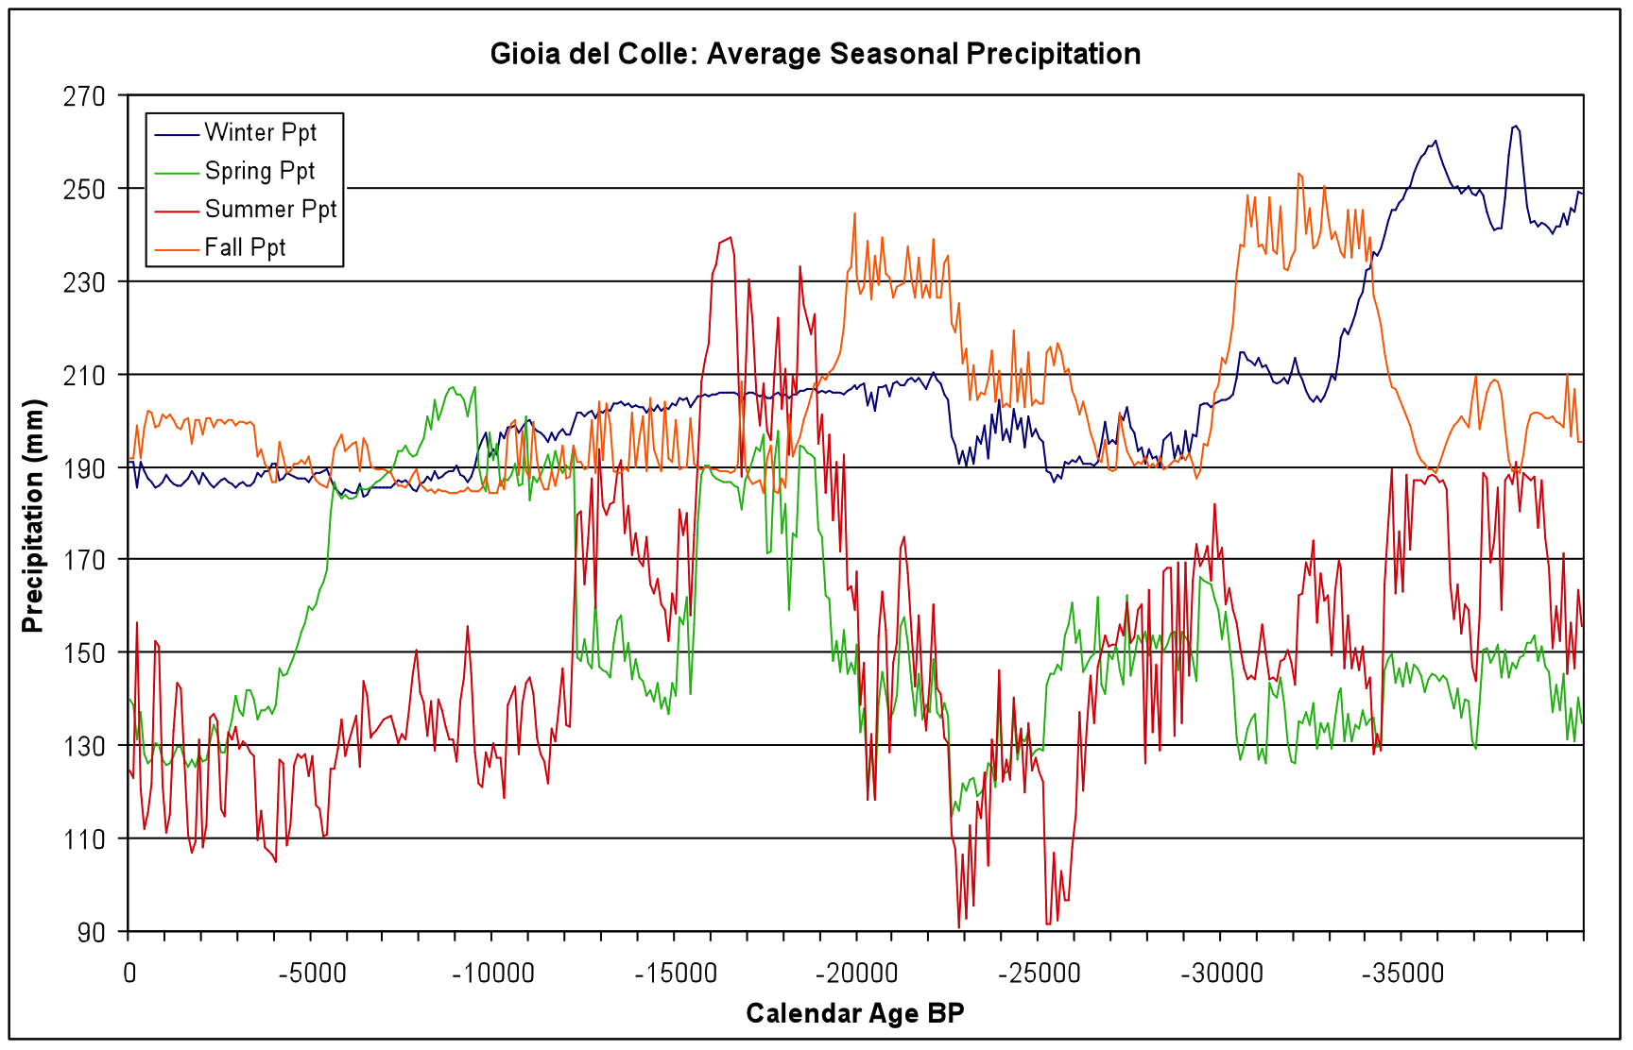
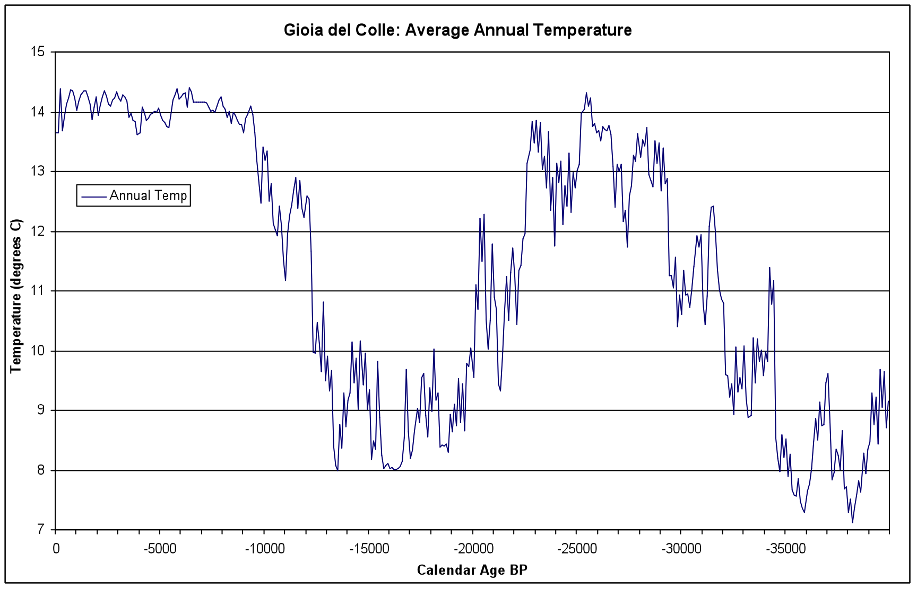
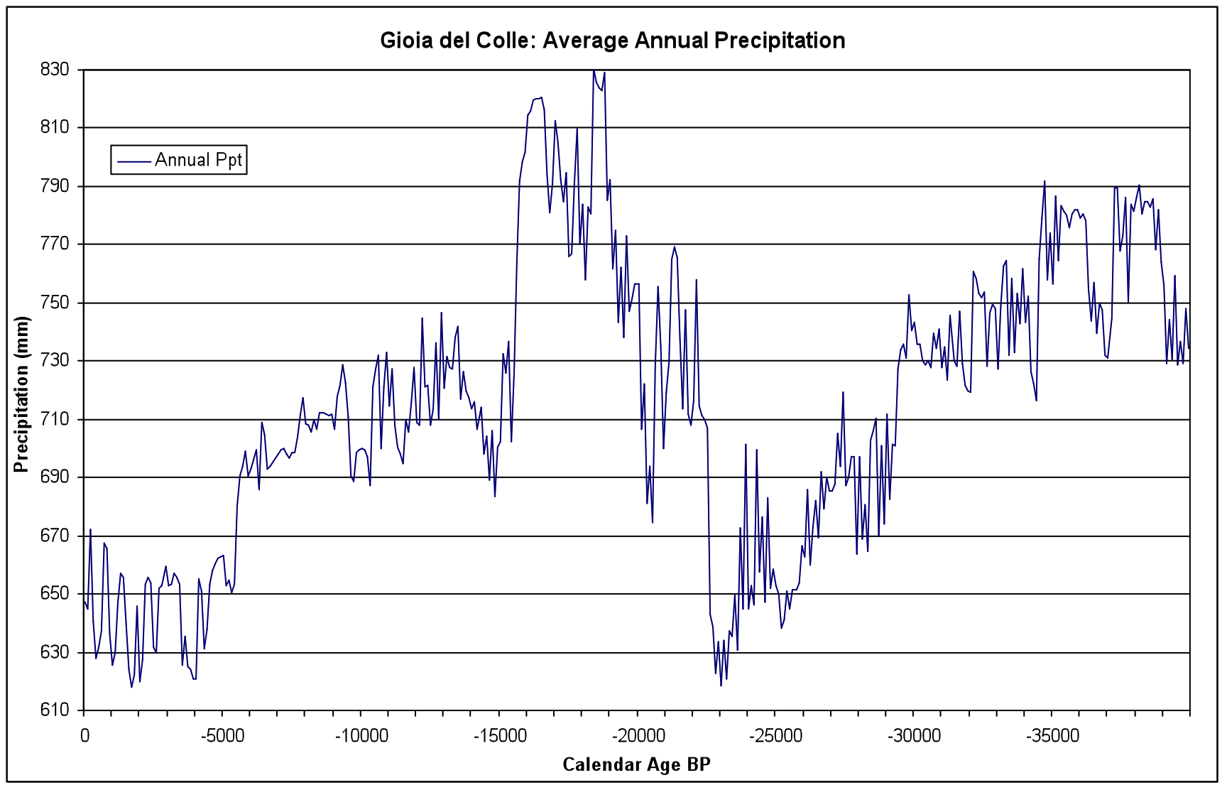
Applied Bryson and Bryson MCM Physical Climate Model: Precipitation and Temperature for 40,000 years

Slide 37
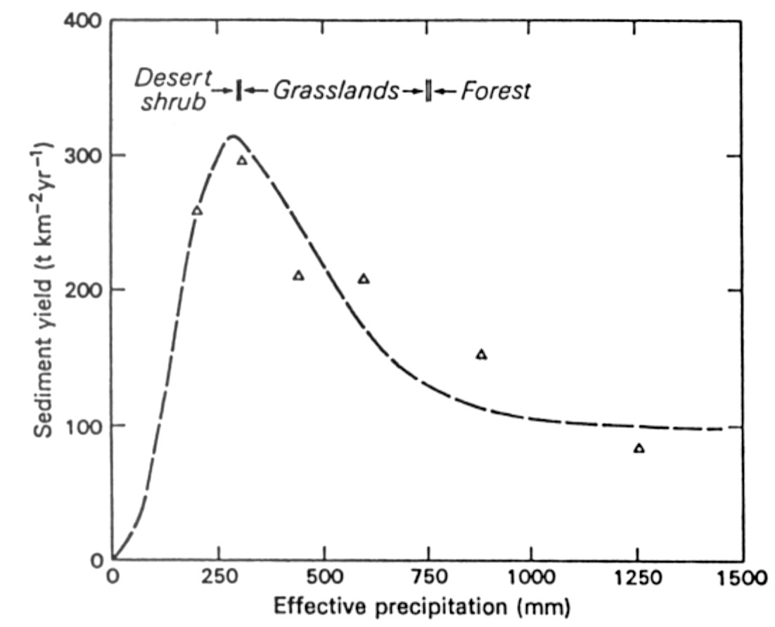
Schumm’s Curve
Modeling Past Erosion Cycles
Desert shrub / Semi-arid woodland / Montañe woodland
To determine the contribution of past climate to regional erosion we applied the Langbein and Schumm model to the MCM climate reconstruction from Gioia del Colle.
The relationship between sediment yield (erosion) and effective precipitation (adjusted for temperature variations; after Langbein and Schumm 1958).

Slide 38
Explanation of Langbein & Schumm's Curve (the Langbein-Schumm Rule)
The relationship between precipitation and sediment yield is not linear because precipitation has an opposite effect on the two factors which directly determine sediment yield — stream discharge and sediment concentration.
    Stream discharge increases with greater precipitation.
    Sediment concentration decreases in response to the associated increase in plant cover.
    The maximum sediment yield observed occurs under semiarid conditions because a semiarid climate has sufficient precipitation to promote ample runoff, yet insufficient rainfall to produce a vegetative cover which will inhibit the erosion process effectively.

Slide 39
Langbein & Schumm's Curve &
Changing Erosion Rates During Glacial & Interglacial Climates in the Same Area.
Interglacial Conditions vs Glacial Conditions
less precipitation more precipitation
less vegetation cover more vegetation cover
less ground surface protection more ground surface protection
more surface erosion less surface erosion

Slide 40
Langbein & Schumm's Curve & Changing Erosion Rates During Transitions from Interglacial to Glacial Climates in the Same Area.
Transition to wetter conditions
precipitation increases
ground cover increase lags behind the increased precipitation
as a result the increase in ground surface protection lags behind the increase in precipitation
erosion rates increase until the vegetation cover and ground surface protection finally catch up.
at that point erosion rates are low because even though there is abundant precipitation vegetation cover and ground surface protection is high.

Slide 41
Langbein & Schumm's Curve & Changing Erosion Rates During Transitions from Glacial to Interglacial Climates in the Same Area.
Transition to drier conditions
precipitation decreases
ground cover decrease lags behind the decreased precipitation, but fire soon thins and clears relict glacial vegetation
the decrease in ground surface protection results in increased erosion rates
however if the trend is to even lower amounts of precipitation so that ground cover becomes minimal, but because precipitation is minimal little erosion occurs.

Slide 42
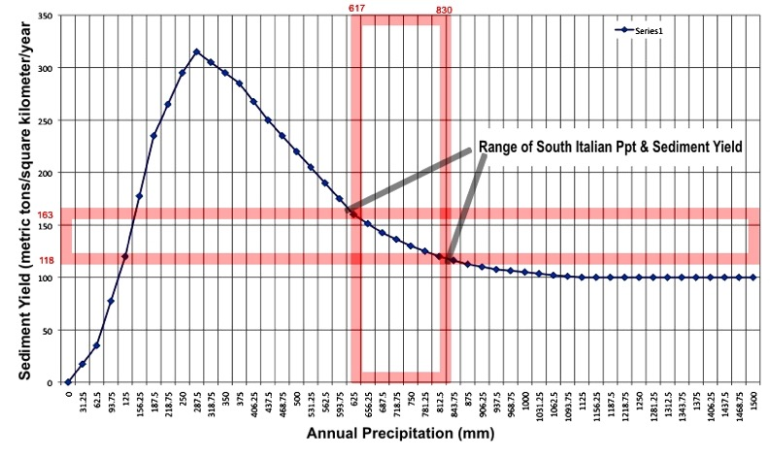
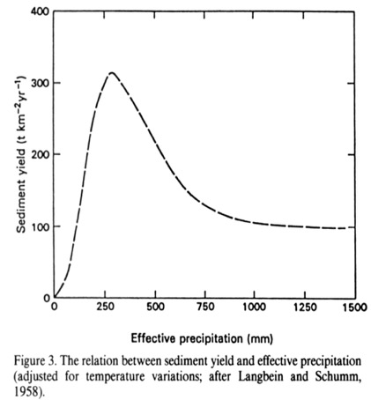
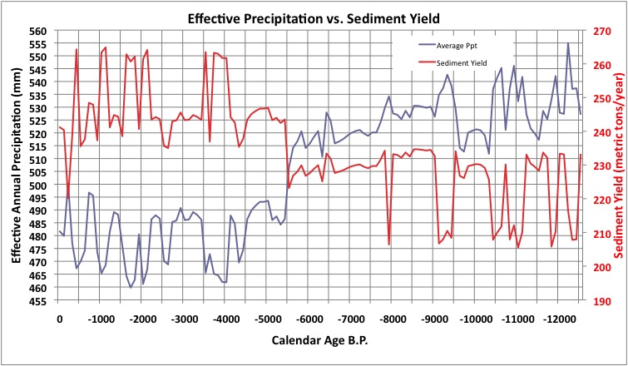
Langbein and Schumm Curve
We have converted the MCM modeled precipitation to effective precipitation, and plotted it with respect to sediment yield from the Langbein and Schumm (1958) model to show predicted correspondence between effective precipitation and Erosion cycles in Southern Italy.

Slide 43

Correlation of Model with Alluvial History
When the model of predicted erosion is compared with the sum of the record of calibrated ages B.P of erosion cycles in the Mezzogiorno, correspondence is clear. Events connected with yellow lines are climate based, whereas with blue lines are caused by intensified land use.

Slide 44

Bryson MCM Physical Climate Model: Role of Seasonal Precipitation
MCM modeled seasonal precipitation for the last 12,500 years. Fall and Winter precipitation have not varied as much as Spring and Summer precipitation.

Slide 45

Correspondence of MCM Modeled Spring plus Summer Precipitation and Erosion Cycles.
MCM modeled seasonal precipitation for the last 12,500 years for Spring and Summer precipitation have been combined (purple line) in the upper diagram.
In the lower diagram are the cumulative dates cal B.P. of erosion cycles in southern Basilicata.

Slide 46

Overlay of the Σ of Spring and Summer Precipitation on the Σ of calibrated dates on erosion cycles.
Erosion cycles began after a major decline in Spring precipitation during the last 8,000 years. Episodes of erosion generally begin after the onset of episodes of Summer precipitation after a Summer drought during the last 5,000 years.

Slide 47

Stream Discharge
Reconstructed regional stream discharge during the Holocene is another clue to both the change in climate, and also to the sediment transport potential of streams.
The Bryson MCM model also includes a module to reconstruct stream discharge.
Unfortunately, the major streams in the Basilicata region either do not have a modern discharge record, or the two that do, have records of only ten years, too short to create a reliable reconstruction of Holocene stream discharge.
The nearest similar stream is the Vjose River across the Adriatic in Albania. We used the modern discharge record from the lowest gage at Dorze, Albania.
The similarity between the late Holocene Summer stream discharge record of the Vjose River and the erosion cycles in southern Italy is evident.
Increased stream discharge enables streams to have greater sediment carrying capacity thereby facilitating landscape erosion.

Slide 48


Holocene Precipitation vs
Holocene
Temperature
As Spring precipitation fell 5,500 years ago, there was a corresponding decline of about ¾°C in Spring temperature. This probably had little effect in offsetting the dramatic decline in Spring precipitation.
However, a decline of average Summer temperature during the last 5,500 years of about 1°C, may have resulted in a more significant increase in effective precipitation, especially during episodes of increased Summer precipitation.

Slide 49

Holocene Pollen from Lago Grande Monticchio
Principle component analysis of the pollen from two cores taken from Lago Grande Monticchio for the last 12,500 years results in the formation of three statistically significant groups. The time spans of these three groups coincide with the three major breaks in Holocene climate revealed in the MCM reconstruction of Gioia dell Colle climate, 1) 12,500-10,000; 2) 10,000-5,500; 3) 5,500-present.

Slide 50

Holocene Pollen from Lago Grande Monticchio
When we construct ratios of the pollen included in the three groups for each of the two cores, the three part division of the Holocene pollen record becomes even more obvious. Also the differences between the two cores due to their location in the lake also is obvious. The impact of human activity is also clear from the pollen record. The pollen included in Group three (the late Holocene) include pollen of cereal grasses, olive, and in the case of the LGM 90 core, vitis (grape). The dominance of Group C pollen increases dramatically during the last 3,000 years. This increase partly tracks the increase in Summer precipitation events, but it increases at rates greater than the increase in Summer precipitation. The probable explanation for this is the impact of human populations. The two diagrams on the right in which late Holocene pollen is plotted against both Middle Holocene and late Pleistocene pollen not only show the difference of the pollen during this period, but the increasing impact.

Slide 51


Erosion Models: Langbein & Schumm versus Wilson
Some have suggested that the Langbein and Schumm Model has limited spatial application. Lee Wilson proposed another model for a stream in the American Southwest (above “B”). Higher precipitation values occur in this model, and land use probably has had a significant impact upon erosion as well. Wilson’s model does provide clues regarding how the Langbein & Schumm model can be adjusted as vegetation cover is decreased by land use, but without any decrease in precipitation. The erosion curve will be displaced to the right and upward. This means that under human impact erosion rates can increase without a change in precipitation, because the protective
vegetation is removed.

Slide 52

Pleistocene Sediment Yield for Puglia/Basilicata Region
And for those of you interested in the deeper past…the sediment yield model can be pushed back to 39,900 years ago using the Bryson MCM model. The sediment yield will appear at times to be a mirror image of the precipitation line, but remember sediment yield is generally directly related to vegetation cover.
Therefore: more precipitation = greater vegetation cover = less erosion
less precipitation = less vegetation cover = more erosion

Slide 53
Applied Palaeoecology:
Past Analogues for Present Applications
Create and test a climate and land use based landscape dynamics model for southern Italy during the Holocene
  Will enable not only the determination of the contributions of climate and people to landscape change.
  Will allow prediction of future trends in landscape change there, and in other regions of the world as well.
We believe that at times climates and human impacts may have been similar to those we see today.
In both cases climate, and human land use practices may have acted together to result in a regional economic collapse.
That seems to be where southern Italy and other regions of the world are heading today, as well.

Slide 54




Our Students and Colleagues in the field.
Dr. Peter E. Wigand
e-mail: pewigand@gmail.com
Ms Haki Bargahi
Dr Behnaz Balmaki
Dr Myles McCallum
and his field school crews
Mr Masoud
Rostami

