Slide 1
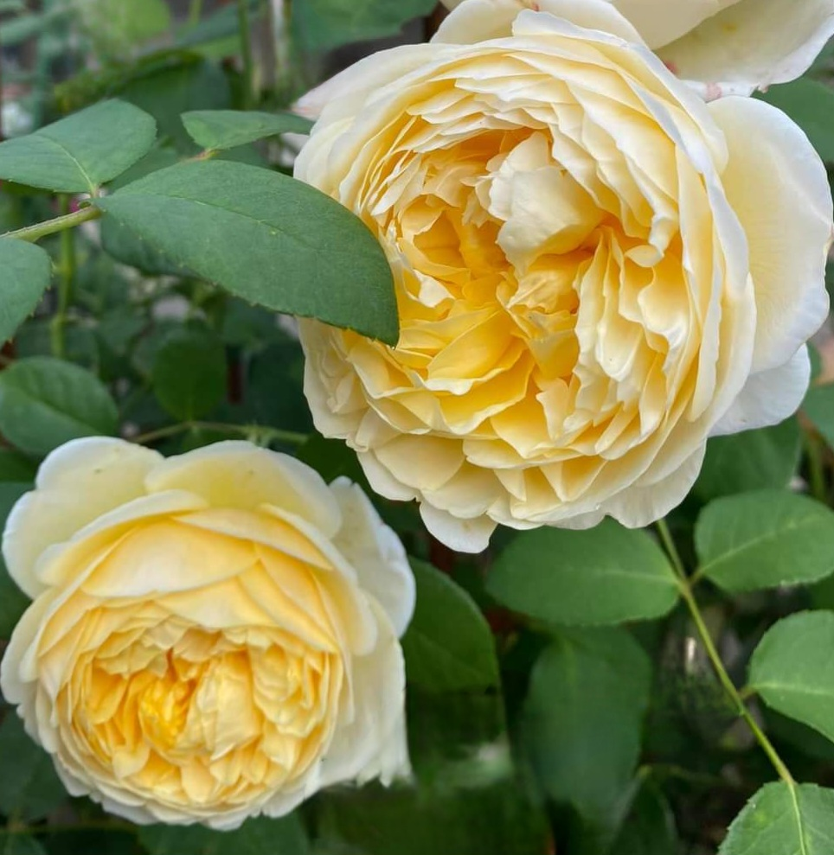
BASIC ROSE CARE
IN SOUTH FLORIDA
Denise Abruzzese, Consulting Rosarian
December 2024

Slide 2
OVERVIEW OF ROSES IN SOUTH FLORIDA
1. CHOOSING ROSES
2. PLANTING BASICS – LOCATION, LOCATION, LOCATION
3. SOIL
4. WATERING BASICS
5. FERTILIZING
6. DISEASES/INSECTS
7. ANNUAL PRUNING AND WEEKLY PRUNING
8. ROSE SOCIETY CLASSES

Slide 3
ROOTSTOCK
Fortuniana
Own Root
Multiflora
Dr. Huey
Lexa

Slide 4
ROOTSTOCK
Fortuniana: You will find these at local nurseries and they are usually in blue pots. They are resistant to the nematodes in our sandy soil. They are for warm weather climates only. Roses tend to get much bigger on Fortuniana.

Slide 5
ROOTSTOCK
Own Root: 2ND PREFERENCE! Own root Roses are not grafted! Most modern roses that are own root should be planted in pots with the exception of some climbing David Austin roses which survive very well in the ground as well as Old Garden Roses on own root such as Teas (not Hybrid Teas), polyanthas, Chinas, Earthkind roses and Bermuda Roses

Slide 6
ROOTSTOCK
Multiflora: Roses grafted onto Multiflora Rootstock does very well in South Florida for a few years and then will decline in health. It will do best in a pot and inexperienced rosarians should skip this rootstock.

Slide 7
ROOTSTOCK
Dr. Huey: Most commercial rose growers graft onto Dr. Huey. They generally will only last 1 to 2 years in the ground. It will live longer in a pot. Also, Dr. Huey likes to take over the rose with suckers eventually killing the grafted rose.

Slide 8
ROOTSTOCK
Lexa: This rootstock needs cold weather to flower. It will not survive South Florida very long.

Slide 9
TYPES OF ROSES for SOUTH FLORIDA
Hybrid Teas:
Old Garden Roses:
Polyanthas:
Floribundas:
Grandifloras:
Miniatures and Minis:
English Roses/Shrub Roses:
Earthkind:
Japanese Roses:

Slide 10
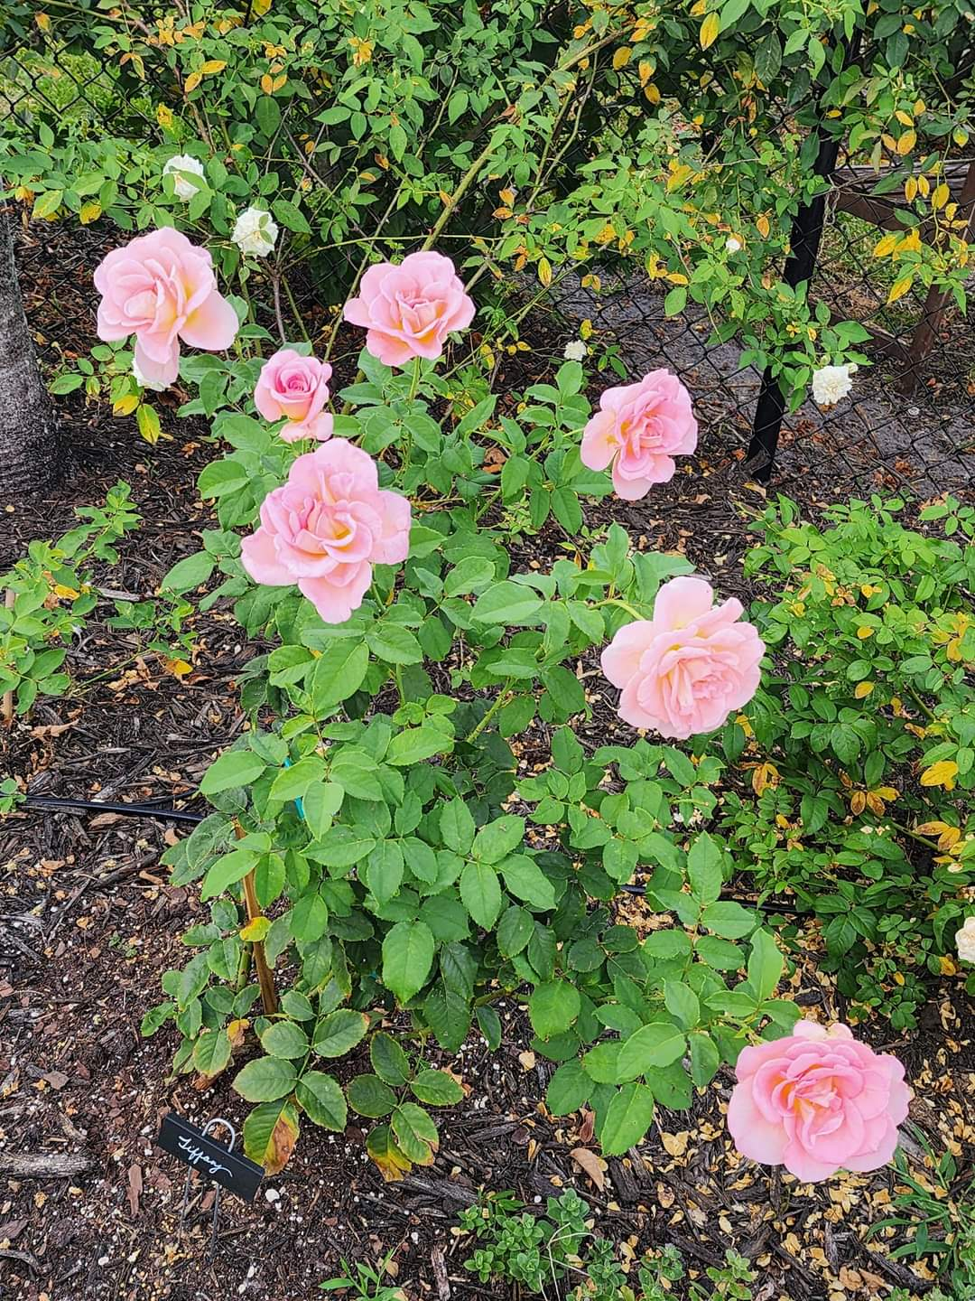
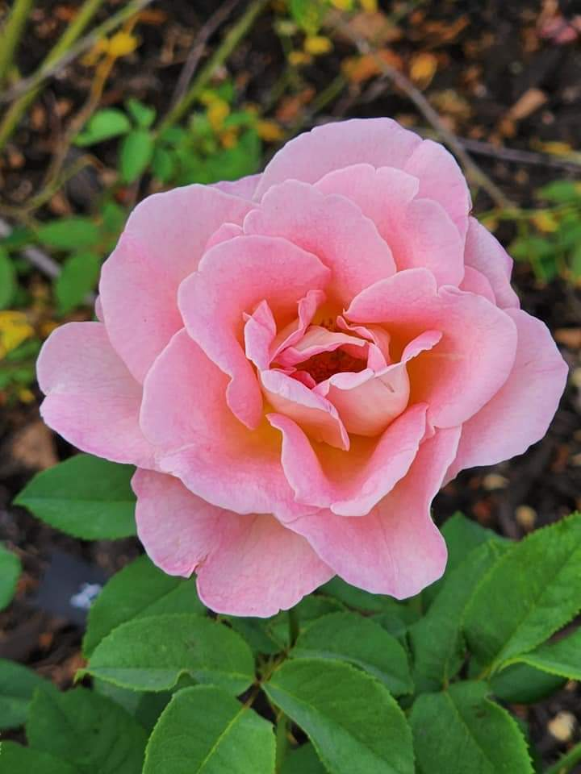
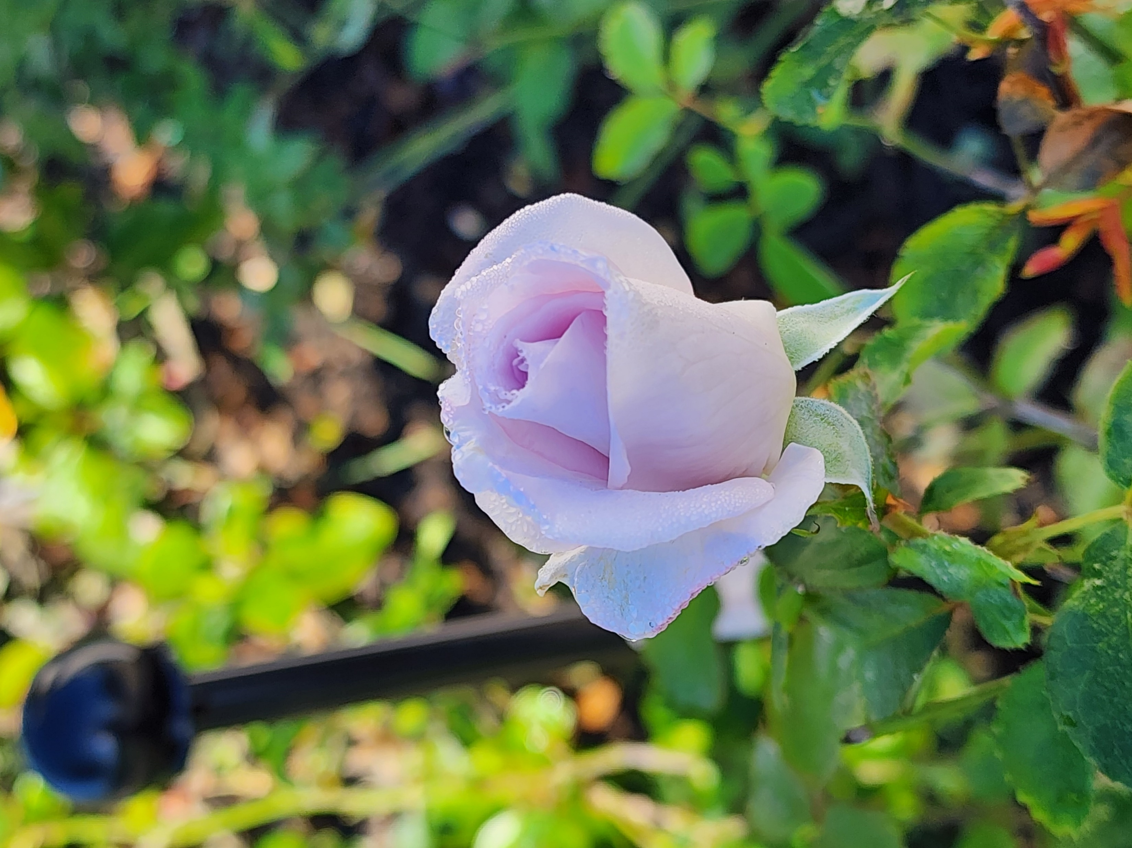
TYPES OF ROSES for SOUTH FLORIDA
Hybrid Teas: They do well on own root and most rootstocks in pots only. They do well on Fortuniana in the ground. Examples are Mr. Lincoln, Tiffany and Lagerfeld.

Slide 11
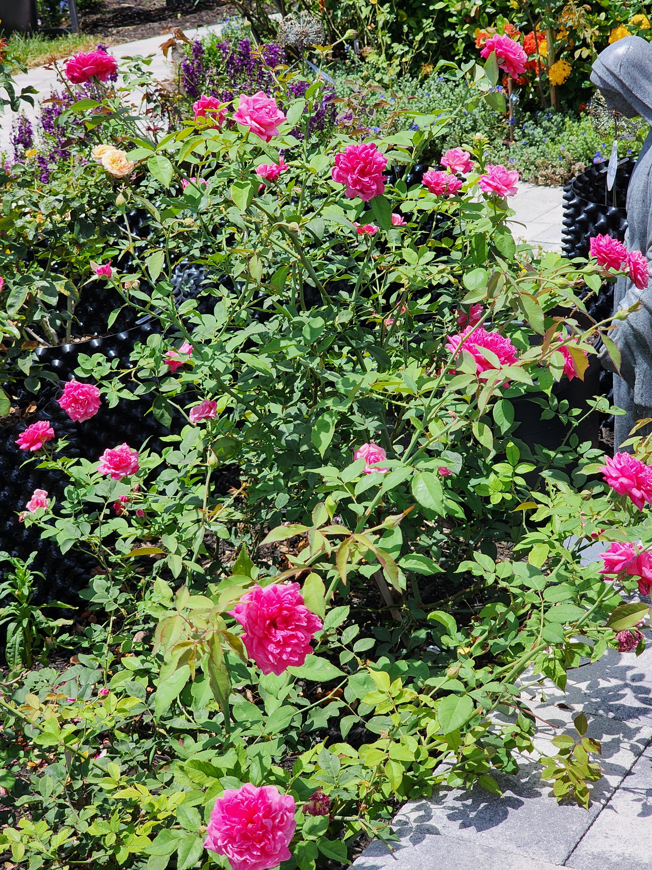
TYPES OF ROSES for SOUTH FLORIDA
Old Garden Roses: Old roses, such as Teas, Portlands (Damask Perpetuals) (these need afternoon shade), Bourbons, Noisettes, Hybrid Perpetuals, Bermuda roses, china roses do well here on own root in the ground. Some can be grafted onto fortuniana but be forewarned that they will get HUGE. An example is Mrs. BR Cant or Smith’s Parish or Louis Phillipe (The Florida Cracker Rose). Old Garden Roses that DO NOT do well in South Florida are: gallicas, damasks, albas, Centifolias and Moss Roses.

Slide 12
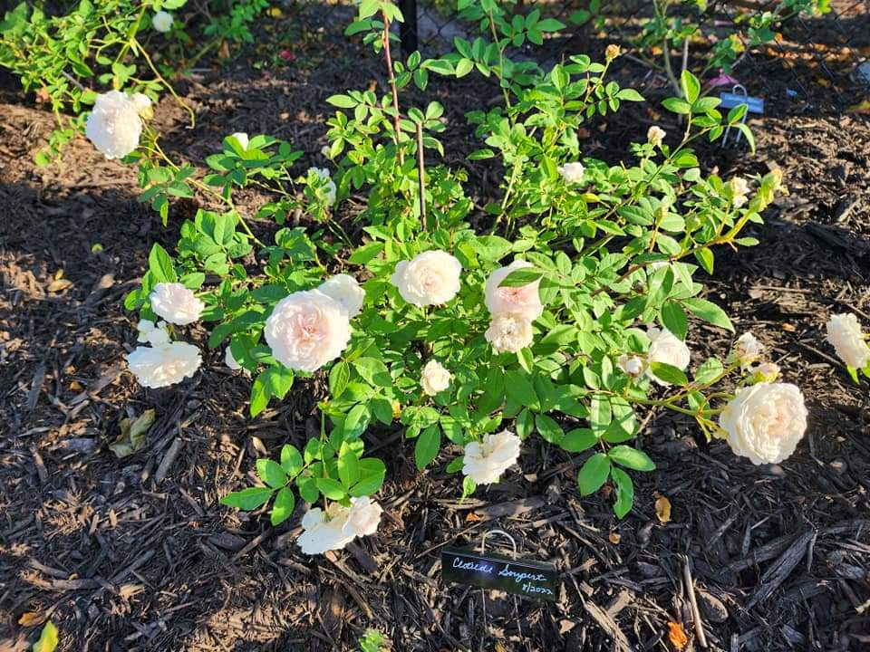
TYPES OF ROSES for SOUTH FLORIDA
Polyanthas: These have smaller flowers 2 to 3 inches and bloom profusely. They are sometimes used as landscape hedges. Clotilde Soupert is an example. They do very well in South Florida.

Slide 13
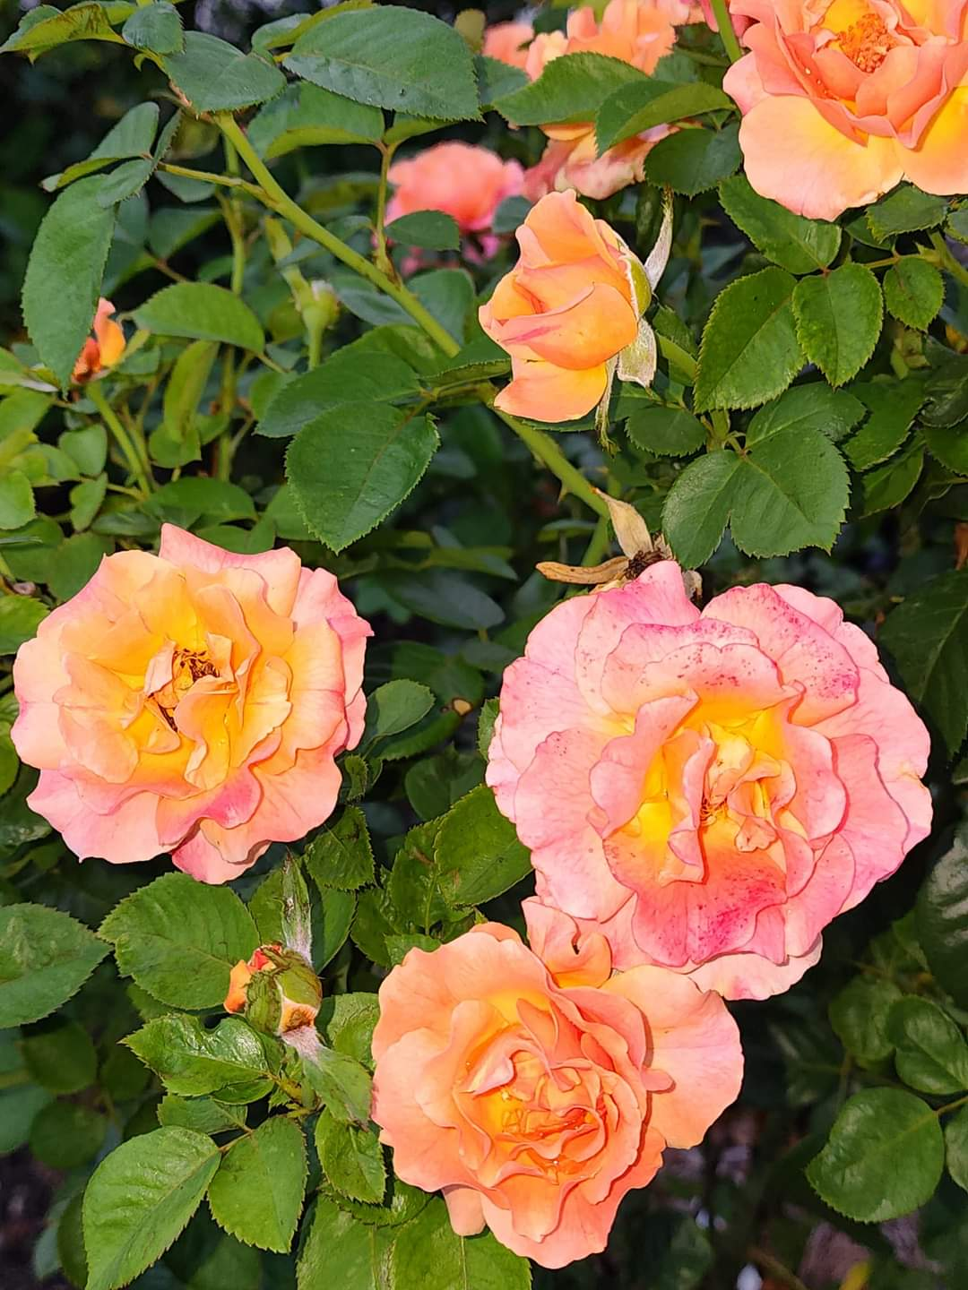
TYPES OF ROSES for SOUTH FLORIDA
Floribundas: Most do well in South Florida depending on the rose. They tend to have clustered flowers and are basically hybridized polyanthas. Ex. Easy Does It which is a GREAT south Florida rose.

Slide 14
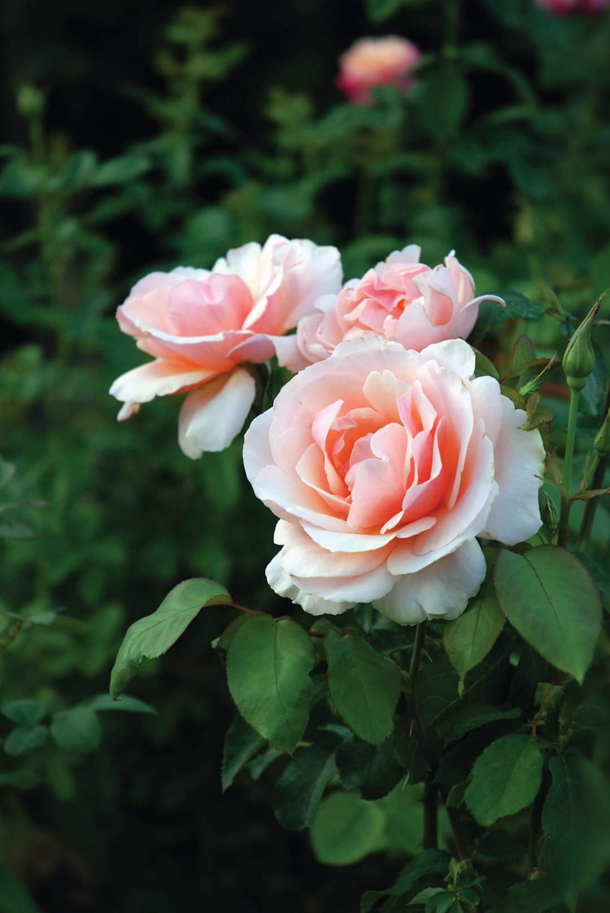
TYPES OF ROSES for SOUTH FLORIDA
Grandifloras: Most do well in South Florida depending on the rose. The flowers are usually much larger than Floribundas, sometimes 5 inches across . Example is Mother of Pearl

Slide 15
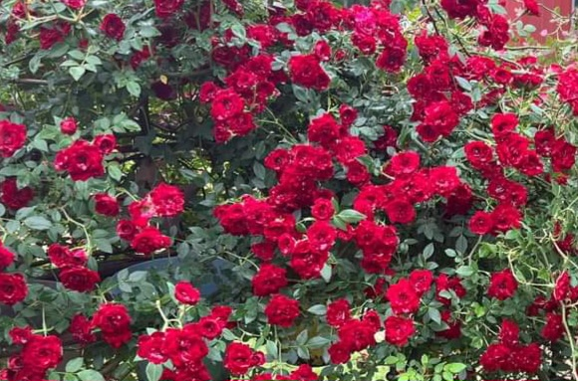
TYPES OF ROSES for SOUTH FLORIDA
Miniatures and Minis: These can be planted right in the ground. Miniatures have very small flowers but the bushes can get quite large. The mini roses at Publix placed in the ground here. You must separate the 4 roses in each pot. Red Cascade is an example of a climbing miniature which I have in a hanging basket.

Slide 16
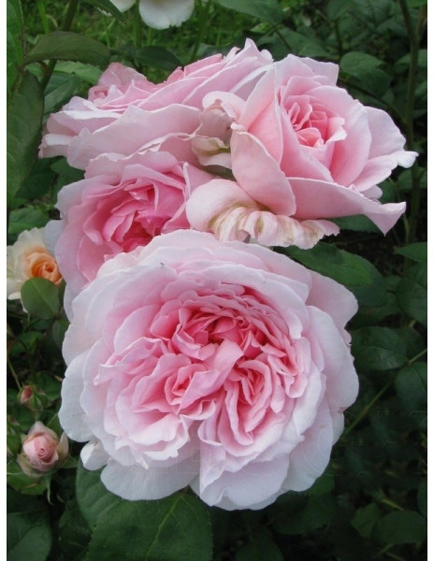
TYPES OF ROSES for SOUTH FLORIDA
English Roses/Shrub Roses: My favorite of all roses. The English roses are a mix. Some do well on fortuniana. Most of the climbers do well on own roots and when grafted onto fortuniana won't flower. There are many english rose bushes that do well on own roots in the ground here and when grafted on fortuniana can be very large. Right: Eglantyne

Slide 17
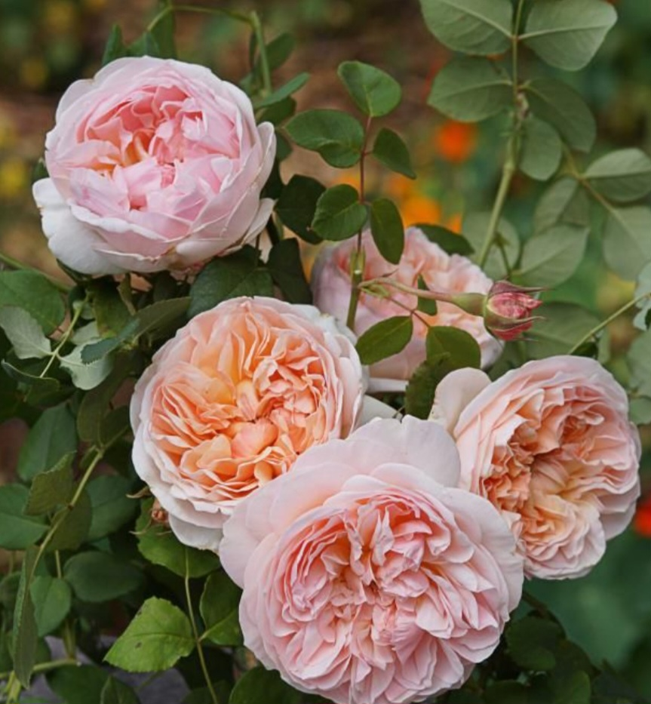
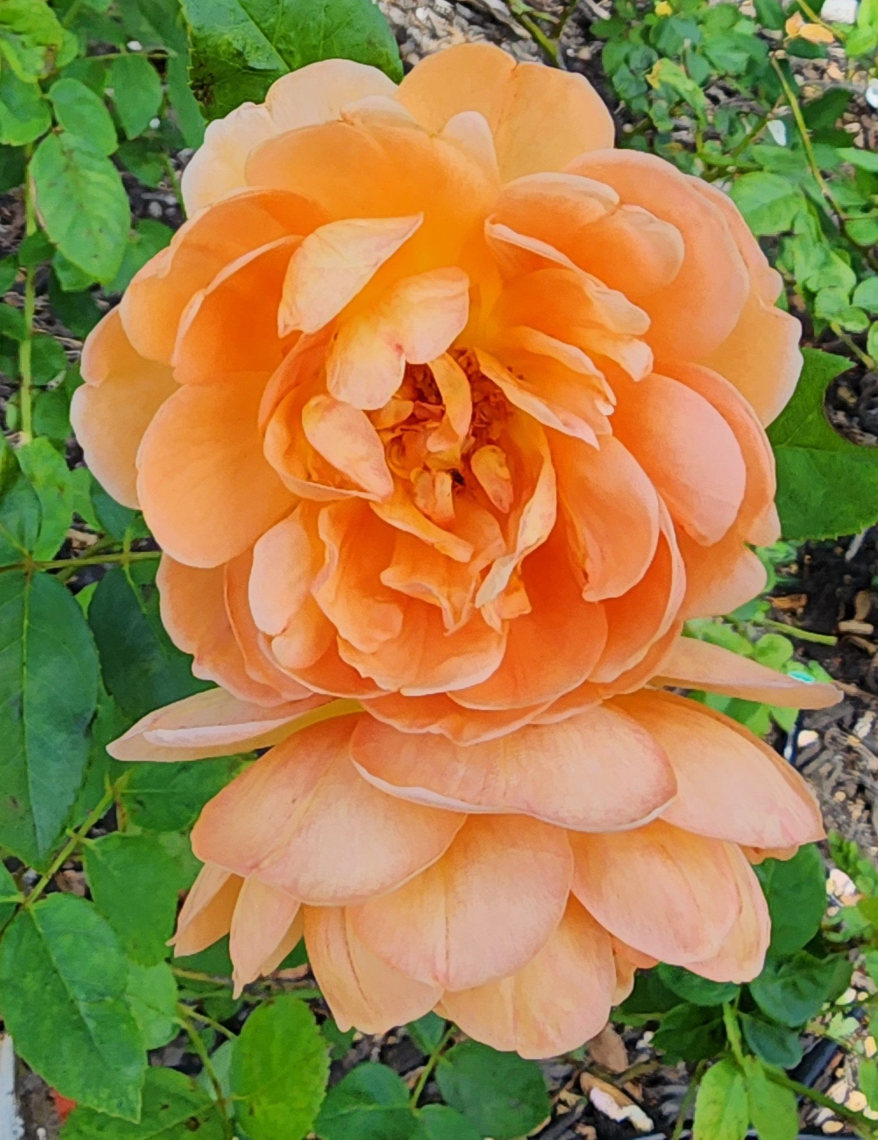
David Austin Roses
Evelyn
Pat Austin

Slide 18
David Austin Roses Bottom: Alnwick Right: Charlotte

Slide 19
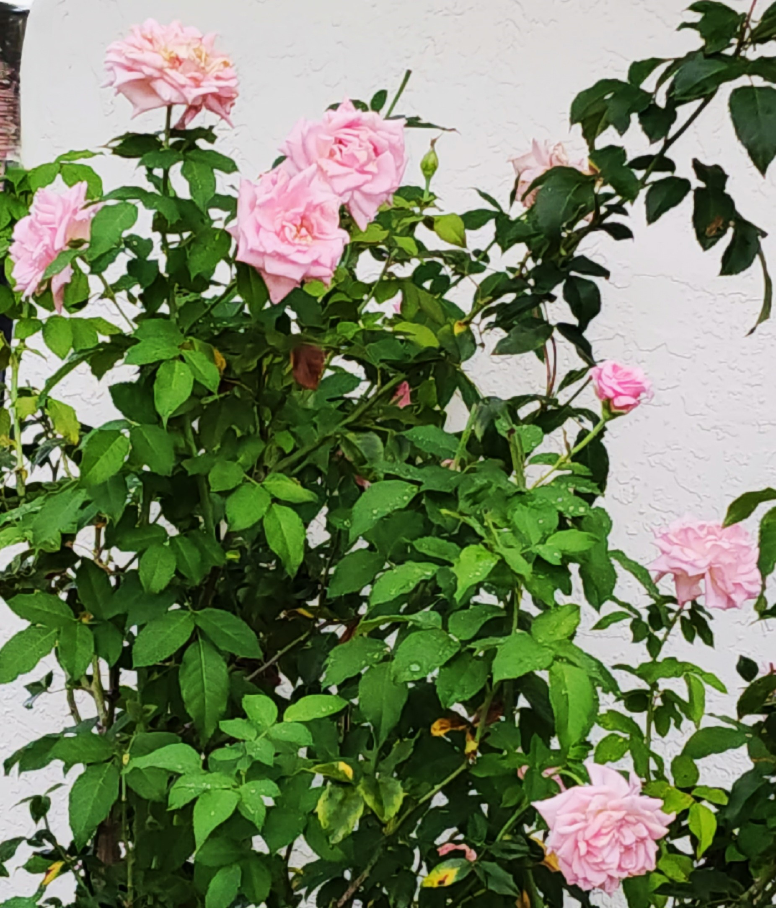
TYPES OF ROSES for SOUTH FLORIDA
Earthkind: These were developed by Texas A&M University and do very well in South Florida Belinda's Dream is an example.

Slide 20
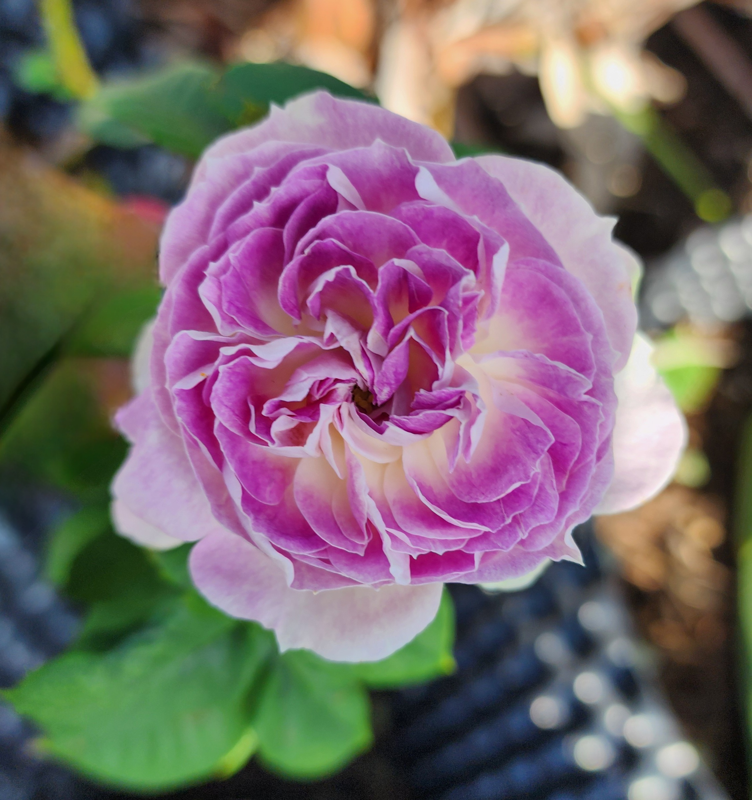
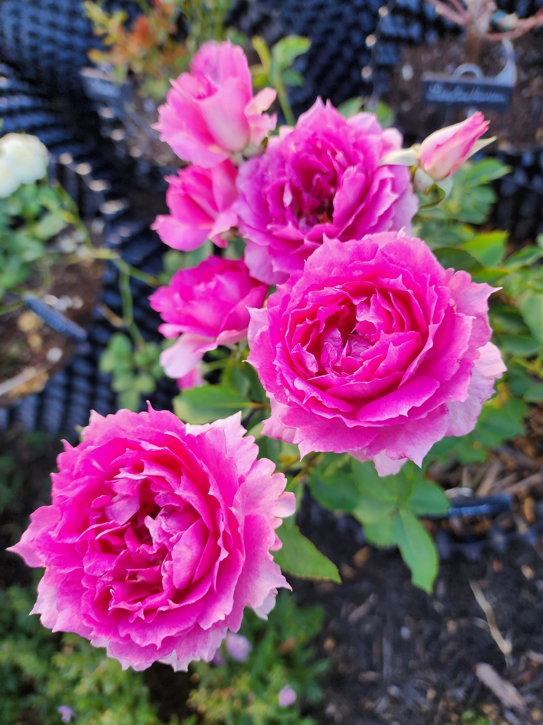
Japanese Roses The New Rage!!!
These roses are hard to find, slow to flourish and very heat tolerant. Once they are established, they are beautiful!
Bottom: Sheherazod Right: Blue Moonstone

Slide 21
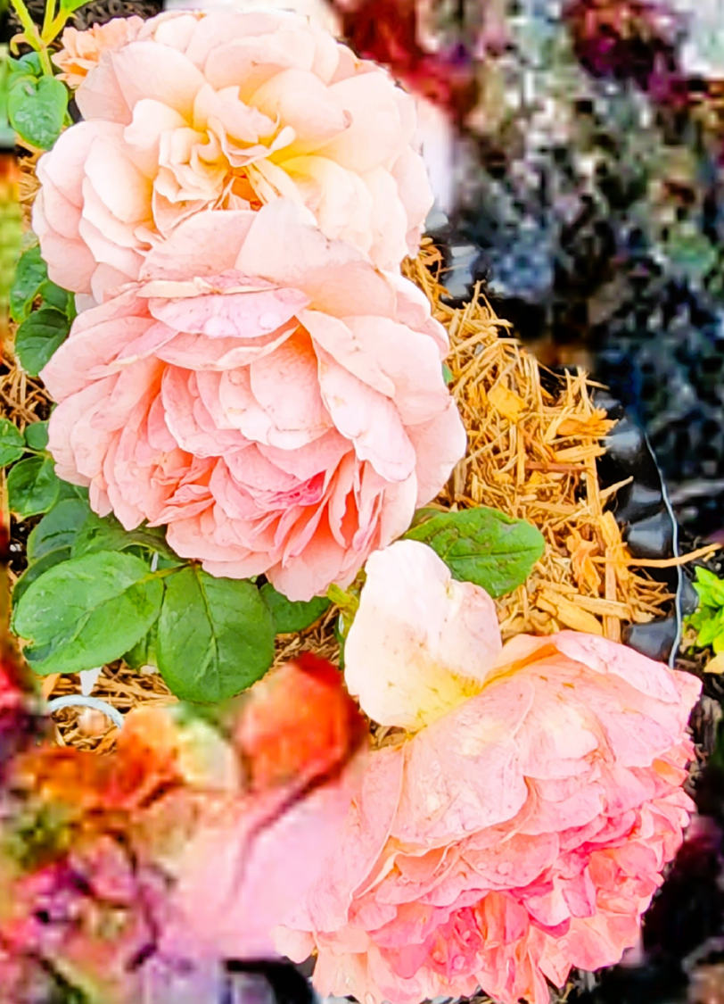
More Japanese Roses Bottom: Flamingo Right: Kaokazali

Slide 22
PLANTING
We are now zone 11A. Roses generally need 6 hour minimum of full sun. In South Florida some roses can take all day full sun. But many need 4 - 5 hours of morning sun and afternoon shade. So keep this in mind when choosing your location. I have many roses that are planted underneath palm trees so they get filtered sun all day. There are some roses that may also thrive in the shade. You can look up any rose characteristics/requirements on helpmefind.com
After choosing your location, dig a hole 20" x 20". Keep in mind roses need airflow so when planting, plant from 3 to 4 feet on center apart.
Roses on Fortuniana need to be staked because of high winds and shallow roots.

Slide 23
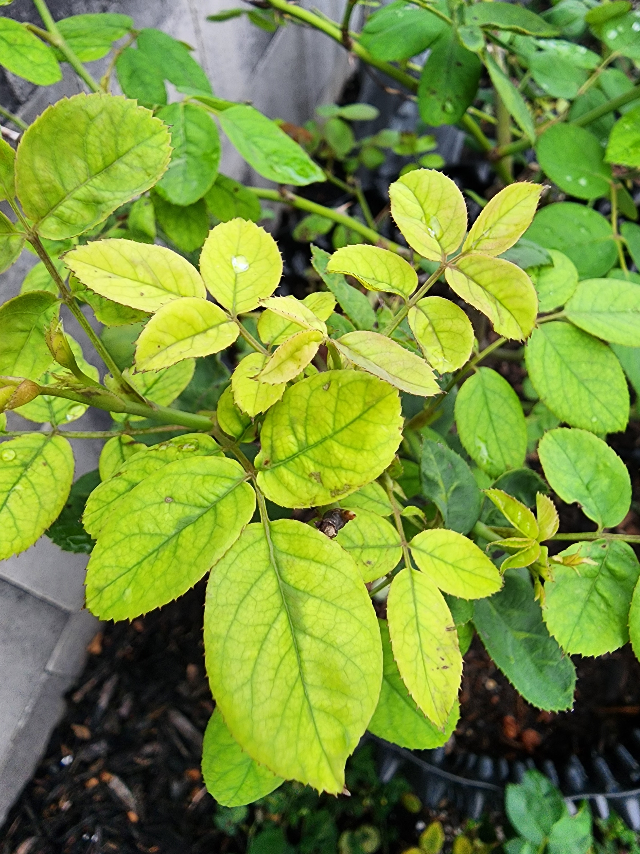
SOIL
Amend your soil! Most rosarians say to remove 50% of what you dig up and mix the remaining amount with your soil mix. I remove it all and mix potting soil, manure and compost. I also add 2 inch layer of peat moss to help resist nematodes. Feel free to add manure, compost, worm castings, blood meal, bone meal and, most importantly, crab meal to ward off nematodes which feed on the roots of roses. Amending your soil is one of the most important parts of growing roses as our sandy soil lacks nitrogen and many other nutrients. Mound your soil so the roots spread out around and sprinkle mychorrizal fungi on the roots when planting. This strengthens the roots system. If you use this, do not use a fungicide in the ground like a drench.
PH: Roses like a PH of 5.5 to 6.5. My preference is 6.0. If the PH is too high, nutrients cannot be up taken to the canes. Use your PH tester on a regular basis! To lower PH use potassium sulphate, sulphur. Sometimes rainwater will lower it as well. To raise PH (which almost never happens in South Florida) use baking soda, volcanic ash.
RIGHT: Example of High PH which inhibits nutrient uptake.

Slide 24
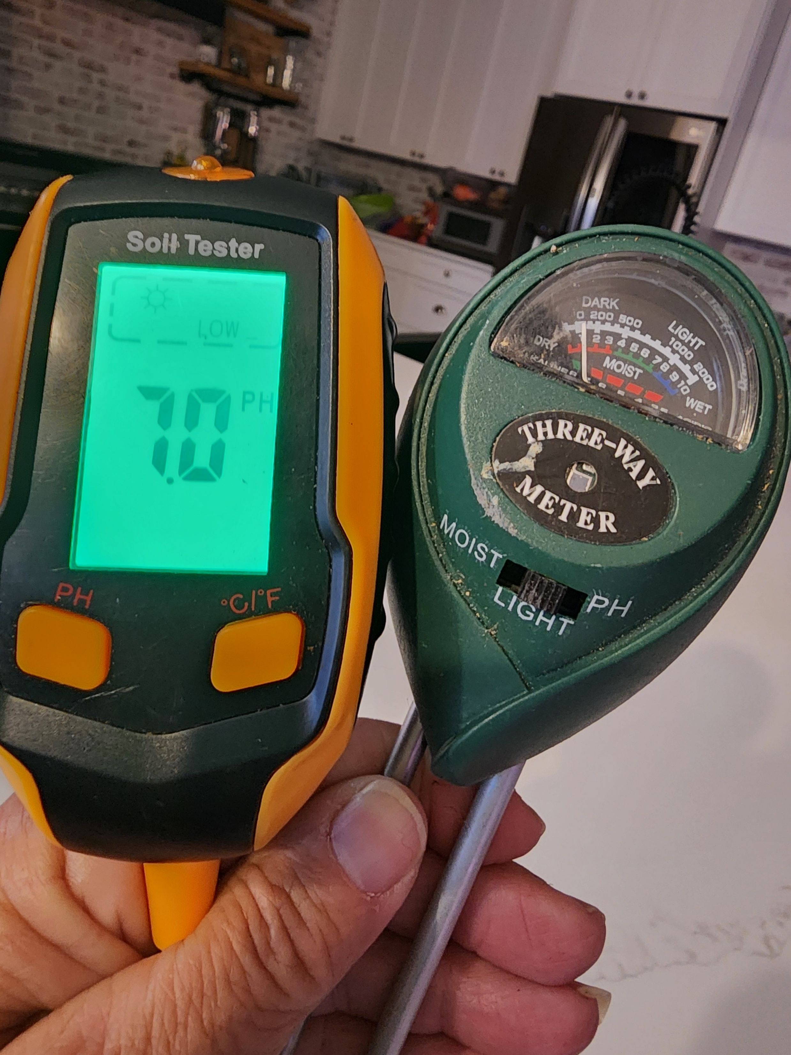
Water
Use a water meter to test your water level.
If you grow roses in pots, remember that while they have to be watered daily in the summer months (sometimes twice a day), in late fall and winter, only water every other day. Water when soil is dry and water deeply to encourage strong root growth. Think 1 - 2 gallons per rose.
Remember though to always water prior to fertilizing.
During rainy season, roses will need more fertilizer due to heavy rains washing nutrients away.

Slide 25
Fertilizing
Test your soil Nutrients!!! In Florida we have sandy soil that drains quickly. And when the rainy season hits, it washes all the nutrients right out of the ground and/or pots.
February: Use a long term fertilizer like Osmocote Plus 8 - 9 month granular Also, use alfalfa pellets. One to two cups per plant and water in.
March through June: Use a balanced fertilizer like Max Sea 16 16 16. I use this weekly. You can use it every few weeks.
July - September: Use Potassium Sulphate or Banana Water. Keep as many leaves on the bush as possible and do not give nitrogen so the bush can weather the hot weather. Blooms will be faded and smaller. This is normal. Feed with potassium and phosphate rich fertilizers like Milorganite and K-mag or Potassium Sulphate. The goal is to keep lots of mature green leaves on your plants. They help cool your roses in the brutal heat of the summer as well as help remove the extra water in the soil from the heavy summer rains. Leaves also produce energy through photosynthesis which is used for flowers in the winter months but is stored in the plants stems in the summer. When we cut roses in the summer, that energy is wasted on spindly stems and inferior blooms and causes stress to the plants. The tender new growth that results from cutting attracts every insect in the state to your rose garden.
October - November: This is the time to put down horse manure or other composts.

Slide 26
Diseases/Insects
Most pets can be eliminated with spraying such as Captain Jacks Dead Bug Spray. There are exceptions. The alternative is to release predator insects such as lacewings, ladybugs and pirate bugs. Also releasing good nematodes in the soil will help lessen the bad nematodes in the soil. A good source of these predator bugs is Arbico Organics. Make sure to release predator bugs at night when the dew is on the roses.
Aphids: These are little green insects that suck on new buds and new growth. They can be squished with your fingers if there are just a few. Use an insecticidal soap if they are found in large numbers.
Chili Thrips Chili Thrips are minute bugs and show by the crinkled leaves with brown marks underneath and buds that won't open and brown. As the weather cools down, the thrip activity will decrease and in warmer weather they will their life cycle is shorter. If you need to treat them, the best choice is Conserve rotating with a product like Merit. This insecticide routine is effective on Chili thrips, but you should apply it early morning or late in the day, when bees are not active. An alternative would be a ground drench of imidocloprid. It's safer for bees.
Gall (Crown & Root) Crown gall presents as a cauliflower like growth on the rose. Root gall presents in small growths on the root of the rose which can also show as inflamed roots. These are highly contagious and the rose must be bagged and thrown out. You cannot plant another rose in the spot without solarization of the soil for 3 months. All tools must be bleached so as to not spread it.
MealyBugs This are horrible white bugs that adhere to the canes. You can kill them with 70% alcohol. Sometimes you may need to scrub the cane with a brush.
Scarab beetles In April, you may notice beetles in the blooms. They can be knocked off into a jar of water with a little Clorox added. (Or they can be squished between petals or rose leaves). April is often dry and sometimes you will get a infestation of spider mites later in the month. They live on the underside of the leaves and are very small. If you have them, the leaf will start to lose color and feel gritty or sandy on the underside. A hard blast of water to the underside of the leaves will control them. This should be repeated several days in a row, or every other day for about 3 days, then once a week until the rains start. You can also use the Imidocloprid drench to kill them while they are grubs in the ground. I would do this in March
Spidermites Spidermites thrive in dry conditions, but you can control them with a hard spray of water to the undersides of the leaves. If you have leaves that are a light green, or grayish, shake the leaf over a white sheet of paper. Using a magnifying glass, you will see the tiny spider mites. If you have an infestation, do the water spray every other day for three treatments.

Slide 27
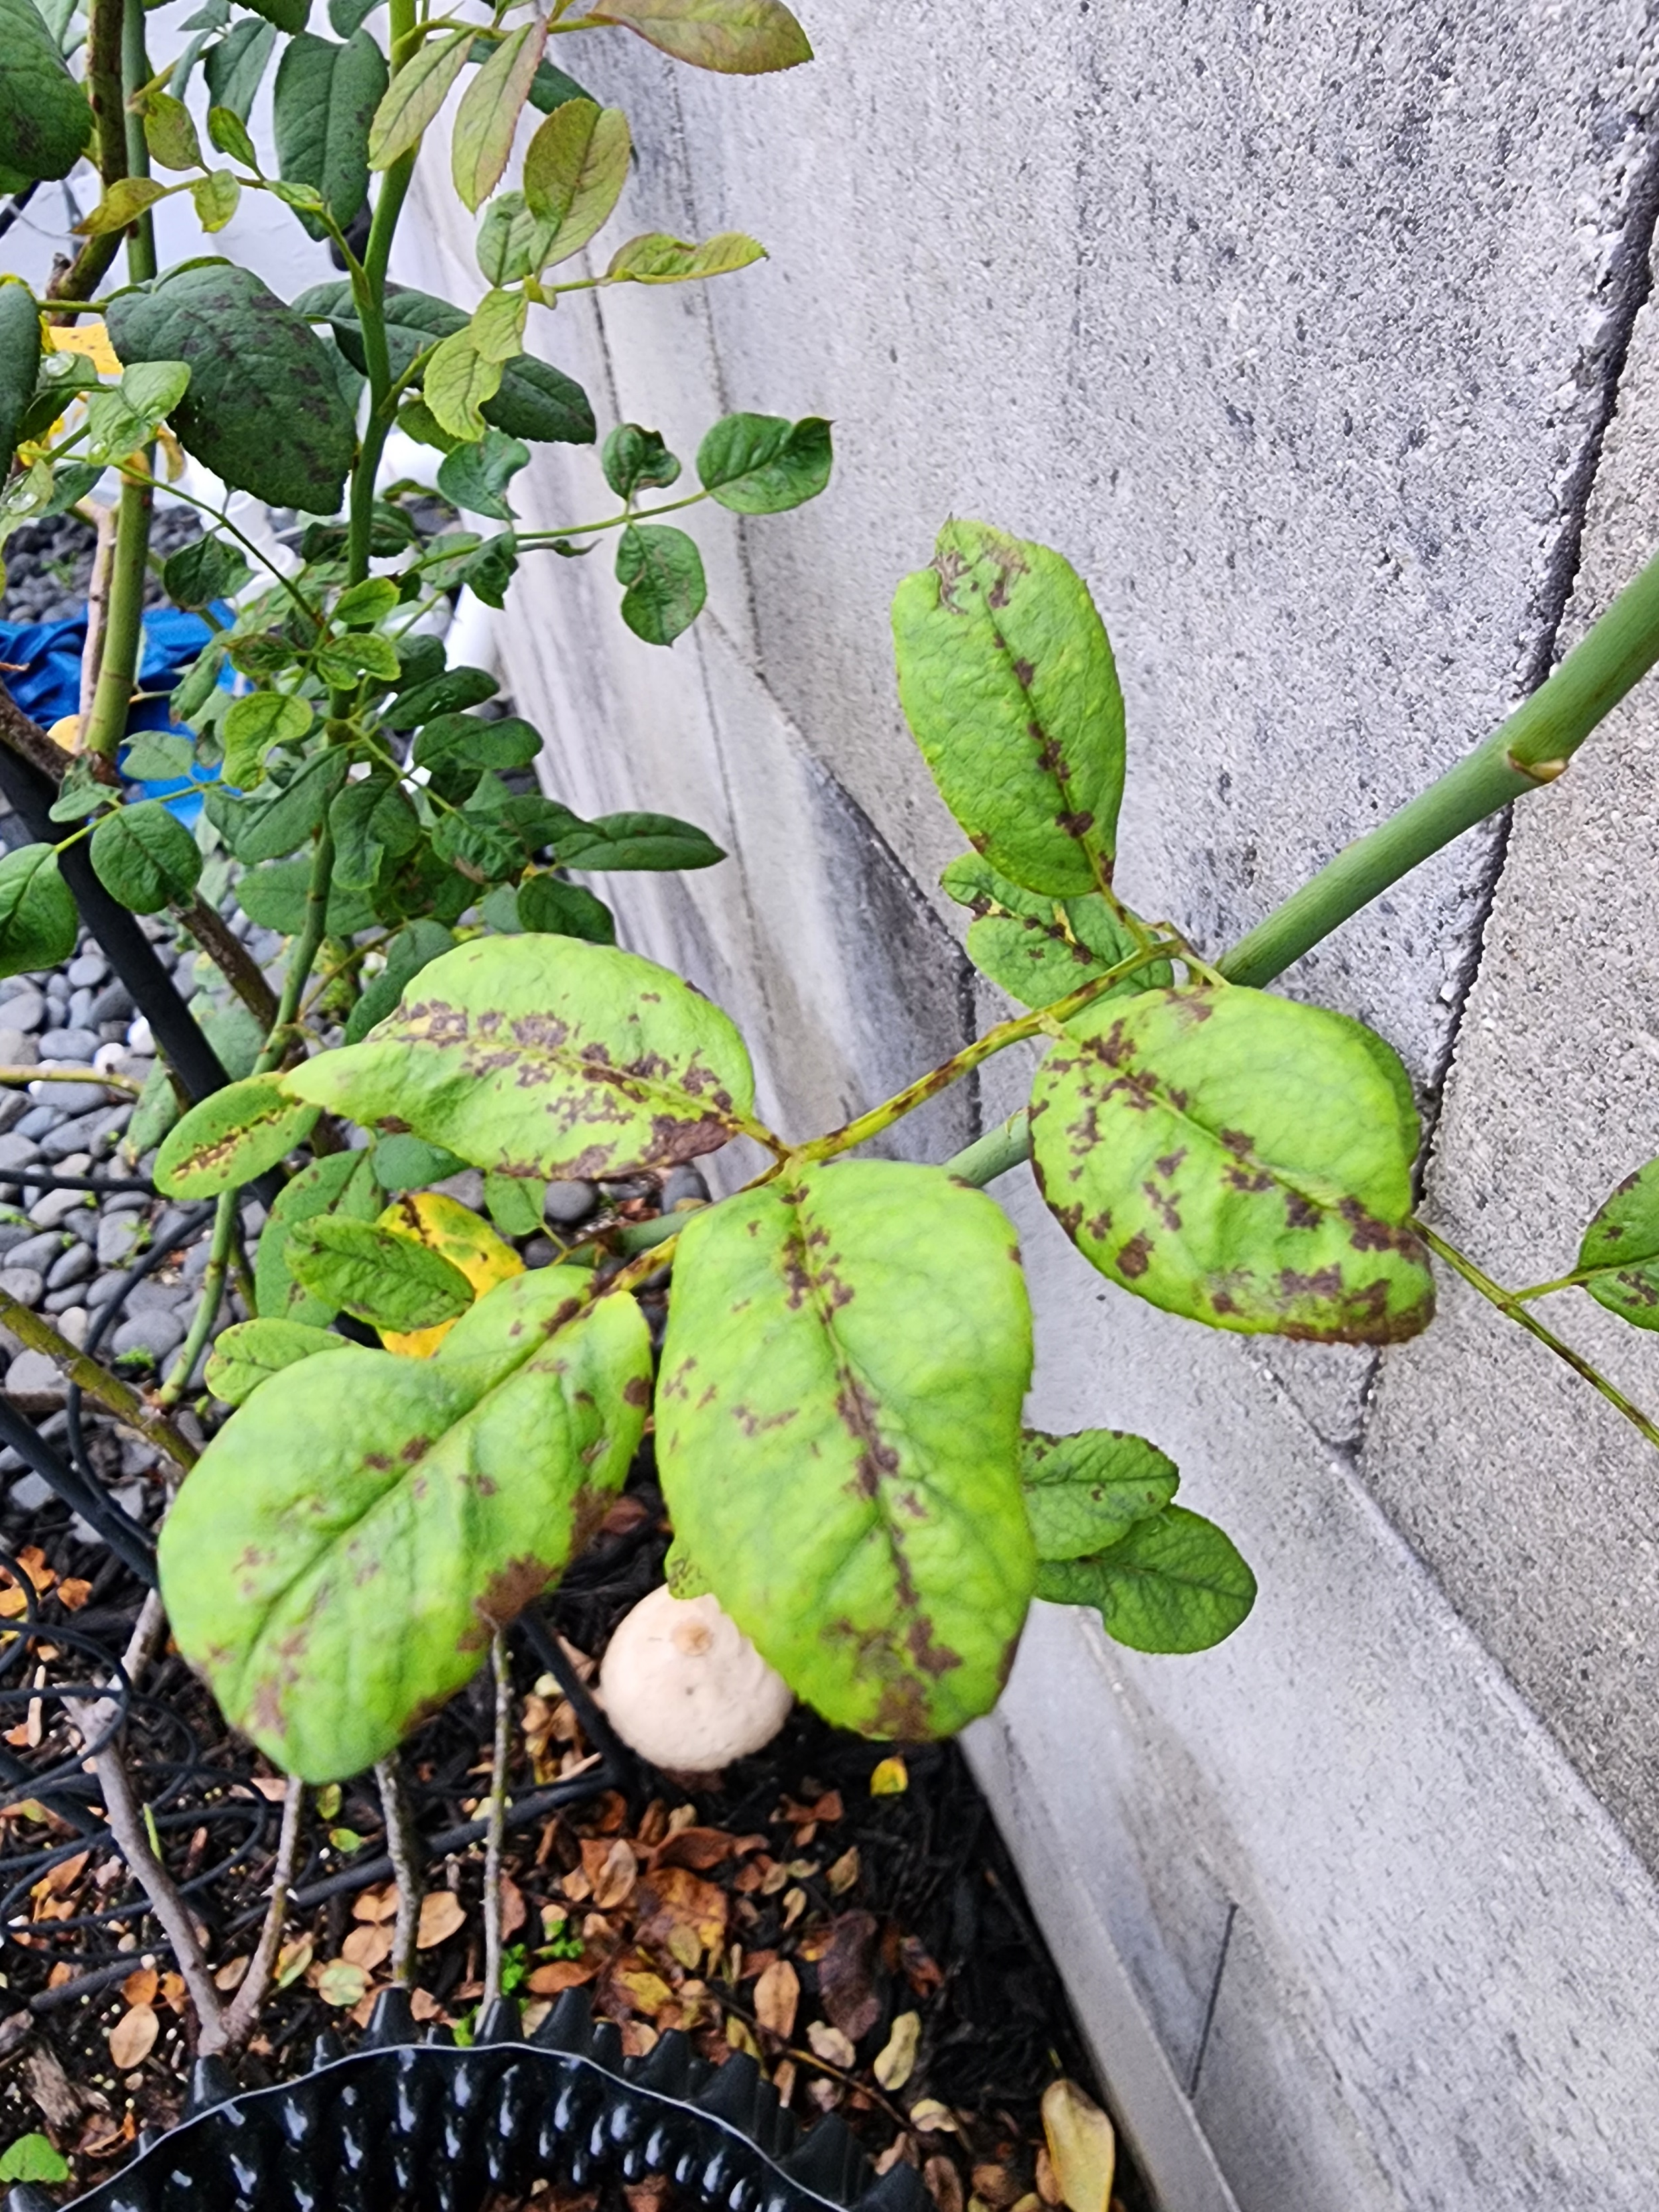
Diseases/Insects
Blackspot Keep up with your weekly fungicide spray program. Do not use horticultural oils when it is over 80 degrees. Spray early in the morning or late in the evening to avoid spray burn. Alternatively, you can use cornmeal. 1 or 1/2 cup around the base of the rose and water in. Use every 3 to 4 weeks. Pull off blackspot-infected leaves whether your spray or not (this should be done year-round) and throw them in the garbage. Pick up all fallen leaves to stop the spread. RIGHT: EXAMPLE OF BLACKSPOT
Powdery Mildew This can happen during dry season. You can use a diluted whole milk spray every few days to eradicate this.
Rose Rosette This is caused by the mite. It is transmitted easily from one bush to another through the wind and through contact. Immediately bag the rose and then dig it out and toss out in a sealed bag. We do not have this in Florida at the moment but everyone should be aware. There is no remedy for this disease yet but research is ongoing.

Slide 28
Pruning
Sharpen your pruners. The cuts you make while pruning should be sharp and clean. If they are not or it is difficult to cut a cane, try sharpening (or replacing) the blade on your pruners. It is also highly recommended that you disinfect your pruners between pruning each different bush so you are less likely to spread disease between bushes. This can be done with spraying the blades peroxide, alcohol or with Lysol TM or using Lysol TM wipes. Do not use bleach, as it can damage steel pruner blades. It is a good practice to clean, dry and store your pruners (inside).
Prune your roses no later than Valentines' day. When you prune, do so just above a 5-leaf cluster (choosing an outward facing bud eye), no more than 1/4" above the bud eye that is at the base of the leaf cluster. If you more than 1/4" of stem is left you often will get dieback that can continue down the stem. Usually it's best to prune 1/3 off the height of the bush. For hybrid teas, you can prune to ¹/₂ height or more if necessary. Remove any dead, dying or diseased canes. Remove any crossing canes. Remove canes that are thinner than a pencil. Seal the cut canes. After you have completed pruning, it is recommended that you seal the cuts on larger canes. Simply apply a small amount of Elmer's Glue-A11TM on the cut end of each cane. Try not to get any glue on the bud eyes. If you have a lot of stems left (which will be the case with some varieties) you should concentrate on sealing the larger canes and don't bother with the smaller ones. Just make sure that you are not expecting rain when you do the sealing, as the glue will wash away if it has not had time to dry. For climbing roses prune all lateral canes to two or three bud eyes. For main canes you prune of any dead, diseased or dying main canes or canes growing in the wrong direction. If you have too many main canes, prune off the oldest ones.
Remove remaining foliage. In most cases, when you have completed spring pruning, there will not be many leaves left. Then you can remove the remaining foliage. In the unlikely event that you have a lot of healthy foliage remaining, it can be left on the bush. All cuttings and leaves should be put out for collection and not left in the rose bed or put in a compost bin. They can be harboring disease or unwanted pests, which you do not want attacking your new growth.
Do not prune once bloomers until after they bloom. Do not prune roses that are less than one year old. Some older garden roses do not like pruning. An example of this would be Mrs. BR Cant. You will have blooms 5 to 7 weeks after you prune.
During the growing season, it's you should always pinch off blooms to encourage new blooms to grow or you can prune down to the first 5 leaf node. You should always remove dead, dying, diseased or die back (blackening) canes through out the year.

Slide 29
JOIN YOUR LOCAL ROSE SOCIETY
There are two local and one national rose societies:
Greater Palm Beach Rose Society At Mounts Botanical Gardens, www.gpbrs.org. $25.00 per year includes free classes every month and access to Consulting and Master Rosarians for FREE. Monthly newsletter and discount at some rose nurseries
Tropical Rose Society in Miami on facebook. $25.00 per year includes free classes every month and access to Consulting Rosarians for FREE. Monthly newsletter
American Rose Society. $57.50 per year includes free online seminars and classes, discount at many rose nurseries, digital copy of their incredible magazine

Slide 30
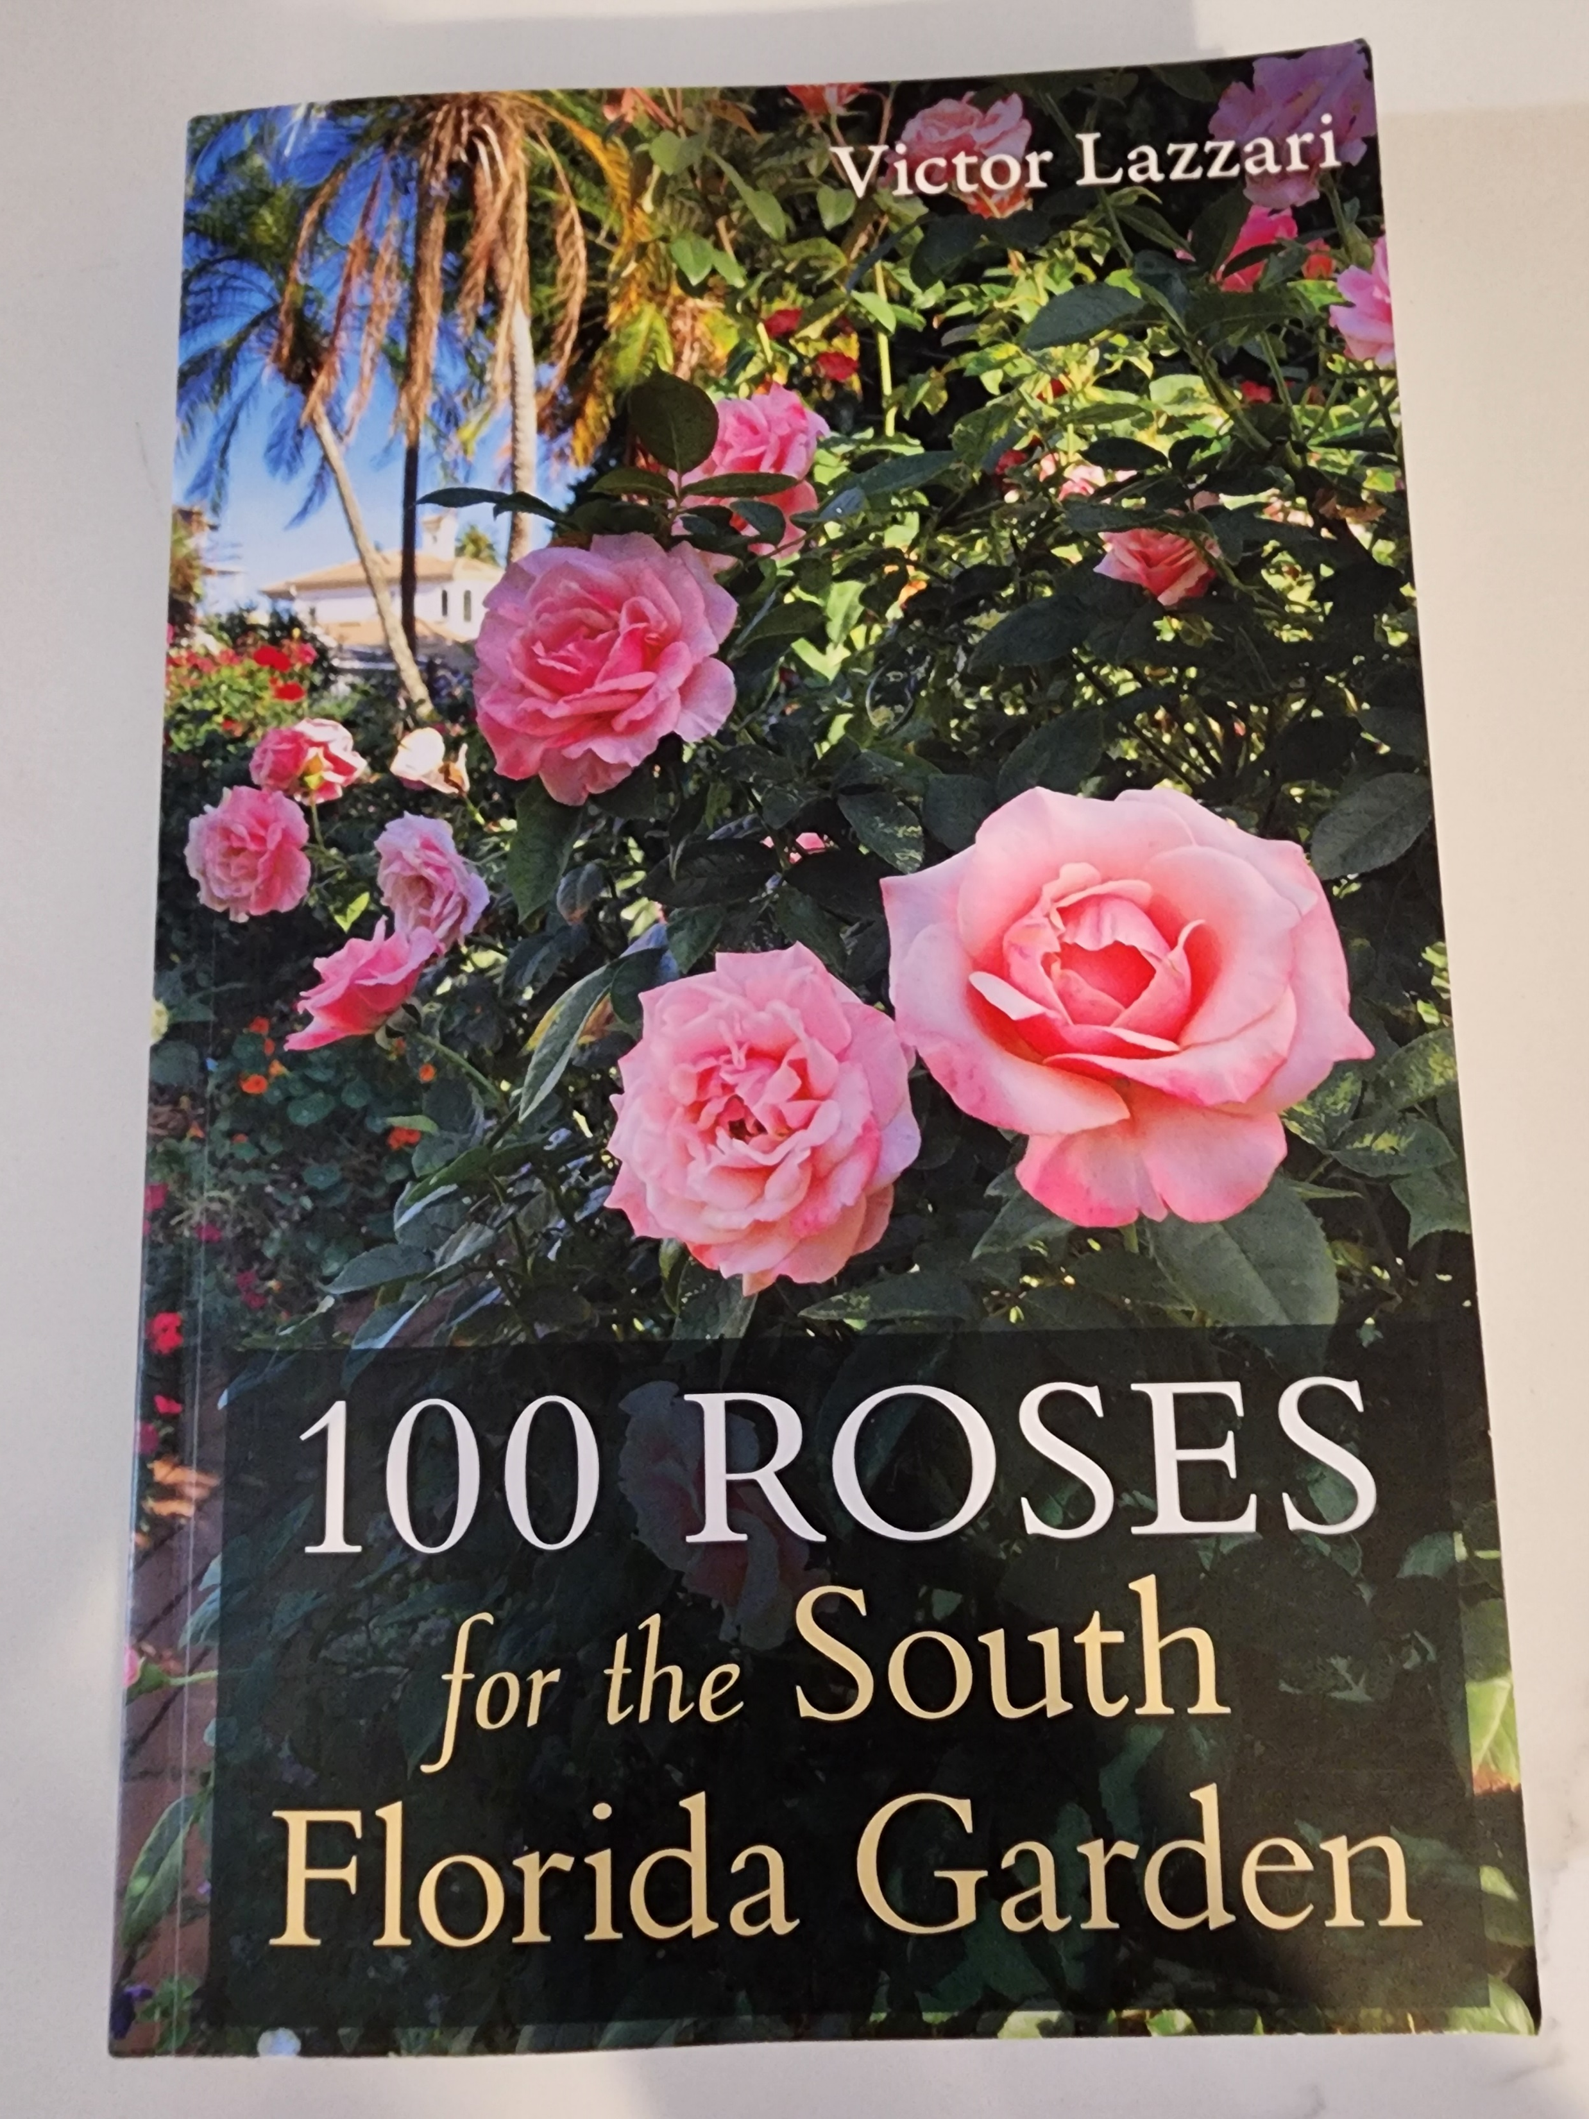
100 Roses for South Florida
Victor Lazzari’s book (which can be found at your local library or purchased on Amazon) 100 Roses for South Florida is a GREAT guide for which roses do well in South Florida. It’s my rose bible! I highly recommend it!

Slide 31
Denise Abruzzese *Consulting Rosarian for The American Rose Society *Consulting Rosarian, President,Treasurer, Newsletter Editor, Lecturer for The Greater Palm Beach Rose Society *Consulting Rosarian, Lecturer for The Tropical Rose Society *Owner, Foxview Roses, rose nursery
Contact information:
email foxviewroses@gmail.com
message through my rose nursery website www.foxviewroses.com

