Slide 1
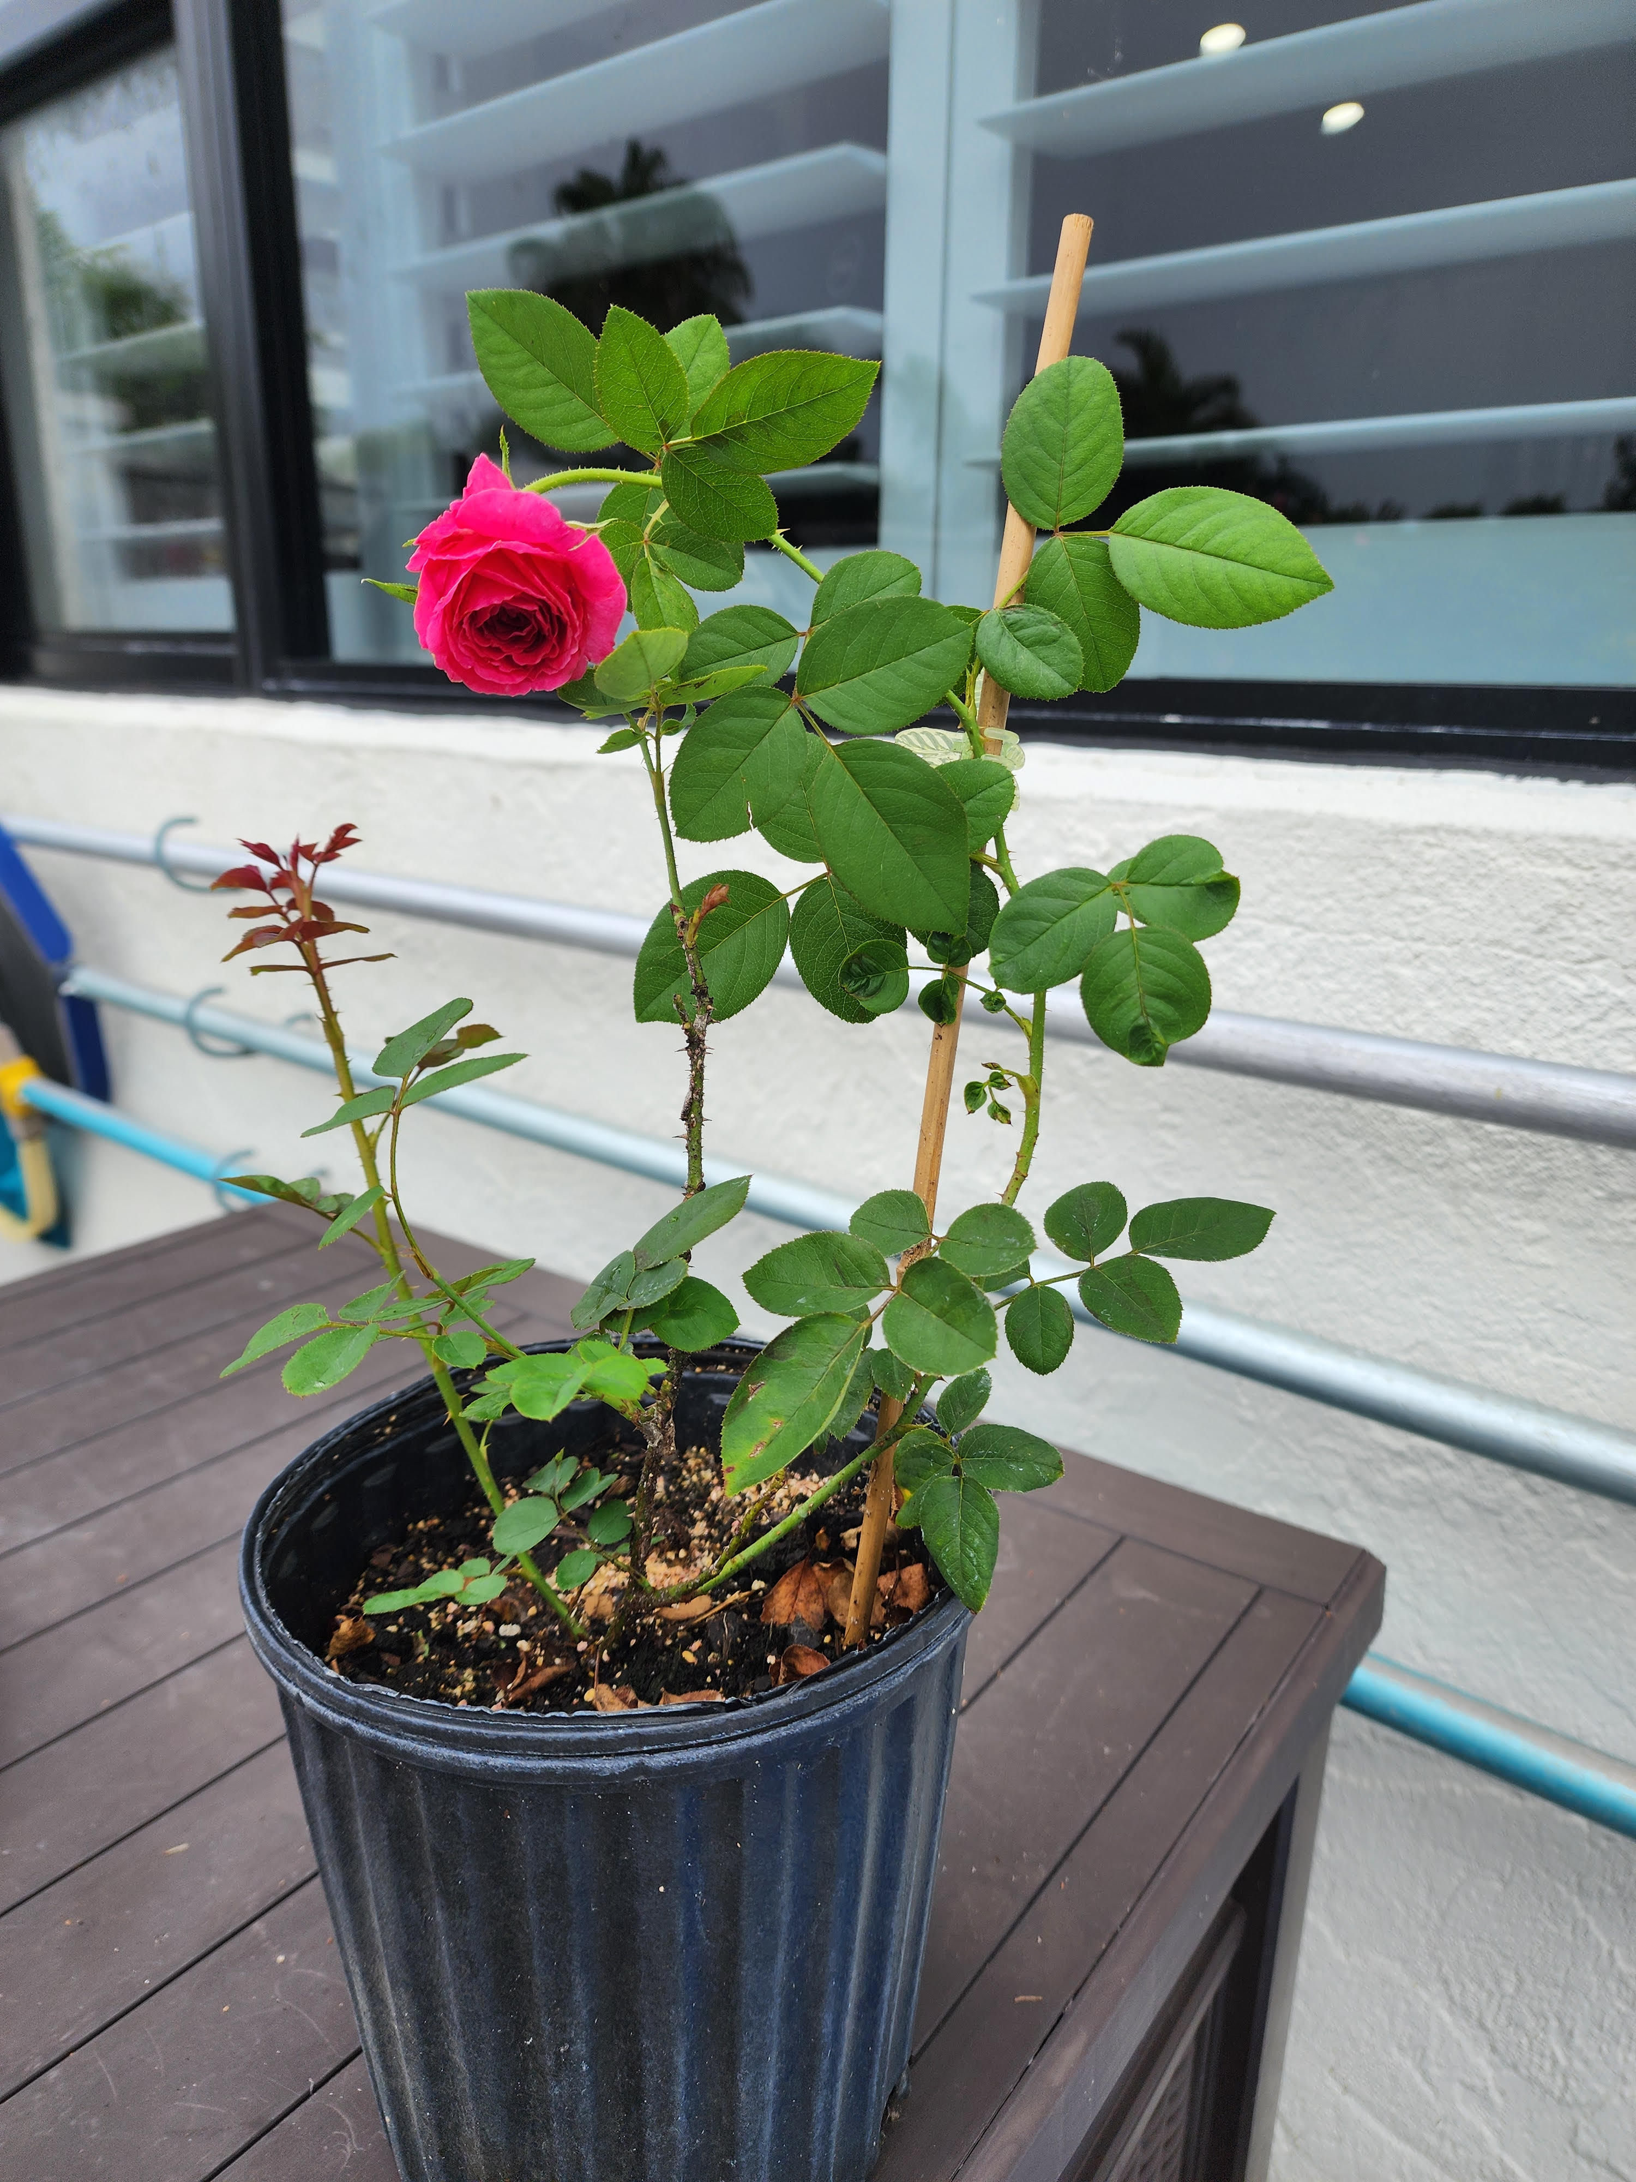
ROSE PROPAGATION
Denise Abruzzese,
President, Treasure, Greater Palm Beach Rose Society
Consulting Rosarian
foxviewroses@gmail.com

Slide 2
There is no right or wrong way. Whatever works for you!
- Propagating Legally! Check Patents: helpmefind.com justia.com or garden.org
Patent is good for 20 years from the patent application date;
After that you may propagate but if the common name is trademarked, you cannot use the common name.
- Propagation Techniques through Cuttings
- Care Timeline
- Do’s and Don’ts!

Slide 3
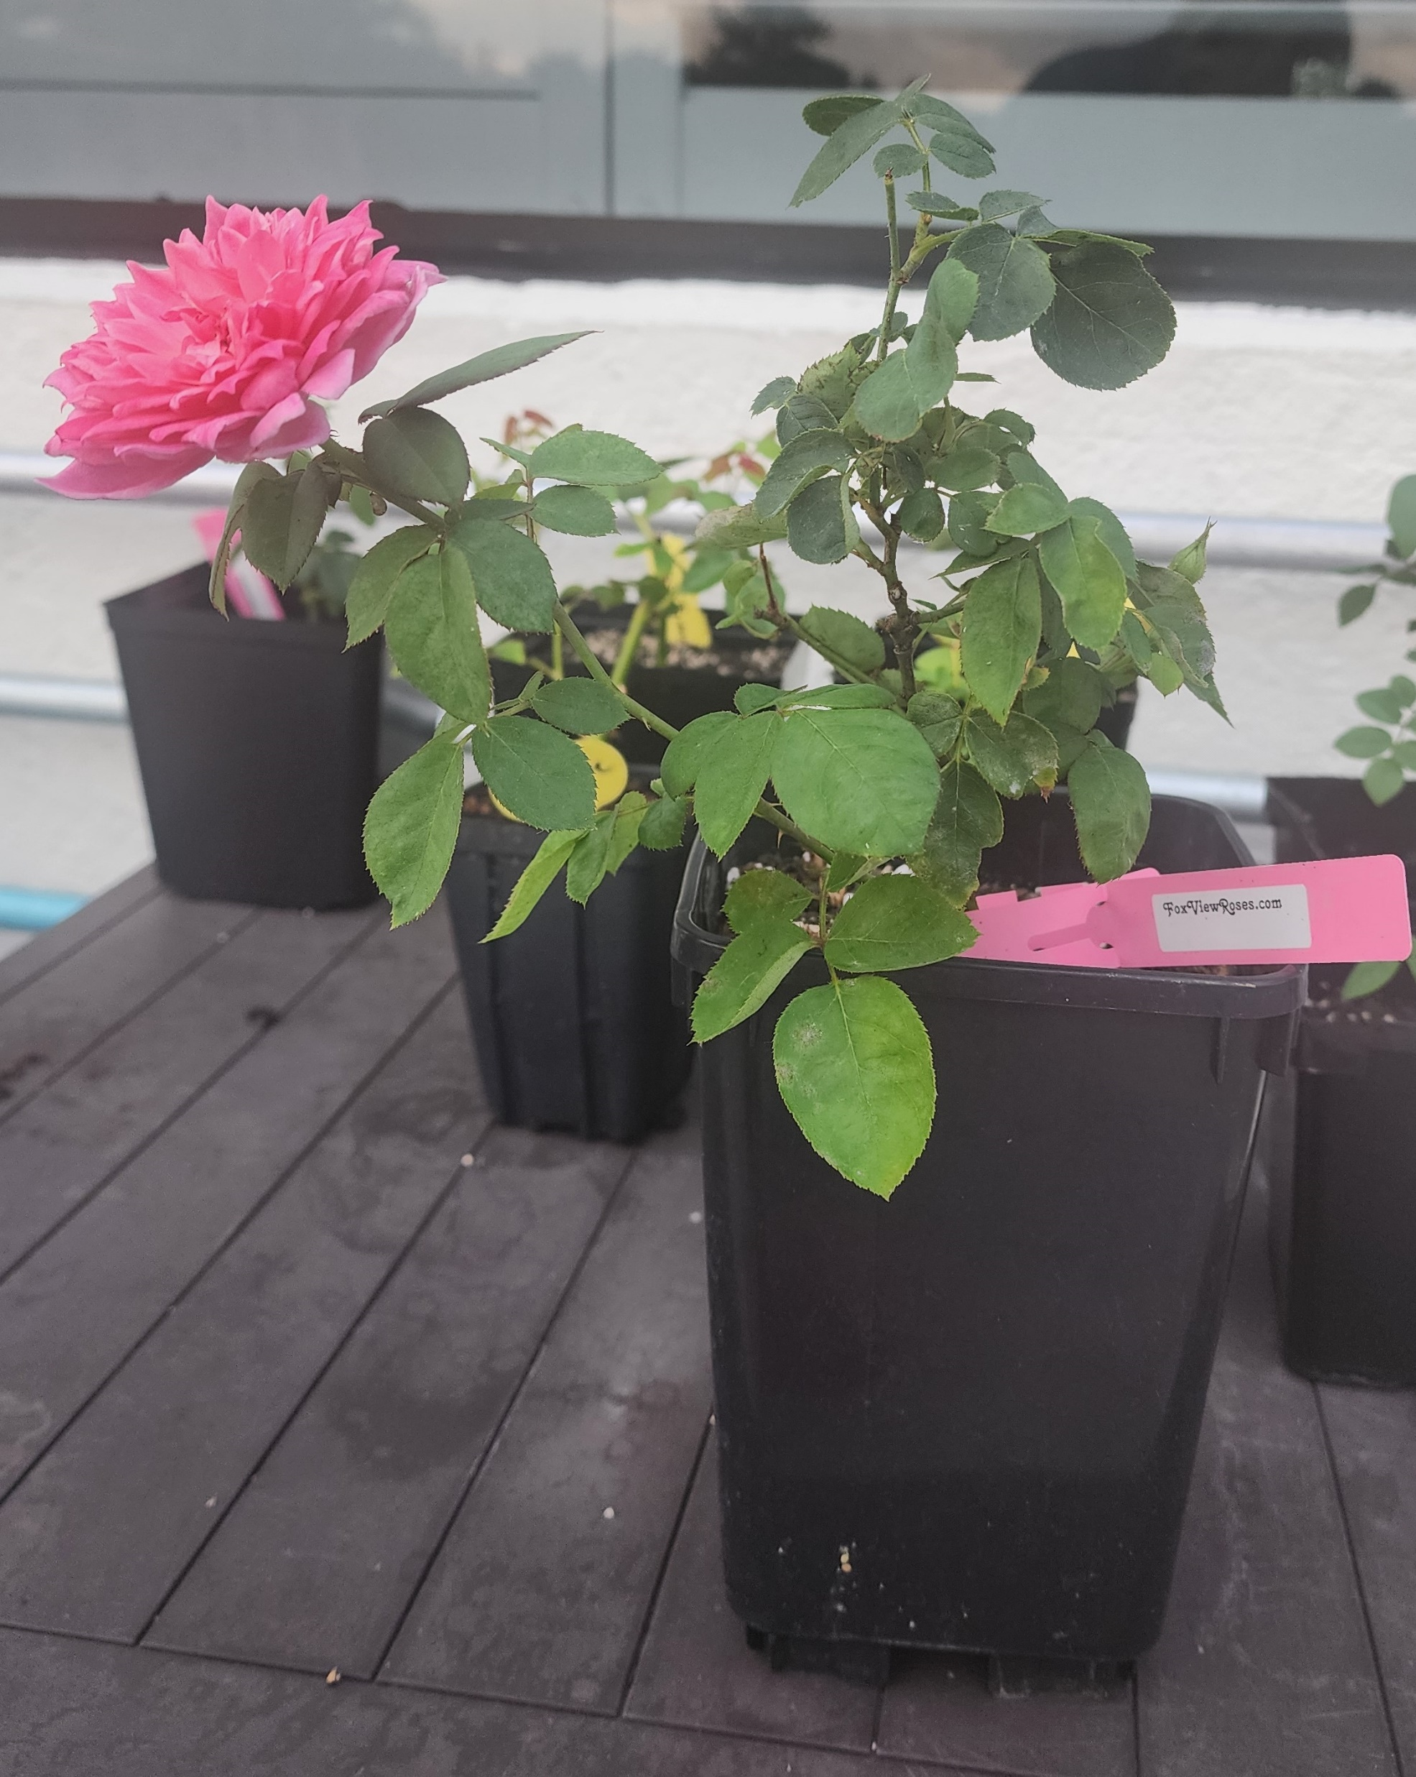
I. Medium
II. Rooting Hormones and Other Additives
III. Pots, Containers, Bins and Humidity Covers
IV. Location, Location, Location
V. Environment and Care
VI. Where to get cuttings
Let’s Take a Cutting & Prep
VIII. Burrito Method
IX. Own Root Care with Nematodes
X. QUESTIONS???

Slide 4
Medium:
You can use any medium you like. It’s best to choose something that is sterile. Whatever medium you choose (except for root riot plugs and water), I wet my medium with superthrive (1/4 teaspoon to one gallon of water) slowly pouring it in, for a damp consistency, mixing with my hands. The soil should slightly compact in your hand but should NOT be dripping when you squeeze or drenched.
➡️ Coco Coir 70% mixed with Pelite 30% (THIS IS MY PREFERRED MIXTURE. I use FoxFarms Cultivation Nation. It’s already in this ratio.)
➡️ One Part Promix (contains: 60 - 60% sphagnum peat, vermiculite, coco coir, sand, lime, perlite, mycorrhizal fungi) mixed with One Part Perlite. This works very well.
➡️ Fine Fir Bark (used by Mike Kincaid at Fraser Valley Farms)
➡️ Cactus Potting soil
➡️ One Part Sand mixed with One Part Potting Soil
➡️ One Part Potting Soil mixed with One Part Perlite (Kitty Belendez uses this)
➡️ Straight Peat.
➡️ One Part Seed Starting Mix mixed with One Part Perlite
➡️ Root Riot Plugs: If you use these, once you are rooted, you will have to pinch away some of the plug near the stem. You are supposed to plant with the plug, but truthfully, it holds too much water and the new plants will get root rot.
➡️ Plain Water: Must change the water every few days. Takes much longer to root and often the cutting is lost once planted in soil
➡️ Bubble Propagators. Water must be changed weekly.
I use a combination of these things sometimes when I have a lot of rooting to do.

Slide 5
Rooting Hormones and Other Additives:
IAA: Indole 3 acetic acid: Found naturally in plants. It is short term and breaks down quickly.
IBA: Indole 3 butryic acid: Found naturally in plants. It is long term and converts to IAA.
NAA: Alpha Napththalene Acetic Acid: Manmade rooting hormone
We will start with the natural rooting agents.
Aloe Vera: in its gel form, it is a natural rooting hormone, has salisilic acid, minerals and vitamins. Dip the stem in the gel form just like you do with rooting hormone. It has antifungal and antibacterial properties.
Willow Water: This has a high percentage of Rooting Hormone. It has antifungal and antibacterial properties: In a blender: Willow twigs and water.
Honey: Has no rooting hormone. It has antifungal and antibacterial properties.
Cinnamon: Has no rooting hormone. It has antifungal and antibacterial properties.

Slide 6
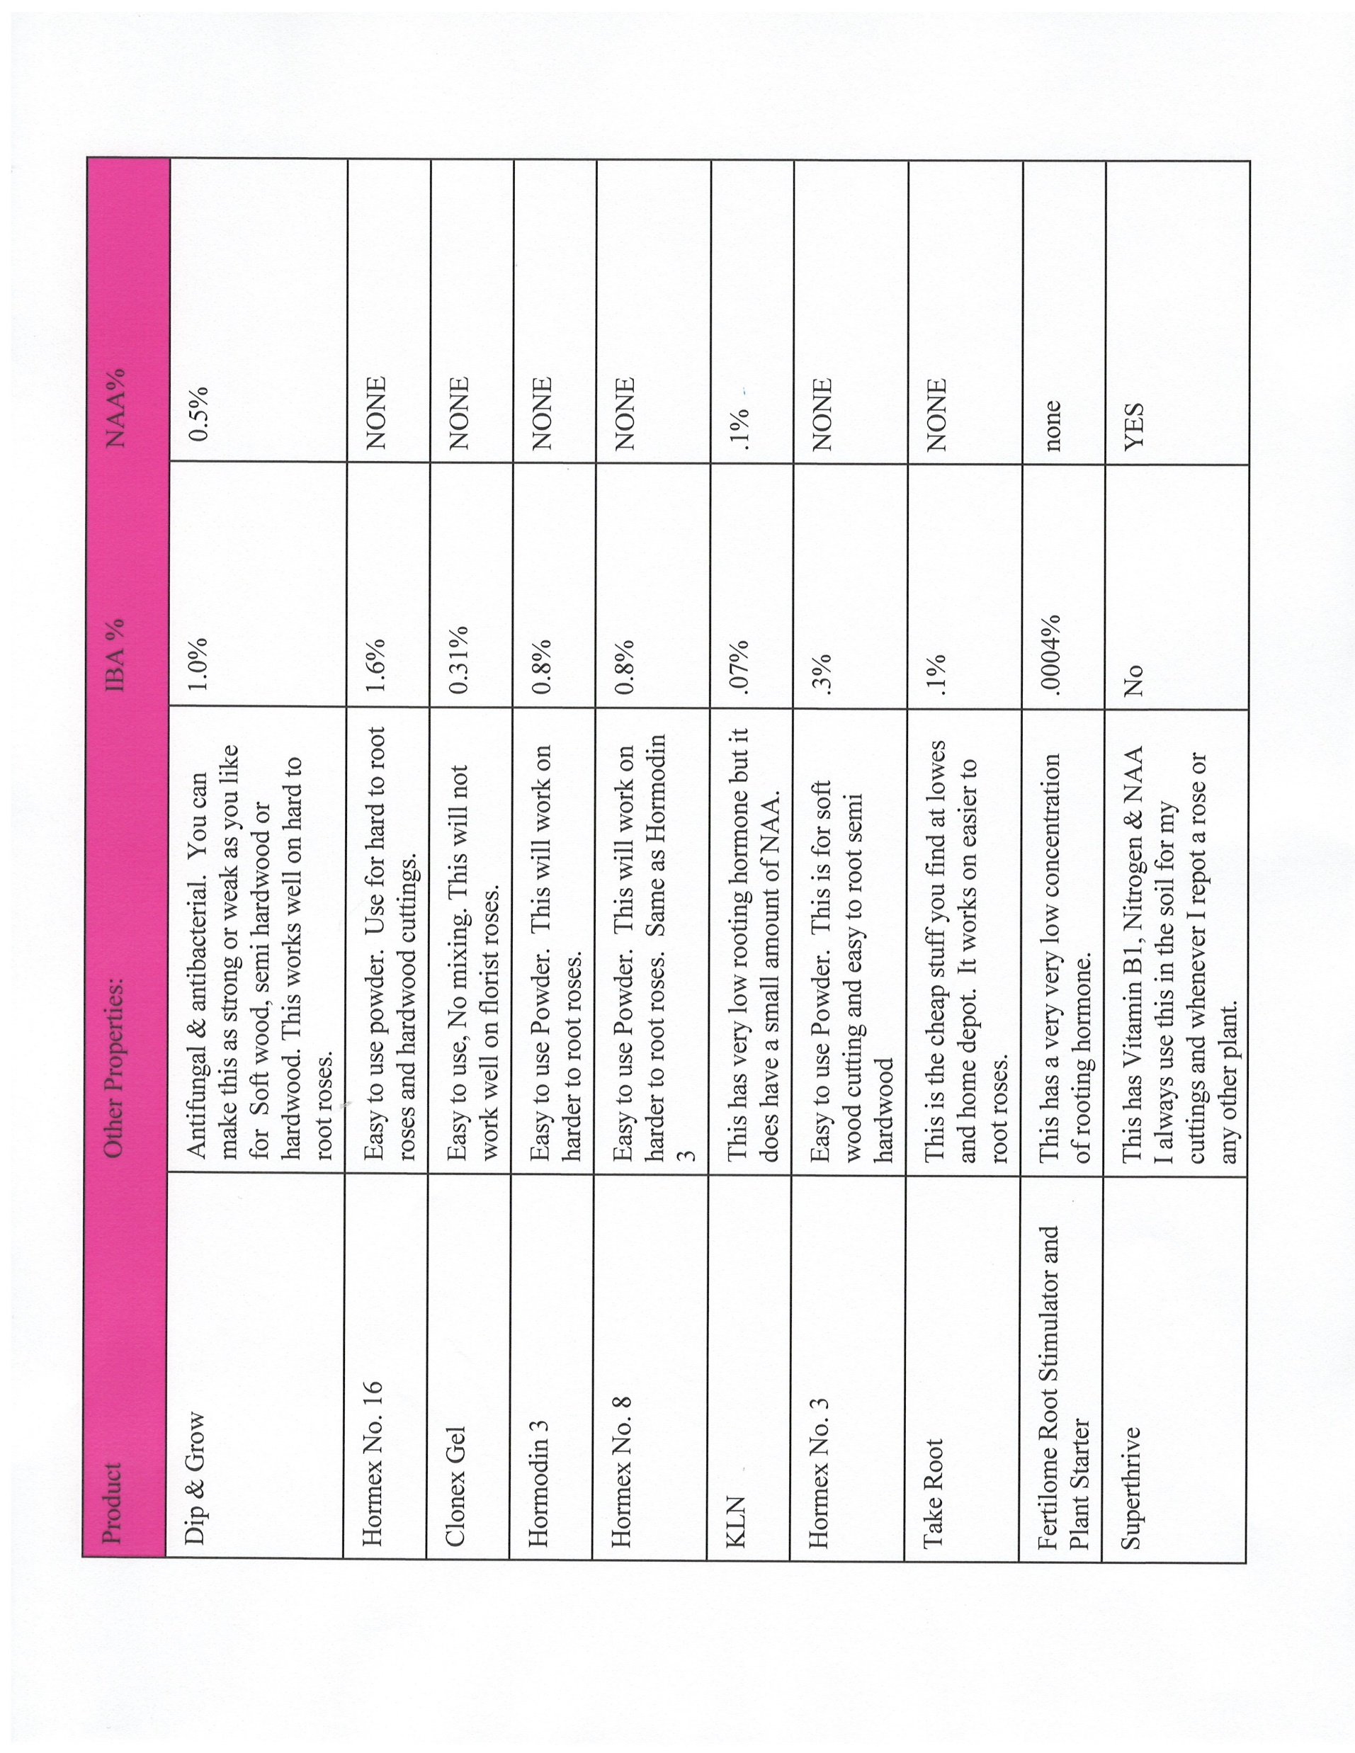

Slide 7
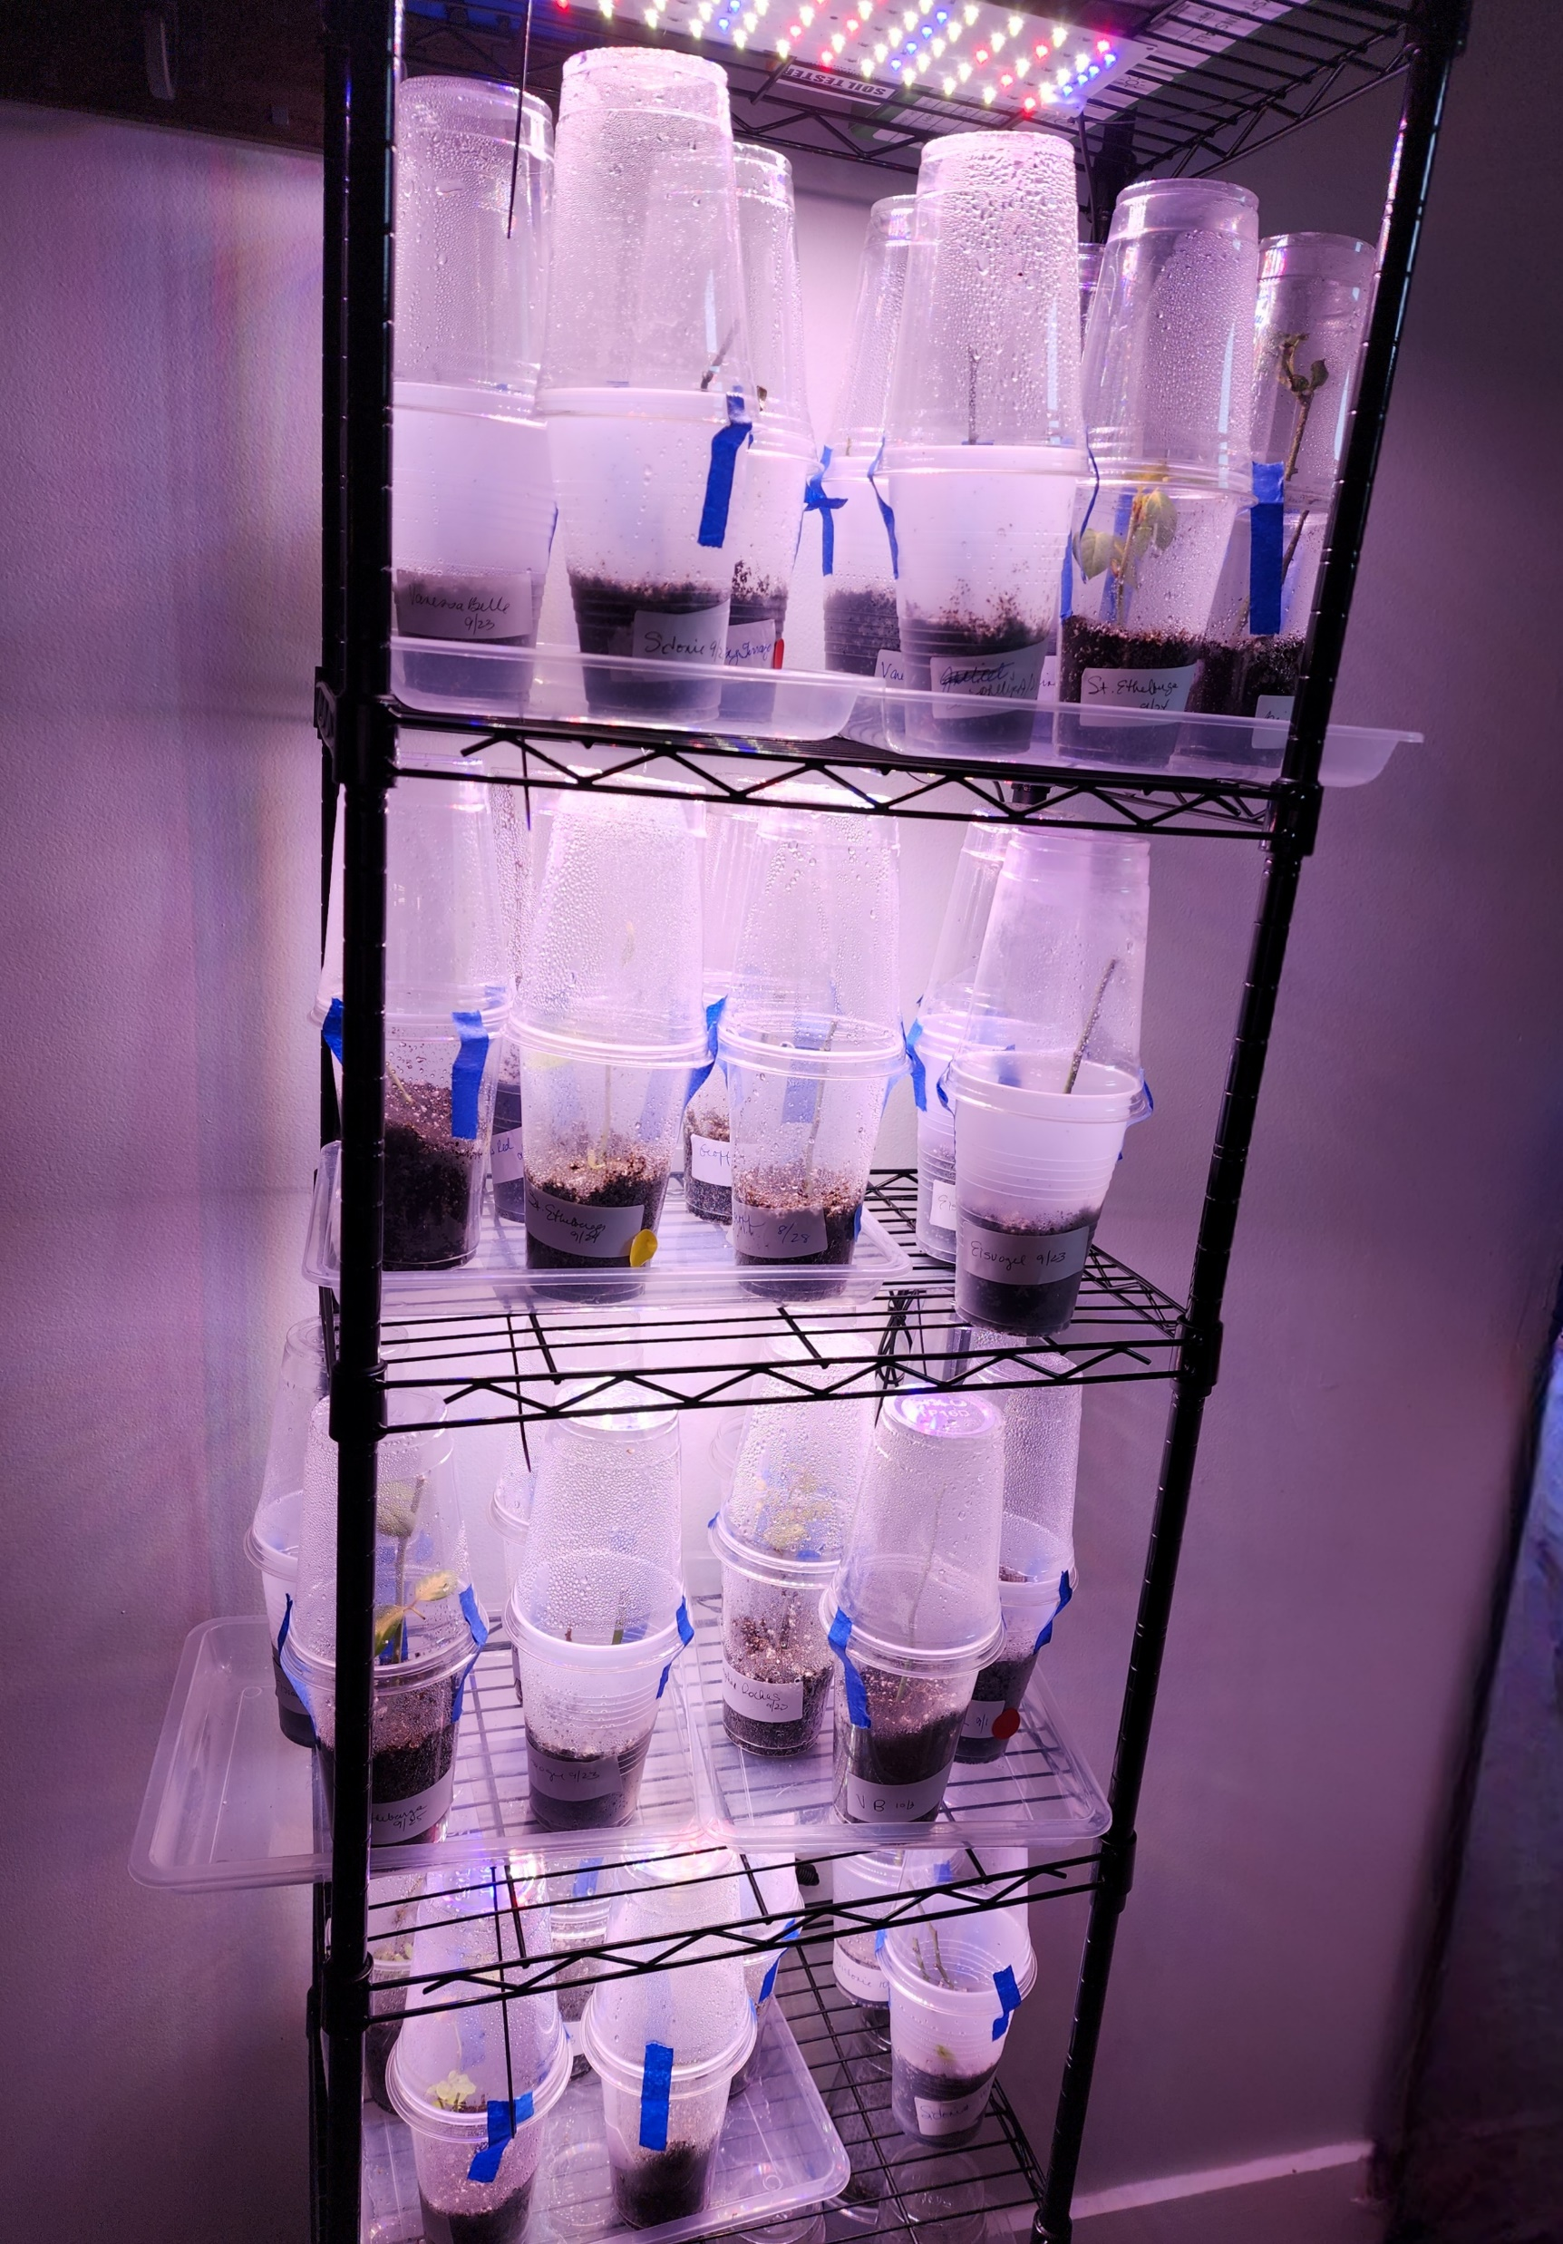
Pots, Containers, Bins and Humidity Covers
Biodegradable Grow Bags: This allows air to flow through the medium and the roots pop out the sides when they start to form. If you use the grow bags, the entire bag needs to be in a humidity dome.
Clear solo cups: holes drilled in the bottom for drainage; these allow you to see the roots easily.
2 x 2 or 3 x 3 pot growers pot. You can put multiple cuttings in a larger pot but you run the risk of losing the cutting when you separate them; you also cannot see the roots which puts you at a disadvantage.
Green Glass Bottles: This is good for the water propagation.

Slide 8
BINS AND HUMIDITY COVERS:
Anything that closes and can be opened occasionally for airflow will work. Make sure you open your humidity dome every day for a minute or two. Check your temperature and humidity!!!! I have used MANY of these:
👍 Three Cup Method: This is my favorite method!
👍 2 gallon glass cookie jars: These work great in cooler weather. Otherwise, the temperature could get too warm in them.
👍 Clear Storage Bins: Make sure you don’t get the kind that seals water in or out. I find the cuttings will rot quickly in these.
👍 Fish Tank: An old cleaned and bleached fish tank. Cover the top with cling wrap.
👍 1 gallon zip lock bags: You can put your soil medium in these; I use these for the Root Riot plugs. You can put 2 or 3 in one ziplock. Then I hang them with clothes pins from string in my north facing lanai.
👍 Clear soda / iced tea/ water bottle: Cut off the bottom. Place over your growers pot. Leave the cap off at the top!
👍 Dunkin Donuts clear cup with top: You can plant in these and cover with the domed top!
👍 Bubble Propagators: These are good for the Root Riot Plugs.
👍 Greenhouse: If you’re lucky enough to have a real greenhouse, this is the BEST humidity dome. You do not need any other humidity dome. You will have to put your misters on FOG. For the schedule on how often to come on and how long depends on the outside temperatures, size of the greenhouse, etc. Some put it on every minute for 10 seconds. Some put it on every 15 minutes for 10 seconds. The smaller and airtight the greenhouse is, the less moisture you will need. I once tried automatic foggers in a huge tote. I killed everything.
👍 Burrito Method: This is a good method that works well also.

Slide 9
Location, Location, Location:
Any location that is protected from harsh wind and does NOT get direct sun will usually work. I use my North facing lanai from late October through early June. I use my pantry and laundry room late June through early October. The lanai gets too warm and I cannot keep the temperature low enough for the cuttings. In the summer, I keep my house temperature at 68 to 70 degrees so the cuttings inside a humidity dome will be slightly warmer so it’s perfect.
North Facing Shaded Garden Under a BUSH
Covered Porch or Lanai Garage w/ Grow Lights
without direct sunlight
Indoors in a window
Bright Bathroom in tub w/ bright indirect light
Greenhouse

Slide 10
Environment and Care:
🌹 Temperature Range: 65 - 75 degrees (I have a small round, digital thermometer that tells me the temperature and humidity)
🌹 Humidity Range: 70% - 85%
🌹 Light: Indirect light; If room has no windows, you can use grow lights 10 hours a day
🌹 Misting: Only mist the sides and top of the humidity dome if the humidity drops below 70%. If you accidentally leave a humidity dome open all day like I have, well then you can mist the soil if it is dry to the touch but only around the edges of the pot or cup. If the stem looks dry as a result of this screw up, you can lightly mist it.
🌹 Fertilizing: You can start fertilizing 2 weeks AFTER you see roots. 1/4 strength of a basic liquid 10 10 10 fertilizer, fish fertilizer etc. I also give a dose of water with Superthrive.
🌹 Fungus/Stem Rot Control Options:
(a) Sprinkle cinnamon in medium
(b) Spray stems with mixture of water and hydrogen peroxide
(c) Clean up all fallen leaves
(d) Toss Black Stems immediately and toss the soil. You can bleach the container and reuse.
(e) Keep humidity below 85%
(f) Never mist soil unless you are in a greenhouse and need to bring the temperature down. They put the misters on fog.
(g) Make sure you open your humidity dome daily for fresh air
IF YOUR CUTTINGS ACCIDENTALLY GET SOAKED BY FLOOD, RAIN, MISTAKE, ETC. YOU NEED TO ABSORB THE WATER OUT IMMEDIATE. YOU CAN USE PAPER TOWELS, DIAPERS, TAMPONS. Kitty litter would work too but I’m not sure if I would introduce it into your sterile soil.

Slide 11
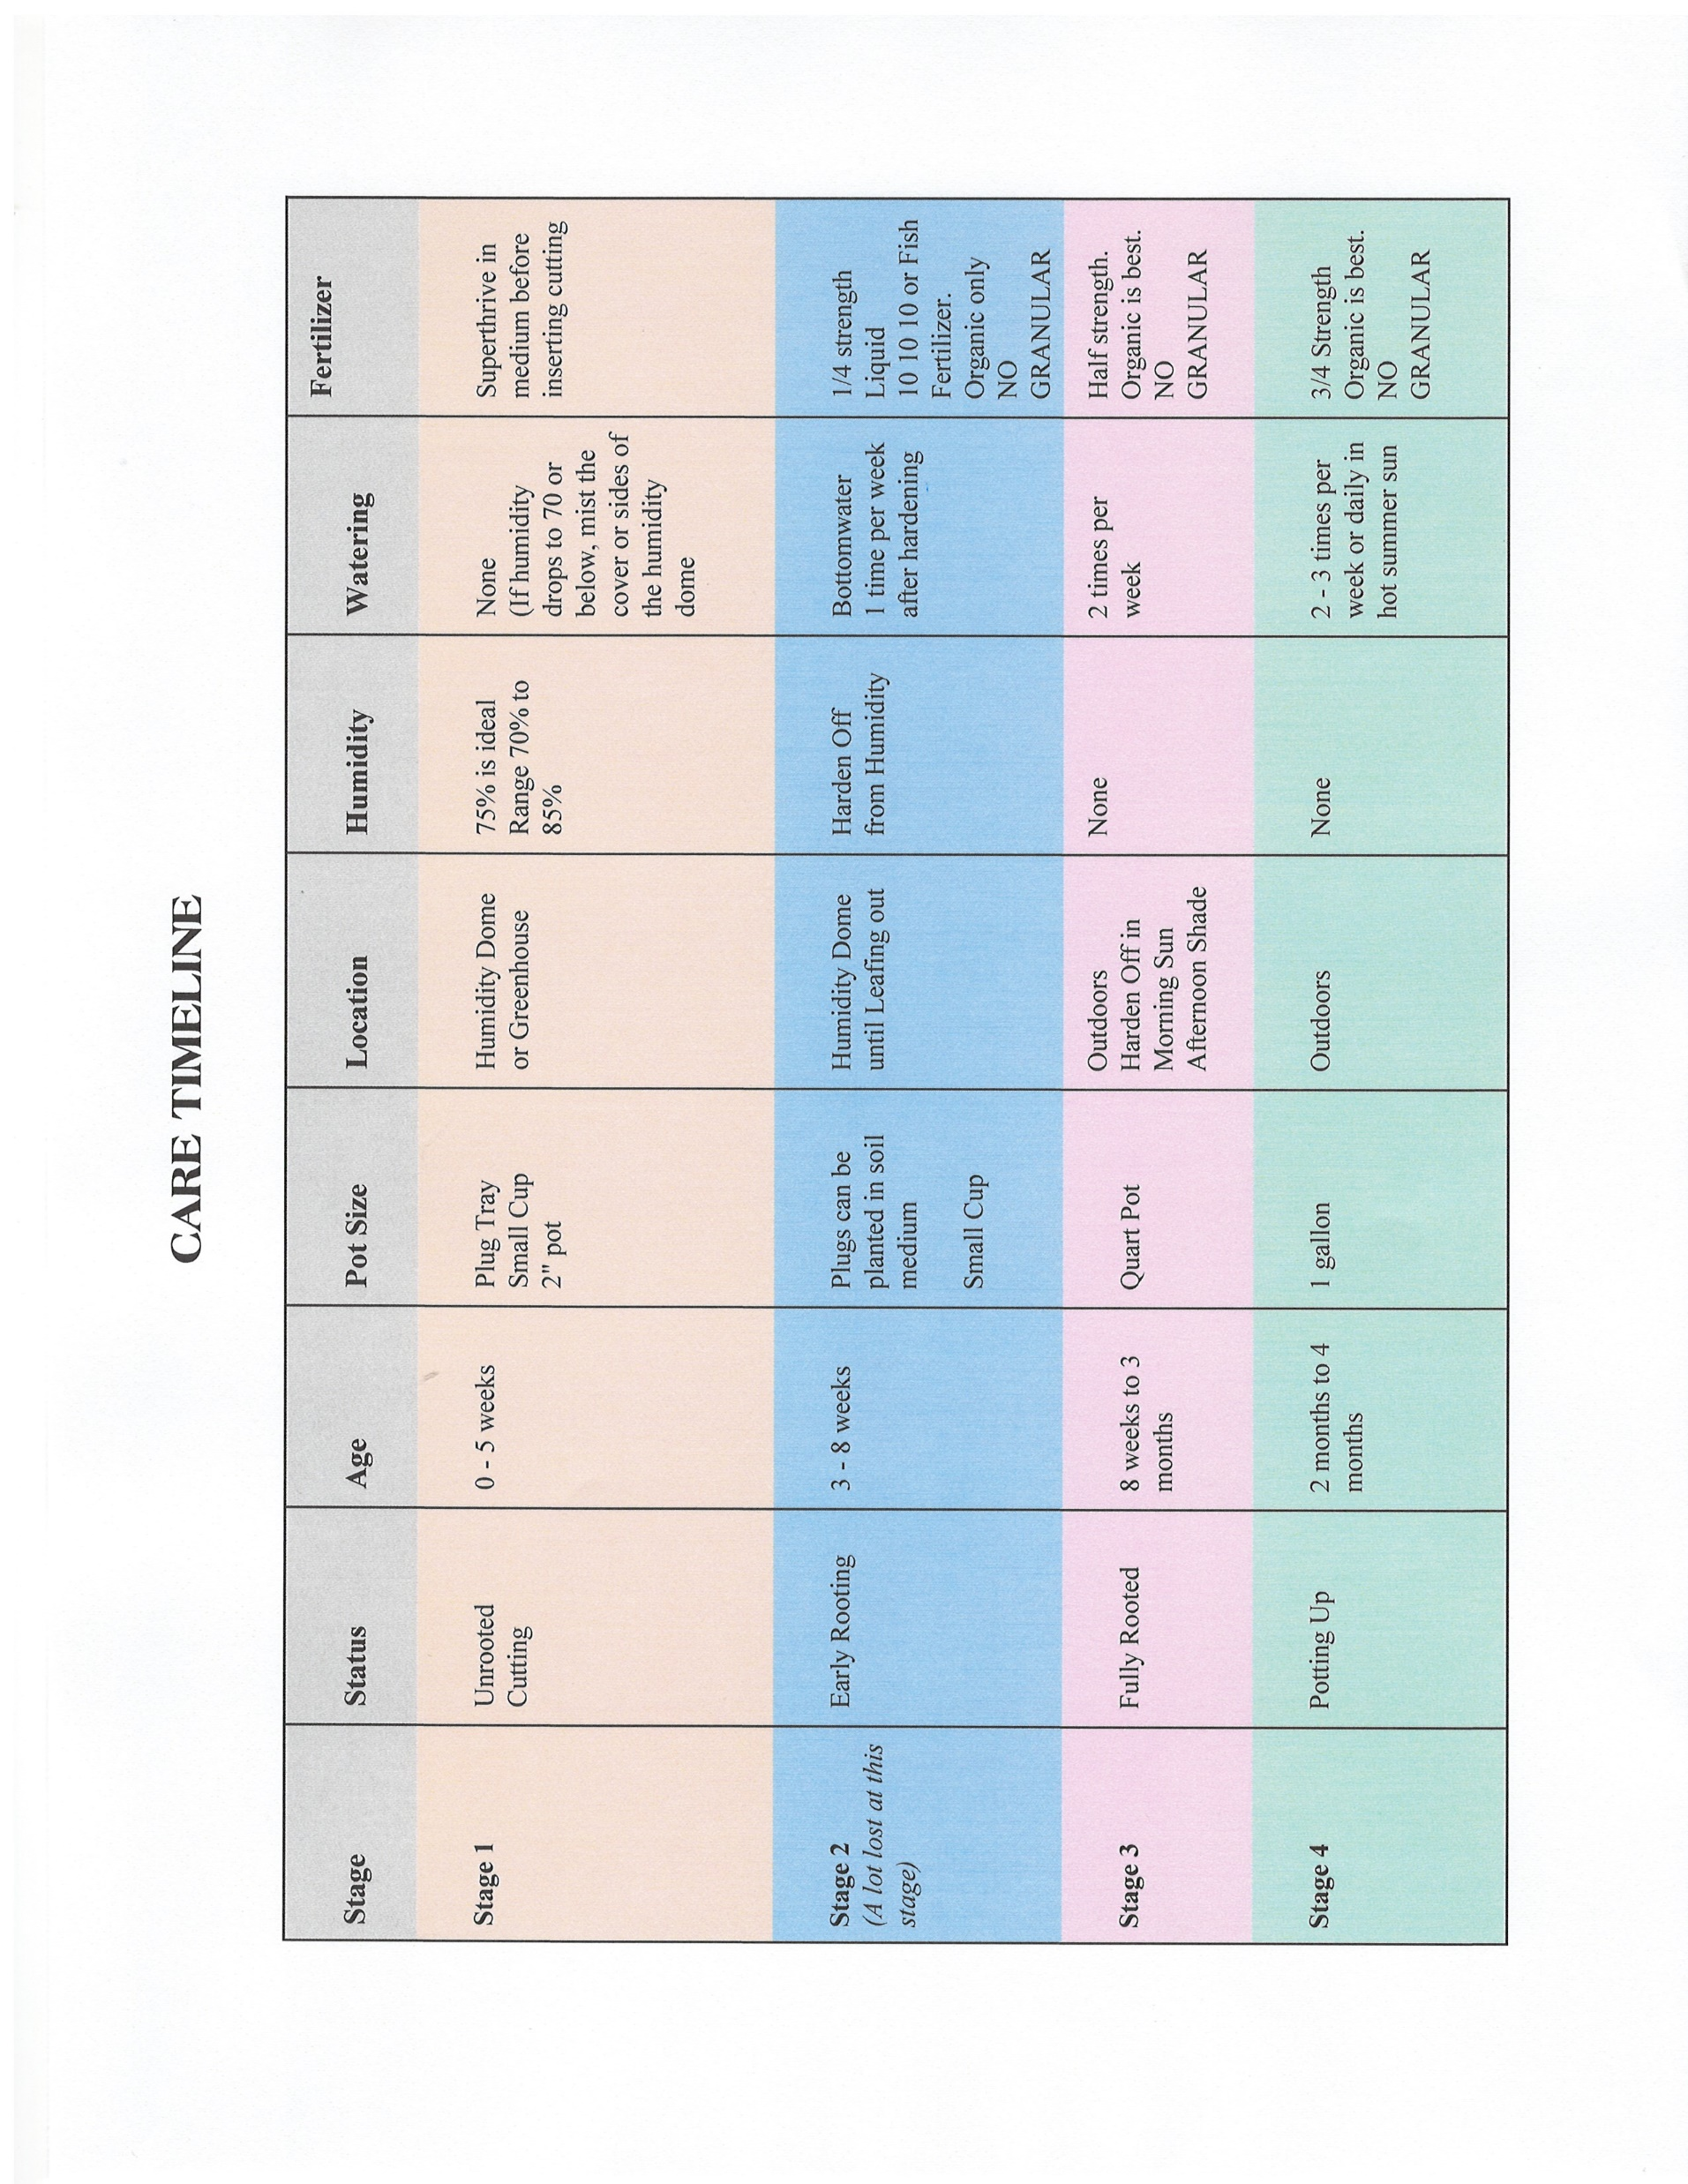

Slide 12
Now let’s get to the Cuttings!!!
A. Fresh cut from your own or a friend’s garden = highest success rate !!!
B. Cutting Trading Groups such as Rose Geek Propagation (trade cuttings only) and Rose, Rose I Love you (you can buy cuttings here). If you send cuttings to someone, make sure you wrap stems in wet paper towel, wrapped in saran wrap and in a Ziplock bag. Send 2 day postal service or Fedex!
C. Amazon or Ebay, you can buy cuttings.
D. Florist Roses and Bouquets: FYI Trader Joe’s has beautiful garden roses $8.00 for EIGHT of them; Online rose resellers direct from the grower as they are not treated with anything. You must use a stronger rooting hormone for these as they are more difficult to root.
E. Easiest roses to propagate are: old garden roses, english roses, shrubs and miniatures.

Slide 13
CUTTINGS AND PREP:
You want a semi-hardwood cutting propagation. This is perfect for rooting. The best stem would be one that just finished flowering and dropped its petals. You want something that is close to the thickness of a pencil and has no disease or bugs. The stem should be green and flexible enough to bend slightly but not break. Do not cut any red stems, as this is new growth.
If you have a stem that has a heel wood, the heel wood will root the easiest! Always choose the heel wood! The heel wood should be used for the root below the soil!
* The cutting must have 3 or 4 leaf nodes. Try to find leaf nodes that have 5 or 7 leaves and are “pushing pink”. You will have better success rate.
* Cutting should be 4" - 8" long depending upon how far apart the nodes are.
* Use sterilized secateurs or scissors: I use peroxide in a spray bottle to sterilize.
* Take the cutting about 1" below the 4th leaf node.
* Put the cuttings directly into hot water. Carry a cup with you. I put a little powdered rooting hormone in the hot water.
* Mark the cutting immediately as to what it is. This is pretty important unless you want to be surprised. I use labels and I put name and the date I took the cuttings.

Slide 14
PREPARING THE CUTTING:
* Once you are near all your supplies for propagating, we are ready to prepare the cutting:
* Cut below the bottom node, not more than 1/4" below. You can cut straight, on an angle or you can use a V shape. Results might be slightly better if you try the V shape to give more room for Roots or Callous to Form. Again, sterilize your cutting tool. You can use secateurs, scissors, exacto knife or razor blade. Whatever you are comfortable with.
* Score ½" of the bottom stem with a razor blade OR use a potato peeler, knife or razor to scrape off the green from the stem near the bottom. I go right over bud eye lightly. Make sure you wound directly under or over the bud eye as this promotes healing by forming roots! Remove any thorns near the bottom bud eye or below the soil level.
* Remove all leaves except the top two bud eye leaves (or one bud eye). You basically want 2 to 4 leaves at the top for photosynthesis.
* Make a hole in your medium with a dowel or pencil
* Dip the cutting in a mixture of peroxide and water 50/50
* Dip the bottom end of your cutting in your rooting hormone. I leave in DIP N Grow for 5 minutes. Then I dip in a combination of Hormex 16 and Great White mycorrhizal fungi.
* Place the cutting in the hole in the medium
* Press gently in the soil around the stem so the cutting holds in place.
* Label your cutting!
* Put cutting in the humidity dome in a bright but shaded location.

Slide 15
BURRITO METHOD
✂️ Cut below the bottom node, not more than 1/4" below. You can cut straight, on an angle or you can use a V shape. Results might be slightly better if you try the V shape to give more room for Roots or Callous to Form. Again, sterilize your cutting tool. You can use secateurs, scissors, exacto knife or razor blade. Whatever you are comfortable with.
✂️ Score ½" of the bottom stem with a razor blade OR use a potato peeler, knife or razor to scrape off the green from the by forming roots! Remove any thorns near the bottom bud eye.
✂️ Remove all leaves. With this method the leaves will fall off anyway.
✂️ Mist two sheets of newspaper on both sides and set aside. You don’t want it dripping, just damp
✂️ Dip the cutting in a mixture of peroxide and water 50/50
✂️ Dip the bottom end of your cutting in your rooting hormone. I leave in DIP N Grow for 5 minutes. Then I dip in a combination of Hormex 16 and Great White mychorrizal fungi.
✂️ Place the cutting or multiple cutting together on the first sheet of newspaper and roll it up. Fold both ends up. And then roll that newspaper inside the other sheet of newspaper.
✂️ Put the newspaper inside a grocery store plastic bag or a ziplock.
✂️ Label your bag! Name and date!
✂️ Put cutting in a dark cool location like your pantry or a drawer. No light. 65% would be perfect temp.
✂️ You should have roots and/or callous in 3 weeks or less.
Transferring to Soil:
So this is the tricky part. Trying to not break off the roots. I feel my pot ½ way with my medium. Then I take my cutting and hold it suspended over the pot and gently pour the soil little by little around the cutting so the tender roots are not damaged. Once it looks like it’s high enough, I add a little water with superthrive which usually makes the soil compress down a little. Then I add more soil to the top. It’s a process!

Slide 16
IX Own Root Care with Nematodes:
So now that we have all these new own root roses we are making, we need to protect them from the Nematodes. Now if you’re like me, you may have 250 roses and most are in the ground and not in pots. I suggest these new babies stay in pots for one year at least so the roots develop stronger. You should treat them like a rose band you just purchased. But when they are ready to go in the ground, there are a few things I have done to keep the Nematodes at bay as nothing will really kill them except solarization.
* I solarize the ground. I do this with my propane heat torch which is 500,000 BTU’s. Do not do this on a windy or hot day! I burn the actual area I intend to plant in as well as the surrounding garden. This also keeps the weeds at bay so I regularly use my weed torch in all the gardens. Keep your hose nearby for potential fires. Mulch and surrounding bushes should be hosed down before torching. I am careful NOT to torch within one month of using Activate (see below).
* KEEP YOUR ORGANIC MATTER HIGH!!! And use a 2 inch layer of peat at the bottom of your hole.
* Always plant with Mycorrhizal Root Fungi. This gives a layer of protection to the roots so they grow strong and healthy. Nematodes/gall will always attack a weakened plant.
* Monterey Nematode Control: Ground Drench every 3 months: 1 ounce per gallon. I use 4 cups on each larger rose poured around in a circle creating a barrier. 2 cups or so on smaller roses.
* Activate: Ground drench every 3 months (opposite months of Monterey): ½ teaspoon per gallon of purified or distilled water. This is an antibacterial product and must be used within 1 year of being opened. It’s very expensive and hard to get but I generally find in online.
* Plant French Marigolds all over the place! It repels the Nematodes. I have it in every rose garden. When they get too big and overgrown, I leave a little section planted and take the rest and leave it out to die. Then I bury it in the garden to decay there.
* Use Worm Castings regularly to encourage good earthworms. Healthy soil is best.
* Good Nematodes can be purchased and released in the ground.
* Crab meal (be careful as this raises soil PH).

Slide 17
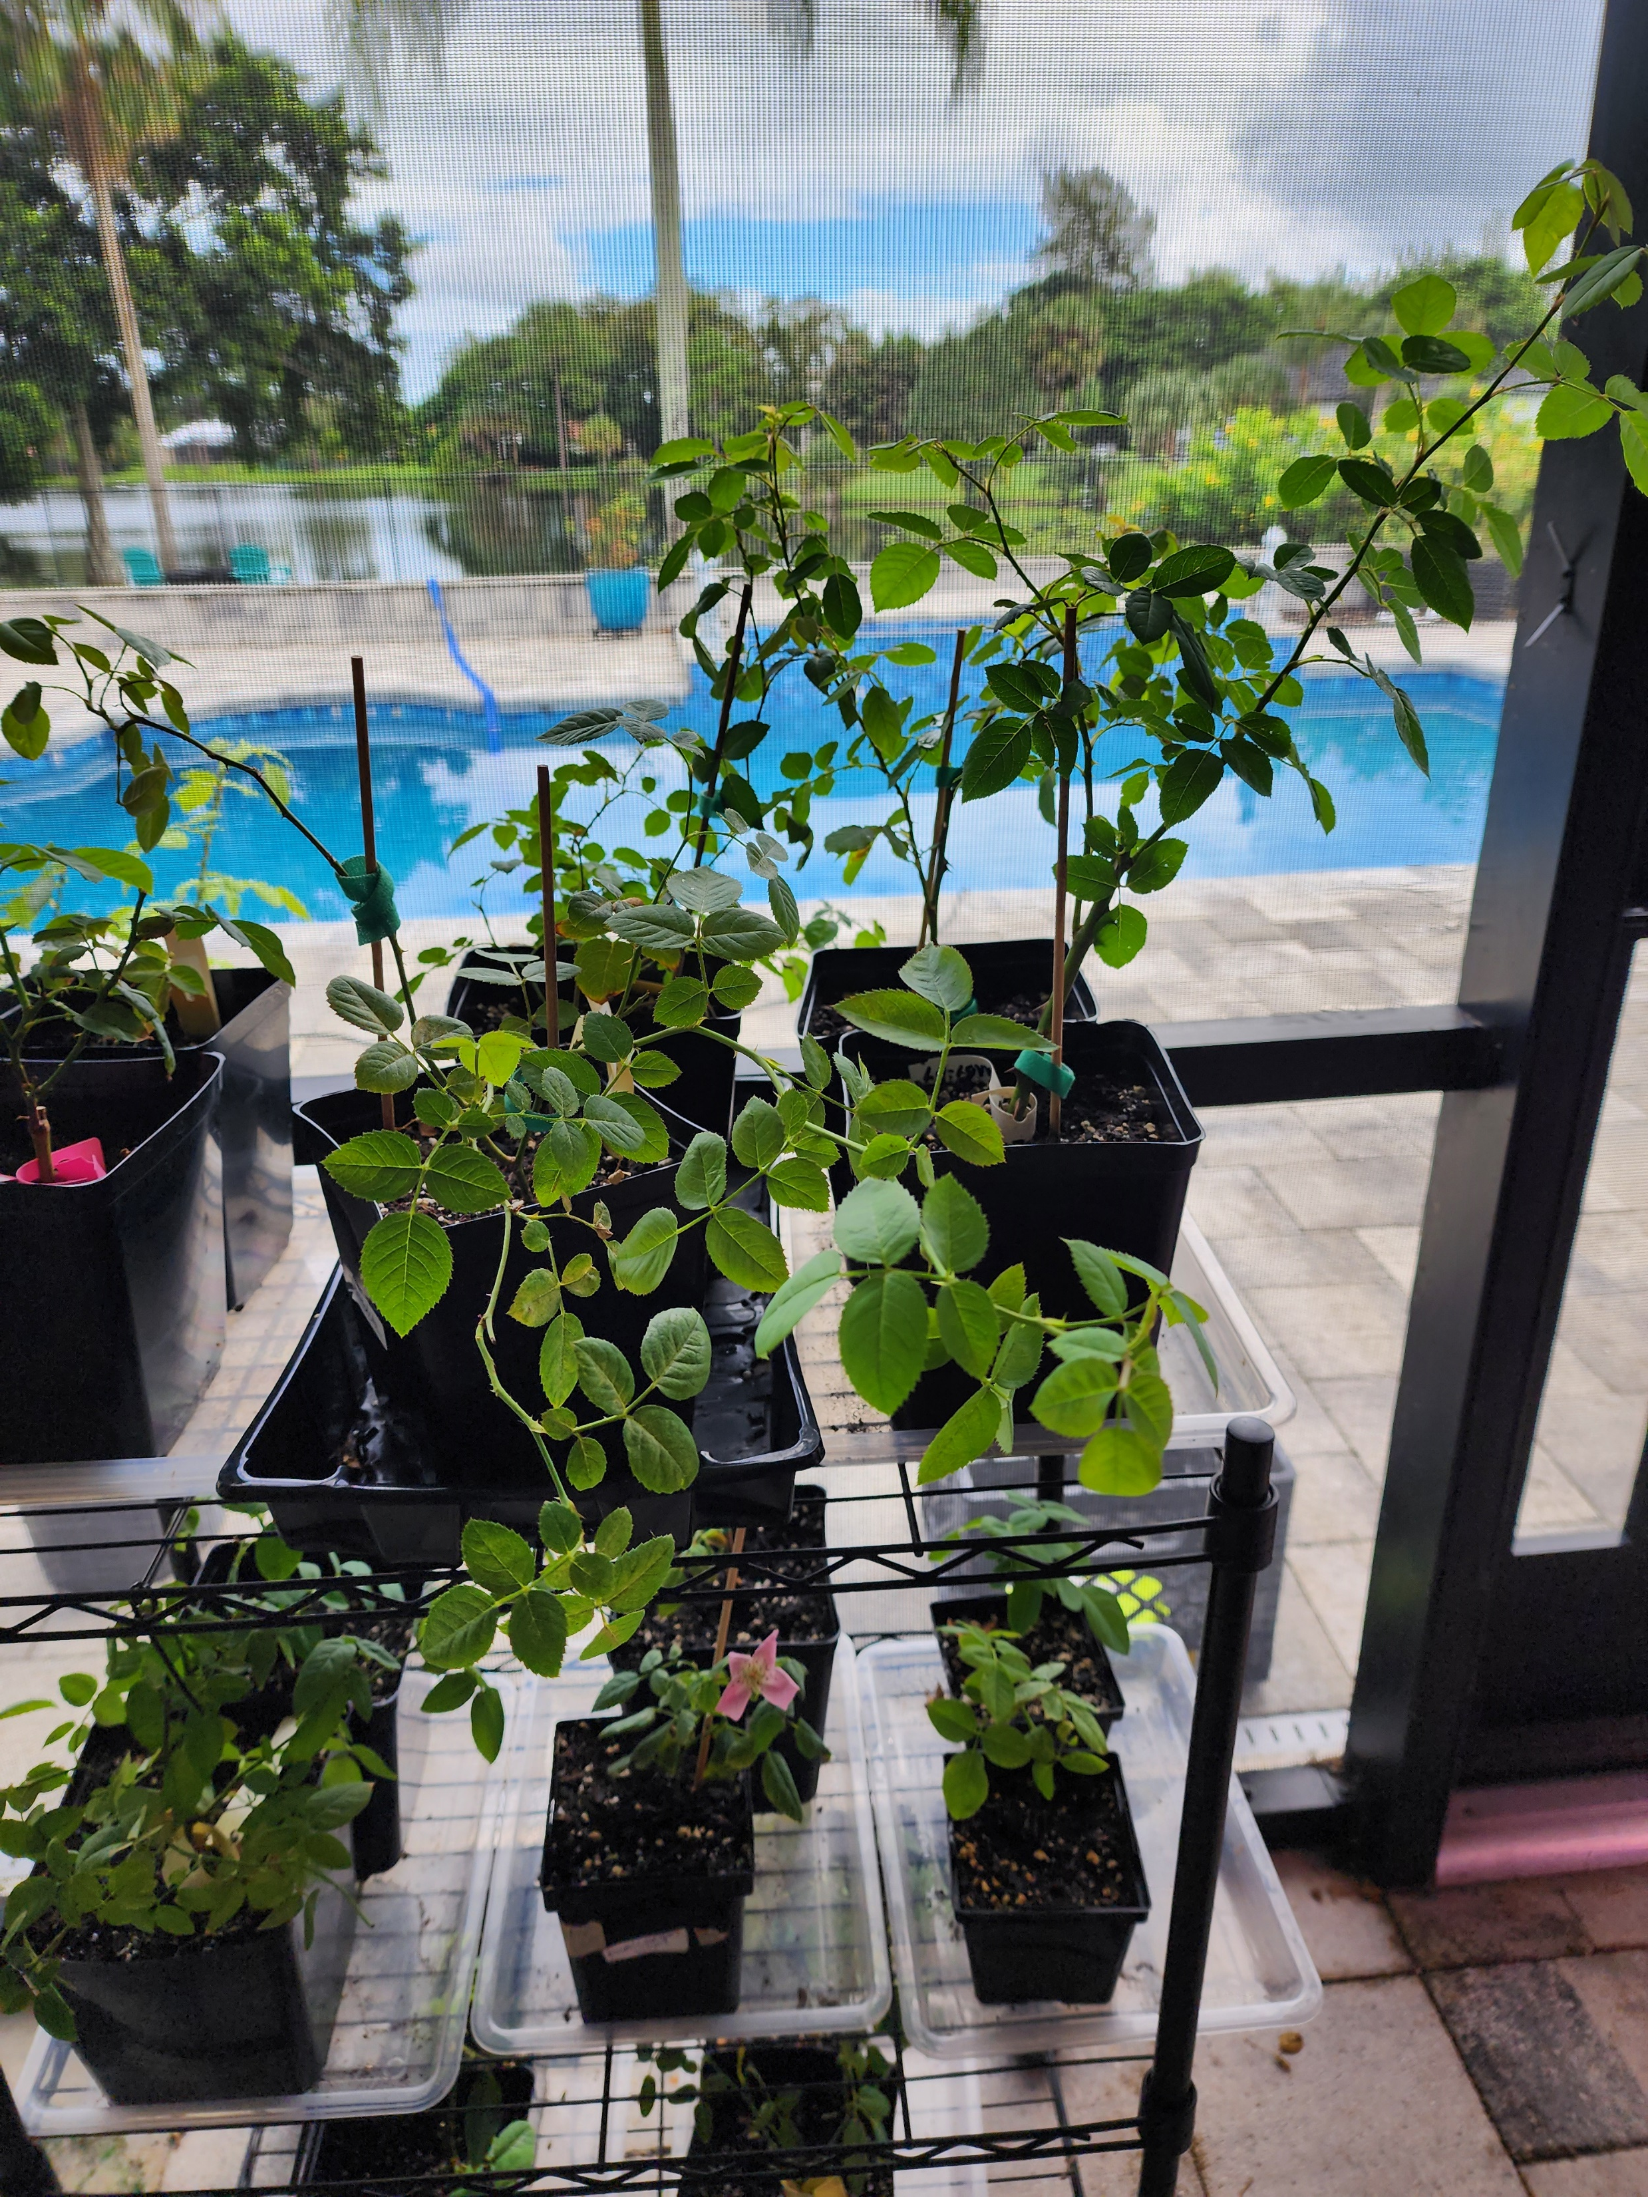
FOR HEALTHY BABIES!
Give cuttings fresh air every day.
Toss all black stems immediately to prevent spread
Toss all fallen leaves
Mist covers of cookie jar or tub if humidity falls below 72% or temperature goes over 85%.
Give 10 hours a day of indirect light
Label your cuttings with the name of the rose and the date
Record what you do and your results so you can try different things to see what works in your environment
Keep in shade or indirect light
Use grow lights 10 hours a day if cuttings are in a garage.
Use a heat mat in cold climates. Temp should be at 70 degrees.
Check to see if you have roots!!!

Slide 18
DON’TS!
DO NOT PULL ON STEMS TO SEE IF THEY ROOTED! You will break tiny fragile stems in the process
DO NOT WATER OR MIST YOUR SOIL MEDIUM. Unless you accidentally have them dry out completely. In that case, just dampen around the outer edges of the pot or cup
DO NOT PLACE IN DIRECT SUN
DO NOT FORGET TO COVER after you uncover.
DO NOT RE-USE YOUR SOIL MEDIUM FOR OTHER CUTTINGS
DO NOT LET YOUR CUTTINGS GET DRIED OUT!
CAUTION!!!

Slide 19
QUESTIONS???
Questions later on? Feel free to contact me through facebook or email foxviewroses@gmail.com
Thank you for having me. It was my pleasure to bring you this presentation. GOOD LUCK!!!

