Slide 1

Founded in 2001 to Fund the Unmet Needs essential to the
Safety, Security, Health & Well-Being
of Talbot County’s Children and
Vulnerable Adults

Slide 2
Talbot Community Connections
Talbot Community Connections (TCC) is a non-profit 501(c)3 volunteer organization
Over $500,000 raised to date to support unfunded needs of Talbot County Department of Social Services (TCDSS) including the Talbot County Children’s Advocacy Center (TCCAC)

Slide 3
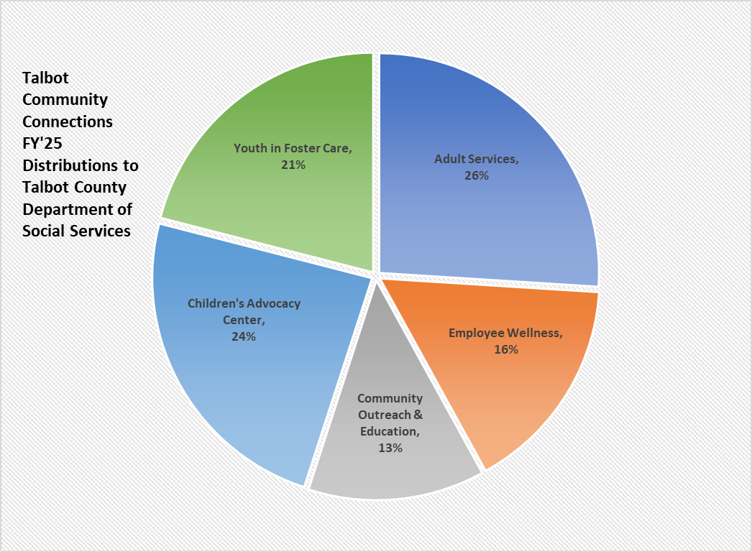

Slide 4
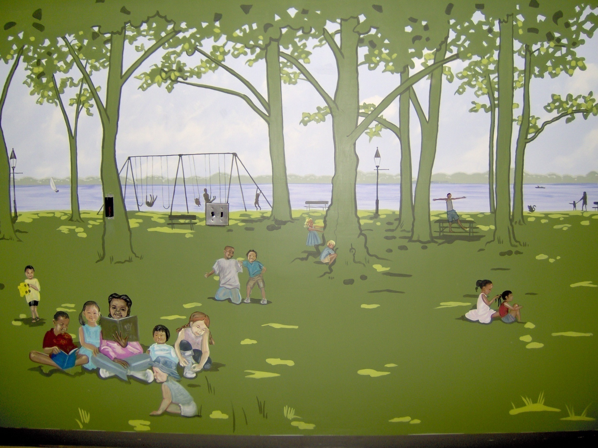
Notes:
History – Multi D Team
Diversity/cultural awareness
Partnership shs and dss created program of hope and healing for victims
Location- where MDT does their work

Slide 5

TALBOT COUNTY CHILDREN’S
ADVOCACY CENTER
Talbot Community Connections (TCC) funds services at Talbot County Children’s Advocacy Center (TCCAC) that enhance outcomes for child victims of sexual abuse, serious physical abuse, and extreme neglect.
A Program of Hope and Healing for Everyone

Slide 6

“Every child deserves a great childhood that's carefree and full of promise.” Lauren Krasko, Coordinator of the Talbot County Children’s Advocacy Center
Notes:
Our job to educate the community

Slide 7
Let’s Talk Statistics
• About 1 in 5 girls and 1 in 20 boys will be sexually abused before they turn 18.
• Child sexual abuse is significantly underreported.
o 73% of child survivors do not tell anyone about the abuse for at least a year.
o 45% of victims do not tell anyone for at least 5 years.
o Some children never disclose.
Of note, numbers of investigated child sexual abuse in Maryland may be higher because data typically excludes sexual assaults of children by strangers or others who do not have custody or supervision of a child.
About 90% of those that sexually abuse a child are acquaintances of either the child or the family, while roughly 10% of sexual abuse is perpetrated by a stranger.
(MCASA- Maryland Coalition Against Sexual Assault, December 2023) https://mcasa.org/

Slide 8
What is a Children’s Advocacy Center and what does it do?
Comprehensive multidisciplinary response to incidents of child abuse
Talbot County Children’s Advocacy Center provides a comfortable, private, child-friendly setting that is both physically and psychologically safe for diverse populations of children and their families
Designed to provide complete separation of victims and alleged offenders to the maximum extent possible
Provides services and support to
  Child victims of sex abuse, severe physical abuse, extreme neglect
  Non offending caregivers support with a family advocate assigned to the case

Slide 9
Talbot County CHILDREN’S ADVOCACY CENTER
A family waiting room offers a wide variety of toys and snacks for the children and parents
A meeting room for family meetings, therapy sessions for victims, and for the Family Advocate to provide support during interviews
A medical exam room
An observation room for law enforcement, state’s attorney, and the CAC Coordinator to discuss and observe forensic interviews
An interview room where the forensic interviews take place
TCCAC ensures ‘best practice’ standards of service and is accredited by the National Children’s Alliance.
Notes:
These are all components required for accreditation

Slide 10
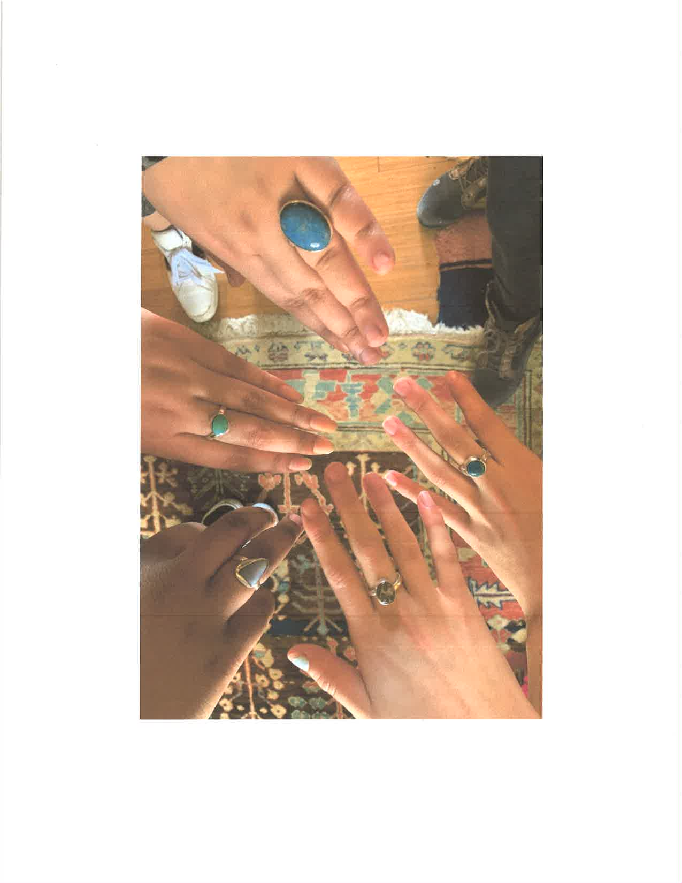
Services
Forensic Interviews
Forensic Medical Examinations for 5 County Mid Shore Region
Mental Health and Other Therapies
  Trauma-Informed Yoga
  Equine Therapy
  Art Therapy
  Music Therapy
  Challenge Course
Independent Living Skills
Team-building Activities
Emergency Financial Assistance
Family Advocacy

Slide 11
THE FAMILY ADVOCATE
    The Family Advocates provide vital case management and support for victims and their families.
    In FY 2025 the advocates provided over 1203 sessions including:
    Crisis counseling
    Referrals for mental health counseling
    Interaction with law enforcement
    Preparation for court assistance
    Victim support
Additionally, provided or assisted with linkages for food, clothing, shelter, educational support and internet access, prescription costs, and transportation.

Slide 12
MULTI-DISCIPLINARY TEAM
Working Together
    Child Protective Services
    Law Enforcement (Talbot County Sheriff’s Office, State Police, Municipal Police Departments)
    Legal – State’s Attorney’s Office
    Mental Health Providers
    Medical
      Medical Director
      Nurses (SANE, lab services, etc.)
    Family Advocates
Child/Family
Mental Health
Child Protective Services
Law Enforcement
Medical
Family Advocate
State’s Attorney’s Office

Slide 13
TCCAC STATS for FY 2025
Medical Exams
  Talbot County 26
  Other Mid Shore Counties 27
Forensic Interviews
  Talbot County 72
  Other Mid Shore Counties 8
Children and Adults served by Family Advocate 214
# of Sessions Provided by Family Advocate 1203
Notes:
1 child/interview -

Slide 14
Other Funds TCC Distributes to Talbot County Department of Social Services

Slide 15
FAMILIES & CHILDREN
Supported through TCC
  Families in Crisis
  Respite Care
  Community Outreach & Education
    Empower Me
    Back-to-School and other community events
  Needs of Children in Foster Care & Parents
    Provided funds for a quadriplegic, foster care youth in need of a specialized car seat necessary for his mobility
    Allowed a 17-year-old youth in foster care to complete driver’s education
    Provided tutoring services for a child who was traumatized by entering foster care
    Facilitated visits and activities to siblings and family members in distant parts of the State
    Celebrations/gifts for youth in foster care living in group or independent living settings, including hosting a recent high school graduation party.
    Summer camps for special needs youth

Slide 16
VULNERABLE ADULTS
Supported through TCC
TCC meets the emergency needs of vulnerable adults by providing funds for :
      Health supplies
      Medications
      Dental needs
      Medical co-pays
      Housing
      Bed bug treatment
      Utilities
      Transportation
      Books, reading material
      Other requests

Slide 17
TCC Board Members
Jennifer Wright, LCSW-C, President
Cindy Pease, Vice-President/Treasurer
Susan Merriken, LCSW-C, Secretary
Diana Lynne Duncan, Ed.D.
Marcie Molloy
Macqueen Parker, LCSW-C
Amy Blades Steward
Ruth Sullivan, MS, RN
Dodie Theune, PhD
Founding Directors
  Sally Vermilye
  Nancy Wilson
Emeritus Member
  William Banks

Slide 18

TO SUPPORT TCC
Visit: talbotcommunityconnections.org
or mail a donation to:
Talbot Community Connections
P.O. Box 2615
Easton, MD 21601

