Slide 1


Save the Brock! AGM & Members’ Meeting 11 November 2025, 7pm
Brockweir Inn Community Benefit Society

Slide 2

WELCOME
to all Members of the
Brockweir Inn Community Benefit Society!

Slide 3

Agenda
Annual General Meeting Adam Sinfield/ Andy Plummer
Apologies for absence
Minutes of previous AGM – review and approval
Chair’s annual report
Management Committee updates
Treasurers report
AOB
Members’ Update Tom Starr/ Lise Brekmoe
Progress on Building
Grant Applications
Historic England
AoB

Slide 4

1. Annual General Meeting

Slide 5
AGM Agenda
Apologies for absence
Minutes of previous AGM – review and approval
Chair’s annual report
Management Committee updates
Treasurers report
AOB

Slide 6
Chair’s report
We now own the pub!
466 number of members following 2 successful share offers
Apologies for lack of comms post ownership, but
Tom busy in background (update to follow)
Ali and Lise working on grants – and amazing community activities
So whilst it appears nothing going on, all incredibly busy
Plans to improve – coming in Part 2
Summary: Transition from Phase 1 of the business plan to Phase 2

Slide 7
Management Committee: Updates
Henry Moorland – Chair
Adam Sinfield – Company Secretary
Andy Plummer – Treasurer
Tom Starr
Lise Brekmoe
David Rodney
Departing: Ali Crawshaw
Joining: Lynda Skuse

Slide 8
Treasurer’s Report
Andy Plummer

Slide 9
19 April 2024 to 31 March 2025
Brockweir Inn Accounts

Slide 10
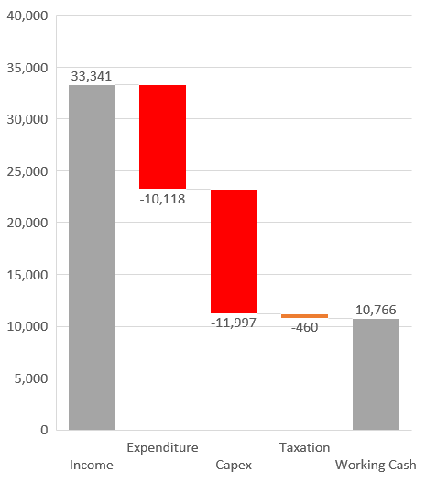
Income & Expenditure Surplus 2024/25
 | £
Income | 33,341
Expenditure | (10,118)
Taxation | (460)
 | ------------
Income & Expenditure Surplus | £22,763
 | ========
Application of Funds:
Capex (Pub Purchase) | 11,997
Working Cash | 10,766
 | -----------
 | Total £22,763
 | =======

Slide 11
Income 2024/25: £33,341

Slide 12
Fundraising 2024/25: £19,549

Slide 13
Expenditure 2024/25: £10,118

Slide 14
Brockweir Inn Pub Purchase Costs
 |  | £
Pub Purchase |  | 400,000
Stamp Duty |  | 9,500
Searches etc |  | 1,997
Total Cost |  | 411,497
Share Offer |  | 388,000
Loans form Shareholders |  | 11,500
Current Account |  | 11,997
 |  | 411,497

Slide 15
Brockweir Inn Balance Sheet @ 31 Mar 25
 | £ | £
Net Assets
Brockweir Inn @ Cost | 411,497
Depreciation | (2,616) | 408,881
Net Current Assets |  | 13,382
Loans from Shareholders |  | (12,500)
Net Assets |  | 410,763
Capital and Reserves
Share Capital |  | 388,000
Profit for the Year |  | 22,763
Shareholders Funds |  | 410,763

Slide 16
2024 Share Issue: £388,000

Slide 17
Brockweir Inn Accounts to 31 Mar 25
Questions?

Slide 18
Brockweir Inn Accounts to 31 Mar 25
Audit Requirement
Resolutions Required

Slide 19
Resolution- Membership Vote
The Membership resolve that Brockweir Inn Community Benefit Society Limited disapplies the requirement to appoint a qualified auditor for the accounting period ending on 31 March 2025
Those NOT in Favour: Raise your Hands
Those in Favour: Raise your Hands
Abstentions
Notes:
At the meeting of the members on 26 February 2025, the Management Team were authorised to appoint a qualified auditor subject to the rules of the society. A formal resolution is required to confirm the subsequent action of the management team in respect of FCA requirements.
Under FCA rules a Community Benefit Society with charitable status is not required to appoint a qualified auditor if :
Total assets are less than £5.1 million; and
Turnover is less than £250,000.
The Brockweir Inn Community Benefit Society Limited Accounts to 31 March 2025 satisfy the above criteria.

Slide 20

Resolution- Membership Vote
The Membership accepts approval of the accounts
Those NOT in Favour: Raise your Hands
Those in Favour: Raise your Hands
Abstentions

Slide 21
The 2nd Share Offer- Results
Minimum Target £25,000
Amount Raised £41,550
No. of Shareholders 83

Slide 22
2025 Share Issue: £41,550

Slide 23
AoB Questions

Slide 24
2. Members’ Update

Slide 25
Building Update- TOM STARR to complete
xxxxxx

Slide 26
Key Timings
Approval of Listed Building Planning - 12 December
Building work starts - January 2026
Pub Opens - Early Summer 2026

Slide 27
Grant Applications- Update
Common Ground Award (up to £10,000) – November 2025
Grassroots Neighbourhood Fund (up to £5,000) - November 2025
Awards for All (up to £20,000) – December 2025
Severn Trent Community Fund (up to £50,000) - February 2026

Slide 28
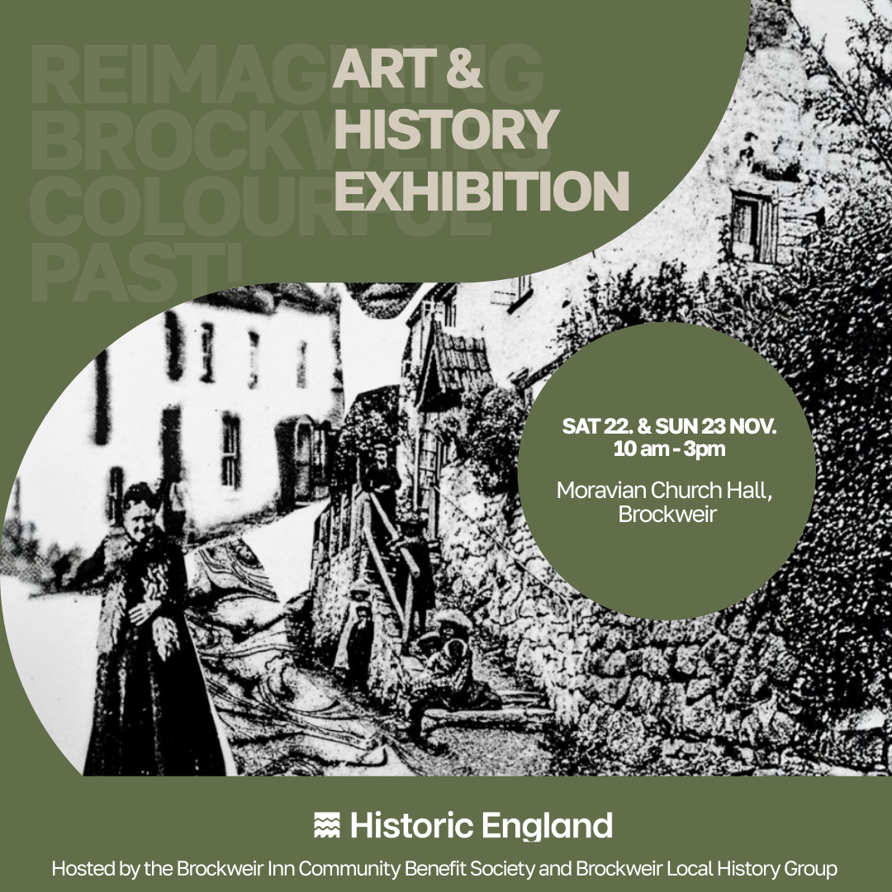
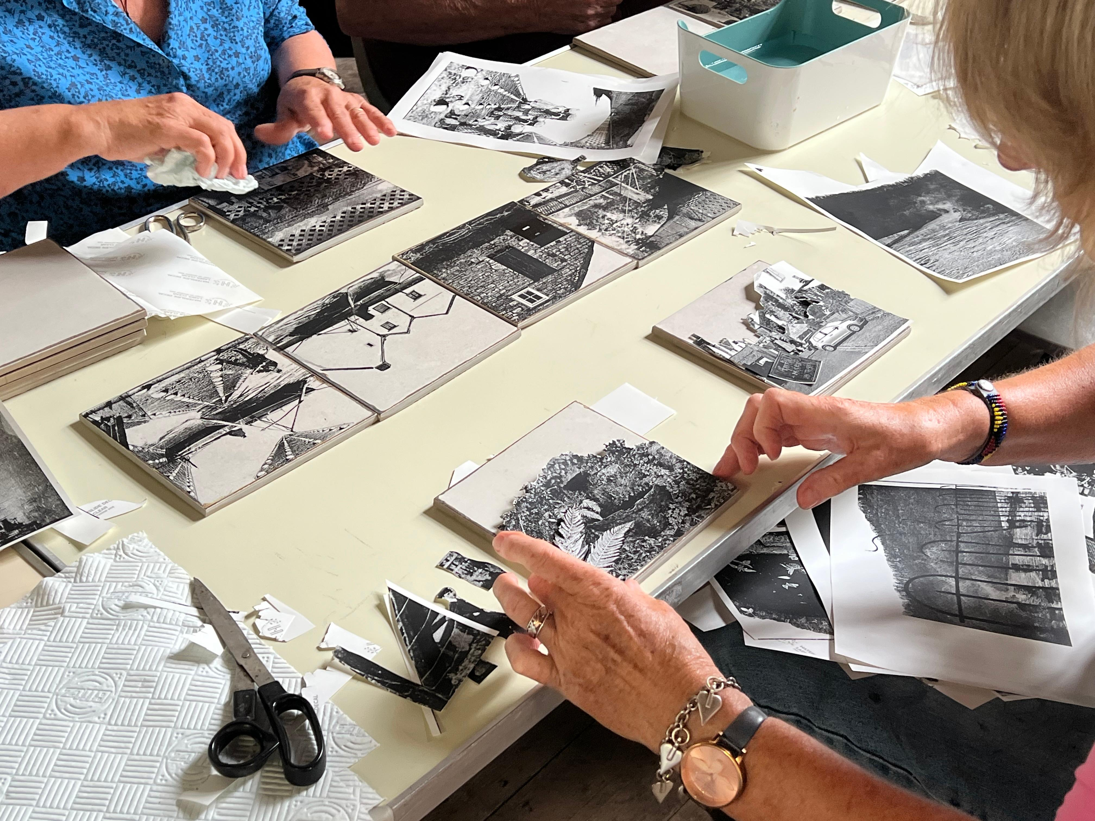
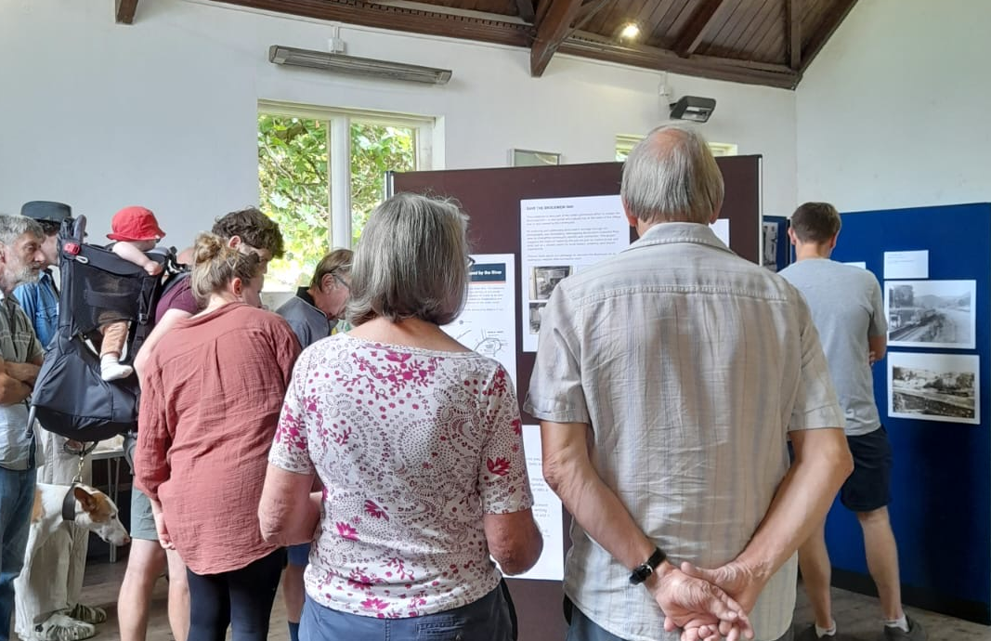

Slide 29
Skills needed – People wanted
Now we are in this next phase of the project we need certain roles filled to help BICBS run effectively
We need someone with skills and experience in media
We need several people to run the Fundraising Overview Team
If you have any valuable skills we have missed – get in touch!

Slide 30
Media Role
We need someone to engage with members, promote community activities, and strengthen our public profile through effective communication and social media presence.
Key Responsibilities:
Manage and update the Society’s social media channels (e.g., Facebook, Instagram).
Draft and schedule posts to promote events, updates, and community initiatives.
Support internal communications with members and stakeholders, including newsletters and notices.
Maintain consistent branding and messaging aligned with the Society’s values and objectives.
Monitor engagement and provide feedback to the Committee.
Notes:
Time Commitment: Flexible, estimated 1-2 hours per week maximum.
Person Specification:
Strong written and verbal communication skills.
Familiarity with social media management and community engagement.
Creative, reliable, and community-minded.
Ability to work collaboratively with volunteers and committee members.

Slide 31
Fundraising Overview Team
A team to oversee the pub fundraising and to work with, supporting and liaising with people who are organising pub fundraising events as well as working with, supporting and liaising with the pub management committee.
This could include:
Liaising with people who are organising fundraising events, providing them logos, info etc.
Helping organisers market the event if needed
Adding events onto a calendar and advising interested organisers of when events could be put on and avoiding clashes (with pub events and also with other village/local events)
Informing pub committee of events
Identify gaps in event timings and approach people to fill them e.g. pub quizzes
Working with the pub committee to identify new events/opportunities to raise
money

Slide 32
Get in contact
Talk to us if you want to know more about the roles – at the bar
Details of the roles are also included in the newly produce newsletter
The newsletter shows a summary of where we are with the project at the moment – what you have just heard in the presentation.
We will continue to produce newsletters to help keep everyone informed of the project.
The newsletter has been created based on feedback from shareholders – if you have feedback on ways we can improve let us know.

Slide 33

The Brockweir Calendar team
The numerous fundraising events – too many to mention
Everyone who has helped to get us to this stage – you know who you are!
AND ABOVE ALL: OUR NEW MEMBERS!!!
Rock for the Brock – 13th December 2025 - tickets available now!

Slide 34
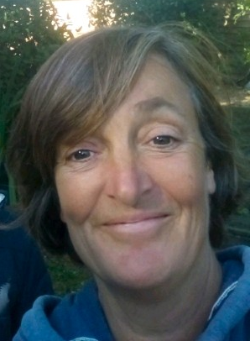
Ali Crawshaw- Funding/ Grants
Making things happen and keeping us all in check!

