Slide 1


Save the Brock! Renovation Share Offer Launch 5 June 2025, 7pm
Brockweir Inn Community Benefit Society

Slide 2

AGENDA
Welcome Henry Morland
2nd Share Offer Adam Sinfield
Progress to date Tom Starr and Ali Crawshaw
4. Corporate Sponsorship Adam Sinfield

Slide 3

WELCOME

Slide 4

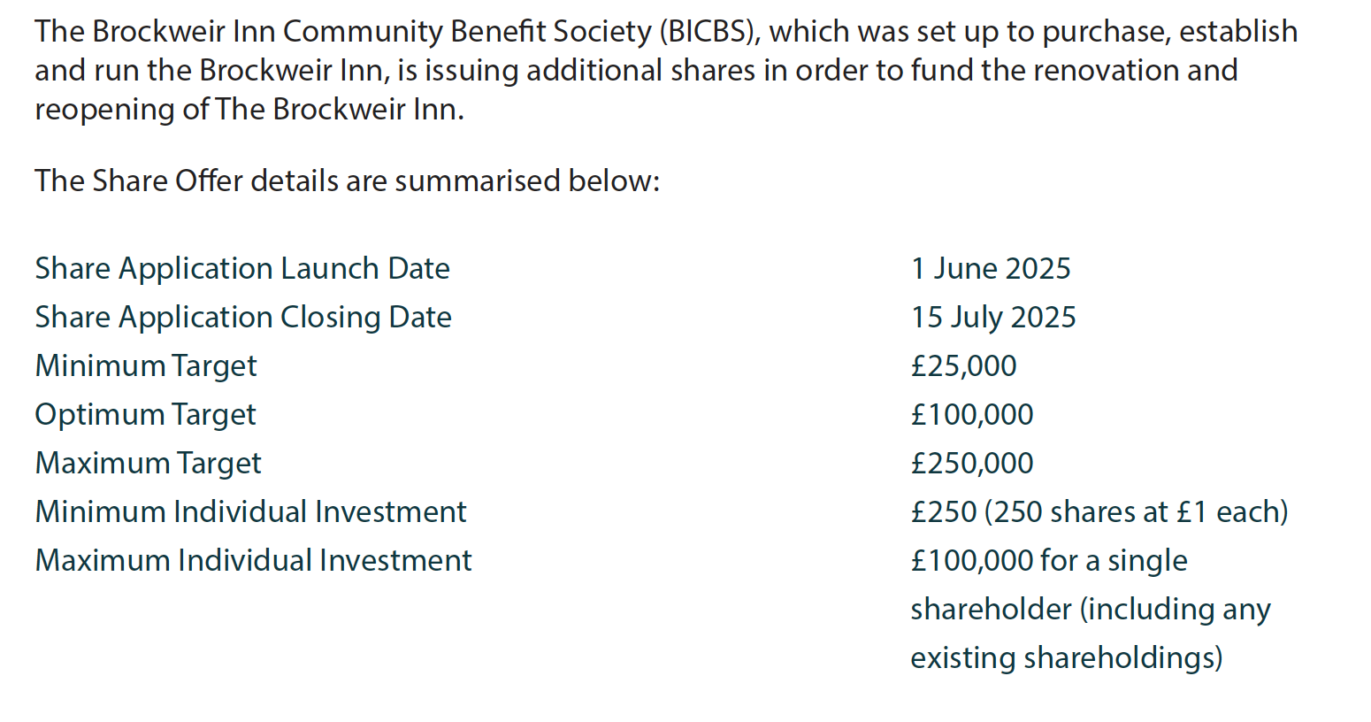
Renovation Share Offer: Summary

Slide 5
Renovation Share Offer: Key Points
Our target is to raise as much capital as possible (up to a maximum of £250,000) by selling shares to support the renovation and re-opening of The Brockweir Inn.
All new shareholders will become members of the Brockweir Inn Community Benefit Society (BICBS) which owns the Brockweir Inn.
Your shares will give you a say on how you wish your pub to be run.
Each shareholder receives one vote regardless of the amount invested, meaning all shareholders carry equal weight.
All the new shares issued will be in addition to, at the same price as and have identical rights to the £385,000 of shares previously issued to finance the purchase of the pub

Slide 6
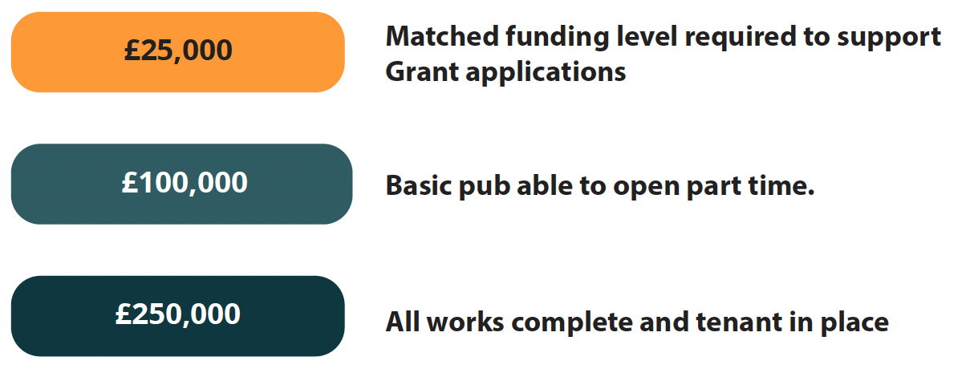
Renovation Share Offer: Why?
Help reopen the doors
Have detailed plans for both the building and the operations
A community asset for all
Fully viable and proven model
Have a say
One member one vote
Be part of the community
Be part of something special! This will outlast us all

Slide 7

Our Request to Members
WE NEED YOU!
If every member gets one more member, we open
If every member gets two (and a bit), we finish!
We are here to support you with whatever you need:
Brochures
Leaflets
Emails…

Slide 8


Slide 9

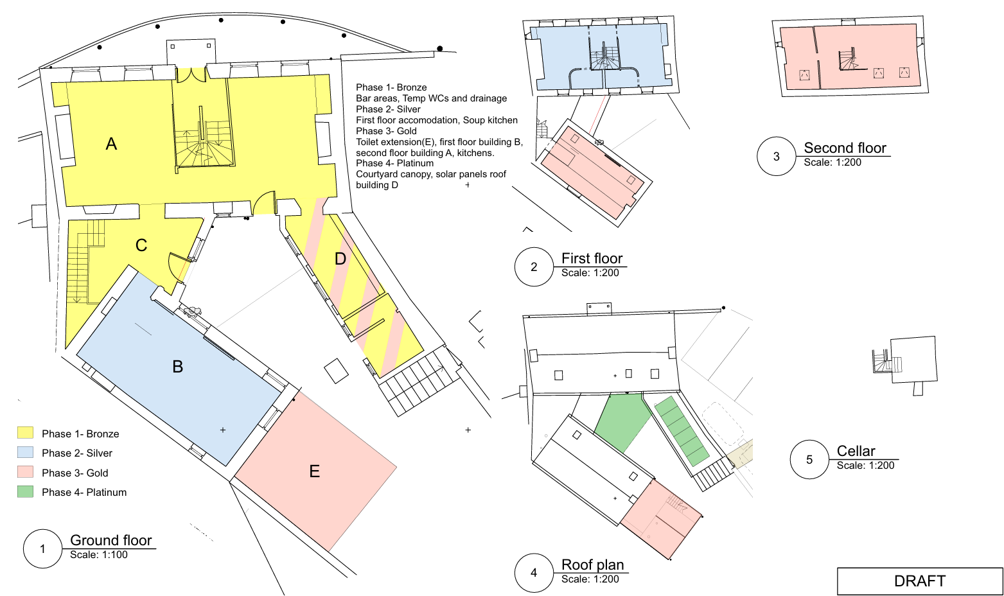
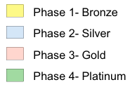
Project Phasing Plan
Complete – Site Acquisition
Building Clearance Complete
Optimum Pub Layout Agreed
Building Control Review and Site Visit
Phased Project Set up
Listed Building Planning Application
Next Steps - Renovation
Full Engagement of MEP services engineer
Bar & Kitchen & Design
Civils & Drainage Design
Interiors and Landscape Design
Contractor/ Supplier Engagement & Procurement

Slide 10

Corporate Sponsorship
Develop a list of packages for businesses to get involved through sponsorship of certain parts of the project
To be finalised – but we want your ideas! Please send them in…
In the meantime, do you and your business, or do you know any businesses, which may be interested? Send in their details or even better, approach them for us!

