Slide 1
Save OUR Brock! SPECIAL Members’ Meeting 21 August 2024, 7pm
Brockweir Inn Community Benefit Society

Slide 2
Welcome
…. to all 395 Members of the Brockweir Inn Community Benefit Society
Notes:
To all 395 Members!
… of the Brockweir Community Benefit Society
Each Member has one vote regardless of the size of the investment, so you all have equal weight in key decisions
Nobody knows how much you invested
Register of Members is available but only shows names

Slide 3

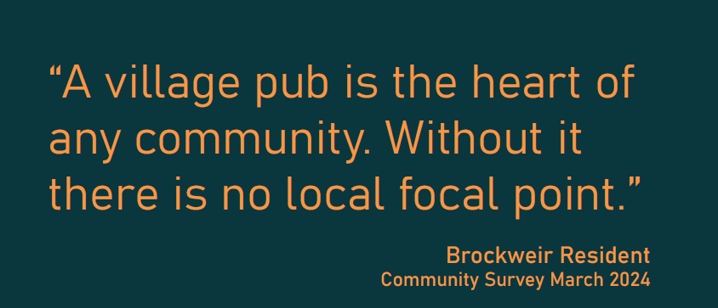

Slide 4
AGENDA
Welcome
Stage 1- Acquisition of the pub
Context
Update and proposal
Management Committee recommendation
Resolution & Members’ Vote
Notes:
To all 405 Members!
… of the Brockweir Community Benefit Society
Each Member has one vote regardless of the size of the investment, so you all have equal weight in key decisions
Nobody knows how much you invested
Register of Members is available but only shows names

Slide 5
Business Plan- Summary
3 Stages to the Business Plan:
Stage 1- Buy the pub August 2024- October 2024
Stage 2- Renovate the pub October 2024- Summer 2025
Stage 3- Find a Tenant, re-open and run the pub Summer 2025
Notes:
The Business plan runs to 80 pages and is on the website so we recommed you read it together with the Share Offer document – which of course everyone should have done already.
There are 3 stages to the Business Plan.
Stage 1- valuations, launch the share offer, make grant applications, finalise the acquisition and purchase the freehold. Hopefully, after tonight, we can complete this stage!
Stage 2- renovation and complete the work to transform it back onto a pub, repond to communityfeedback whilst retianing its wonderful character enagnacing it as a heritsage asset for the future
Stage 3- find a great tenant, bring in the community to enjoy the pub, deblop local activities and intiative hels within the pub
But to get to buy the pub, we needed to create a share offer

Slide 6

Stage 1- Acquisition of the pub
Stage 1
Form Society and consult community – DONE
Prepare business case and launch Share Offer – DONE
Address any funding shortfalls for purchase - ?????
Make formal, fully funded, offer to vendor – HoT AGREED
Instruct solicitors to complete contracts and completion – READY AND WAITING

Slide 7

THE Share Offer- Results (as to complete)
Minimum Target £250,000
Amount Raised £385,500
No. of Shareholders 395
Shortfall £14,500

Slide 8
FUNDING GAP- OPTIONS TO CONSIDER (AS to Complete)
To buy the Pub outright as a community asset, we need £400,000
Angel Investment
Generous individuals have offered to lend the BICBS £15,000 (the maximum possibly needed) at 0% Interest. They will be primary debtors but no special repayment terms regarding timescale (ASAP)
Await grant applications
No known timescale (at least 6 weeks) or certainty – ACV ends 27th August 2024
If successful, would not be debt

Slide 9
Management committee- Recommendation
We advise that the Angel Investors offers us the best option to fund the shortfall
Benefits:
Limited risk
0% Interest charged
Will be paid back as soon as possible, as primary debtors, but no specific timescale
Allows us to proceed to purchase the pub before the expiration of ACV
Notes:
Interwsst

Slide 10
Resolution- membership vote
Does the Membership accept the loan offers and their terms for the purpose of purchasing
the Brockweir Inn?

Slide 11
Special Thanks!
Martin and Marina
Di Orchard – her auction has covered stamp duty on its own!
Brockweir CIC
Brockweir Parish Council
The Mackenzie Hall
Kingstone Brewery
Osborne Clarke LLP
Everyone who has helped with events – you know who you are!
ALL OF YOU!!!

Slide 12
LET’S Celebrate!

