Slide 1
Closing the Loop: Accreditation Council Outcomes
Dr. Malina Monaco,
Senior Vice President, CAEP

Slide 2
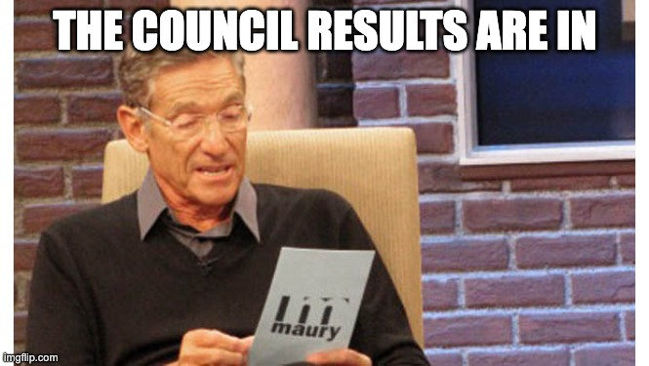
Fall 2024 Accreditation Council
N= 39
35 = Full 7-year Accreditation
3 = Accreditation with Stipulations
1 = Probation
0 revocation/denial
10 Clean cases(no recommendations)
16 cases with 5 or less recommendations

Slide 3
Overview of Accreditation Decisions # of AFIS- Initial
(n= 39 EPPs) Spring 2024 cases, Fall 2024 AC
 | Total | Comp. 1 | Comp. 2 | Comp. 3 | Comp. 4
Standard R1 | 5 | 1 | 0 | 2 | 2
Standard R2 | 14 | 3 | 7 | 4 | N/A
Standard R3 | 14 | 5 | 6 | 3 | N/A
Standard R4 | 16 | 8 | 5 | 3 | N/A
Standard R5 | 52 | 10 | 17 | 9 | 16
Total | 101

Slide 4
Overview of Accreditation Decisions # of AFIS- Advanced
(n= 39 EPPs) Spring 2024 cases, Fall 2024 AC
 | Total | Comp. 1 | Comp. 2 | Comp. 3 | Comp. 4
Standard RA1 | 9 | 5 | 4 | N/A | N/A
Standard RA2 | 10 | 5 | 5 | N/A | N/A
Standard RA3 | 17 | 6 | 5 | 5 | 1
Standard RA4 | 13 | 6 | 7 | N/A | N/A
Standard RA5 | 38 | 9 | 10 | 8 | 11
Total | 87

Slide 5
Overview of Accreditation Decisions # of Stipulations- Advanced (1 Initial Stip)
(n= 39 EPPs) Spring 2024 cases, Fall 2024 AC
 | Total | Comp. 1 | Comp. 2 | Comp. 3 | Comp. 4
Standard RA1 | 0 | 0 | 0 | 0 | 0
Standard RA2 | 0 | 0 | 0 | 0 | N/A
Standard R3 | 1 | 0 | 0 | 0 | 1
Standard RA4 | 2 | 1 | 1 | N/A | N/A
Standard RA5(R5.2) | 2(1) | 1 | 1(1) | 0 | 0
Total | 5(1)

Slide 6
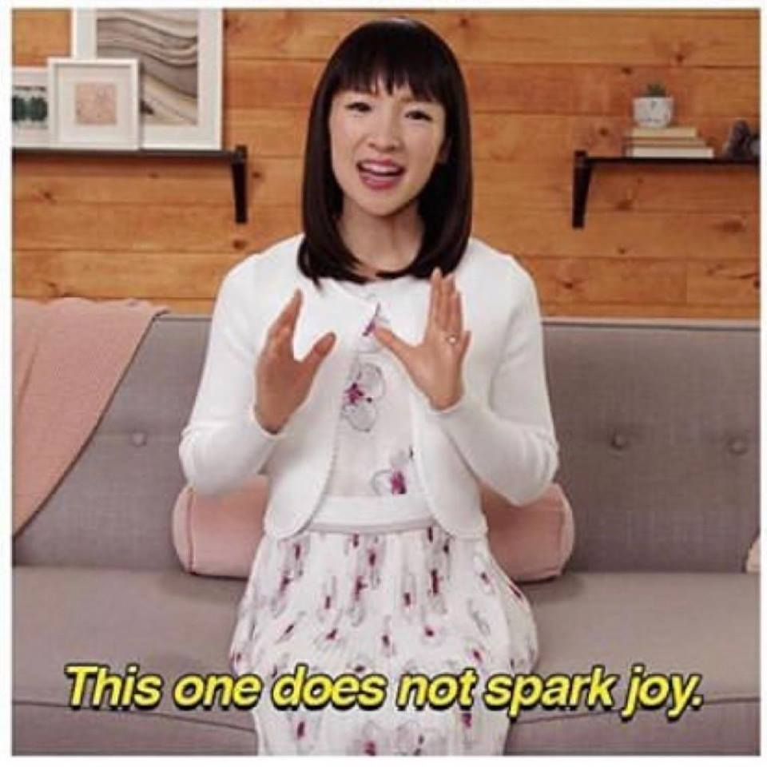
What did the findings tell us?
Data Quality Indices (R5.2/RA5.2)
  Cycles of data
  R & V of key assessments
  Actionable
Selection, Training, and Evaluation of Clinical Educators; Co-construction; clinical experience chili ( R2.1;R2.2; R2.3)
Advanced Standards- uptick in AFIs
Documenting Continuous Improvement (R5.4)

Slide 7
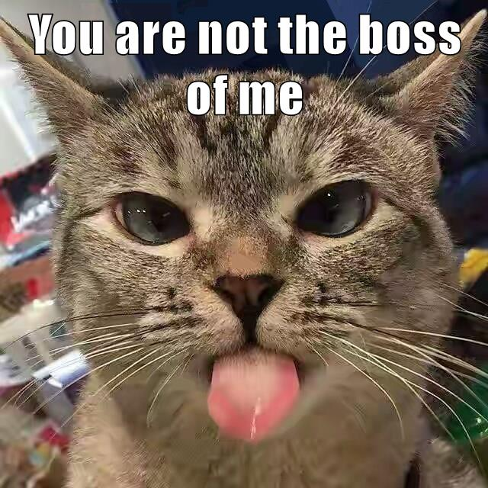
What we saw in reports
EPPs are working on Structure, Process, & Documentation (Standard R5/RA5)
Staff Turnover; lack of EPP historical knowledge(all standards); lack of continuity
Clinical Experience Chili (ST R2)
Advanced Standards
  Tend to be more siloed and autonomous
  Faculty can be more territorial
  There are generally not common assessments across programs
  Short time frames; program gateways and completion(RA3)

Slide 8
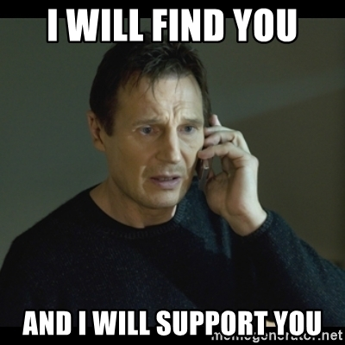
Supports
Individual EPP meetings
Drop in Meetings for AIMS2.0
Resources
CAEPCon/Workshops/State AACTE meetings
Formative Feedback Reports (details)
Open and Responsive Communication
State consultants help with Table 2(program list)*

Slide 9
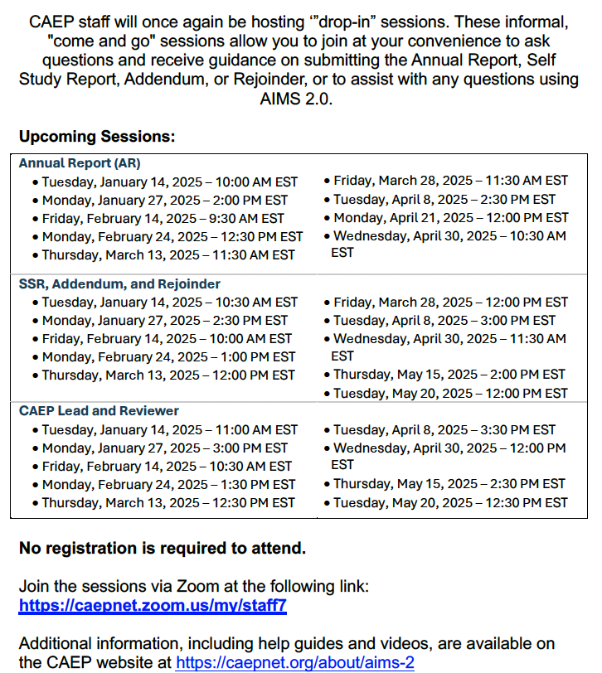

Slide 10
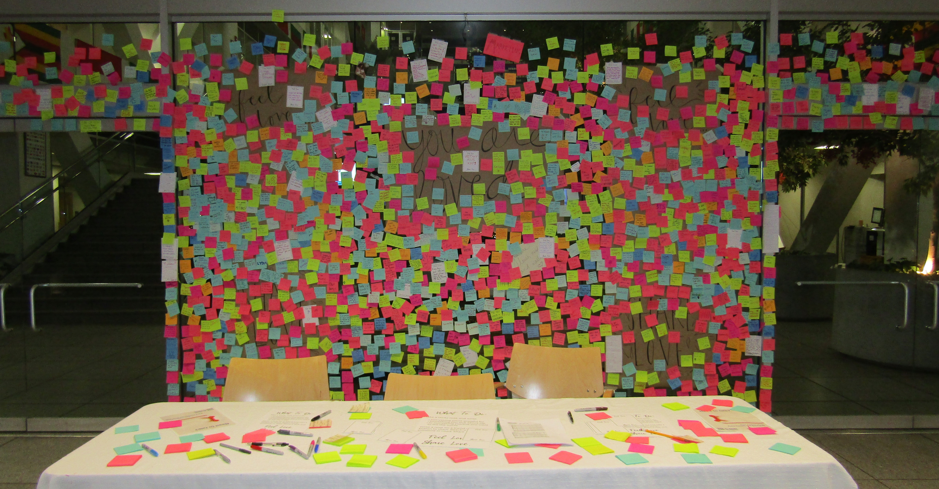

Questions
Malina.Monaco@caepnet.org

