Slide 1
Day 1 Readiness
MYTH OR REALITY?
Presenters: Rhea Carmon, Ph.D. Candidate
Dr. Cheryl Robertson, Ed.D.

Slide 2

What skills do teachers need for Day 1 Readiness?
Notes:
Question for involvement….we will create a word cloud from the responses. Mentimenter - Rhea

Slide 3
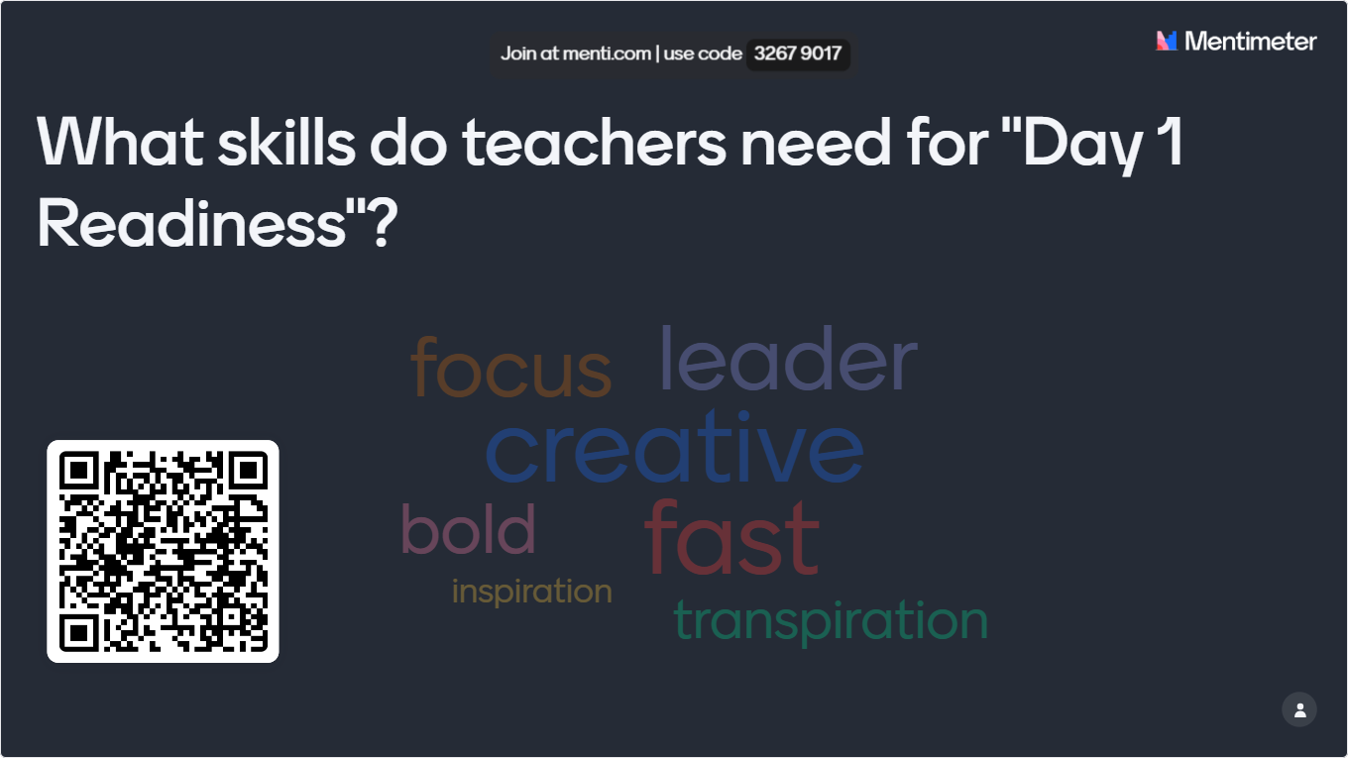

Slide 4
AGENDA
Day 1 Readiness
The UT PLAYS Program Approach
Integrating InTASC Standards
Real-World Feedback
Q&A and Discussions
Notes:
Rhea

Slide 5

Think About It?
How would you define the concept of "Day 1 Readiness,” and in what ways do you believe it is achievable or not?

Slide 6
“DAY 1 READINESS”
For a teacher in K-12, day 1 readiness refers to the state of preparedness required for effective teaching from the very first day of the school year. This concept emphasizes the importance of being organized, equipped, and mentally prepared to engage students immediately upon their arrival, fostering a productive learning environment.
Obstacles in Preparing Teachers for Day 1
  Must include information on classroom management, parent communication, time management, and understanding student needs
  It takes time to practice and develop these skills
  Every teacher candidate needs a mentor
  How do you assess their readiness?
Notes:
Rhea

Slide 7
“DAY 1 READINESS”
The Daunting Transition:
Transitioning from a student to a full-time educator is one of the most challenging shifts in a teaching career.
Many new teachers feel unprepared and overwhelmed during their first days in the classroom.
The gap between theoretical knowledge and practical application can make new teachers feel as though they lack the tools needed for immediate success.
Common Perception of Day 1 Readiness:
This concept refers to the ideal state where teachers can step into the classroom on their first day with the skills, confidence, and preparedness to lead and instruct effectively.
Unfortunately, this idea often feels like a myth. New teachers frequently encounter unexpected challenges, from classroom management to understanding student needs, that are not fully covered in traditional preparation programs.
Research shows that many new teachers struggle to balance lesson planning, assessment, and classroom management, leading to a lack of confidence and early burnout.
Notes:
Cheryl

Slide 8

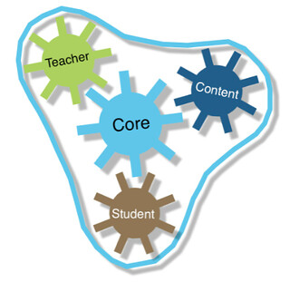

“DAY 1 READINESS”
Typical Gaps in Traditional Teacher Preparation:
Theory vs. Practice: Many programs emphasize pedagogical theory but provide limited real-world experience, leaving new teachers unprepared for practical challenges.
Lack of Focus on Critical Competencies: Competencies like classroom management, student engagement, and differentiated instruction are crucial for early success but are often underdeveloped in standard training.
Limited Clinical Experience: Traditional preparation programs may offer limited opportunities for hands-on learning, with only a few months of student teaching that may not fully prepare new teachers for the diversity of real-world classrooms.
Notes:
Cheryl

Slide 9

The Program

Slide 10
UT PLAYS
Practical Skills
Real-World Application
Continuous Feedback
DAY 1 Readiness
The UT PLAYS Program’s Response:
Recognizing the struggle that many teachers face in achieving Day 1 Readiness, the UT PLAYS program was designed to address this gap.
Through its competency-based, asynchronous curriculum, the program focuses on equipping future teachers with essential skills before they enter the classroom.
Key Focus: The program emphasizes practical skills, real-world application, and continuous feedback to ensure that teachers have the tools necessary to thrive from the very first day.
Notes:
Rhea

Slide 11
UT PLAYS
Program Overview:
  Initial Licensure (Apprenticeship Pathway and Job Embedded Pathway) and Additional Endorsements
  Special Education (Interventionist K-16; 6-12; SPED Comprehensive K-12) and Mathematics (6-8; 6-12
  Competency-based, Non-credit generating, Asynchronous
  Targeting Bachelor’s degree holders and licensed teachers
Goals:
  Immediate effectiveness in the classroom
  Meet the needs of districts by taking away barriers to education such as tuition, travel, and seat-time
  Teachers prepared with everything they need for Day 1 Readiness
Notes:
Rhea

Slide 12
COURSE DESIGN
Asynchronous
Competency Based
The entire course is designed to be completed asynchronously.
Teacher candidates can complete lessons and portfolio assignments during a plan period, over the weekend, or after school.
A group of professors and content specialist worked together to create competencies based on the InTASC standards addressed in the core and clinical courses necessary for receiving an initial teaching license.
From the standards addressed, a list of competencies was developed and modules to address each competency was created for the core/clinical course
On-the-job training
Teacher Candidates must be in the classroom.
Job-embedded and apprenticeship options allow teacher candidates to be in the classroom while learning
Notes:
Rhea - Mention the low cost and high touch here…the next slide will go deeper into the high touch

Slide 13
KEY COMPONENTS OF THE UT-PLAYS PROGRAM
UT PLAYS
Pedagogy
Clinical Experience
Job-Embedded
Consistent Support
Pedagogy
  Evidence-based instructional strategies
  Competency-driven instruction
Clinical Experiences
  Practical application of theoretical knowledge
  Real-time classroom integration
Job-Embedded Learning
  Flexible, self-paced progress
  Applying skills in the current educational roles
  4. Consistent Support
Notes:
Cheryl

Slide 14
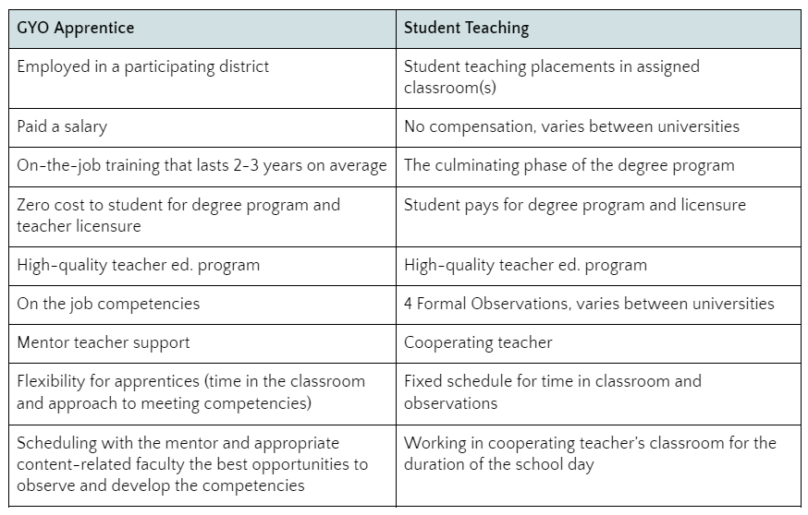
UT-PLAYS vs. Student Teaching/
Internship
UT-PLAYS Clinical Experience
Notes:
Cheryl

Slide 15

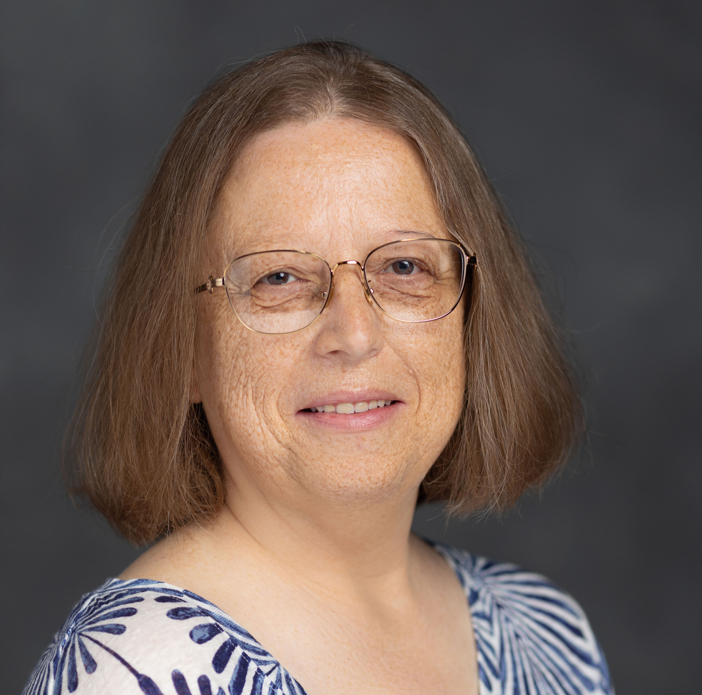

CONSISTENT SUPPORT
Dedicated Subject Specialists
The UT-PLAYS Team:
Core/Clinical Competencies – Dr. Cheryl Robertson
Secondary Mathematics – Rhea Carmon
Special Education – Dr. Jamie Smith
Notes:
Rhea and Cheryl

Slide 16

InTASC Integration

Slide 17
LEVERAGING INTASC
The InTASC (Interstate Teacher Assessment and Support Consortium) standards are a set of professional guidelines designed to support teacher development and ensure high-quality instruction.
These standards outline what teachers should know and be able to do to effectively promote student learning across all grade levels and subject areas.
The InTASC standards are organized into four key domains:
  The Learner and Learning
  Content Knowledge
  Instructional Practice
  Professional Responsibility.
Each domain includes specific competencies, such as understanding diverse learner needs, mastering subject content, applying effective teaching strategies, and engaging in continuous professional growth.
Notes:
Cheryl - The InTASC (Interstate Teacher Assessment and Support Consortium) standards are a set of professional guidelines designed to support teacher development and ensure high-quality instruction. These standards outline what teachers should know and be able to do to effectively promote student learning across all grade levels and subject areas. The InTASC standards are organized into four key domains: The Learner and Learning, Content Knowledge, Instructional Practice, and Professional Responsibility. Each domain includes specific competencies, such as understanding diverse learner needs, mastering subject content, applying effective teaching strategies, and engaging in continuous professional growth.

Slide 18

STANDARDS ALIGNMENT
The syllabi from core courses were used to determine what InTASC standards were being addressed with each assignment or assessment
Each assessment was evaluated based on the specialist decision of whether the assessment addressed a need for day 1 readiness
Only the assessments that addressed and prepared teachers for day 1 readiness were maintained and placed into the asynchronous model
The Modules were organized to include lessons and assessments necessary to meet the day 1 readiness needs
Notes:
Cheryl- Talk about the COW on this slide and how they worked together to create the assessments for each competency!

Slide 19

The Feedback

Slide 20
REAL-WORLD FEEDBACK
We asked teachers that are currently in the classroom to provide feedback on skills needed for day 1 readiness
The feedback was analyzed and grouped into 4 main categories:
Classroom Management, Parent Communication, Time Management, and Understanding Student Needs
Notes:
Mention that when finalizing our course, we looked at these 4 categories to ensure the teacher candidates were receiving instruction and feedback in these areas.

Slide 21

CLASSROOM MANAGEMENT
Classroom managed behaviors vs office managed behaviors
Confident communication with parents regarding behavior
Staying calm
Not engaging
Is "matching energy" worth it?
De-escalation strategies
Making connections with students
Ability to redirect students without a big loss in instructional time
Establish and teach expectations
Establish routines
Don't start off being a friend, be the teacher, relationships will come
When students believe they can be successful, they will stay more engaged in class and cause less disruption
Keep students busy!
Strategies to settle the class down
Proximity is powerful
Classroom environment is key
Stick to your word - no empty threats
Firm, fair and consistent expectations
Try to understand misbehavior before criticizing the student
Brisk learning pace
Notes:
Rhea – make this slide interactive by asking which ones jump out at you - In what ways can you address these needs for future teachers?

Slide 22
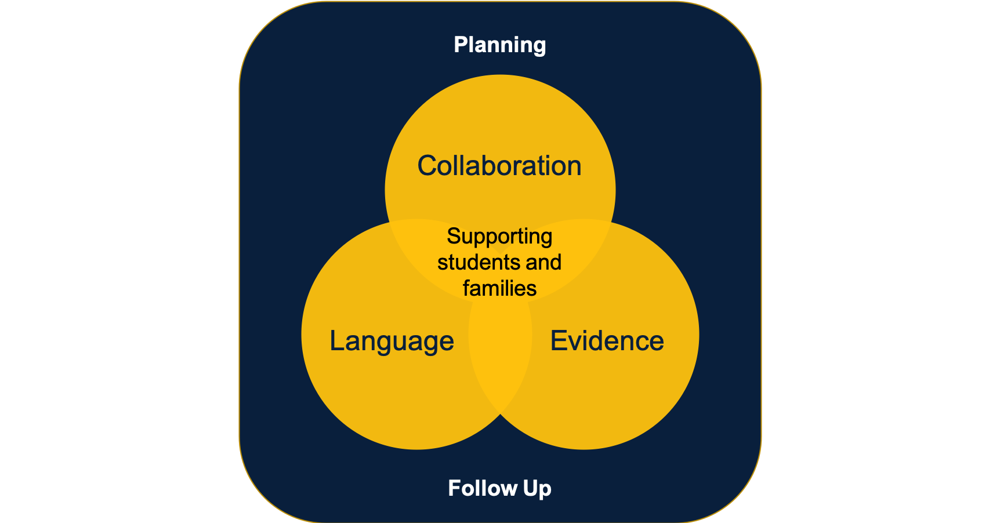
PARENT COMMUNICATION
Frequent and clear parent communication (newsletter, email, phone call, individual messages)
Practice different scenarios (missing work; parent concerned; parent angry; child's behavior)
Reach out early in the year to build relationships
Reach out for positive reasons as well as negative
Talk to colleagues about an upcoming parent conversation to go over talking points
Role-playing to develop confidence
Don't let a negative behavior call be your first call
Reiterate that there are options to help their student succeed
Be prepared for a variety of parent responses (disinterested, overinvolved, unrealistic, etc.)
Know what you can and cannot share with parents
Importance of introducing yourself and sharing your expectations with them
How to rebound from parent communication that didn't go as planned
Notes:
Rhea

Slide 23

TIME MANAGEMENT
Grading and feedback to maximize teacher's time
Strategies for keeping an organized schedule
It is okay that you don't finish everything you may have planned, its better students understand what you did discuss
How to organize your classroom and paperwork!
Planners are a must
Make your to-do list in a priority order
Be flexible - relax and stay the course when things don't go as planned
Don't be afraid to "steal" good ideas and make them your own
Grading - what to grade and what not to
Don't take school work home
Notes:
Rhea

Slide 24
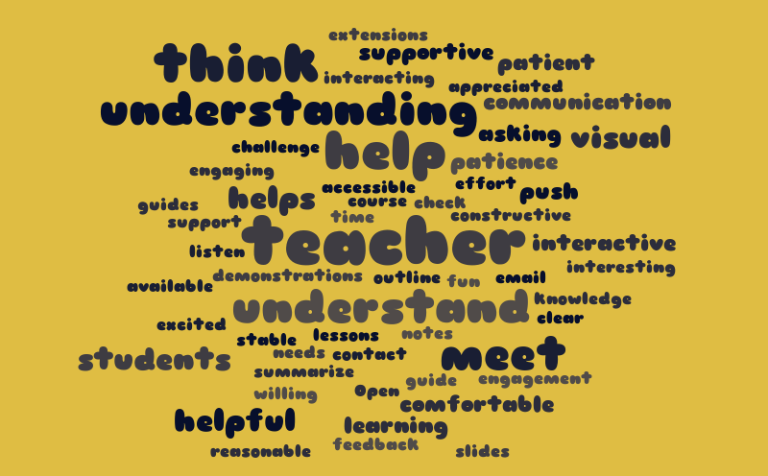
UNDERSTANDING STUDENT NEEDS
  Data markers to see and teach to student potential
  Identifying student needs - trauma - activating support networks
  Understanding the importance of help (calling DCS when appropriate and not avoiding it because the staff member thinks that calling is being mean
  Connections
  Trauma-Informed
  How to read IEPs and BIPs
  How to implement IEPs and BIPs
  Get to know your students
  relationships
  Examine CRs and CCRs
  Use formative assessments as data
  Behaviors signify a need
  Relationships!
  Notice behavioral triggers and try to be proactive
  Identifying students that may have fallen through the cracks
  When to address or ignore behaviors
  Giving achievable assignments so students experience success
  Create unique, out-of-the-box experiences to build
Notes:
Rhea

Slide 25

Reflection/Response

Slide 26

How would you define the concept of "Day 1 Readiness," and in what ways do you believe it is achievable or not?
Notes:
Rhea – either use padlet or mentimeter

Slide 27
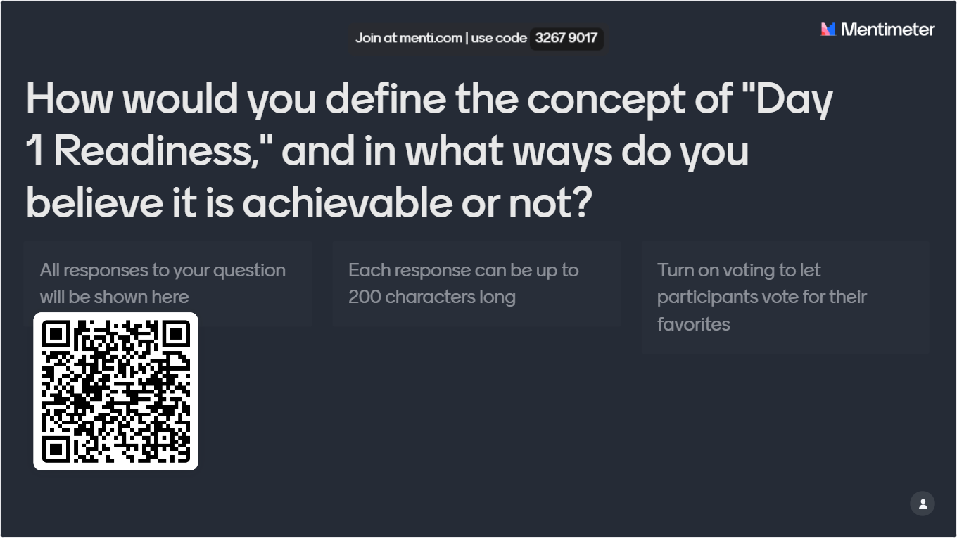

Slide 28

Based on what you’ve heard, do you believe teacher preparation programs can provide adequate support for 'Day 1' readiness? What improvements would you suggest?
Notes:
Rhea – add way for feedback

Slide 29
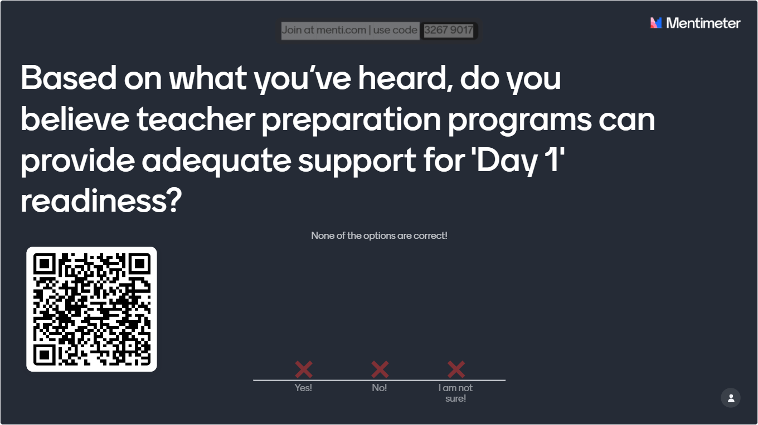

Slide 30
After attending this session, do you feel “Day 1 Readiness” is more of a myth or reality? Why?
Myth
Reality
“DAY 1 READINESS”
Notes:
Rhea – Add a way for feedback

Slide 31
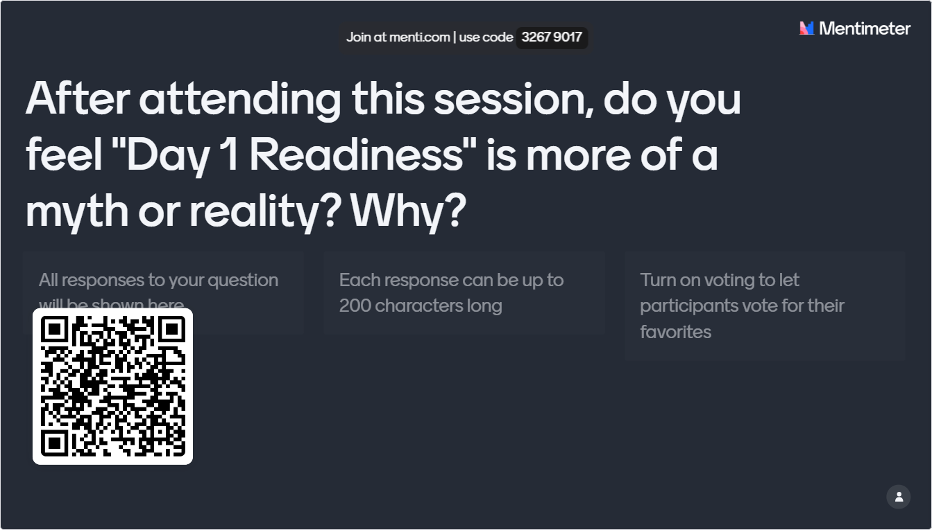

Slide 32
Thank you!
YOUR FEEDBACK HELPS US DO BETTER WORK!
UT PLAYS
utplays@utk.edu
http://tinyurl.com/utplays
Notes:
Ask if there are any other questions at this time.

