Slide 1


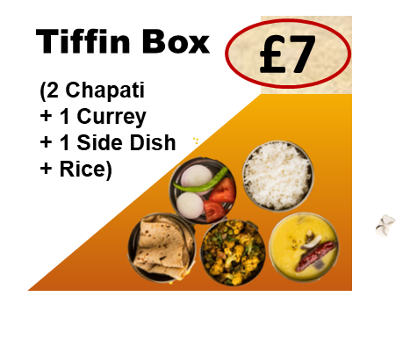
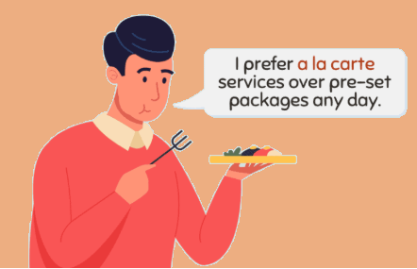

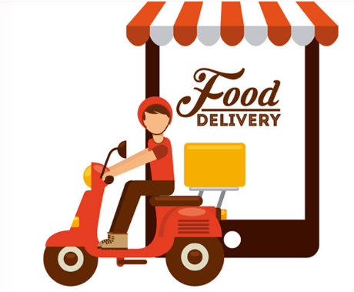



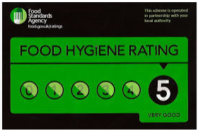
2026
Serving Basingstoke and around
since last 10 years !
Our Food Services
Enjoy fresh, homely vegetarian meals prepared with love every day. Perfect for those who crave authentic flavours without the hassle of cooking.
Daily Menu
Pick from a wide range of mouth-watering Indian and Chinese dishes. Customize your meal just the way you like it! Call us if you don’t find it on the menu.
A-La-Carte Menu
Make your celebrations unforgettable with our special party menu. We cater for birthdays, anniversaries, and family gatherings for up to 100 guests.
Party Menu
We can do Home Delivery in case you are not able to pick up from RG215UQ, with a nominal charge, provided you inform us well in advance.
Home
Delivery
* Order to be placed 1 Day in advance for guaranteed Delivery
* Packaging Charge may be applicable for bulk orders
www.homelyfooduk.com
Facebook Reviews Google Review
Amruta +44 745 941 9446
Allergy Advice: Food prepared in our premises may contain Milk, Gluten, Garlic, Nuts, Mustard, Lupin and Peanuts as ingredients. If you have any allergies, please let us know before ordering. We will do our best to advise you.

Slide 2
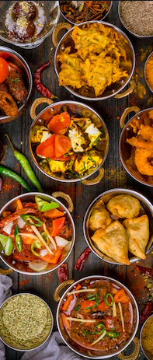
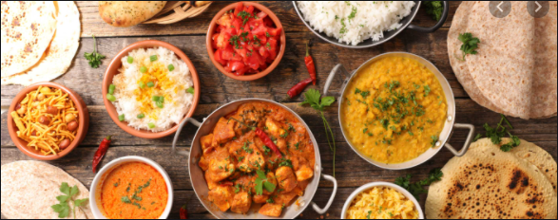

2026
Starters (£7/ Box)
Gobi Manchurian
Veg Manchurian
Chilli Paneer
Chilli Baby Corn
Chilli Mushroom
Main Course
One Serving (£5) Two Servings (£7.50)
Paneer Butter Masala
Malai Kofta
Methi Matar Malai
Navaratan Kurma
Bharali Vangi
Baingan Bharata
Veg Kolhapuri
Bhindi Masala
Palak Paneer
Veg Hyderabadi
Baby Corn Masala
Veg Maratha
Daal Makhani
One Serving (£4) Two Servings (£6.50)
Mix Veg
Mushroom Curry Masala
Amrutsari Chole
Panjabi Chole
Dum Aaloo
Panchmel Daal
Daal Tadka
Kadhi Pakoda
Breads
( * Minimum Order Quantity is 5 )
Puri | £0.70 Each
Palak Puri | £0.80 Each
Chapati | £0.80 Each
Naan | £1.00 Each
Jawar Roti | £1.10 Each
Bajra Roti | £1.10 Each
Puran Poli | £1.25 Each
Thali Peeth | £1.25 Each
Aloo Paratha | £1.50 Each
Rice (/ Box)
Veg Biryani | £ 7
Veg Pulav | £ 7
Veg. Fried Rice | £ 7
Jeera Rice | £ 4
Lemon Rice | £ 4
Special Curd Rice | £ 4
Amruta +44 745 941 9446
Allergy Advice: Food prepared in our premises may contain Milk, Gluten, Garlic, Nuts, Mustard, Lupin and Peanuts as ingredients. If you have any allergies, please let us know before ordering. We will do our best to advise you.

Slide 3
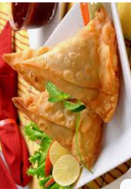
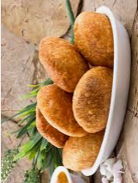
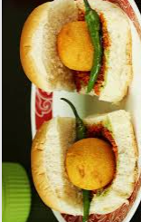
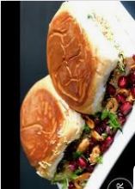
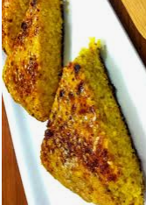
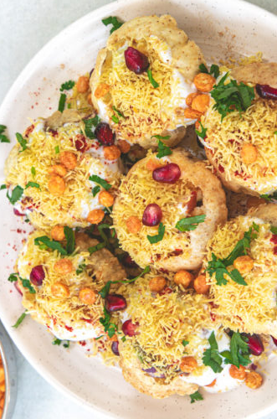
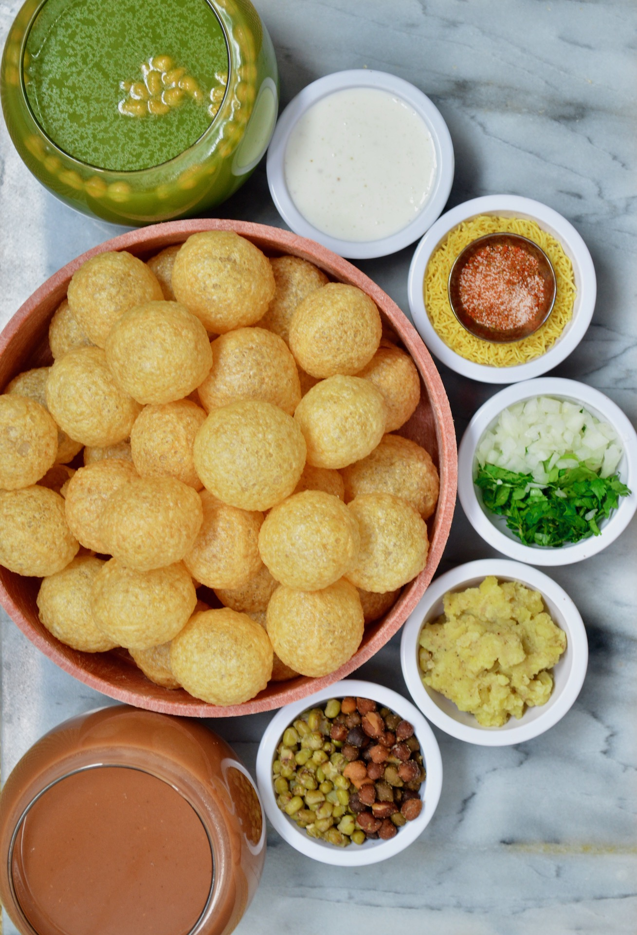
2026
Snacks
( * Minimum Order Quantity is 5 for below items )
Vada Pav | £ 1.75 Each
Kacchi Dabeli | £ 1.75 Each
Panjabi Samosa | £ 1.50 Each
Veg Puff | £ 1.50 Each
Bread Pakoda | £ 1.50 Each
Khasta Kachori | £ 1.50 Each
Stuff Mirchi Pakoda | £ 1.50 Each
Sabudana Vada | £ 0.80 Each
Snacks (£7 / Box)
Veg Cutlet
Misal Pav
Khaman Dhokala
Pav Bhaji
Chole Bhature
Dahi Vada
Daal Bati
Gujarathi Handvo
Kolhapuri Cut Vada
Chat (£7 / Box)
Dahi Puri
Samosa Chat
Katori Chat
Papdi Chat
Ragada Pattice
Amruta +44 745 941 9446
Allergy Advice: Food prepared in our premises may contain Milk, Gluten, Garlic, Nuts, Mustard, Lupin and Peanuts as ingredients. If you have any allergies, please let us know before ordering. We will do our best to advise you.

Slide 4
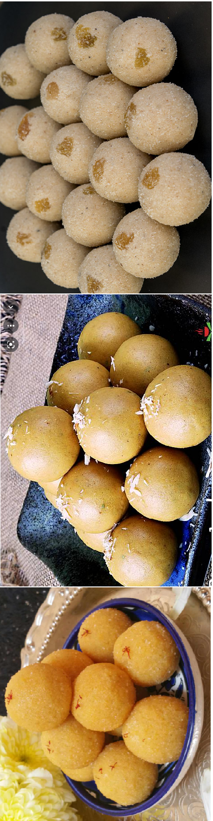
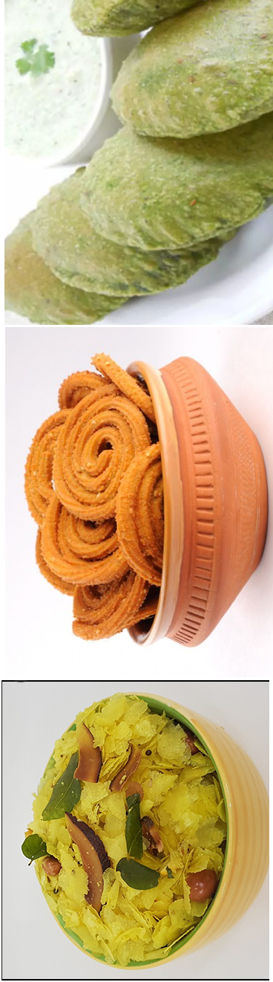
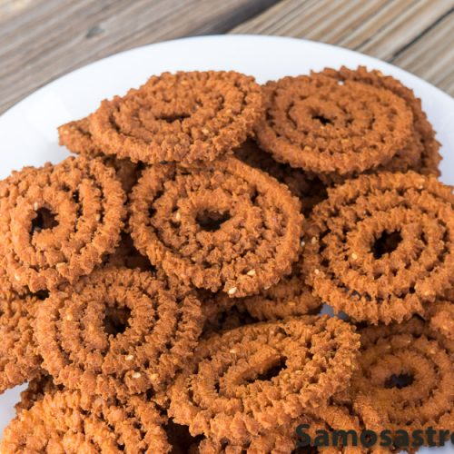
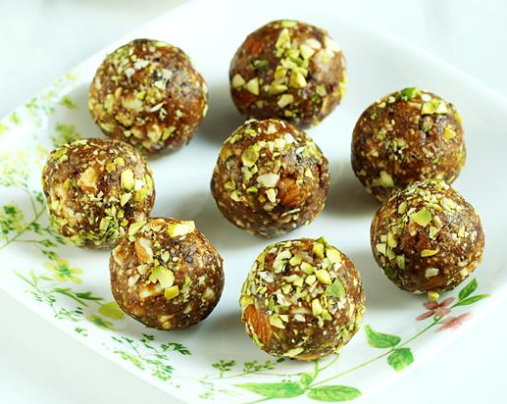
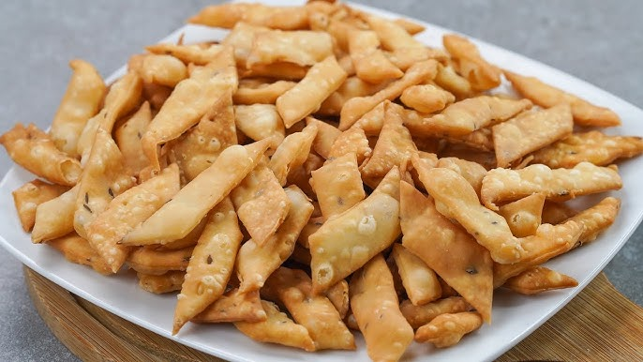
2026
Sweets
Gulab Jamun | £ 8 / Kg
Mung Daal Halwa | £ 8 / Kg
Gajar Halwa | £ 12/ Kg
Rawa Ladoo | £ 15 / Kg
Besan Ladoo | £ 15 / Kg
Shankarpare | £ 15 / Kg
Dry Fruit Ladoo | £ 26 / Kg
Dates Roll | £ 20 / Kg
Methi Ladoo | £ 27 / Kg
Goond Ladoo | £ 28 / Kg
Raagi Dryfruit Ladoo | £ 24 / Kg
Savouries (£13 per KG)
Chakali / Murukku
Chivada
Spicy Shev
Masala Puri
Palak Puri
Namkin Pare
Khari Boondi
Masala Chana Daal
Amruta +44 745 941 9446
Allergy Advice: Food prepared in our premises may contain Milk, Gluten, Garlic, Nuts, Mustard, Lupin and Peanuts as ingredients. If you have any allergies, please let us know before ordering. We will do our best to advise you.

