Slide 1
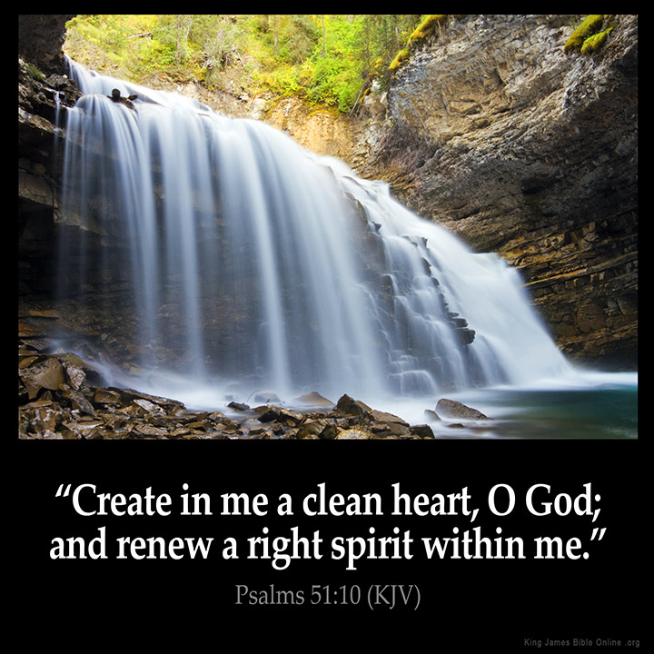
Adult Sunday School Fellowship Church February 21, 2021
Title: Mixing Fellowship with God and Devils Text: 1 Corinthians 10 :14-22
9:55 Countdown
Create in Me a Clean Heart by Keith Green, 1984 (Psalm 51) Create in me a clean heart, O God And renew a right spirit within me Create in me a clean heart, O God And renew a right spirit within me Cast me not away from Thy presence, O Lord And take not Thy Holy Spirit from me Restore unto me, the joy of Thy salvation And renew a right spirit within me

Slide 2
Congregational Scripture Reading
1 Corinthians 10:14-17, 22 (KJV)
ME: (14) Wherefore, my dearly beloved, flee from idolatry.
YOU: (15) I speak as to wise [men]; judge ye what I say.
ME: (16) The cup of blessing which we bless,
is it not the communion of the blood of Christ?
YOU: (17) For we being many are one bread, and one body: for we are
all partakers of that one bread.
ME: (22a) Do we provoke the Lord to jealousy?
YOU: (22b) Are we stronger than he?

Slide 3
1 Corinthians 10:14-22 Mixing Fellowship with God and Demons
Vs 14: FLEE Idolatry
Vs 15: WISE JUDGE
Vs 16a: the CUP Communion
Vs 16b-17: the BREAD Communion
Vs 18-19: IDOL Partakers
Vs 20-21: DEVILS or GOD Table Fellowship Partakers
Vs 22: Provoke JEALOUSY

Slide 4
Questions about Mixing Christ with demons
Definition of idolatry: Putting anything before God. An image of anything in heaven, on earth, or in the sea. (Idolatry changes in time and culture)
A philosophy, tradition, or ideology. (Humanism, Religion or self-1 Cor 4:10)
1. What idols am I tempted to put before God in my daily life? (with my eyes and ears, with my time)
2. (22a) Do we provoke the Lord to jealousy? Can we? Do we? Did Paul? NO
(22b) Are we stronger than he? NO
3. Questions on this Sunday School series in 1 Corinthians 10?
Next Sunday for read-ahead
1 Corinthians 10:23-33 Keeping a Pure Conscience
10:55 Countdown

