Slide 1
Adult Sunday School Fellowship Church February 7, 2021
Title: Victory in Temptation Text: 1 Corinthians 10 :1-13 Key Verse 1:13
9:55 Countdown
Tier 2 doctrine
Why?
Believer’s works that honor God escape the fire at the Judgment Seat of our Lord Jesus Christ
1 Cor 3:10-15
2 Cor 5:10-12

Slide 2
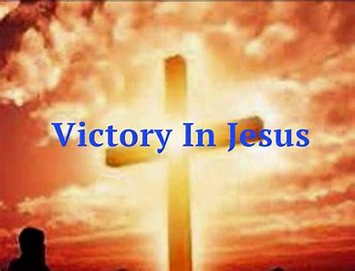
I heard an old, old story how a Savior came from glory How He gave His life on Calvary to save a wretch like me I heard about His groaning of His precious blood's atoning Then I repented of my sins and won the victory Oh, victory in Jesus, my Savior forever He sought me and bought me with His redeeming blood He loved me ere I knew Him and all my love is due Him He plunged me to victory beneath the cleansing flood I heard about His healing of His cleansing power revealing How He made the lame to walk again and caused the blind to see And then I cried, "Dear Jesus come and heal my broken spirit" And somehow Jesus came and brought to me the victory

Slide 3
Oh, victory in Jesus, my Savior forever He sought me and bought me with His redeeming blood He loved me ere I knew Him and all my love is due Him He plunged me to victory beneath the cleansing flood I heard about a mansion He has built for me in glory And I heard about the streets of gold beyond the crystal sea About the angels singing and the old redemption story And some sweet day I'll sing up there the song of victory Oh, victory in Jesus, my Savior forever He sought me and bought me with His redeeming blood He loved me ere I knew Him and all my love is due Him He plunged me to victory beneath the cleansing flood

Slide 4
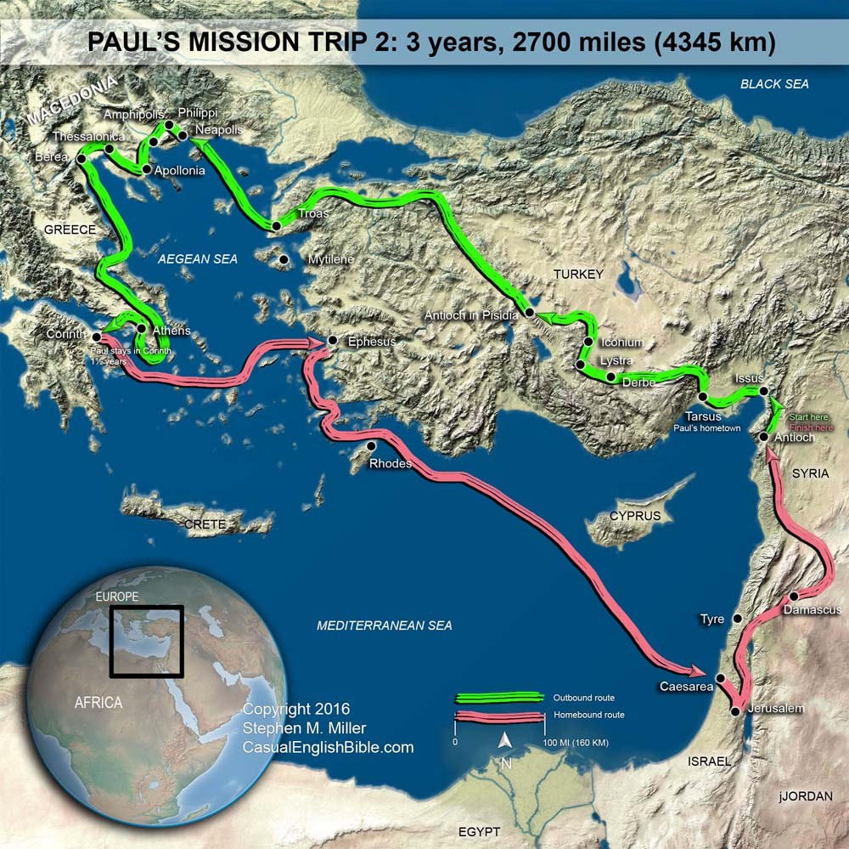
Paul’s Known Contact with Corinth
51-52 AD 2nd missionary trip
(18 months at Corinth, Acts 18:1-18)
54 -56 AD 3rd missionary trip
(3 years at Ephesus, Acts 19:1-10)
Writes 1st Corinthians
---------------------------------------------
Paul’s “painful visit” to Corinth
(2 Cor 2:1, 5-8, 7:12, 12:14, 13:1-2)
Paul’s “severe letter” to Corinth
(2 Cor 2:3-4, 7:8-12, 12:18 )
55-57 AD
Writes 2nd Corinthians (Acts 19:23 ?)
? AD Paul’s anticipated visit
(Acts 20:1-3)

Slide 5
The apostle
(sent one)
Paul
ministered
1 ½ years
at Corinth
Large seaport
and crossroads.
A commercial
city with a
cosmopolitan
population.
The hill temple
of Aphrodite
is 1 km away
at Acrocorinth

Slide 6
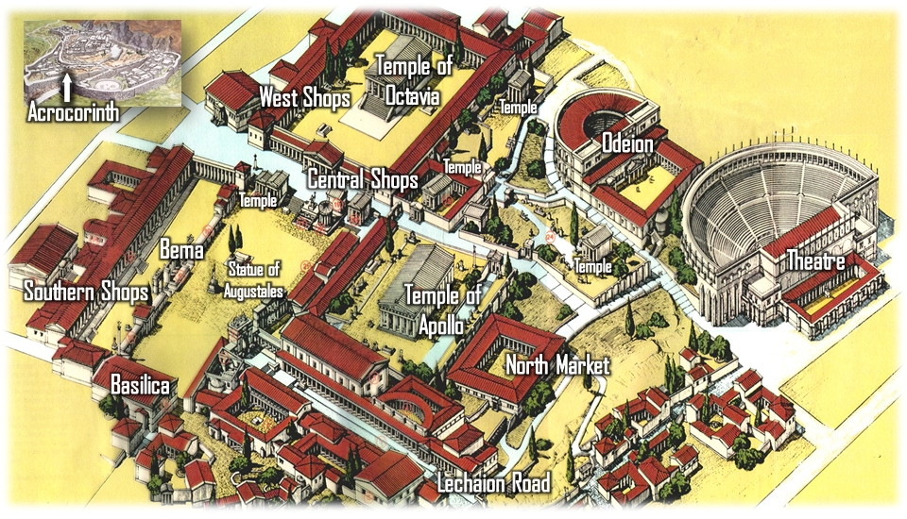
Ancient City of Corinth with the Bema Seat (1 Cor 3:10-15)
Temple of Aphrodite at Acrocorinth

Slide 7
Outlines of 1 Corinthians
I Body Life “in a local church”
(body is soma in Greek)
1-4 Body divided (0x)
5-7 Body sins physically (12x)
8-11 Body sins spiritually (6x)
12-14 Body united (23x)
Body transformed (10x)
Body life (0x)
II Sin “in a local church”
1-3 Foolishness or wisdom
4 Pride or brokenness
5-7 Sin in body and spirit
8-11 Sin in culture
12-14 Sin in worship
15 Hope of the resurrection
16 Farewell
III Structure of 1 Corinthians
1:1-9 Intro to all saints, “Our Lord Jesus Christ” 9x
1-6 Paul corrects problems from personal reports
1:10-4 No spiritual growth - pride & divisions
5-6 (7) Lack of discipline in sexual relations
7-15 Paul corrects problems in reply to a letter
Marriage counseling
8-11:1 Food offered to idols
(8:1 knowledge puffs up with pride - puts self first,
but love build’s up; denying self & puts others first)
11:2-14 Order in the congregation
15 The resurrection
16 Farewell

Slide 8
1 Corinthians 10 in 4 Sundays
1st 9:24-27 Background, Prelude & 10:1-13 Victory in Temptation
10:1-4 Be not ignorant of our past - Christ the spiritual rock
Where God guides He protects and provides
(Ps 105:39-41 clarifies the cloud and fire, bread and water)
10:5-12 6 – God not pleased with them, for our example
7 to 10 – Four temptations in order of severity
Idols > Sex > Tempt God > Murmur of leaders
11 – Their sin is written for our admonition (danger)
2nd 10:13 The Promise of Victory in Temptation (next Sunday)
3rd 10:14-22 Temptation of Mixing Truth and Error (God and demons)
4th 10:23-33 Temptation with a Pure Conscience (the glory of God)
11:1 Conclusion: Be ye followers of me,
even as I also am of Christ

Slide 9
Our relation with 1 Corinthians Corinth is a large commercial city of great prosperity and sin, much like the time of the prophet Hosea with the nation Israel and any nation that knows and departs the one true God.
Lesson: We learn from Paul’s example for blessing and the Corinthian believers example for curse, with the goal to grow in christ.
2021 Challenge: What are my personal temptations? How can I follow Christ more and more so I have more victory in temptation?
Question: Am I saved and Growing in Christ? If saved, am 1?
a help or hindrance?
a blessing or burden?
a Stepping stone or stumbling block?

