Slide 1

9:55 Countdown
Fellowship Church Adult Sunday School March 7, 2021
Title: Fellowship is to Walk in the Light Text: 1 John 1
Thought: As 1 Corinthians 10 tells us how to have Victory in Temptation, so does 1 John tell us how to have Victory in Sin
Congregational Scripture Reading: 1 John 4:7-8 Reader: 7 Beloved, let us love one another: for love is of God; and every one that loveth is born of God, and knoweth God. Congregation: 8 He that loveth not knoweth not God; for God is love. Congregational Song: Reader: 7 Beloved, let us love one another: for love is of God; and every one that loveth is born of God, and knoweth God. Congregation: 8 He that loveth not knoweth not God; for God is love. Beloved let us love one another, 1 John 4:7&8.
We are building our 12 stones
with Joshua in light-love-life

Slide 2
Fellowship is Required to Walk in the Light
1:1-5a Fellowship with the Apostles, the Father and the Son
1:5b-10 Fellowship with Jesus and one another as we Walk in the Light
The alternative to walk in the light is to walk in the darkness.
Sin causes our white robes to be covered with spots and blemishes (Ephesians 5:22-33)
Questions
Announcements:
Wednesday prayer: 6:30-7:30 extended to 8:00 – small group focused prayer
Next Sunday: 1 John 2 Light-Love-Life
March 25 – small group meetings, next slide

Slide 3
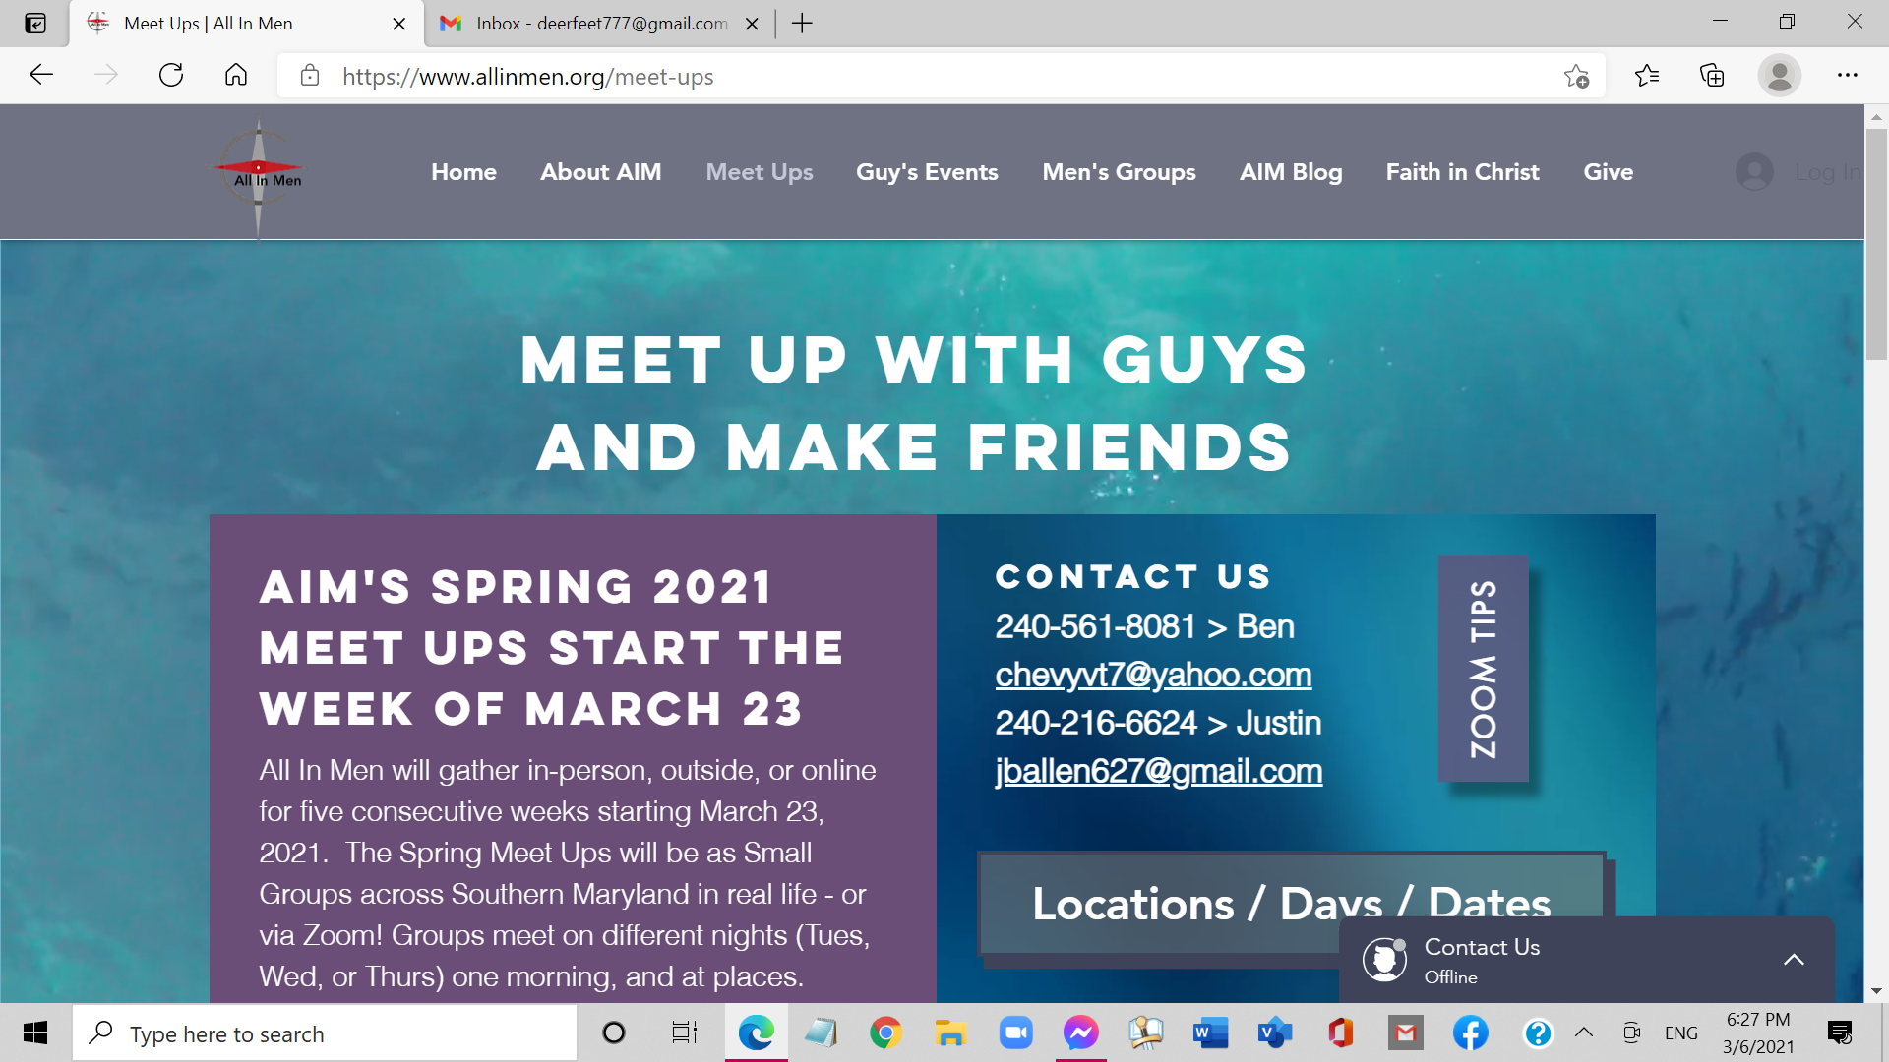
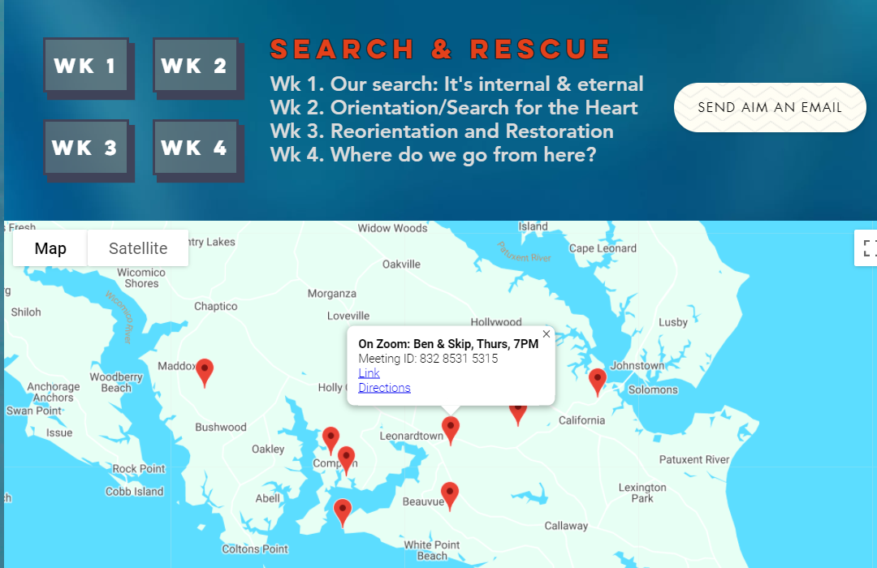
All-In-Men
First meet up is March 25 Thursdays for 5 weeks
7:00-8:30pm at Bill’s
Capacity is 6 men
Sign-up sheet in back
Website: allinmen.org
10:40 Countdown

