Slide 1
9:55 Countdown
Fellowship Church Adult Sunday School March 28, 2021
Title: Light-Love-Life (Victory over Sin) Text: 1 John 4 (focus on love)
Thought: As 1 Corinthians 10 tells us how to have Victory in Temptation, so does 1 John tell us how to have Victory over Sin
Congregational Scripture Reading: 1 John 4:1-4 READER: ¹ Beloved, believe not every spirit, but try the spirits whether they are of God: because many false prophets are gone out into the world. CONGREGATION: ² Hereby know ye the Spirit of God: Every spirit that confesseth that Jesus Christ is come in the flesh is of God: READER: ³ And every spirit that confesseth not that Jesus Christ is come in the flesh is not of God: and this is that [spirit] of antichrist, whereof ye have heard that it should come; and even now already is it in the world. CONGREGATION: ⁴ Ye are of God, little children, and have overcome them: because greater is he that is in you, than he that is in the world.
We are building our 12 stones
with Joshua in light, love, and life

Slide 2
The progression of OPPOSITE words & ThemeS

Slide 3
(world, devil, antichrist, wicked one, sin, hate, etc)
Who are the antichrists / gnostics today? (1 John 4:1-3)

Slide 4
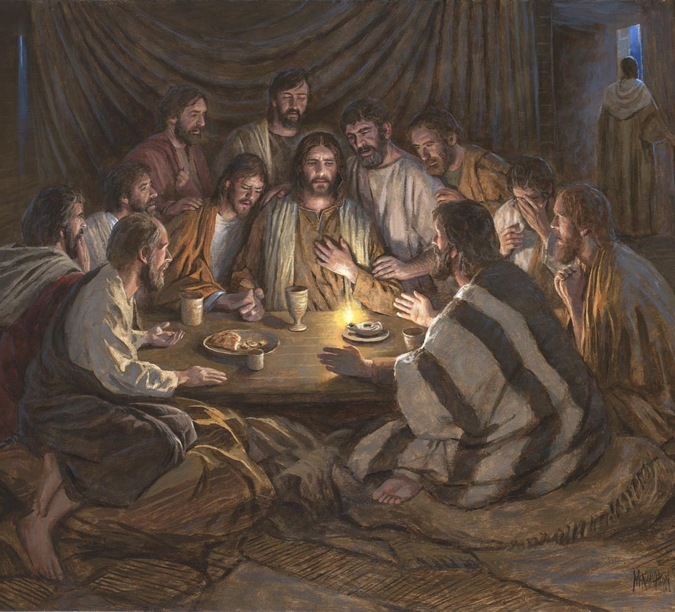
Text: 1 John 4 Title: Light-Love-Life (Victory over sin) 4:1-6 Test the Spirits 4:7-21 love is perfected 17-21 Judgment & Fear Questions Next Sunday: 1 John 5 Light-Love-Life series (focus on Life)

