Slide 1
9:55 Countdown
Fellowship Church Adult Sunday School April 11, 2021
Title: Victory Over Sin (Light-Love-Life) Text: 1 John 5 (Life or Death)
Thought: As 1 Corinthians 10 tells us how to have Victory in Temptation, so does 1 John tell us how to have Victory over Sin
Congregational Scripture Reading: 1 John 5:10-13 (KJV) READER: ¹⁰ He that believeth on the Son of God hath the witness in himself: he that believeth not God hath made him a liar; because he believeth not the record that God gave of his Son. CONGREGATION: ¹¹ And this is the record, that God hath given to us eternal life, and this life is in his Son. READER: ¹² He that hath the Son hath life; [and] he that hath not the Son of God hath not life. CONGREGATION: ¹³ These things have I written unto you that believe on the name of the Son of God; that ye may know that ye have eternal life, and that ye may believe on the name of the Son of God.
We are building our 12 stones
with Joshua in light, love, & life

Slide 2
The progression of OPPOSITE words

Slide 3
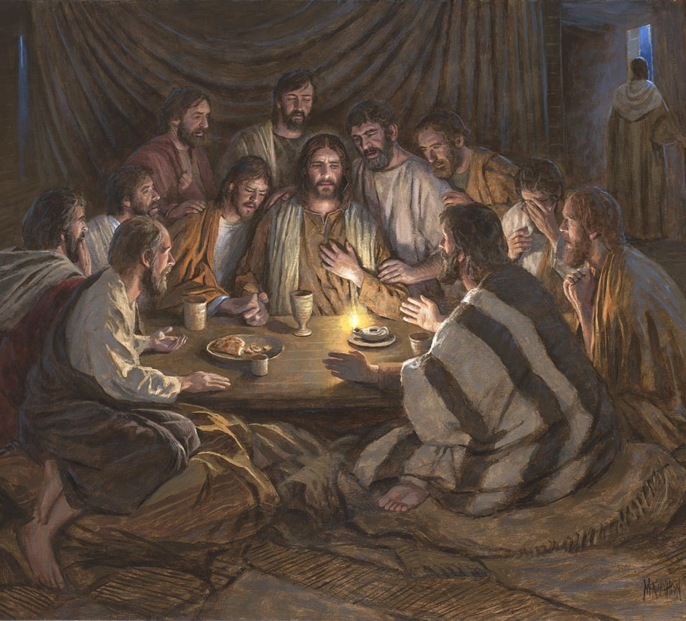
Title: Victory over sin Text: 1 John 5 (life or death) 5:1-3 Keep His commandments 5:4-5 Overcome the World 5:6-9 Witnesses (2 – 3s & more) 5:10-13 life or Death 5: 14-21 Prayer & sin 5:20-21 Truth & Idols Questions Next Sunday: 1 John 1-5 connect light, love, & life to have victory over sin. Read ahead – 15 minutes
10:40 Countdown

