Slide 1
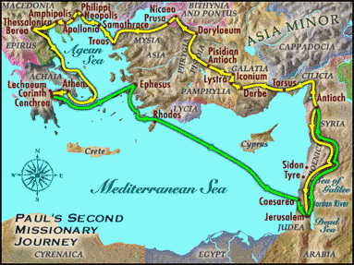
9:55 Countdown
Fellowship Church – Adult Sunday School – July 11, 2021
Title: Our Readiness for the Return of Christ
Text: 1& 2 Thessalonians
Acts 17:1-9
Sub-titles:
1 Thessalonians
12 Preparations for
the Return of Christ
2 Thessalonians
Trainings for
the Return of Christ

Slide 2
Congregational Scripture reading – 1 Thessalonians 1 (KJV)
3. Remembering without ceasing your (1) work of faith, and (2) labor of love, and
(3) patience of hope in our Lord Jesus Christ, in the sight of God and our Father;
4. Knowing, brethren beloved, your election of God.
5. For our gospel came not to you in word only, but also (1) in power, and (2) in the Holy Spirit, and (3) in much assurance; as ye know what manner of men we were among you for your sake.
6. And ye became followers of us, and of the Lord, having received the word in much affliction, with joy of the Holy Spirit:
7. So that ye were ensamples to all that believe in Macedonia and Achaia.
8. For from you sounded out the word of the Lord not only in Macedonia and Achaia, but also in every place your faith to God-ward is spread abroad; so that we need not to speak anything.
9. For they themselves show of us what manner of entering in we had to you, and
how (1) ye turned to God from idols (2) to serve the living and true God;
10. And (3) to wait for his Son from heaven, whom he raised from the dead, [even] Jesus,
which delivered us from the wrath to come.

