Slide 1
9:55 Countdown
Fellowship Church – Adult Sunday School – July 18, 2021
Title: Our Readiness for the Return of Christ
Text: 1& 2 Thessalonians
Doctrine: Tier 2
Background: Acts 17:1-9
Sub-titles:
1 Thessalonians
12 Preparations for
the Return of Christ
2 Thessalonians
Trainings for
the Return of Christ

Slide 2
1 Thessalonians 1 Review Our salvation and the gospel in three phases
3. Remembering without ceasing your
(1) work of faith, and /salvation/
(2) labor of love, and /sanctification/
(3) patience of hope in our Lord Jesus Christ /return/
5. For our gospel came not to you in word only, but also
(1) in power, and /salvation/
(2) in the Holy Spirit, and /sanctification/
(3) in much assurance; /return/
9-10. (1) ye turned to God from idols /salvation/
(2) to serve the living and true God; And /sanctification/
(3) to wait for his Son from heaven, /return/
[even] Jesus, which delivered us from the wrath to come.

Slide 3
Outline
1 Thessalonians
1. 1:1-10 Salvation (after Introduction)
2:1-3:9 Sanctification of ministry
3:10-4:12 Sanctification of believers, general
4:13-5:11 Return of Christ
5:12-5:28 Sanctification of believers, specifics
2 Thessalonians
1:1-4 Sanctification of believers, general
1:5-2:12 Return of Christ
2:13-3:18 Sanctification of believers, specifics

Slide 4
Outline
1 Thessalonians 2:1-3:9 Sanctification of Ministry
2:1-2 Persecution at Philippi due to the Gospel of God
2:3-6 Seven ministry sins
2:7-13 Spiritual mother and father who travail and labor
2:14-16 Persecution of brethren and wrath on persecutors
2:17-20 Reunion in heaven
3:1-5 Paul sends Timothy to Thessalonica in their afflictions
3:6-9 Timothy returns with good news
Next Sunday. 3:10-4:12 Sanctification of believers, general

Slide 5
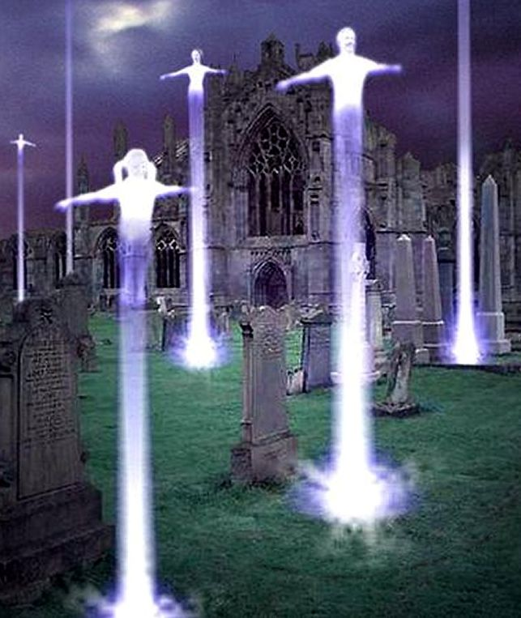
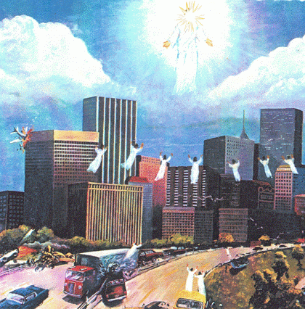
Today > Rapture of church > tribulation on earth > Return of Christ everlasting destruction (1 & 2 Thessalonians)

