Slide 1
9:55 Countdown
Fellowship Church – Adult Sunday School – July 25, 2021
Title: Our Readiness for the Return of Christ
Text: 1& 2 Thessalonians
Doctrine: Tier 2
Background: Acts 17:1-9
Acts 16-18
Sub-titles:
1 Thessalonians
12 Preparations for
the Return of Christ
2 Thessalonians
Trainings for
the Return of Christ

Slide 2
1 Thessalonians 1 Review Our salvation and the gospel in three phases
3. Remembering without ceasing your
(1) work of faith, and /salvation/
(2) labor of love, and /sanctification/
(3) patience of hope in our Lord Jesus Christ /return/
5. For our gospel came not to you in word only, but also
(1) in power, and /salvation/
(2) in the Holy Spirit, and /sanctification/
(3) in much assurance; /return/
9-10. (1) ye turned to God from idols /salvation/
(2) to serve the living and true God; And /sanctification/
(3) to wait for his Son from heaven, /return/
[even] Jesus, which delivered us from the wrath to come.

Slide 3
Outline
1 Thessalonians
1. 1:1-10 Salvation (after Introduction)
2:1-3:9 Sanctification of ministry
3:10-4:12 Sanctification of brethren – in general
4:13-5:11 Return of Christ
5:12-5:28 Sanctification of brethren - specifics
2 Thessalonians
1:1-4 Sanctification of brethren – in general
1:5-2:12 Return of Christ
2:13-3:18 Sanctification of brethren – specifics
? Assess our readiness for the return of Christ

Slide 4
Outline
1 Thessalonians 3:10-4:12 Sanctification of brethren – in general
3:10-13 Increase and abound in love one toward another
4:1-3a Abound more and more to walk and please God
4:3b-8 Sin is confronted (sexual)
4:9-10 Increase more and more to love one another
4:11-12 Sin is confronted (laziness)
Next Sunday. 1 Thessalonians 4:13-5:11 Return of Christ

Slide 5
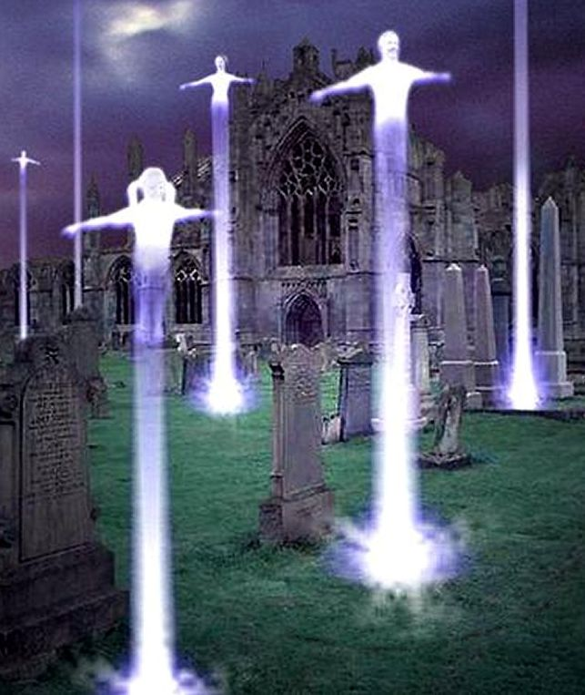
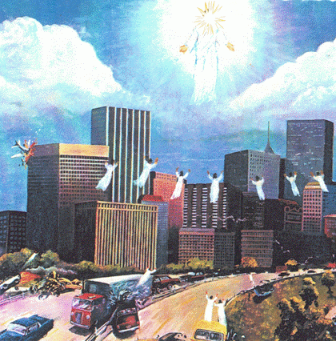
1 & 2 Thessalonians end time prophecies Today / Rapture > Tribulation > return > reign present / future > 7 years > 1000 yrs S1-S2 R1 / R2 > R3 > R4 > R5 Affliction/ 1 day > prophets > 1 day everlasting destruction – R6 or New Jerusalem

