Slide 1
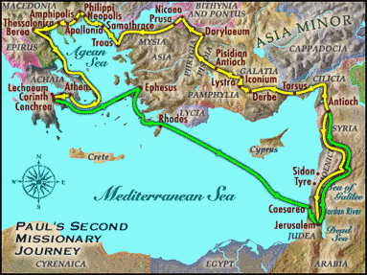
9:55 Countdown
Fellowship Church – Adult Sunday School – August 1, 2021
Title: Readiness for the Rapture of the Church (ekklesia)
Text: 1& 2 Thessalonians
Doctrine: Tier 2
Background: Acts 17:1-9
Sub-titles:
1 Thessalonians
12 Preparations for
the Rapture
2 Thessalonians
Trainings for
the Rapture

Slide 2
1 Thessalonians 1 Our salvation and the gospel are repeated three timeS
1
3. Remembering without ceasing your
(1) work of faith, and /salvation – past/
(2) labor of love, and /sanctification - present/
(3) patience of hope in our Lord Jesus Christ /return - future/
5. For our gospel came not to you in word only, but also
(1) in power, and /salvation - past/
(2) in the Holy Spirit, and /sanctification - present/
(3) in much assurance; /return - future/
9-10. (1) ye turned to God from idols /salvation – past/
(2) to serve the living and true God; And /sanctification - present/
(3) to wait for his Son from heaven, /return - future/
[even] Jesus, which delivered us from the wrath to come. /return - future/
2
3

Slide 3
Outline
1 Thessalonians
1. 1:1-10 Salvation (after Introduction)
2:1-3:9 Sanctification of ministry
3:10-4:12 Sanctification of believers – in general
4:13-5:11 Rapture of the Church (ekklesia)
5:12-5:28 Sanctification of believers - specifics
2 Thessalonians
1:1-4 Sanctification of believers – in general
1:5-2:12 Return of Christ ?
2:13-3:18 Sanctification of believers – specifics
9. Assess our readiness for the return of Christ

Slide 4
Congregational Reading: 1 Thessalonians 4:13-17
4:13 ¶ But I would not have you to be ignorant, brethren, concerning them which are asleep, that ye sorrow not, even as others which have no hope. 4:14 For if we believe that Jesus died and rose again, even so them also which sleep in Jesus will God bring with him.
4:15 For this we say unto you by the word of the Lord, that we which are alive [and] remain unto the coming of the Lord shall not prevent them which are asleep. 4:16 For the Lord himself shall descend from heaven with a shout, with the voice of the archangel, and with the trump of God: and the dead in Christ shall rise first:
4:17 Then we which are alive [and] remain shall be caught up together with them in the clouds, to meet the Lord in the air: and so shall we ever be with the Lord. 4:18 Wherefore comfort one another with these words.

Slide 5
1 Thes 4:13-5:11 words and phrases
Present is the same for all believers from Acts 2 to Revelation 4:1
Rapture Post Rapture Pre Rapture
S1: Salvation 4:14 5:10 = (2x)
S2: Sanctification 4:13-18 (6x) 5:1-5 (7x) 5:6-11 (10x) = (23x)
R1: Pre-rapture 5:3-4 (2x) 5:7-9 (6x) = (8x)
Future 4:13-18 comfort 5:6-11 comfort & edify
R2: Rapture 4:14-17 (8x) 5:2 (2x) 5:9 = (11x)
R3: Post Rapture Wrath 5:3 (4x) 5:9 = (5x) 7 Year Tribulation
R4: Return – 0x. R5: Reign – 0x ,1000 Years. R6: Hell or Heaven – 0x = (0x)

Slide 6
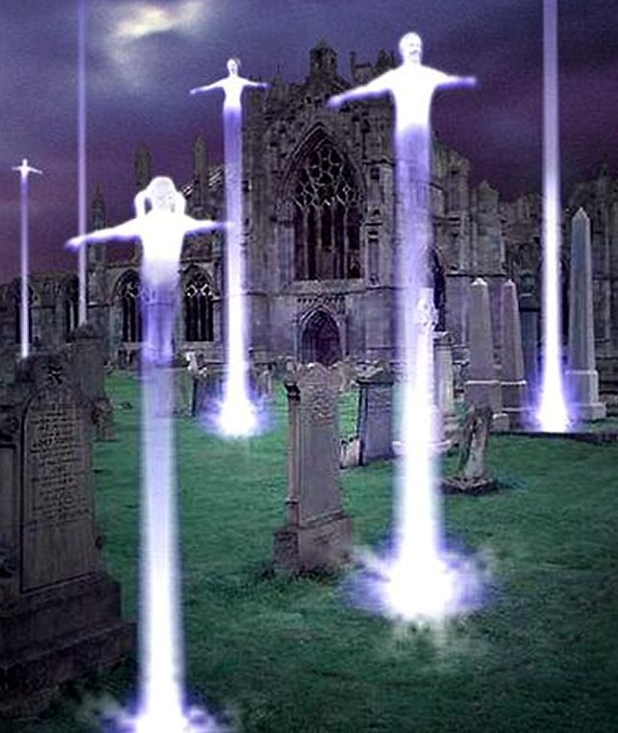
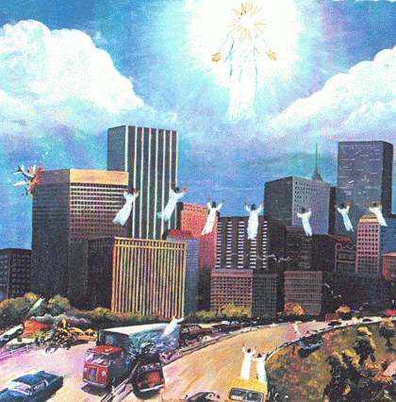
1 Thessalonians 4:13-5:11 Rapture of the Church
4:13-18 Rapture
Not ignorant brethren
Dead in Christ shall raise first
Caught up together
5:1-5 Post Rapture
Times and seasons ye know perfectly
Day of the Lord
Children of Light, not of darkness Rapture (asleep) (alive)
5:6-11 Pre-Rapture
Watch and be sober
Put on the breastplate of faith and love
Comfort and edify each other
Next Sunday. 1 Thessalonians 5:12-28 Sanctification of believers - specifics

