Slide 1
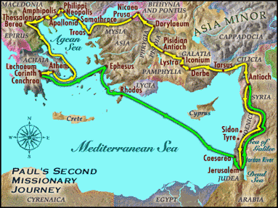
9:55 Countdown
Fellowship Church – Adult Sunday School – August 8, 2021
Title: Readiness for the Rapture of the Church (ekklesia)
Text: 1& 2 Thessalonians
Doctrine: Tier 2
Background: Acts 17:1-9
Sub-titles:
1 Thessalonians
12 Preparations for
the Rapture
2 Thessalonians
Trainings for
the Rapture

Slide 2
1 Thessalonians 1
Our salvation and the gospel are repeated three timeS
1
3. Remembering without ceasing your
(1) work of faith, and /salvation – past/
(2) labor of love, and /sanctification - present/
(3) patience of hope in our Lord Jesus Christ /return - future/
5. For our gospel came not to you in word only, but also
(1) in power, and /salvation - past/
(2) in the Holy Spirit, and /sanctification - present/
(3) in much assurance; /return - future/
9-10. (1) ye turned to God from idols /salvation – past/
(2) to serve the living and true God; And /sanctification - present/
(3) to wait for his Son from heaven, /return - future/
[even] Jesus, which delivered us from the wrath to come. /return - future/
2
3

Slide 3
Outline
1 Thessalonians
1. 1:1-10 Salvation (after Introduction 1:1-2)
2:1-3:9 Sanctification of ministers/ministry
3:10-4:12 Sanctification of believers – in general
4:13-5:11 Rapture of the Church (ekklesia)
5:12-5:28 Sanctification of believers - specifics
2 Thessalonians
1:1-6 Sanctification of believers – in general
1:7-2:12 Return of Christ ?
2:13-3:18 Sanctification of believers – specifics
9. Assess our readiness for the return of Christ

Slide 4
Congregational Reading: 1 Thessalonians 5
¹² And we beseech you, brethren,
to know them which labor among you, and are over you in the Lord,
and admonish you;
¹³ And to esteem them very highly in love for their work's sake.
²² Abstain from all appearance of evil.
²³ And the very God of peace sanctify you wholly;
and [I pray God] your whole spirit and soul and body
be preserved blameless to the coming of our Lord Jesus Christ.

Slide 5
1 Thessalonians 5:12-28 Sanctification of believers – specifics (S2-27)
5:12-13 We beseech you to
  - Love your leaders (pastors and teachers)
  Be at peace among yourselves
5:14-22 We exhort you to
- Love other believers, 5:14-15
- Love God in Christ Jesus, 5:16-18
- Love the Holy Spirit and other believers, 5:19-22
5:23-28 and the God of peace sanctify you wholly;
  Your whole spirit, soul, and body
  Be preserved blameless to the coming of our Lord Jesus Christ (R2)
  Pray for leaders, holy kiss and holy brethren
Next Sunday. 2 Thessalonians 1:1-6 Sanctification of believers – in general

