Slide 1

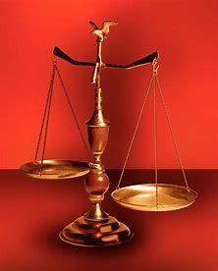
Fellowship Church, August 11, 2024 B Heath
Straight and Balanced
(Luke 3:4-6)
Twelve series
Genesis 1-11 (9:57-9:59, 2:25 minutes)
#1 – 12 degrees to sow and reap hate with Obadiah
#2 – 12 beginnings (origins) of life with Genesis 1-2
#3a – 12 beginnings (origins) of death with Adam, Genesis 3
#3b – beginnings of death with Cain & Noah, Genesis 4-9
#3c – beginnings of death with Nimrod & Babel, Genesis 10-11
#4 – 12 beginnings of Israel with Genesis 12-50
with Exodus
with Leviticus
with Numbers
with Deuteronomy
with Hebrews
with Matthew
OT: Ps 5:8, Pr 4:25-27
Amos 7:7-8
Isaiah 28:13, 17
NT: Mt 3:3, Acts 9:11
Hebrews 12:13, Jude 3
1 Corinthians 15:1-4
2 Timothy 3:10, John 7:16
OT: Deut 25:13-16
Proverbs 20:10
Daniel 5:25-28
NT: Hebrews12:1
1 Cor 3:11-15
Philippians 4:5
James 3:17

Slide 2
Two Worldviews
Young Earth believer
- Historic, orthodox view until the mid-20th century. The Bible leads Science.
Old Earth & Intelligent
Design believer
- New private interpretation using Science, falsely so-called (1 Timothy 6:20).
Science leads the Bible.
Notes:
-

Slide 3
Beginnings (origins) of Death with Genesis 3, 4-9, 10-11
Death in Adam (historical, grammatical, literal) Life in Jesus Endings in
Revelation
Gen 3: Tree of the Knowledge of good and evil Tree of Life 2:3/2:7
2. God commands > Satan deceives > Man disobeys Obedience, Romans 6:16 2-3
3. Sin: Lust of the eyes, lust of the flesh, pride of life Repent & believe, Mark 1:15 2-3/2:17
4. Adam: shame of nakedness & hides from God Jesus’ shame on the cross 2-3
5. Satan cursed himself and all mankind 1st prophecy of Gen 3:15 2-3
6. Eve cursed herself and all women 2 Cor 11:3, 1 Tim 2:14 2-3
7. Adam cursed himself and all men Romans 5:12, 17 2-3
---------------------------------------------------------------------------------------------------------------------------------------------------------------------------------------------------------------
8. Gen 4-6, Cain grew in wickedness until demon possession better than Abel, Heb 12:24 2-3/3:21
9. Gen 6-9, Noah & the flood 1 Peter 3:19-21 2-3/2:11
10. Noah’s sons Shem, Ham, Japheth (alcohol & nakedness) Christ in all, Col 3:11 2-3/3:10
11. Gen 10-11, Tower of Babel and Babylon (70 languages) One in Christ, Acts 2:42 17-18/3:12
12. Nimrod is a hunter of men’s bodies and souls (govt) Fear God, MT 10:28 18:13/2:26-27

Slide 4
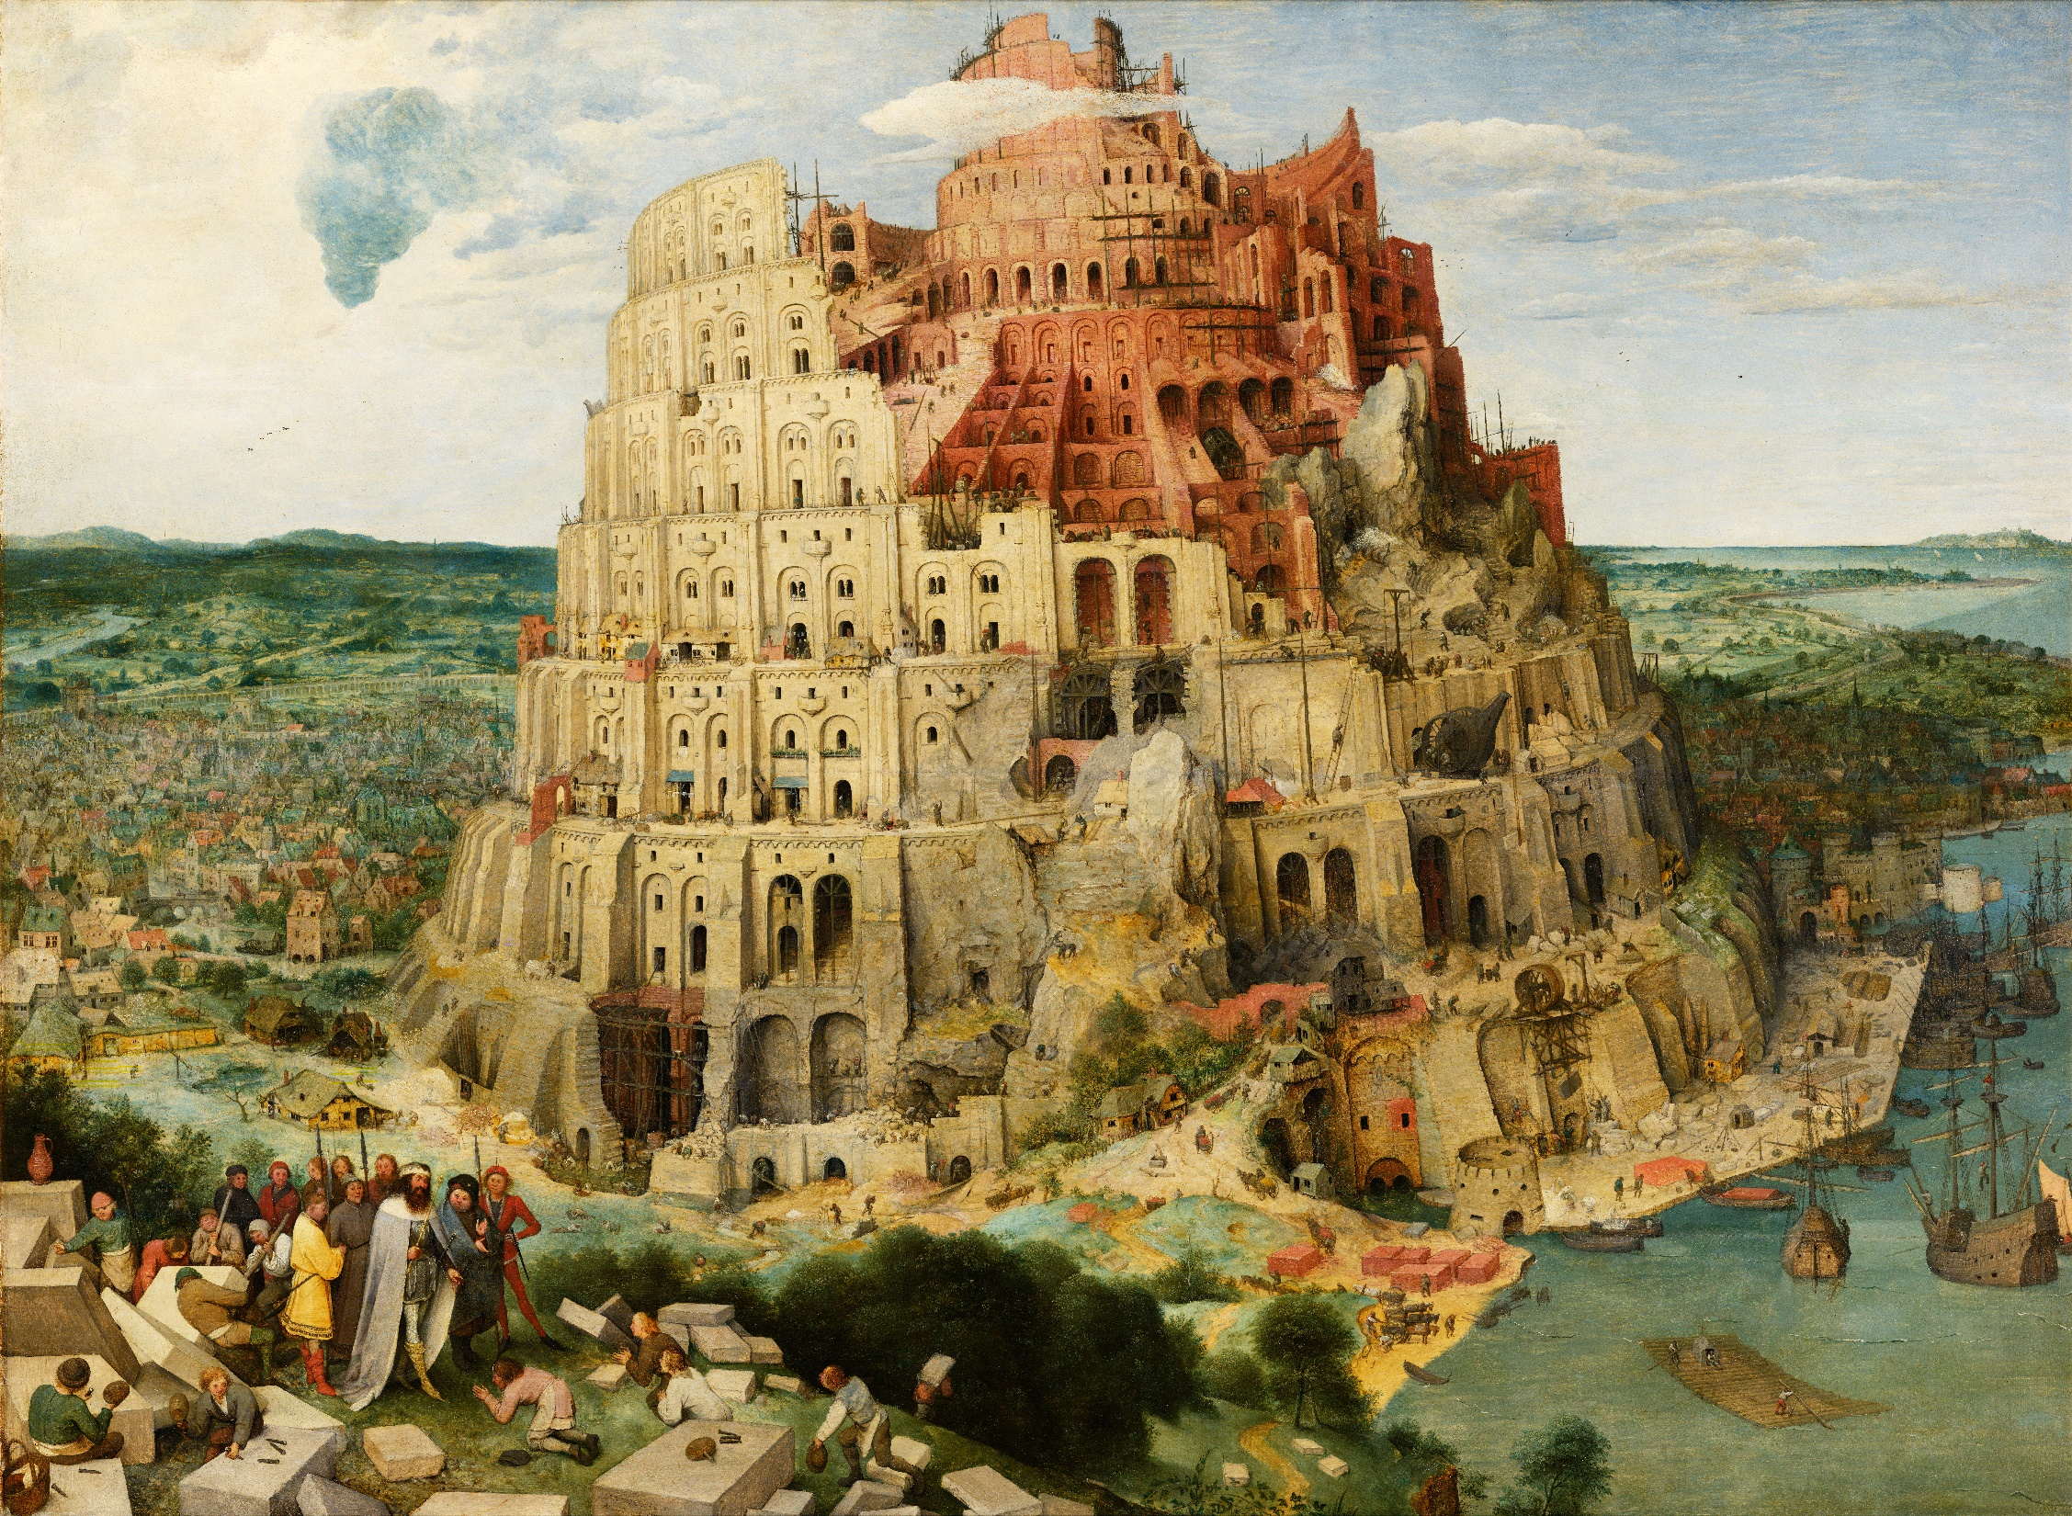
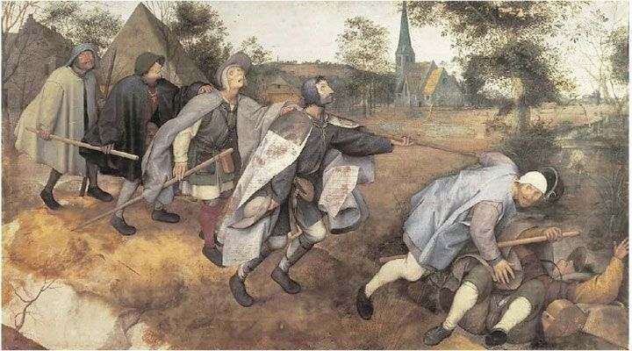
Tower of Babel
By
Pieter Bruegel the Elder
1563
The Northern Renaissance

Slide 5

Sunday School Schedule
Mas de Cristo class
Continue with the 12 series. Pray-pray. Pray for me.
You may request a Book of the Bible we have not completed.
COMPLETED:
OT/ Genesis (3 of 4), Psalms (4), Proverbs, Ecclesiastes, Amos, Obadiah, Malachi
NT/ Mark, Colossians, Philemon, James, Jude
Invitation to the 2024 daily Bible reading schedule.
Isaiah from May 9 to Oct 18. Copies on the back table.
Museum of the Bible trip next Sunday after church service
Next Sunday, Genesis 12-50
Notes:
-

