Slide 1
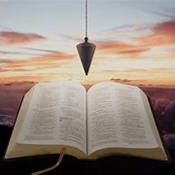
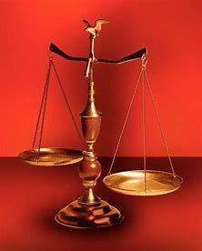
Fellowship Church, August 11, 2024 B Heath
Straight and Balanced
(Luke 3:4-6)
Twelve series
It's all about you Jesus (9:55-9:59)
#1 – 12 degrees to sow and reap hate with Obadiah
#2 – 12 beginnings (origins) of life with Genesis 1-2
#3a – 12 beginnings (origins) of death with Adam, Genesis 3
#3b – death with Cain & Noah, Genesis 4-9:17
#3c – death with Nimrod & Babel, Genesis 9:18-11
#4 – 12 beginnings of Israel with Genesis 12-50
#5 – with Exodus
with Leviticus
with Numbers
with Deuteronomy
with Hebrews
with Matthew
OT: Ps 5:8, Pr 4:25-27
Amos 7:7-8
Isaiah 28:13, 17
NT: Mt 3:3, Acts 9:11
Hebrews 12:13, Jude 3
1 Corinthians 15:1-4
2 Timothy 3:10, John 7:16
OT: Deut 25:13-16
Proverbs 20:10
Daniel 5:25-28
NT: Hebrews12:1
1 Cor 3:11-15
Philippians 4:5
James 3:17

Slide 2
Two Worldviews
Young Earth believer
Historic, orthodox view until the mid-20th century.
The Bible leads Science.
Old Earth believer
Science, falsely so-called
(1 Tim 6:20).
Science leads the Bible.
Types of Jesus (life)
Adam (1-2)
Abel (4-5) → Enoch
Noah (6-9)
Anti-types of Jesus (death)
Serpent (3:1-15)
Cain (4:1-24) → Nephilim (6:1-7)
Nimrod (10:8, 10:1-11:9)
Notes:
-

Slide 3
12 Beginnings (origins) of Israel with Genesis 12-50
Israel is a people and a land (historical, grammatical, literal)
Date: 2100 to 1800 BC Genesis is the book of beginnings Genesis
Abrahamic Covenant. Unconditional. Everlasting. Fulfilled when Christ returns as king. 12:1-3
People (Jews)
3. Land (Israel)
4. Abraham (father) & Sarah: Melchizedek-Ps 110–Hebrews 7, 1 Pe 3:5-7 (Ishmael) 12-25
5. Lot & family: wife-salt, 2 daughters, Luke 17:20-37, 2 Peter 2:7-9 (Sodom) 18-19
6. Isaac (laughter) & Rebekah 22-24
Jacob (heel catcher) & Rachel (Esau) 25-36
Jacob wrestled with an angel all night, then his name changed to Israel 32:24-30
Joseph: Faith through trials, Hebrews 11:20-22, Rev 7:8 (Pharoah) 37-50
Israel’s past, present, and future
10. Jesus in Mt-Mk-Lu-Jn. Stephen in Acts 7:1-16. Paul in Romans, Galatians & Hebrews. Rev 2:9, 3:9. 11. Acts 2-28 declare the transition from one nation Israel to all nations on the earth
12. Romans 15:4 (KJV) For whatsoever things were written aforetime were written for our learning,
that we through patience and comfort of the scriptures might have hope.
In the context of 15:5-13 and 12:-16.

Slide 4
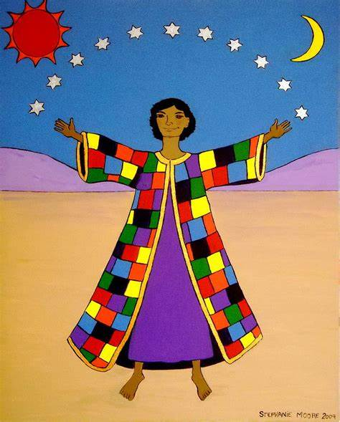
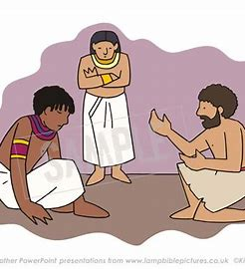
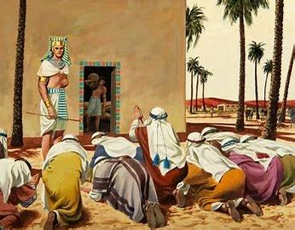
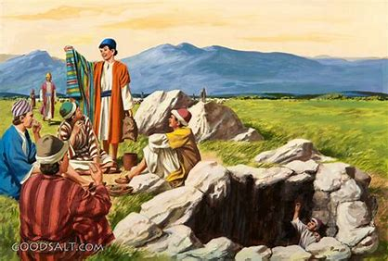
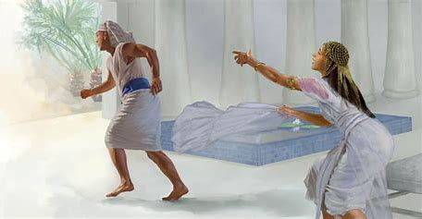
4th
1st
5th
2nd
3rd
Notes:
-

Slide 5

Sunday School Schedule
Mas de Cristo class
Continue with the 12 series. Pray-pray. Pray for me.
You may request a Book of the Bible we have not completed.
COMPLETED:
OT/ Genesis (4), Psalms (4), Proverbs, Ecclesiastes, Amos, Obadiah, Malachi
NT/ Mark, Colossians, Philemon, James, Jude
Invitation to the 2024 daily Bible reading schedule.
Isaiah from May 9 to Oct 18. Copies on the back table.
Today, Museum of the Bible trip after church service
Next Sunday, Exodus - book of the Exit. Read in 3 hours.
Notes:
-

