Slide 1
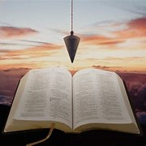
Fellowship Church, August 25, 2024 B Heath
Straight and Balanced
(Luke 3:4-6)
Twelve series
It's all about you Jesus (9:55-9:59)
1 – 12 degrees to sow and reap hate with Obadiah
2 – 12 beginnings (origins) of life with Adam, Genesis 1-2
3a – 12 beginnings (origins) of death with Adam, Genesis 3
3b – death with Cain & Noah, Genesis 4-9:17
3c – death with Nimrod & Babel, Genesis 9:18-11
4 – 12 beginnings of Israel with Abraham, Genesis 12-50
5a – 12 exits from slavery in Egypt with Moses, Exodus 1-12
5b – Egypt to Mount Sinai (the Law) with Moses, Exodus 13-40
with Leviticus
with Numbers
with Deuteronomy
with Matthew, Hebrews, Galatians, Romans 9-11
OT: Ps 5:8, Pr 4:25-27
Amos 7:7-8
Isaiah 28:13, 17
NT: Mt 3:3, Acts 9:11
Hebrews 12:13, Jude 3
1 Corinthians 15:1-4
2 Timothy 3:10, John 7:16
OT: Deut 25:13-16
Proverbs 20:10
Daniel 5:25-28
NT: Hebrews12:1
1 Cor 3:11-15
Philippians 4:5
James 3:17

Slide 2
12 exits from slavery in Egypt with Moses, Exodus 1-12
Date: 1490-1410 BC (Moses is 40 years in Egypt and 40 years in the wilderness)
Key words: Exodus = the going forth. Hardened heart – 15x, let my people go - 9x, three – 6x.
People: Moses = son brought forth (out of the water, Ex 2:10), family of Moses, Pharoah
I exit from death in Adam and a slave to sin unto life in Jesus Christ as:
1) Babies suffer death by government and Moses has life in God’s hand and timing (a type of Christ) 1:15-23
2) God remembers his covenant with Abraham and all believers (Ephesians 2:8-9, Mt 28:20) 2:23-25
3) Moses takes off his shoes on holy ground at the burning bush that is not consumed 3:1-5, 18
4) Moses’ rod was used for a time of exceeding wonders and great change for the nation Israel (1 of 5x) 4:1-5
5) People go to sacrifice to the LORD our God (Ro 12:1-2). Pharoah hears and hardens his heart. 5-11
6) (purity) 7 days of unleavened bread and the (sin) blood of the lamb (remember & eat worthily) 12:1,19-23
Next Sunday 7-12) Moving from Egypt to Mount Sinai (the Red Sea, Law & Tabernacle) with Moses, Exodus 13-40
Exodus 19:6, a kingdom of priests and a holy nation is completed in the New Testament, 1 Peter 2:5
Hebrews 11:23-28. Romans 15:4 (KJV) For whatsoever things were written aforetime were written for our learning, that we through patience and comfort of the scriptures might have hope.

Slide 3
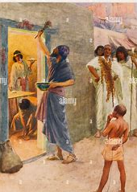
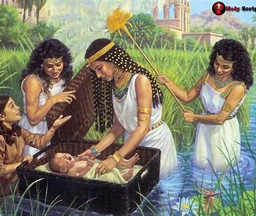
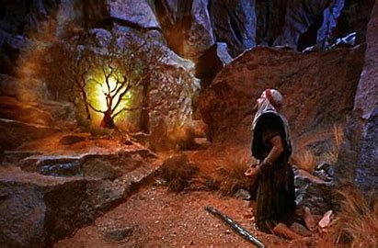
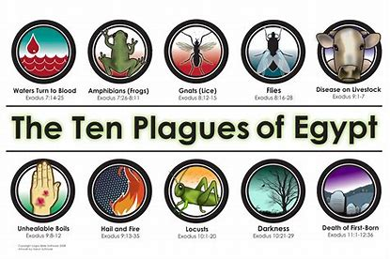
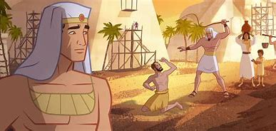
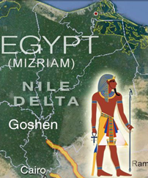
Moses is 3 months (Acts 7:20)
Christ our passover (1 Cor 5:7)
Moses is 80 years (Acts 7:30)
Moses is 40 years (Acts 7:23)
120 days
Stephen’s response to the high priest about Moses (Acts 7:18-36 from Exodus 1-12)

Slide 4
Sunday School Schedule-2024
Mas de Cristo class
Continue with the 12 series. Pray-pray. Pray for me.
You may request a Book of the Bible we have not completed.
COMPLETED:
OT/ Genesis (4), Exodus (2), Psalms (4), Proverbs, Ecclesiastes, Amos, Obadiah, Malachi
NT/ Mark, Colossians, Philemon, James, Jude
Invitation to the 2024 daily Bible reading schedule.
Isaiah from May 9 to Oct 18. Copies on the back table.
Next Sunday, Exodus 12-40
Notes:
-

