Slide 1
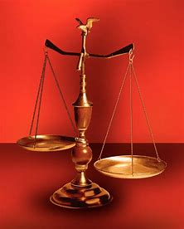
Fellowship Church, September 1, 2024 B Heath
Straight and Balanced
(Luke 3:4-6)
Twelve series
It's all about you Jesus (9:55-9:59)
1 – 12 beginnings (origins) of life with Adam, Genesis 1-2
2a – 12 beginnings (origins) of death with Adam, Genesis 3
2b – death with Cain & Noah, Genesis 4:1-9:17
2c – death with Nimrod & Babel, Genesis 9:18-11:32
3 – 12 beginnings of Israel with Abraham, Genesis 12-50
4a – exit from slavery in Egypt to the Red Sea, Exodus 1-12
4b – from the Red Sea to Mount Sinai, Exodus 13-18
4c – at Mount Sinai (Law) and the Tabernacle, Exodus 19-40
5 – at Mount Sinai (Law) for priest and people, Leviticus 1-27
6a – at Mount Sinai (Law) Numbers 1-10
6b – Wanderings in the desert for 38 years, Numbers 11-36
Deuteronomy, Matthew, Galatians, Hebrews
OT: Ps 5:8, Pr 4:25-27
Amos 7:7-8
Isaiah 28:13, 17
NT: Mt 3:3, Acts 9:11
Hebrews 12:13, Jude 3
1 Corinthians 15:1-4
2 Timothy 3:10, John 7:16
OT: Deut 25:13-16
Proverbs 20:10
Daniel 5:25-28
NT: Hebrews12:1
1 Cor 3:11-15
Philippians 4:5
James 3:17

Slide 2
from the Red Sea to Mount Sinai, Exodus 13-18
Date: 1490 BC, 45 days after departing Egypt (Ex 16:1), 90 days to enter the wilderness of Sinai (Ex 19:1)
Moses’ leadership in 6 problems: Exodus
(Philippians 2:14 Do all things without murmurings and disputings, Romans 14:1, doubtful disputations)
Problem 1/complaint – Solution, God directs to Moses for the Red Sea crossing 13:1-15:21
(fear death, return to Egypt, Moses cried unto the LORD, 1 Cor 10:2, Heb 11:29)
2) Problem 2/murmur – Solution, God’s wisdom to turn bitter water into sweet water 15:22-27
(Moses cried unto the LORD, Romans 1-2 sin is bitter, 3-5 salvation is sweet, 6-8 sanctification)
3) Problem 3/murmur – Solution, God provides daily manna for the next 40 years 16:1-36
(return to Egypt, the bread of heaven, John 6:31-58, 1 Cor 11:17-34, Rev 2:17)
4) Problem 4/murmur – Solution, God instructs Moses to hit the rock for water 17:1-7
(fear death, return to Egypt, Moses cried unto the LORD, stone Moses, Acts 7:37, 1 Cor 3:11, Eph 2:20)
5) Problem 5/War – Solution, Aaron & Hur help Moses hold up his hands with his rod for victory 17:8-16
(Fellowship: They reason and work together for victory over the identified enemy - Amalekites)
(Write this in a book 17:14, 400 years later with King Saul and Samuel in 1 Samuel 5:3)
6) Problem 6/Family – Jethro advised Moses to delegate leadership in judging others 18:1-27
(Moses continues on – Aaron & Miriam. Jethro & Zipporah, 2 sons Gershom & Eliezer, Acts 6:1-4)

Slide 3
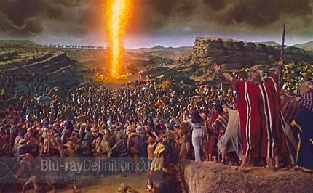
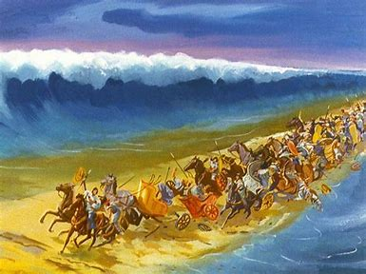
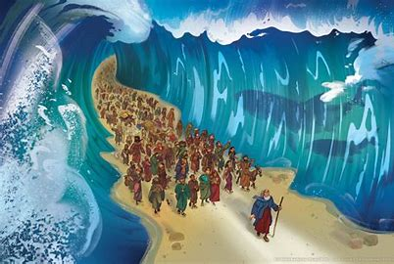
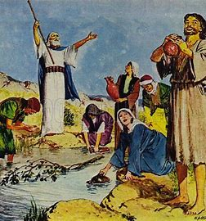
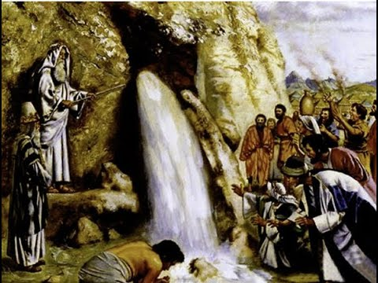
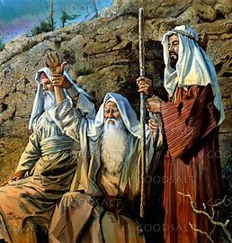
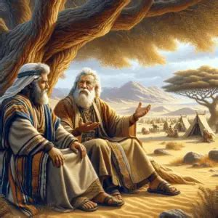
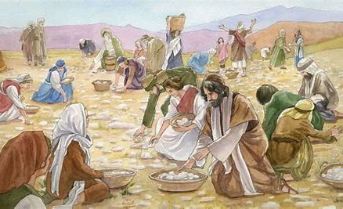
Exodus 13:1-15:21
Exodus 15:22-18:27

Slide 4
Sunday School Schedule-2024
Mas de Cristo class
The purpose of the Old Testament is for our: (1) Learning – Romans 15:4 (2) Admonishing – 1 Corinthians 10:1-10 (3) Shadow – Col 2:17, Heb 8:5, 10:1 (4) Figure – Ro 5:14, 1 Cor 4:6, Heb 9:9, 11:19, 1 Peter 3:21
(5) Type or antitype (like figure, but referring to specific people); so New Testament Christ-followers can better discern good from evil, obey God, follow Jesus, and be filled with the Holy Spirit.
COMPLETED:
Old Testament/ Genesis (5), Exodus (3), Psalms (4), Proverbs, Ecclesiastes, Amos, Obadiah, Malachi
New Testament/ Mark, Colossians, Philemon, James, Jude
Invitation to the 2024 daily Bible reading schedule.
Isaiah from May 9 to Oct 18. Copies on the back table.
Next Sunday, Exodus 19-40. Thought to consider. Exodus 19:6 says Israel is a kingdom of
priests and a holy nation. 1 Peter 2:9 says we are a royal priesthood, a holy nation.
Notes:
-

