Slide 1
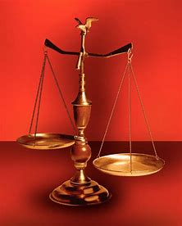
Fellowship Church, Sept 8, 2024 B Heath
Straight and Balanced
(Luke 3:4-6)
It's all about you Jesus (9:55-9:59)
1 – 12 beginnings (origins) of life with Adam, Genesis 1-2
2a – 12 beginnings (origins) of death with Adam, Genesis 3
2b – death with Cain & Noah, Genesis 4:1-9:17
2c – death with Nimrod & Babel, Genesis 9:18-11:32
3 – 12 beginnings of Israel with Abraham, Genesis 12-50
4a – exit from slavery in Egypt to the Red Sea, Exodus 1-12
4b – from the Red Sea to Mount Sinai, Exodus 13-18
4c – Mount Sinai (Law) - 10 Commandments, Exodus 19-24
4d – Mount Sinai (Law) - the Tabernacle, Exodus 25-40
5a – Mount Sinai (Law) – approach a holy God, Leviticus 1-17
5b – Mount Sinai (Law) – live a holy life, Leviticus 18-27
6a – Mount Sinai (Law) - prepare to depart, Numbers 1-10
OT: Ps 5:8, Pr 4:25-27
Amos 7:7-8
Isaiah 28:13, 17
NT: Mt 3:3, Acts 9:11
Hebrews 12:13, Jude 3
1 Corinthians 15:1-4
2 Timothy 3:10, John 7:16
OT: Deut 25:13-16
Proverbs 20:10
Daniel 5:25-28
NT: Hebrews12:1
1 Cor 3:11-15
Philippians 4:5
James 3:17

Slide 2
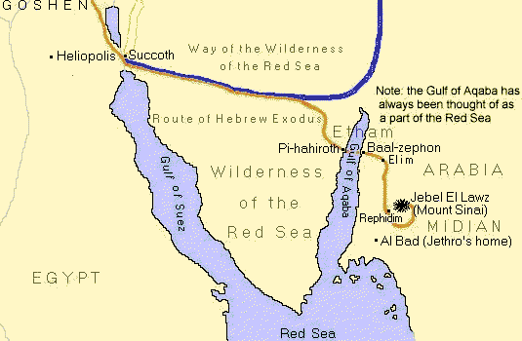
Mount Sinai
(1) traditional religious site
(2)
historic
Biblical site
(3)
Alternate
sea crossing
(2)
(1) Traditional
Mt. Sinai
(3)
Burning Bush
Ex 3:1-5
Mt Horeb

Slide 3
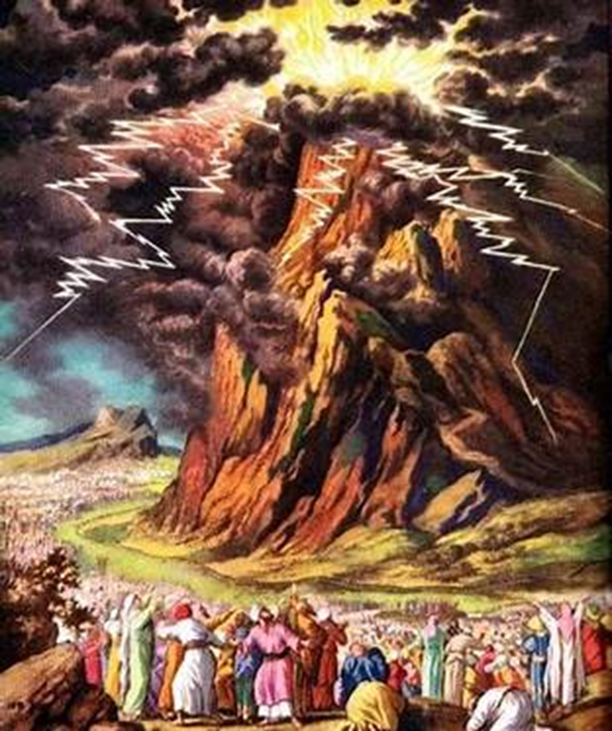
The 10 Commandments Exodus 19-20
# | Command | God Man | New Testament
1 | One God |  | 1 Cor 8:6 | 1 Tim 2:5
2 | Images-idols |  | 1 Jn 5:21 | Rev 2:14, 20
3 | Name of God |  | 1 Tim 6:1 | Rev 3:17
4 | Sabbath day |  | N/A Col 2:16 | Jesus-Heb 4
5 | Honor parents |  | Eph 6:1-3 | Mt 15:3-9
6 | Murder |  | 1 Pe 4:15 | Ro 13:8-10
7 | Adultery |  | 1 Cor 6:9-10 | Ro 13:8-10
8 | Theft |  | Eph 4:28 | Ro 13:8-10
9 | False witness |  | Rev 21:8 | Ro 13:8-10
10 | Covet |  | Col 3:5 | Ro 13:8-10 Ro 7:7-13
Thick cloud, thunders - lightnings, voice of trumpet
smoke – great quake – devouring fire

Slide 4
at Mount Sinai (Law) & 10 Commandments, Exodus 19-24
Date: 1490-1489 BC, appx 1 year camped at Mount Sinai (Exodus 19:1 to Numbers 10:10)
Moses receives the 10 Commandments and some civil laws Exodus
In the desert of Sinai at Mount Sinai Moses is the mediator between God and the people 19
(Moses goes up the mountain 6x in Exodus 19:3, 7 – all hear/ 20, 22b, 24:18 for 40 days & 40 nights, 34:4 for 40 days & nights.
Moses comes down the mountain 6x in Exodus 19:8, 14 – all hear/ 24a, 25, 32:15, 34:29 to Numbers 10:10)
God’s Law – The 10 Commandments (1-2, 3-17 ten commandments, 18—21 people fear, 22-26 idols) 20
(stone & naked, vs 25-26, New Testament: MT 5:17-48, Acts 7:38-39, Ro 7:1-6, 7-13, 7:14-8:39, 2 Cor 3:6-18, Gal 3:17-19, Heb 12:18-29)
Moses Law – Servants (1-10) and Personal injury (11-36) 21
(7th year choice. Put to death 7x - vs 12, 14, 15, 16, 17, 23, 29. Unborn child - vs 22-25. Judges 2x, 30 pieces of silver - vs 32)
Moses Law – Theft & Property (1-15) and 10 civil laws (16-31) 22
(restitution – 4x, double – 3x, judges – 3x. Put to death 4x – vs 18, 19, 20, 24. Virginity – vs 16-17. Stranger-widow-fatherless – vs 21-24)
Moses Law – 9 civil laws (1-9), Land sabbath (10-13), Three Natl feasts (14-19), Land conquests (20-33) 23
(love enemy – vs 4-5, take no gift – vs 8, oppress stranger – vs 9. Command for rest of land on 7th year
Annually, all males celebrate Unleavened bread – Pentecost – Trumpets. An angel & fear go before Israel, make no covenant -beware of sin.)
Moses prepares to go up Mount Sinai (1-8), Glory of God appears and Moses goes up the mountain (9-18) 24 (early morning, altar – 12 pillars – burnt and peace offering, sprinkled blood, read book. Sappihre stone, Cloud and glory of God, devouring fire)

Slide 5
Sunday School Schedule-2024
Mas de Cristo class
COMPLETED:
OT/ Genesis (4), Exodus (4), Psalms (4), Proverbs, Ecclesiastes, Amos, Obadiah, Malachi
NT/ Mark, Colossians, Philemon, James, Jude
The purpose of the Old Testament: (1) Learn – Romans 15:4 (2) Admonish – 1 Corinthians 10:1-10
(3) Shadow – Col 2:17, Heb 8:5, 10:1 (4) Figure – Ro 5:14, 1 Cor 4:6, Heb 9:9, 11:19, 1 Peter 3:21
(5) Type or antitype - specific people are like God or the Devil to help New Testament Christ-followers to
discern good from evil, obey God, follow Jesus, and be filled with the Holy Spirit.
Invitation to the 2024 daily Bible reading schedule.
Isaiah from May 9 to Oct 18. Copies on the back table.
Next Sunday, Exodus 25-40. The Tabernacle and more of the law of Moses.
Notes:
-

Slide 6
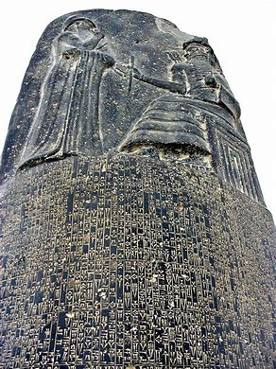
The History and Spirit of Babylon (the antitype of Jerusalem)
Old Testament: Source of human government and false religions. Physical, temporary.
Scripture Babylon Date Note
1. Genesis 10-11 Tower of Babel, Nimrod 2100 BC
2. Code of Hammurabi Old Babylon 1750 BC Discovered in 1901
(300 years before the law of Moses. 282 criminal and civil laws. God is Shamash. No provision for forgiveness.)
3. Exodus 20 to Deu 34 Law of Moses 1440 BC 613 commandments
(Similar for murder, theft, adultery, & kidnapping. Contrast is sin and holiness accountable to one God in heaven)
4. Jeremiah-Daniel Neo-Babylon 605-586 BC > Assyria, < Medo-Persia
(King Nebuchadnezzar, King Cyrus)
New Testament: Same as the Old Testament, except spiritual and eternal.
5. Revelation 17-18 Babylon is fallen > 2024 AD Biblical worldview

