Slide 1

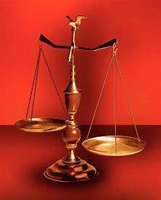
Straight and Balanced
(Luke 3:4-6)
Twelve series
#1 – 12 Evidence of Brotherly Love with Philemon
#2 – 12 Reproofs & Corrections for Good Works with James
#3 – 12 Helps to be Hid with Christ in God with Colossians
#4 – 12 Helps to Keep Yourselves in the Love of God with Jude
#5 – 12 Basics to Grow in the Wisdom of God with Proverbs
1-9, proverbs for young men (wisdom of the pilgrims)
10-24, proverbs for all people
25-31, proverbs for kings and leaders
#6 – What book of the Bible shall we cover next?
OT: Ps 5:8, Pr 4:25-27
Amos 7:7-8, Is 28:13, 17
NT: Mt 3:3, Acts 9:11
Hebrews 12:13
OT: Deut 25:13-16
Daniel 5:25-28
NT: Hebrews12:1
1 Cor 3:11-15
Fellowship Church, November 19, 2023, by Bill Heath

Slide 2
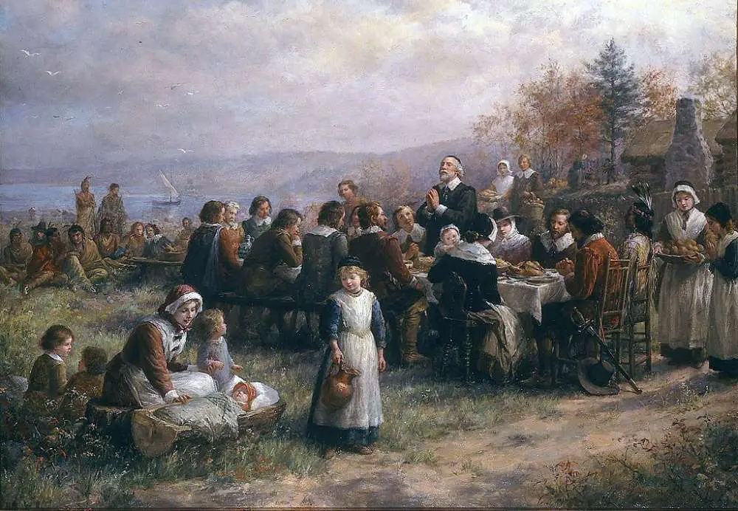
Wisdom of the Pilgrims for Thanksgiving
Time: 1606-1667 AD
Place: England > Holland > Plymouth, Massachusetts
People: Pilgrims – Pastor John Robinson, Governor William Bradford, and Elder W. Brewster
Indians – Samoset-Massasoit Sachem, Squanto, John Sassamon
Wisdom: Family focus, Mayflower Compact, alliance with Indians, work ethics, righteousness
“Breaking away from the bondage of tyranny and tolerance of the dark ages to the Biblical liberties in a simple people named the pilgrims” (Hebrews 11:13, 1 Peter 2:11)
Purpose: To remember the Thanksgiving story of the United States of America
Straight: Abraham Lincoln recognized the value of the Plymouth Thanksgiving holiday, 1864
Balanced: Believers today can trust in God to lead us as He did the pilgrims of Plymouth

Slide 3
Proverbs for Young Men, 1-9
1:1-7 Introduction to the book of Proverbs
(knowledge, wisdom, and understanding)
1:8-9 The nuclear family is the foundation of God’s wisdom on earth
(linking verses: father-mother, sons and daughters)
1:10-7:27 To a young man and all young believers
(2-4 basics, 5-7 relations with strange women)
8-9 Capstone of wisdom (beginning with Jesus Christ, 8:22-31)
(8:1-9:12. 9:13-18 finishes 5-7)
Next two Sundays: Proverbs for all believers, 10-24
(select 1 chapter, assign +/-, -/+, +/+ or -/- to verse. wise = +, fool = -)
Proverbs for kings and leaders, 25-31

Slide 4
12 series with _________________
What book of the Bible after Proverbs?
Pray and say!

