Slide 1


Straight and Balanced
(Luke 3:4-6)
Twelve series
#1 – 12 Evidence of Brotherly Love with Philemon
#2 – 12 Reproofs & Corrections for Good Works with James
#3 – 12 Helps to be Hid with Christ in God with Colossians
#4 – 12 Helps to Keep Yourselves in the Love of God with Jude
#5 – 12 Basics to Grow in the Wisdom of God with Proverbs
1-9, proverbs for young men (wisdom of the pilgrims)
10-24, proverbs for all people
25-31, proverbs for kings and leaders
#6 – 12 Vanities that Diminish God’s Wisdom with Ecclesiastes
#7 – What book shall we cover next?
OT: Ps 5:8, Pr 4:25-27
Amos 7:7-8, Is 28:13, 17
NT: Mt 3:3, Acts 9:11
Hebrews 12:13
OT: Deut 25:13-16
Pr 16:11, Da 5:25-28
NT: Hebrews12:1
1 Cor 3:11-15
Fellowship Church, December 3, 2023, by Bill Heath

Slide 2
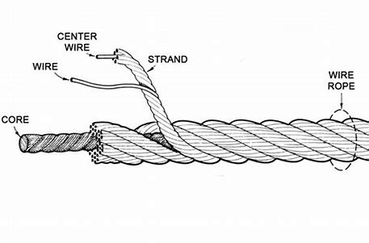
Proverbs for Kings and Leaders, 25-31 (458 proverbs)
25-29
(+) 25:2-7 Wise behavior with kings, 8-18 neighbors, 19-28 anyone
(-) 26:1-12 Fool, 13-16 sloth, 17-22 strife, 23-28 hate
(+) 27:1-4 Wisdom general, 5-10 friendship, 11-14 prudence, 15-22 vigilance, 23-27 diligence
(+/-) 28-29 Contrasts between the righteous and the wicked
30 Six groups of four things
(+) Introduction (1a) Solomon (Agur) the son of David (Jakeh)
(1b-6) Prophecy of Solomon, God and Jesus (7-9) prayer
(-4) Wicked (10-14), never satisfied (15-16), wonderful (17-19), disturbing (20-23)
(+2) Exceedingly wise (24-28), go well (29-31)
(-) Conclusion (32-33)
31
(+/+) 1-9. King Solomon’s mother warns of women, wine
& strong drink. Help others with his words.
(+/+) 10-31. 21 ways of the Godly woman.
Next Sunday: 12 Vanities that Diminish God’s Wisdom with Ecclesiastes.

