Slide 1
Fellowship Church, Nov 3, 2024 B Heath
Straight and Balanced
(Luke 3:4-6)
It's all about you Jesus (9:55-9:59)
The Law of Moses
1 – 12 beginnings (origins) of life with Adam, Genesis 1-2
2a – 12 beginnings (origins) of death with Adam, Genesis 3
2b – death with Cain & Noah, Genesis 4:1-9:17
2c – death with Nimrod & Babel, Genesis 9:18-11:32
3 – 12 beginnings of Israel with Abraham, Genesis 12-50
4a – exit from slavery in Egypt to the Red Sea, Exodus 1-12
4b – from the Red Sea to Mount Sinai, Exodus 13-18
4c – Mt Sinai (Law) 10 Commandments, Exodus 19-24
4d – Mt Sinai (Law) the Tabernacle, Exodus 25-40
5a – Mt Sinai (Law) approaching a holy God, Leviticus 1-17
5b – Mt Sinai (Law) living a holy life, Leviticus 18-27
6a – Mt Sinai (Law) Prepare to Obey God, Numbers 1:1-10:10
6b – The Desert of Disobedience, Numbers 10:11-25
6c – Preparing for Your Eternal Inheritance, Numbers 26-36
7a – God’s Perspective of Your Past, Deuteronomy 1-3
7b – Moses’ Thesis Statement for his Last Messages, Deu 4
OT: Ps 5:8, Pr 4:25-27
Amos 7:7-8
Isaiah 28:13, 17
NT: Mt 3:3, Acts 9:11
Hebrews 12:13, Jude 3
1 Corinthians 15:1-4
2 Timothy 3:10, John 7:16
OT: Deut 25:13-16
Proverbs 20:10
Daniel 5:25-28
NT: Hebrews12:1
1 Cor 3:11-15
Philippians 4:5
James 3:17

Slide 2
Moses’ Farewell Thesis Statement for his Last Messages (Deuteronomy 4:1-2)
4:1
1. Now therefore hearken, (Ephesians 1:13, 4:20-24)
2. O Israel, (Ephesians 1:22, 3:10, 21)
3. unto the statutes and unto the judgments, (Eph 5:15-21)
4. which I teach you, (Ephesians 4:20, 1 John 2:27)
5. for to do [them], (Ephesians 3:20, John 13:17)
6. that ye may live, and (Ephesians 3:14-21, John 10:10)
7. go in and possess the land (Ephesians 1:11, 14, 18)
8. which the LORD God of your fathers giveth you. (Ephesians 2:20)
4:2
9. Ye shall not add unto the word which I command you, (Revelation 22:18-19, Proverbs 30:6)
10. neither shall ye diminish [ought] from it, (Matthew 5:18)
11. that ye may keep the commandments of the LORD your God which I command you. (John 14:15)

Slide 3
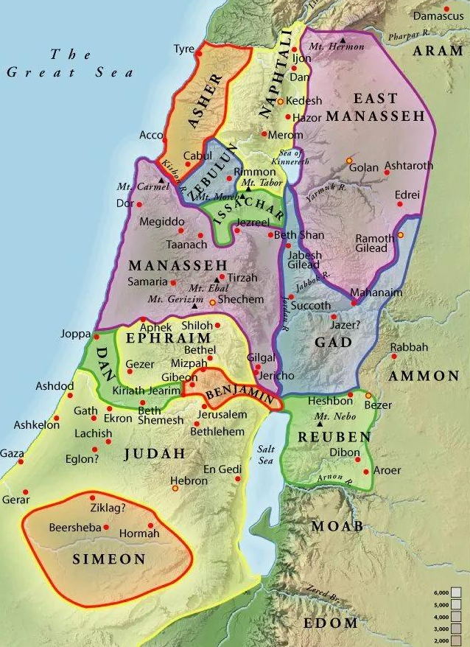
Moses’ Farewell - Message 1, part 2 (Deu 4)
1-9 Battleplan (for Israel)
10-24 Promise (to Isreal at Mt Sinai)
25-31 Prophecy (to Israel)
32-40 Salvation (Israel from Egypt)
41-49 Statutes & Judgments (for Israel)
Moses’ Three Messages in Deuteronomy
1st 1-4, 2nd 5-26, 3rd 27-34
Keywords: Command/ed/s – 86x, Hearken/hear – 82x,
this day – 77x, Heart -45x, Commandments – 42x,
Love – 21x, Statutes & Judgments – 17x, Forget – 16x, Remember 13x, Teach 13x. Fire – 13x (Mt Sinai in chapters 4-5)

Slide 4
Sunday School Through the Bible - 2024
Mas de Cristo class
What is concealed in the Old Testament is revealed in the New Testament (19 mysteries).
(1) Learn – Romans 15:4 (2) Admonish – 1 Corinthians 10:1-13
(3) Shadow – Col 2:17, Heb 8:5, 10:1 (4) Figure (model) – Heb 9:9, 11:19, 1 Peter 3:21
(5) Type or antitype - specific people that are Godly or Ungodly
COMPLETED books of the Bible
Old Testament: Genesis (4), Exodus (4), Leviticus (2), Numbers (3), Deuteronomy (2), Psalms (4), Proverbs, Ecclesiastes, Amos, Obadiah, Malachi
New Testament: Mark, Colossians, Philemon, James, Jude
Invites: November 8-9 seminar at Annapolis, 10 MOTB Scribes & Scripture (2-6), 11 Men’s bonfire at Aquasco (5-8),
13 MOTB America’s story of religious liberty (1-5), 26 MOTB Free entry (10-5)
28-30 2 Pe 3:18 Thanksgiving Retreat, “Preparing for the Rapture.”
Invite to the 2024 daily Bible reading plan in 1 Samuel. Reminder - Prepare for 2025.
Notes:
-

