Slide 1

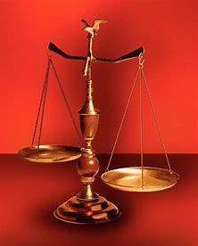
Fellowship Church, Jan 4, 2026 2 Peter 3:18 Sunday School Bill Heath
Music: Parables in Blues
Straight & Balanced
(Luke 3:4-6)
Jesus Teaches in Parables
1. New Wine in New Bottles (Luke 5:37-39)
2. Let us Bind the Strong Man (Mark 3:23-30)
3. Is My House Built on Rock? (Luke6:46-49)
4. Asaph’s Secret Revealed (Matthew 13:1-52)
5. Defiled Eating & Words (Mark 7:1-23)
6. Workers’ Time in the Vineyard (Mt 20:1-16)
7. The Rich Fool (Luke 12:13-21)
8. God’s Fairness Acts (Luke 12:41-48)
9. The Barren Fig Tree for 3+ Years (Luke 13:6-9)
10. Lost & Found Sheep, Silver, & Son (Lu 15:1-32)
OT: 2 Kings 21:13, Ps 5:8 Pr 4:25-27, Amos 7:7-8 Isaiah 28:13, 17
NT: Mt 3:3, Acts 9:11
Hebrews 12:13, Jude 3
1 Corinthians 15:1-4
2 Timothy 3:10, John 7:16
OT: Deut 25:13-16
Proverbs 20:10
Daniel 5:25-28
NT: Hebrews 12:1
1 Cor 3:11-15
Philippians 4:5
James 3:17

Slide 2
2nd Sunday of 2026, read the parable of Luke 14:7-24 or Luke 16:1-13?
A parable is an earthly story with a heavenly truth.

Slide 3
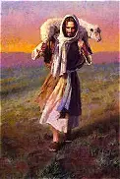
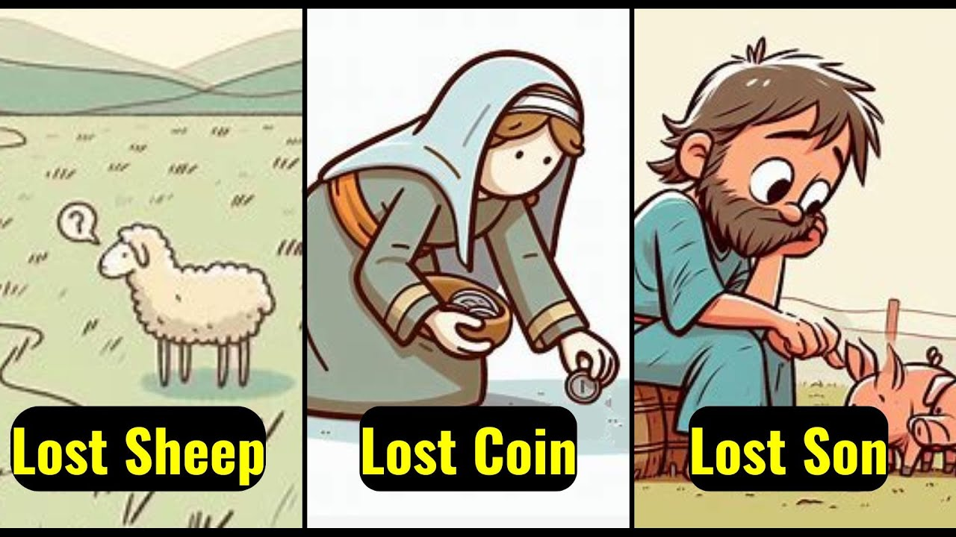
Parable: Lost & Found Sheep, Silver, & Son Luke 15:1-32
Content (compare & contrast) | 15:1-2 publicans & sinners hear / Pharisees & scribes murmur 15:3-7 Sheep (1 of 100): 1 lost sheep found 15:8-10 Silver (1 of 10): 1 lost coin found 15:11-32 Sons (1 of 2): 1 lost son found 11-16 prodigal son’s wickedness & distress 17-24 prodigal son’s repentance and pardon ^{25-32 elder brother’s anger}

Slide 4

Sunday School Through the Bible (2023 - 2025)
Grow in grace, and in the knowledge of our Lord and Savior Jesus Christ
2 Peter 3:18
COMPLETED books of the Bible
Old Testament: Genesis (4), Exodus (4), Leviticus (2), Numbers (3), Deuteronomy (5), Ruth, Esther, Psalms (4), Psalm 68 (3), Asaph (12), Proverbs, Ecclesiastes, Amos, Obadiah, Malachi
New Testament: Mark, Parables (10), Colossians, 1-2 Thessalonians (10), Ephesians, Philemon, James, 2 Peter (4), 2 John, Jude
Invitation to Fellowship Church 2026 daily schedule for Bible and prayer
1 Corinthians – January and February 2026 (60-day daily word & prayer)

Slide 5
Parable: Lost & Found Sheep, Silver, & Son Luke 15:1-32
Content (compare & contrast) 9x lost/perish/dead 9x found/alive | 15:1-2 publicans & sinners hear / Pharisees & scribes murmur 15:3-7 Sheep (1 of 100): 1 lost sheep found (shepherd - Jesus Christ, John 10) friends & neighbors rejoice. Joy in heaven, One sinner that repents >99 repent not. (Eph 5:25-33a) 15:8-10 Silver (1 of 10): 1 lost coin found (woman – Holy Spirit, 1 John 2:20, 27) 1st lights candle, 2nd sweeps, 3rd seeks diligently (Proverbs 31, Gen 3:16, Eph 5:22-24, 33b; 1 Pet 3:1-6) friends & neighbors rejoice. Joy in the presence of the angels of God – 1 sinner that repents. 15:11-32 Sons (1 of 2): 1 lost son found (father - God, Joh 14-16, 1 Cor 16:13-14) 11-16 prodigal son’s wickedness & distress the sinful state of gaining much (11-12) and losing everything (13-16) 17-24 prodigal son’s repentance and pardon perish (17), repent to God & father (18-21), Joy/merry by the father & his household (22-24, Eph 2:19) ^{25-32 elder brother’s anger} angry (25-30) Israel the nation is always with the father (31, Romans 9-11), dead/alive, lost/found (32)

